Slide 1
LEGACY NEST
T E A M
S T O R Y C O D E R S

Slide 2
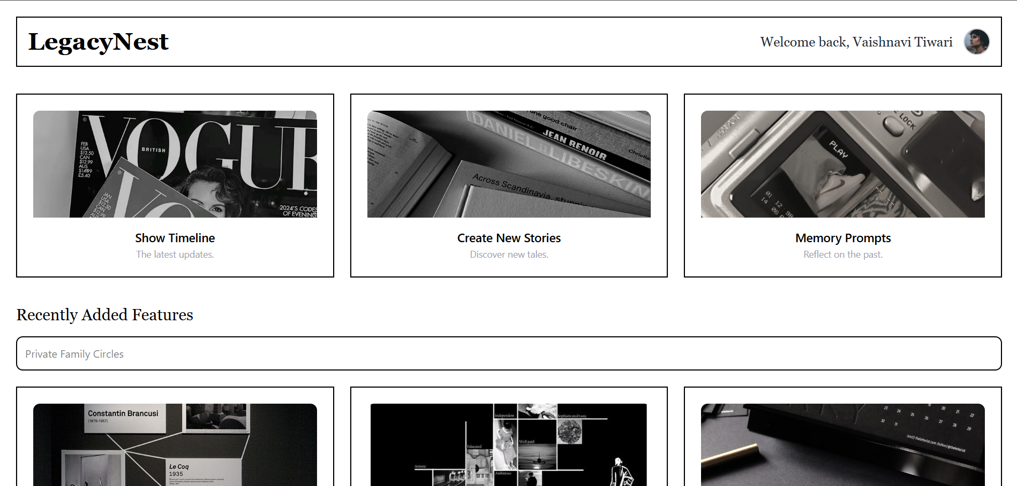

Slide 3
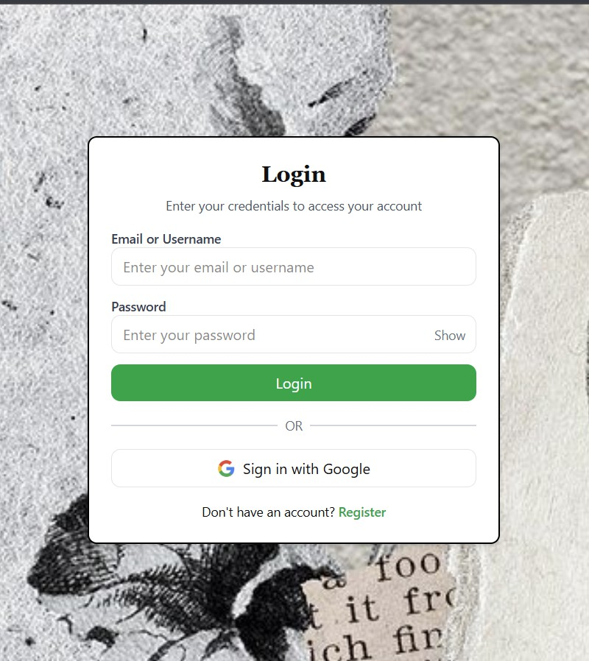
PROBLEM?
THE PLATFORM SOLVES THE CHALLENGE OF PRESERVING FAMILY HISTORY DIGITALLY WHILE MAINTAINING PRIVACY. IT ALLOWS MEMBERS TO CONTRIBUTE STORIES, CREATE TIMELINES, TAG MEMORIES, COLLABORATE ON CONTENT, AND SECURELY SHARE WITHIN PRIVATE FAMILY CIRCLES.

Slide 4
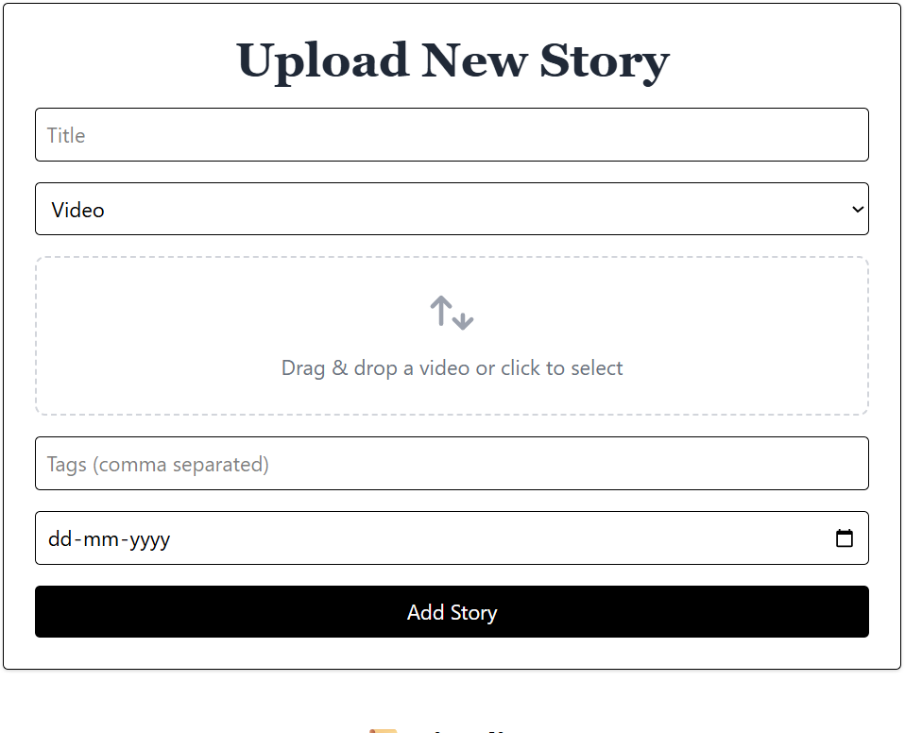
HOW WE PRESERVE YOUR LEGACY
FAMILY STORY RECORDING – UPLOAD TEXT, PHOTO, AUDIO, OR VIDEO STORIES
TIMELINE CREATION – CHRONOLOGICAL MAPPING OF LIFE EVENTS
PHOTO UPLOADS WITH TAGGING – ADD DESCRIPTIONS, TAGS, AND DATES
PRIVATE FAMILY CIRCLES – SECURE SHARING WITH SELECTED MEMBERS
SEARCH FUNCTIONALITY – SEARCH BY KEYWORD, TAG, OR MEDIA TYPE
STORY EXPORT – GENERATE PDFS OR BOOKS FROM STORIES

Slide 5
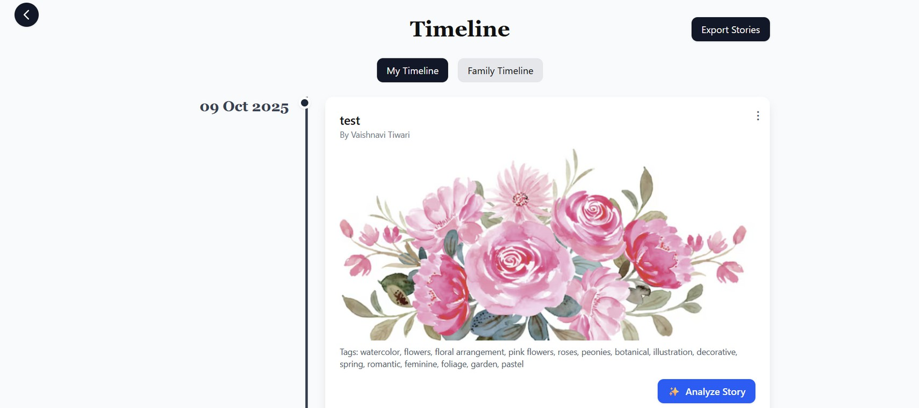
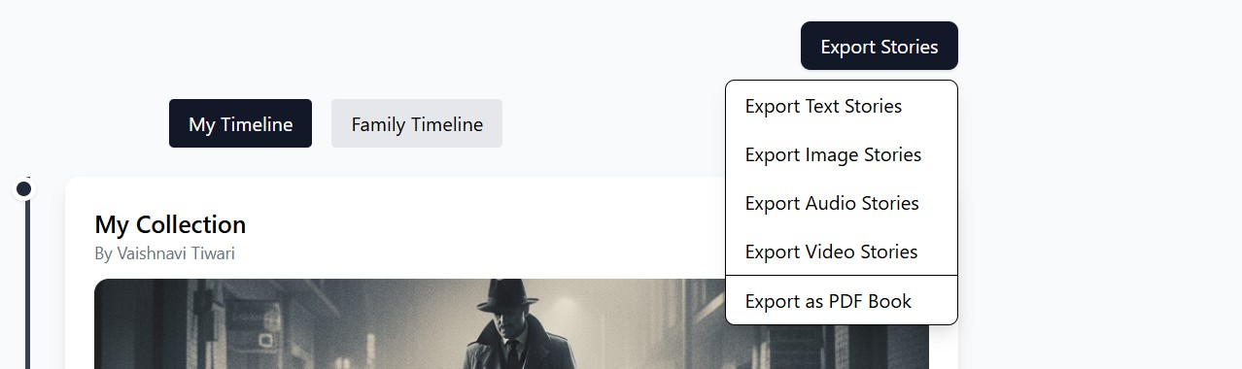
TIMELINE
STORY EXPORT

Slide 6
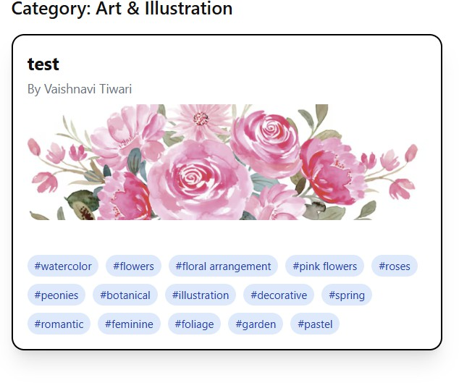
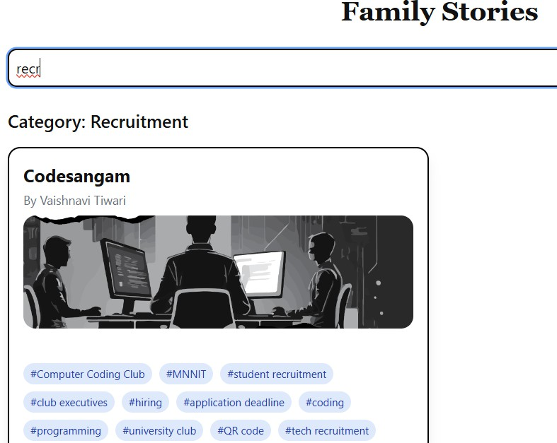
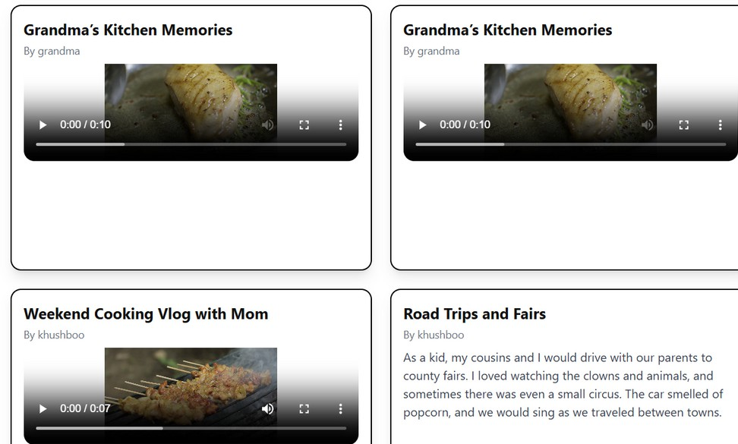
SEARCH BASED ON TAGS, CATEGORY

Slide 7
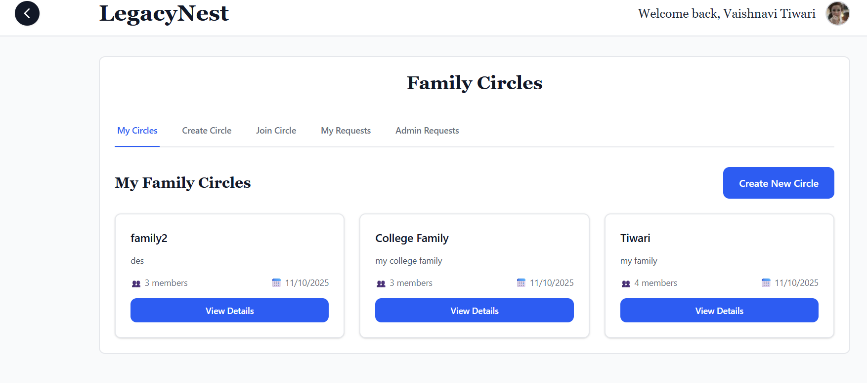
MY FAMILY FEATURE

Slide 8
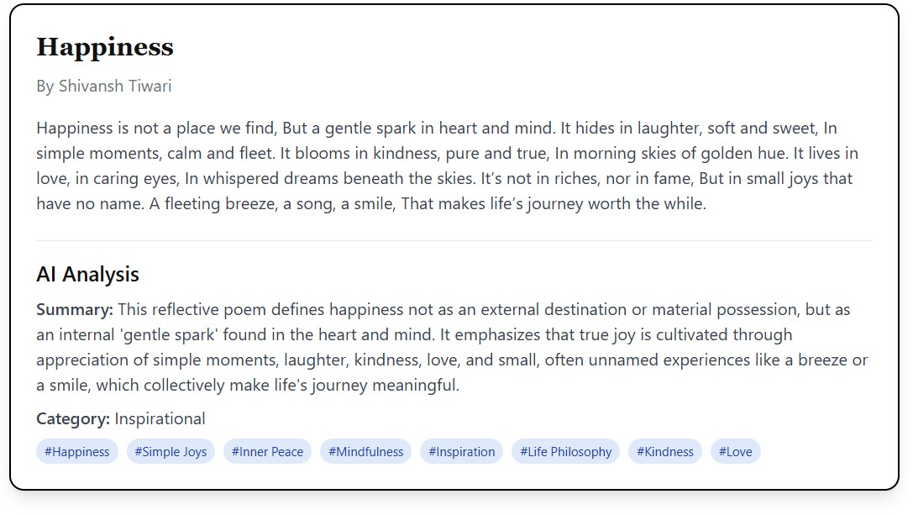
ADVANCED FEATURES
AI TEXT ANALYSIS – AUTO- TAGGING & CATEGORIZATION
MEMORY PROMPTS – PREDEFINED TEMPLATES TO ENCOURAGE STORYTELLING
CROSS-GENERATIONAL MATCHING – SUGGEST STORIES OF SIMILAR THEMES ACROSS GENERATIONS
COLLABORATIVE STORY EDITING – MULTIPLE CONTRIBUTORS CO- CREATE A STORY

Slide 9
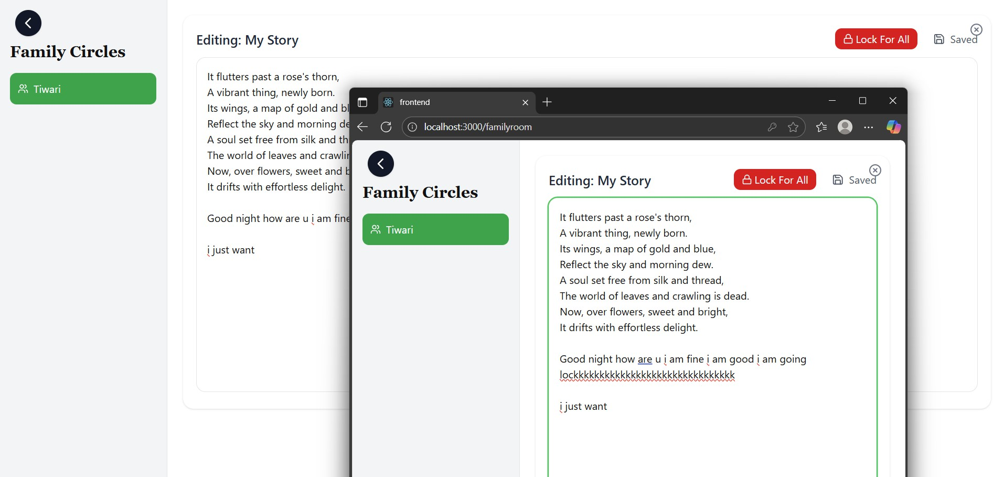
COLLABORATIVE STORY EDITING

Slide 10
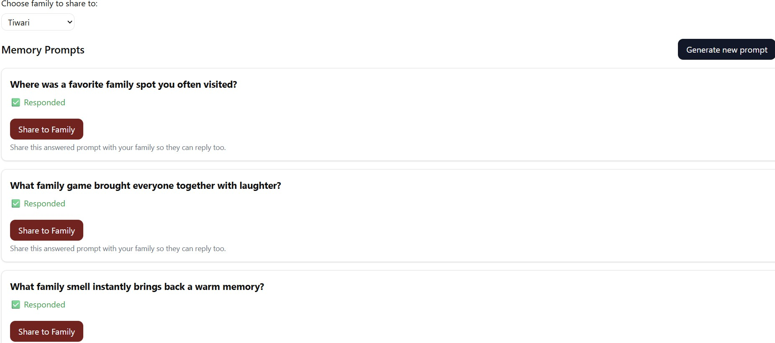
MEMORY PROMPTS

Slide 11
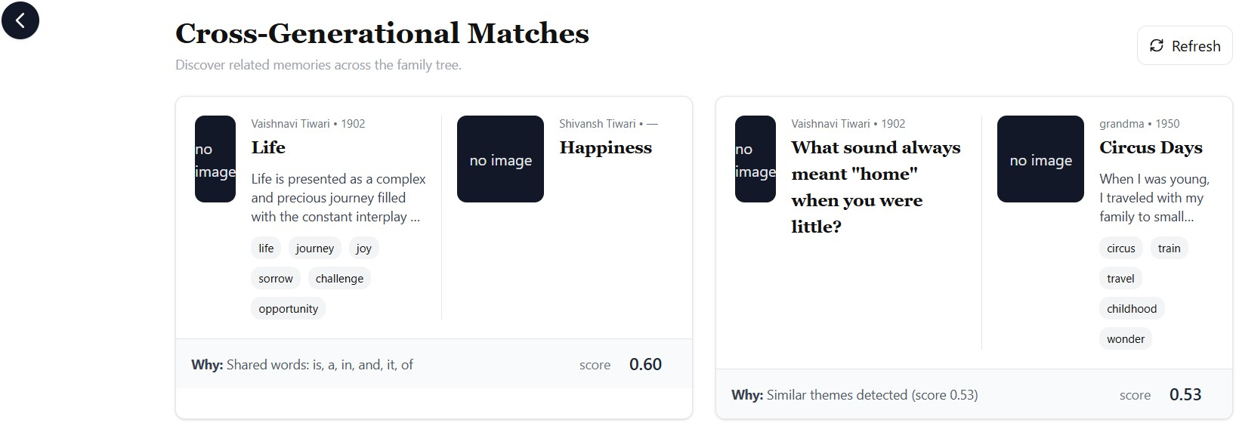
CROSS-GENERATIONAL MATCHING

Slide 12
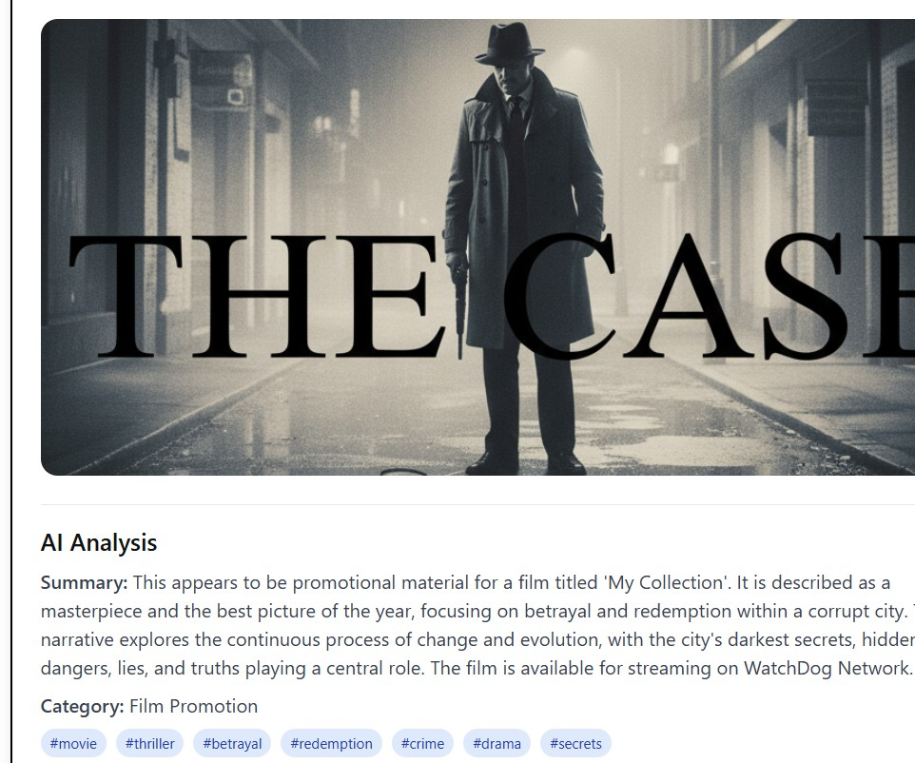
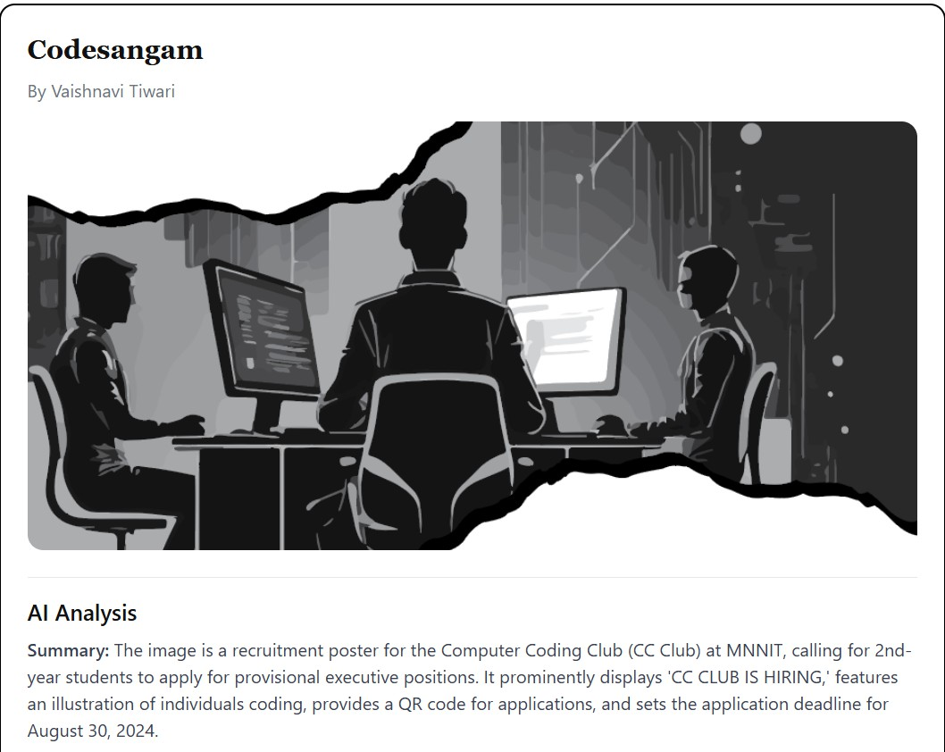
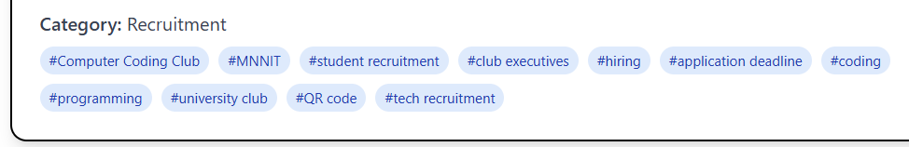
AI TEXT ANALYSIS

Slide 13
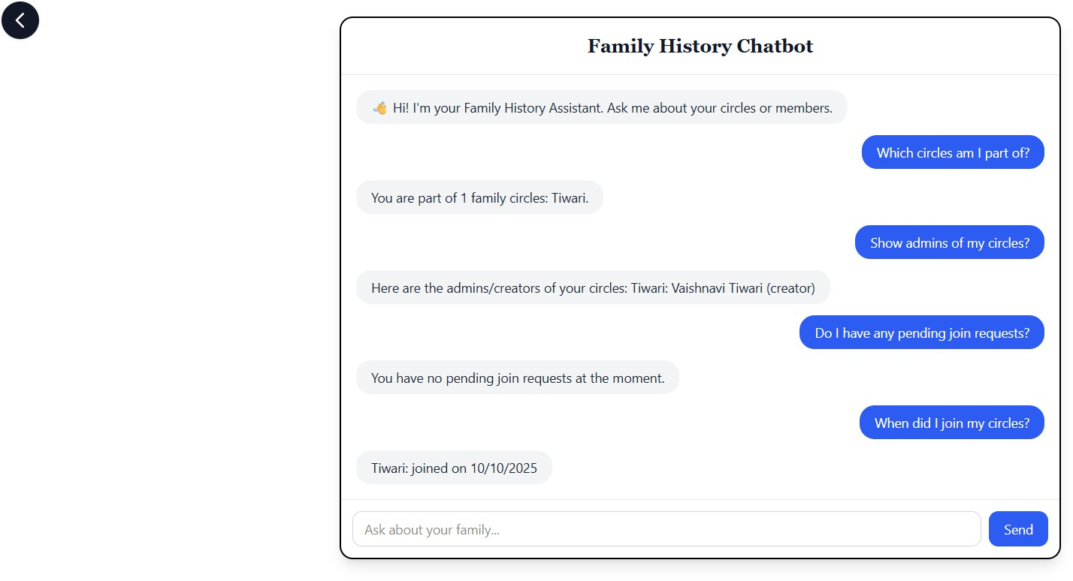
WOW FEATURES
CUSTOMIZABLE CALENDAR – PUBLIC/PRIVATE REMINDERS
FAMILY HISTORY CHATBOT – QUERY FAMILY STORIES & PEOPLE
SHARABLE PROMPTS – SHARE PROMPTS FOR OTHERS TO RESPOND

Slide 14
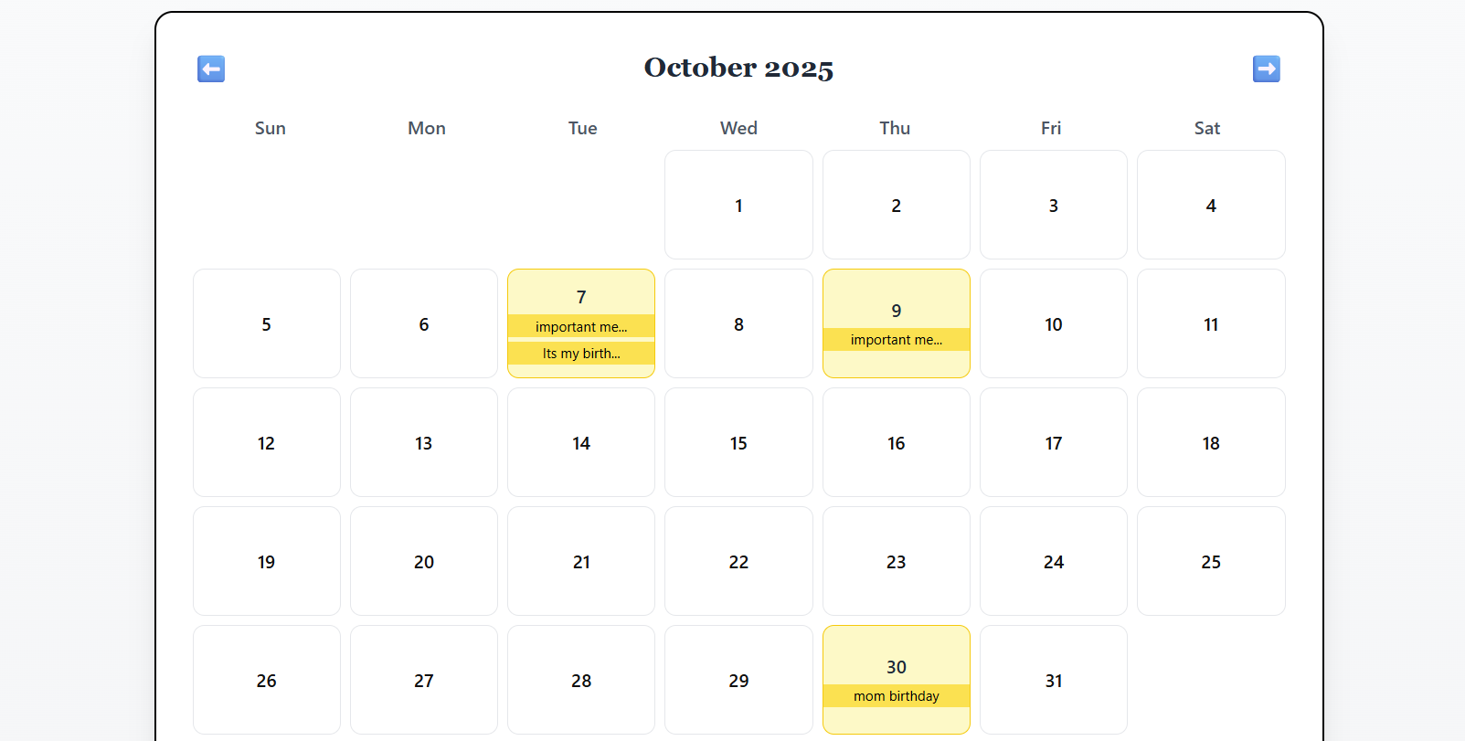
CUSTOMIZABLE CALENDAR

Slide 15
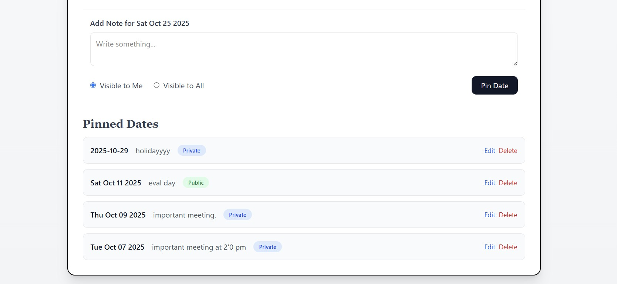
MARK YOUR IMPORTANT DATES

Slide 16
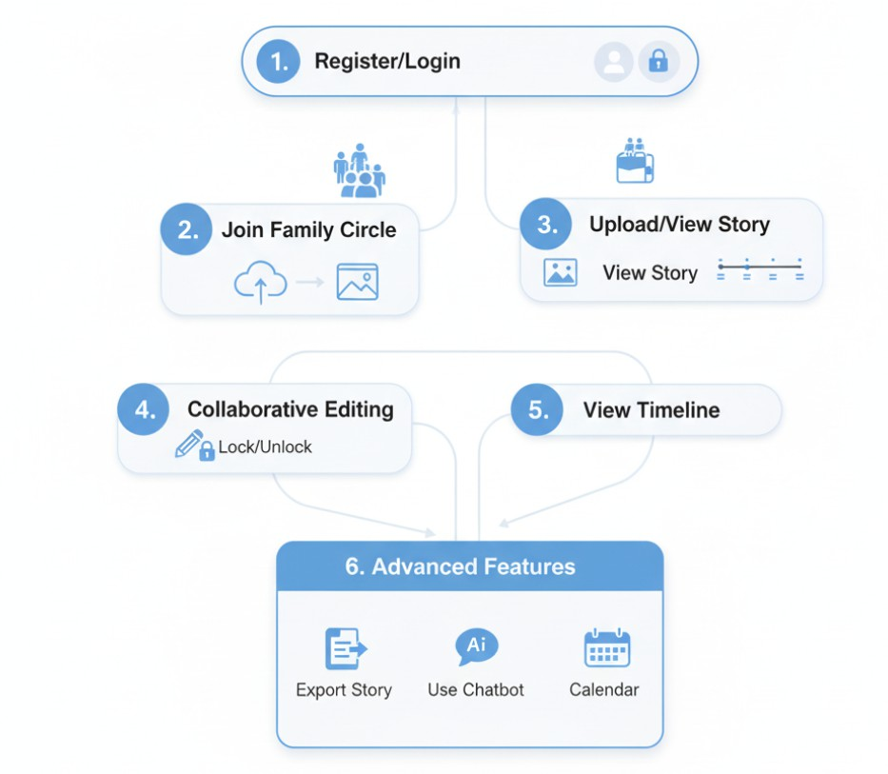
TECH STACK AND FLOW
FRONTEND: REACT. JS, TAILWINDCSS BACKEND: NODE. JS, EXPRESS, MONGODB, SOCKET.IO AUTHENTICATION: JWT, BCRYPT. JS
FILE STORAGE: CLOUDINARY EXPORTING: PDF-LIB / JSPDF
AI: GEMINI API

Slide 17

THANK YOU
VAISHNAVI TIWARI ETISHA JAIN KHUSBOO SOLANKI

