Slide 1
CURRENT STATISTICS
What does our data tell us
The source data points to a sharp loss near Identification, weak onboarding push opt-in, and a strong cart moment that can carry loyalty and retention asks.
295.8k
226.9k
~19.5%
6.5%
~20%
unique users baseline
reach Home, 76.7%
largest loss near Identification
push opt-in in onboarding
industry push benchmark
2.6%
11.6%
17.1%
61%
guest start-to-finish conversion
registered start-to-finish conversion
logged-in start-to-finish conversion
purchase chance after cart visit
Redcare iOS onboarding recommendation
2/18

Slide 2
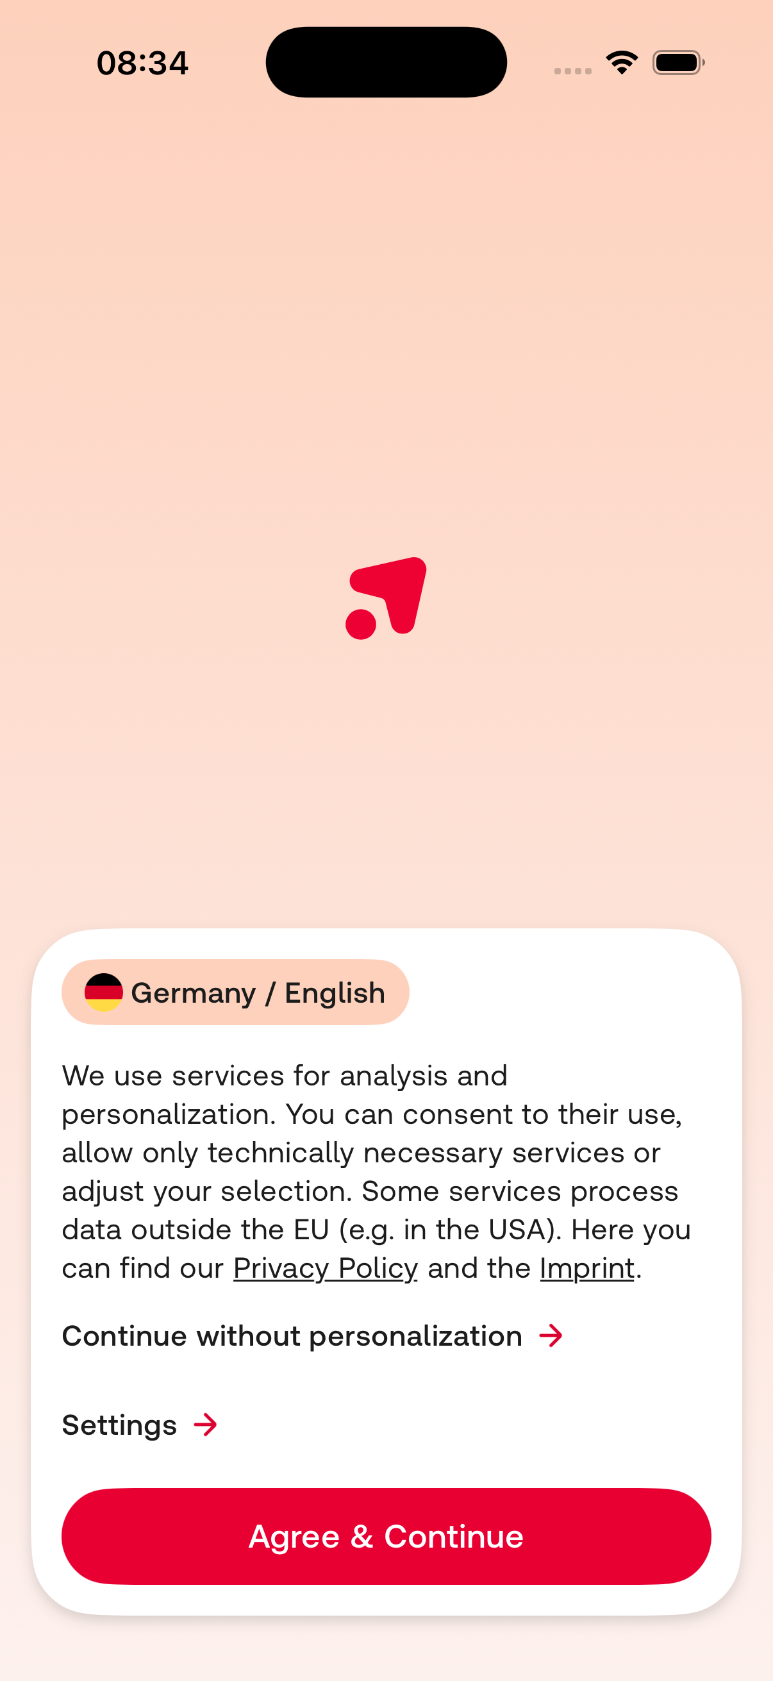
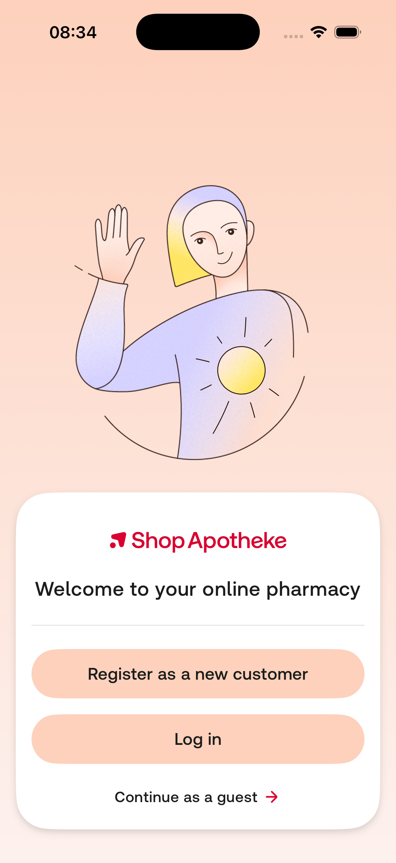
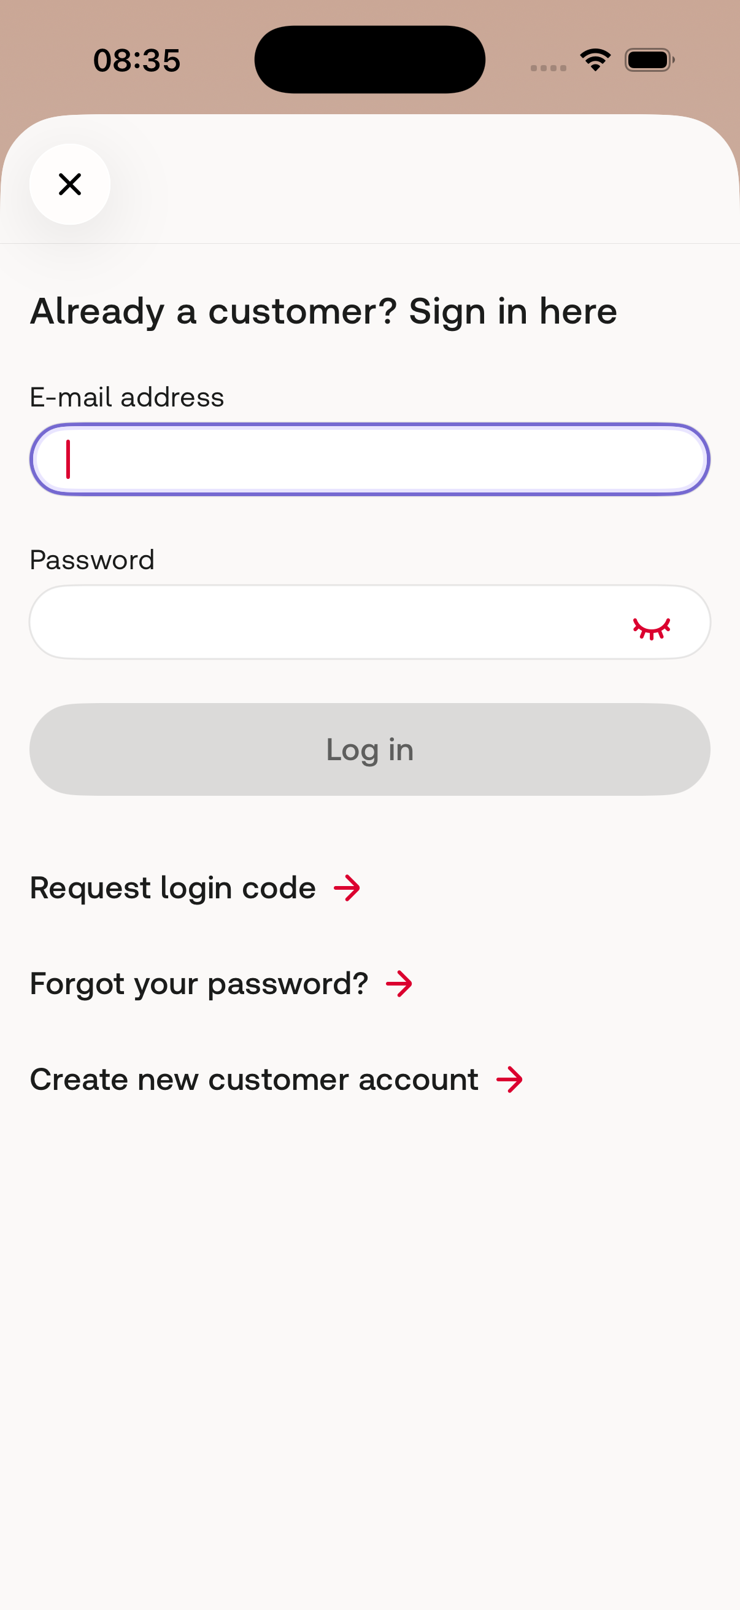
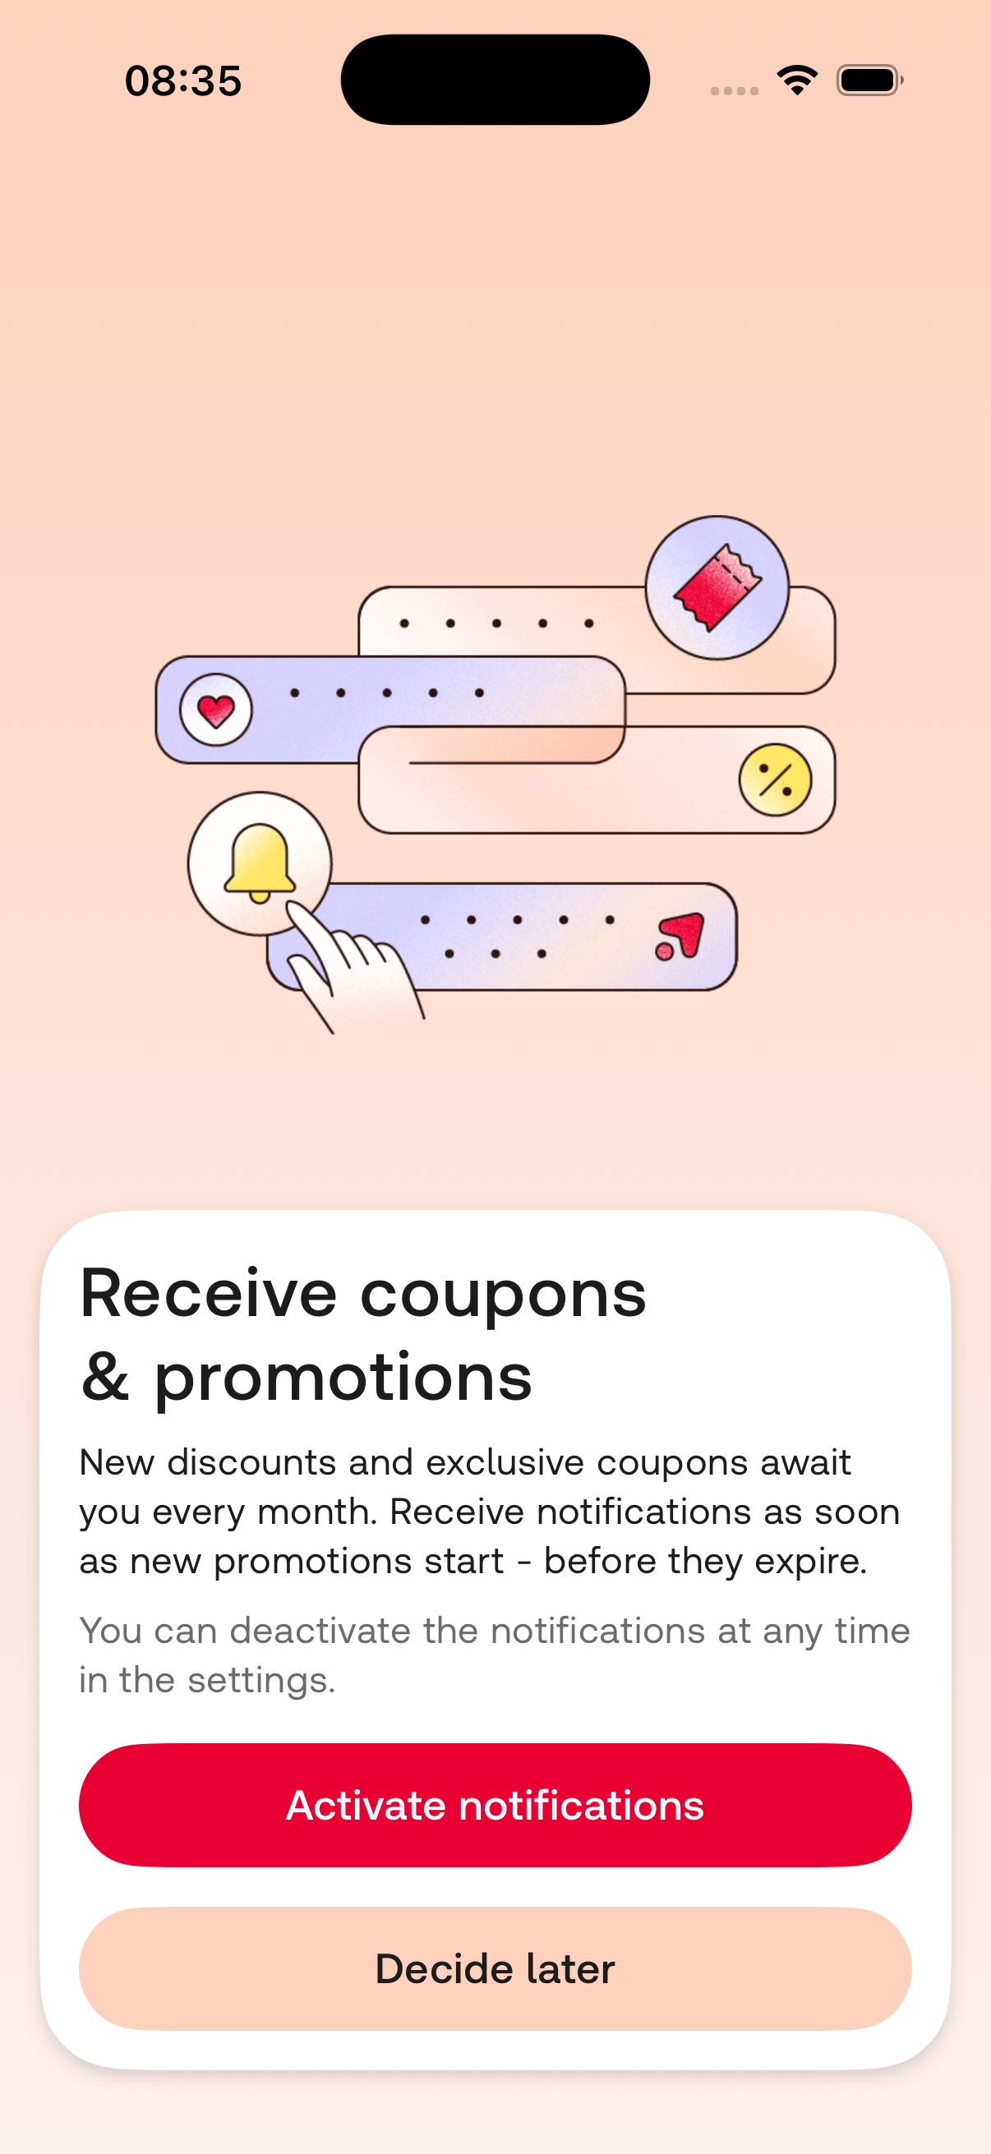
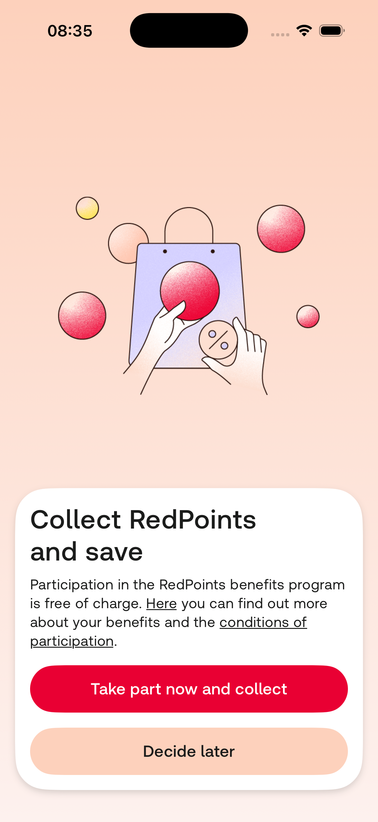
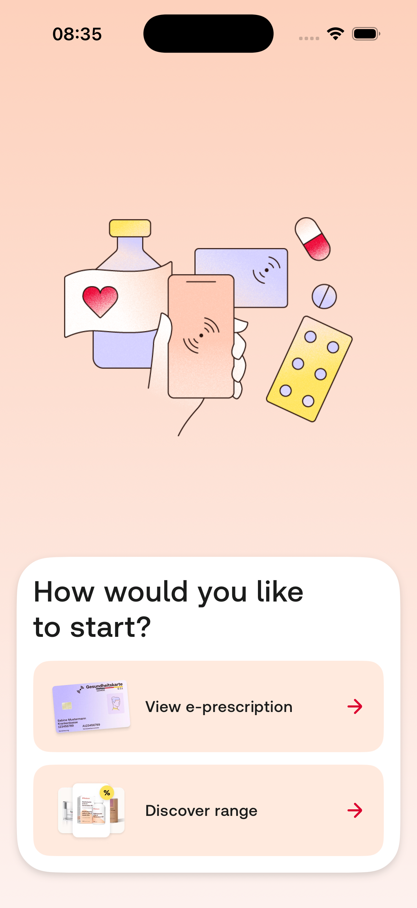
CURRENT ONBOARDING
How many steps does our user take until he arrives at the home page
These screenshots show our app already has the right strategic direction on the intent split but we need to pay attention to sequencing.
Consent
Account choice
Login path
Push ask
RedPoints
Intent split
Redcare iOS onboarding recommendation
3/18

Slide 3
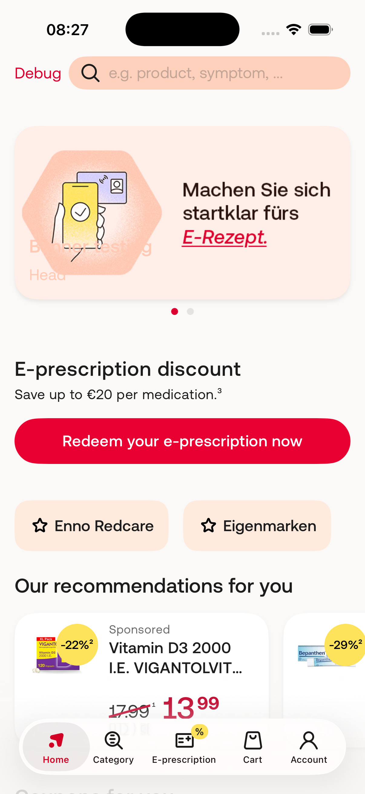
GUEST ONBOARDING
Guests reach Home, but not before confirming they’re a guest
Login blocker and push notifications blocker are presented to the guest without context or semantic meaning.
Account choice
Push ask
Intent split
Discover range opens Home
Redcare iOS onboarding recommendation
4/18

Slide 4
USER ONBOARDING
Returning users meet two prompts before their first useful destination
For logged-in users, the issue remains form after form without any context. Onboarding feels like a questionnaire
Redcare iOS onboarding recommendation
5/18

Slide 5
SCREEN ANALYSIS
RedPoints are a loyalty tool. They only become relevant with or after the first purchase.
There's currently no evidence that a RedPoints Opt-In before would increase conversion. The main objective for guests is to send them the RedPoints newsletter.
61%
17.1%
purchase chance after cart visit
logged-in conversion
Remove RedPoints from the onboarding
We believe there is no need for an A/B test because data doesn’t justify it
Redpoints should be attached to a real basket or product since purchase is the trigger.
Redcare iOS onboarding recommendation
11/18

Slide 6
SCREEN RECOMMENDATION
Push needs a reason stronger than general promotions
The source shows 6.5% onboarding push opt-in versus a roughly 20% benchmark. The prompt should appear after value is visible, not before intent.
A/B Testing
An even better scenario
If we remove push opt-ins from the onboarding and add them to all actions where the users shows commitment (favourite, add to cart, view coupons, view discounts), can we improve the session length and drop-off rate of guest users while still having the same number of opt-ins?
Would this at the same time improve first-time eRx conversion rates?
Redcare iOS onboarding recommendation
10/18

Slide 7
SCREEN RECOMMENDATION
Login should be a branch requirement, not the first answer to every job
The login sheet works, but for mobile returning customers the code path can be more prominent and the screen should appear only when the selected job needs identity.
Recommended changes
Show login after a user chooses eRx, account, checkout, or saved benefits.
Make login code the mobile-friendly default for uncertain returners.
Keep password, reset, and create-account visible, but secondary.
Expected effect: less Identification loss without weakening secure account flows.
Redcare iOS onboarding recommendation
9/18

Slide 8
PROPOSED ONBOARDING
Most valuable screens during onboarding
Consent and Intent split. While consent might be a legal requirement, intent split should come before any permission requirement
~19.5%
6.5%
61%
loss near Identification
onboarding push opt-in
purchase chance after cart
Redcare iOS onboarding recommendation
1/18

Slide 9
EXPERIMENT PLAN
Test sequence and timing separately so the data can tell us what moved the metric
The current production flow can be the control. The next tests should isolate intent order, prompt timing, and branch landing quality.
Control
Remove Redpoints
Consent, auth/guest, push, intent split
Variant 1
Intent-first sequencing
Consent, intent split, then authentication or guest path only when needed
Variant 2
Trigger based Push
Push after eRx setup, or order value, coupon reminder, cart reminder
Variant 3
Deals available via Push
Every day a new exclusive flash deal: Enable push. Everyone would see that as first thing on the home and maybe guests would be interested to get limited exclusive deals. The idea is, you can opt-in to receive these exclusive deals via push or email.
Redcare iOS onboarding recommendation
15/18

Slide 10
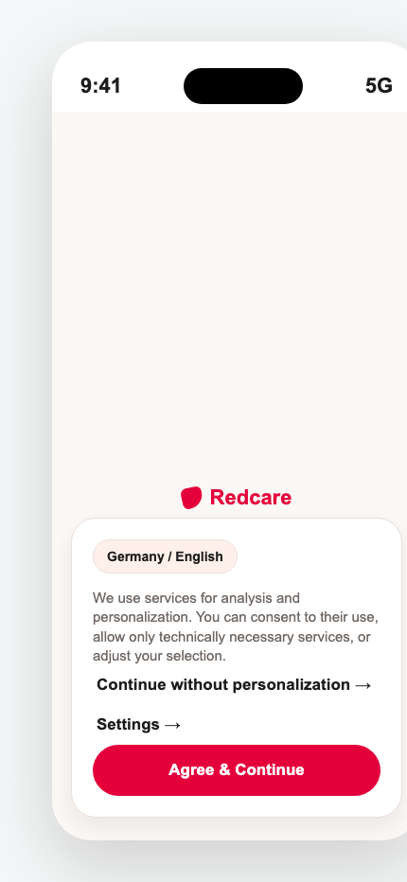
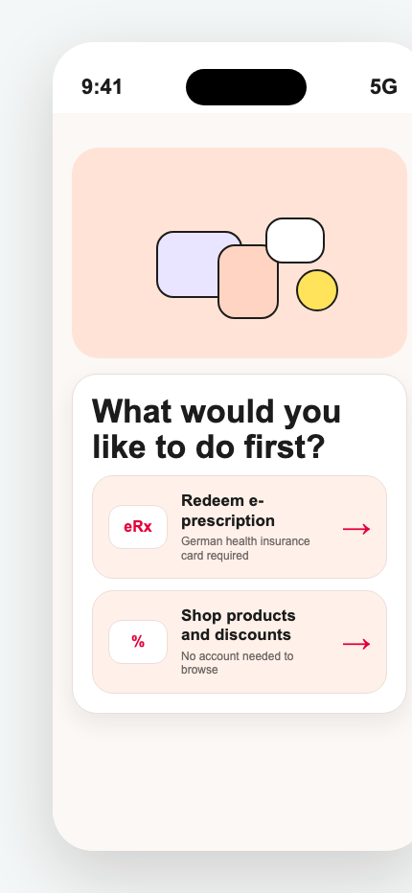
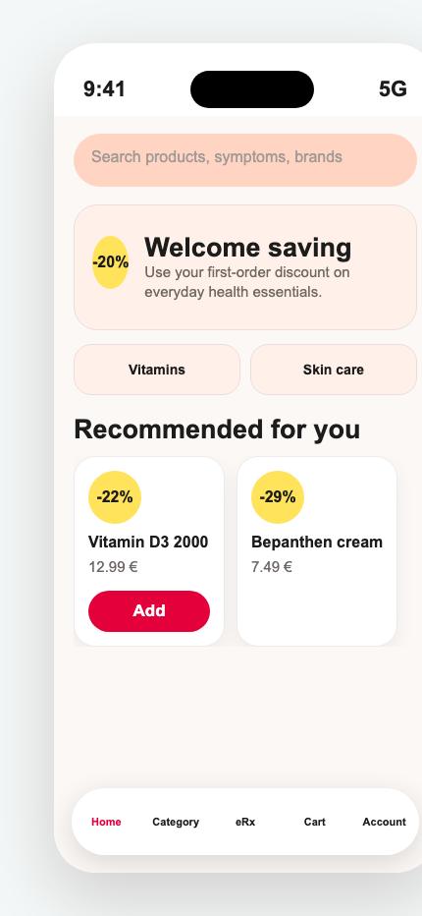
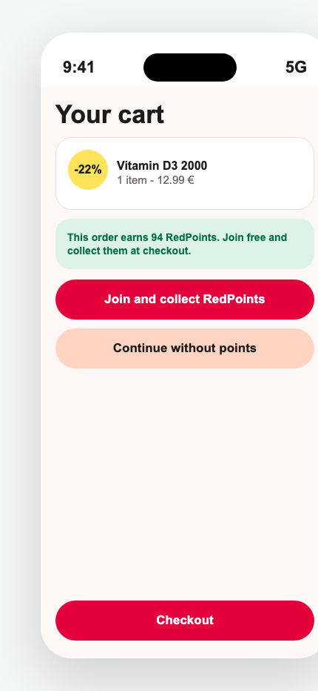
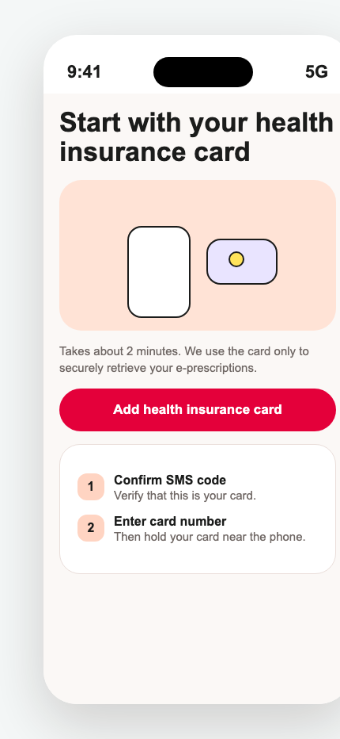
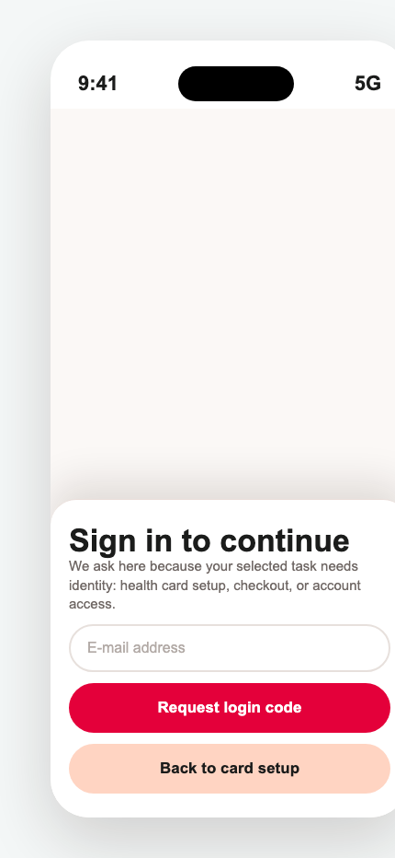
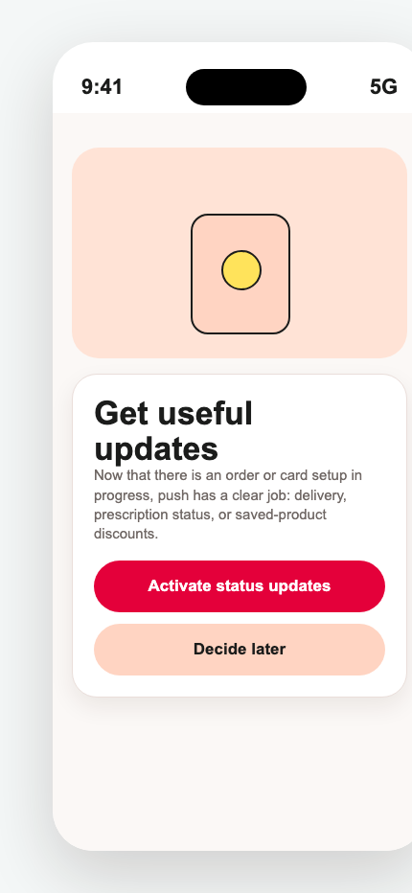
FINAL JOURNEY
The final onboarding is a short router, then contextual asks
Onboarding only includes consent and intent. Login, RedPoints, and push permissions move to moments where the user can understand why they matter.
Consent
Intent split
Shop home
Cart RedPoints
Card setup
Login
Push
Keep legal choice compact
Ask the user's job next
No account needed to browse
Loyalty appears with basket value
Explain requirements before NFC
Ask only when identity is needed
Ask after status value exists
Onboarding: consent and intent only
Delayed asks: cart, card setup, account, status
Redcare iOS onboarding recommendation
18/18

