Slide 1
The Role of the (Successful) Project Manager
COMM 3200: Project Management

Slide 2
What is the primary purpose of a project manager?

Slide 3

Project Delivery Challenges

Slide 4

Keys to Success
Develop Collaboration
Integrate planning & review with learning
Prevent major disruptions
Maintain forward momentum

Slide 5



VS.

Slide 6
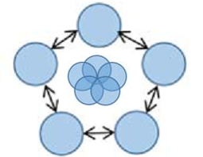
Collaboration
Tightly coupled tasks, loosely coupled parties
Balance is key
Minimal duplication
Maximal trust
Not easy…how to build?

Slide 7

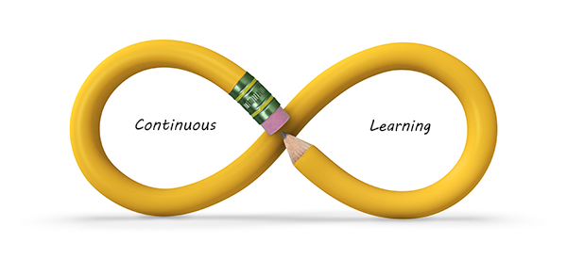
Integrate Planning & Review with Learning
Short-term details, long-term generalities
“What can we learn from the performance data to improve the next cycle of planning?”

Slide 8

Prevent Major Disruptions
Expect the unexpected
Know when to pause
Prioritization

Slide 9

Maintain Forward Momentum
Hands on engagement
Frequent face-to-face communication
Frequent moving above

Slide 10

Recap
PM Competency is not enough
Combine people-, information-, and action-oriented activities
Focus on intention- and event-driven tasks

Slide 11
Class Debrief
In small groups, discuss:
What was most the most surprising recommendation for successful project management?
How have you demonstrated or witnessed these key success factors/traits in projects or groups you have been involved in?
What is missing? What else is critical to project success?

