Slide 1


Slide 2
<IntroFilm>

Slide 3

What a great song does to your ears …
… I want to do to your eyes.
THE MEMBERS I NEED IN MY BAND FOR THAT:
- a world based on frequencies' amplitudes
- FFT and Spectral Flux Analysis
- Oculus Quest
- decisions
And now how I constructed this compositon

Slide 4
a world based on frequencies' amplitudes
a visually pleasing experience made up of a song's frequencies
- immersive, all surronding experience
- frequencies' amplitudes shape the structure
- beatpoints affecting the structure
a fun way to explore and learn about sound and frequencies
- how audio effects shape the sound
- - reverb and chorus effect
- what frequencies make up the sound
- - Mute and Solo Frequencies

Slide 5
a world based on frequencies' amplitudes
< Video of the Tunnel Grid >
< Pictures of the command Center >

Slide 6
FFT and Spectral Flux Analysis
Fast Fourier Transform
- amplitudes for the frequencies of a sound at specific time intervals
→ linear representation of the amplitudes of a sample region at a given point in time
Spectral Flux
- Sudden, large changes in a frequency's amplitude
→ defined by time and Relative change of the amplitudes

Slide 7
FFT and Spectral Flux Analysis
Most importantly
→ PRE-PROCESSED!

Slide 8
FFT and Spectral Flux Analysis
Working with the data
Fast Fourier Transform
- Notes are logarithmically spaced
→ logarithmically stagger fft when applying data to tunnel blocks
- amplitudes of lower frequencies are much higher than of the higher frequencies
→ Inverse logarithm and use as a scaling function for a percieved representation of loudness
Spectral Flux
→ Saving time of beatpoints

Slide 9
Developing for VR / Oculus Quest
Optimizing performance
→ Using profilers to gain insights
<Picture of current profiler with 9 draw calls> <Picture of old profiler with over 1k draw calls>
→Insight gained: Way too many draw calls

Slide 10
Developing for VR / Oculus Quest
Draw calls
- render pipeline looks at each mesh and determines whether or not it has an effect on the other meshes when it draws a frame
→ 32 x 500 individual meshes for my tunnel
→ Solution: create a single mesh for the tunnel

Slide 11
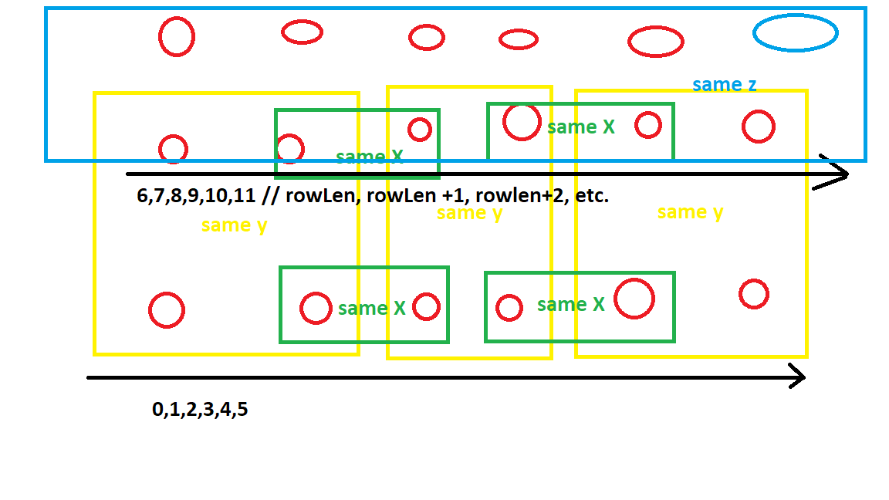
Developing for VR / Oculus Quest
Can't be that hard right?
See my brain melting in action:

Slide 12
Developing for VR / Oculus Quest
Optimizing performance
→ Using profilers to gain insights
→Insight gained: Way too many draw calls
- - Generating a single mesh to reduce draw calls
- Working in 2D for 3D
- - Scaling and feel is vastly different with the headset
- Interactions

Slide 13
Making decisions
- Inability to incorporate the SoundCloud API
- - API only gives streaming URL, but we need to download a file into to game's assets, to "unpack" (decompress) the sound so our time domain is right
- Styling: 2 Worlds
- - How I hope the "Metaworld" of Chromesthesia is able to sell an emotional high, because of it's counterpart in the "Selectworld"

