Slide 1

2012-2014 Gun Deaths in the U.S.
Erin Tsai
MSBA 305
Summer 2019

Slide 2
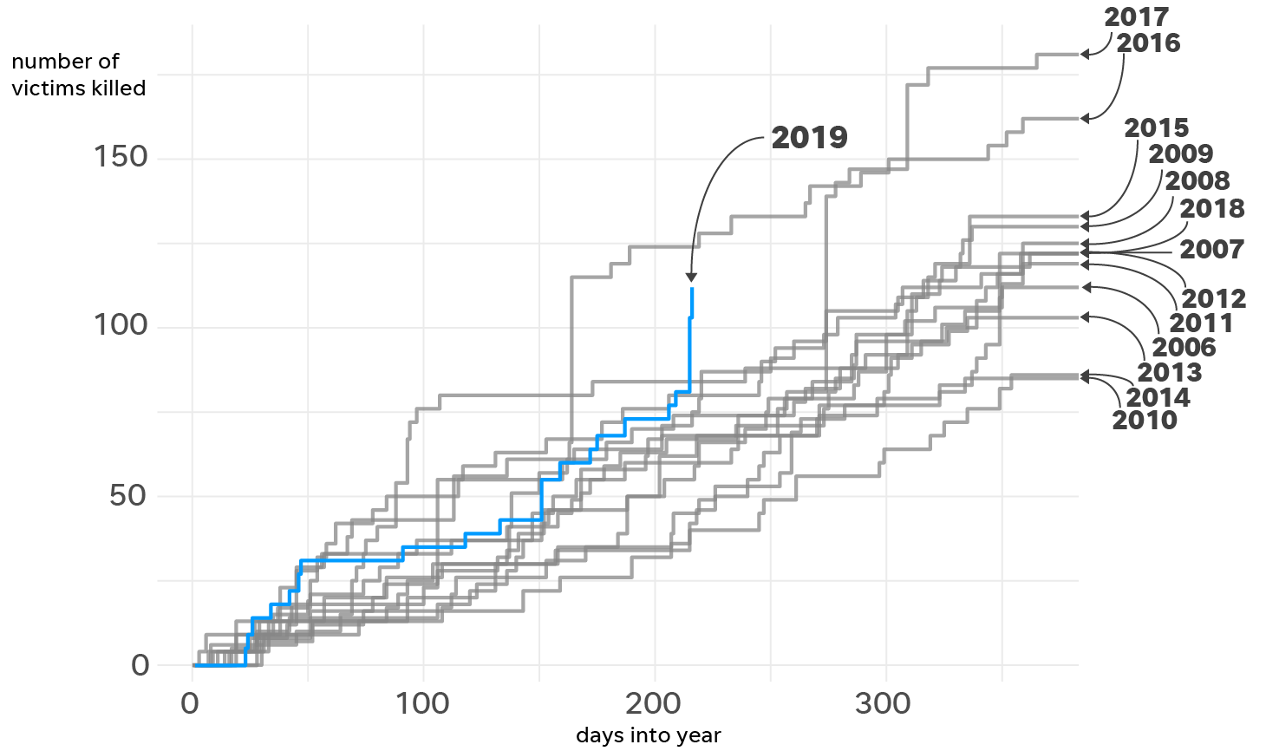
Introduction
As of August 6, 2019, the United States has seen about 112 people killed in mass shootings in the past 216 days. That comes down to approximately one death every other day. (Padilla, 2019.) The media discusses the shooter and the characteristics of the shooter predominantly. However, the focus of this study is on victim data.
We analyze the various characteristics of the victim including age, sex, race, education, aggressor’s intent, time, place, and whether or not police were present. We analyze descriptive, predictive, and prescriptive analytics of this data.
Notes:
As Howard notes, “The findings presented by Feldman et al. show that, overall, individuals are at highest risk for being killed by a police officer in neighborhoods with the highest concentrations of racial/ethnic minorities. This finding is consistent with the broad literature on racial/ethnic health disparities, which typically shows similar health disparity gradients along racial/ethnic and socioeconomic lines.” (Howard, 2019). However in recent years, there has been a growing focus on black men being targeted.
McGroarty states: “According to the study, black men were the demographic most at risk of being killed during interactions with law enforcement, but people with mental illness across all racial groups faced heightened dangers when interacting with law enforcement. In fact, their study found that 23 percent of all people killed by police officers displayed evidence of mental illness. Overall, the risk of death as a result of police intervention was seven times greater for people with mental illness than for those without.” (McGroarty, 2019).

Slide 3
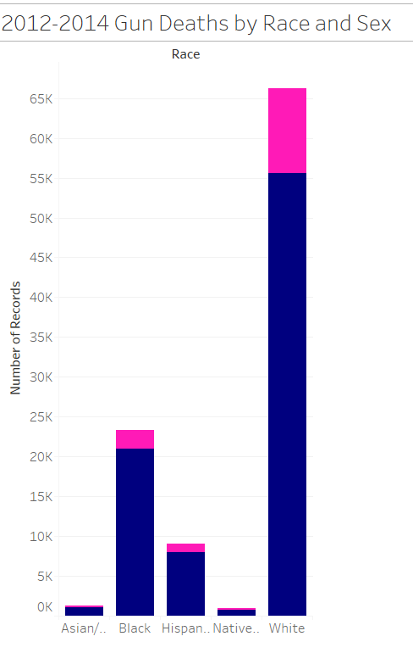
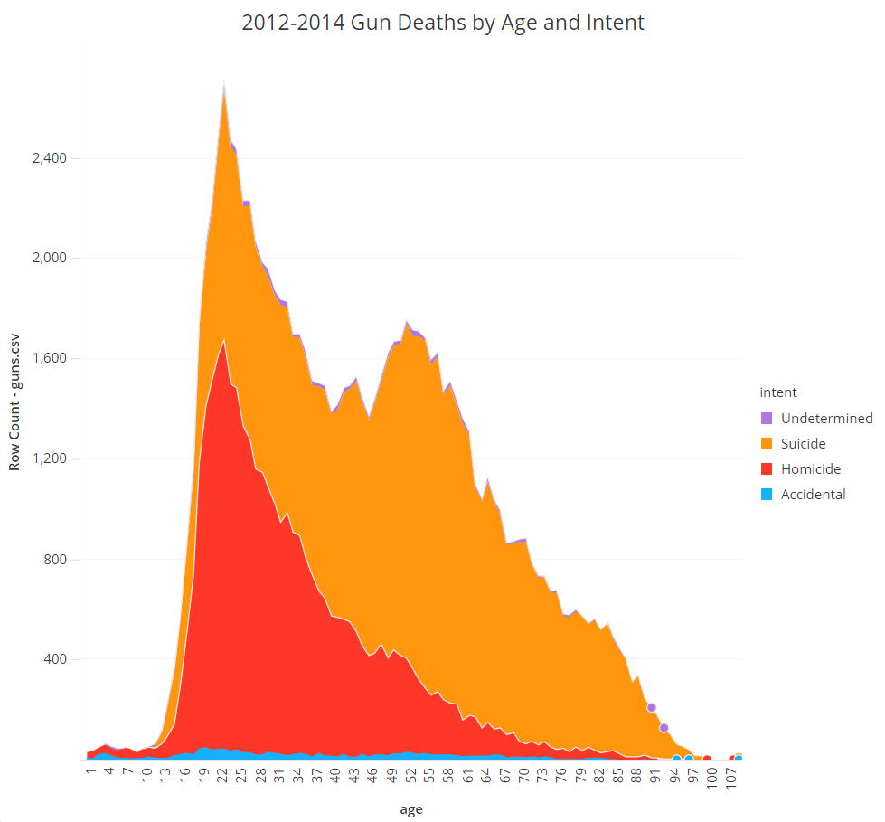
Descriptive Analytics
Key Characteristics to Note:
Majority of the gun death victims are White. But when comparing to percentage of people in the U.S. population by race, there is an unusually large number of gun death victims who are Black.
As the age of the victim increases, there is less homicide death, and much more suicide death.
Notes:
In 2013, there were 41,623,897 Black/African Americans in the Resident Population, which makes up approximately 13% of the whole population in the United States. (U.S. Census Fact Finder, June 2014.) We distinctly note that in our data, the Black victims who died make up approximately a 23% of the data points. This is much higher than the actual population of Black residents. This seems to indicate that people who are racially Black are more often victims of gun deaths.
The U.S. Census determined that White people make up about 77.7% of the population in the United States. This includes the Hispanic population. This seems to be approximately in line with the percentage of gun deaths. Based on the data set, the white victim deaths make up approximately 74.5% of the deaths in the data set, when we combine the White race with Hispanic, as Hispanics are included in the U.S. Census Bureau values. To us, this does not seem to indicate that white persons are more prone to gun deaths, unlike the black persons who experience a higher percentage of gun deaths.
We note that as the age value is higher, the overall number of gun deaths is also far smaller. But, I believe that as a population, the greatest concern should be amongst the sharp peak in gun deaths in the ages of 20s and 30s. Why is this? Is there anything we can do to prevent this or minimize this? Unfortunately, this data is limited and cannot provide us much more information past the actual past information provided. However, this is something we should keep in mind in future analysis.

Slide 4
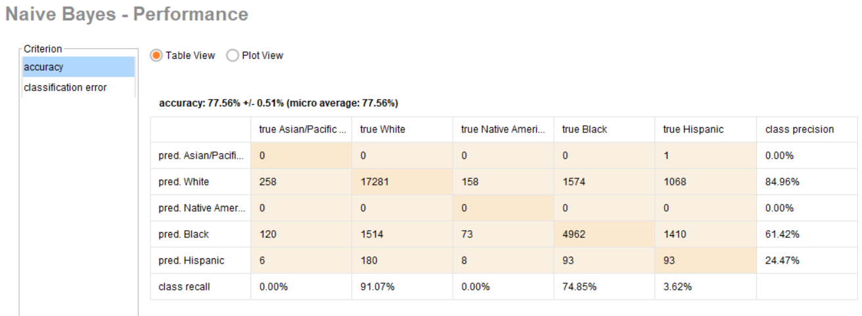
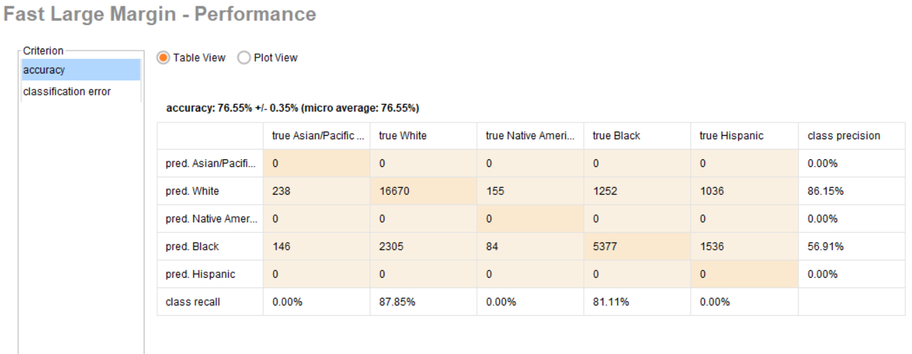
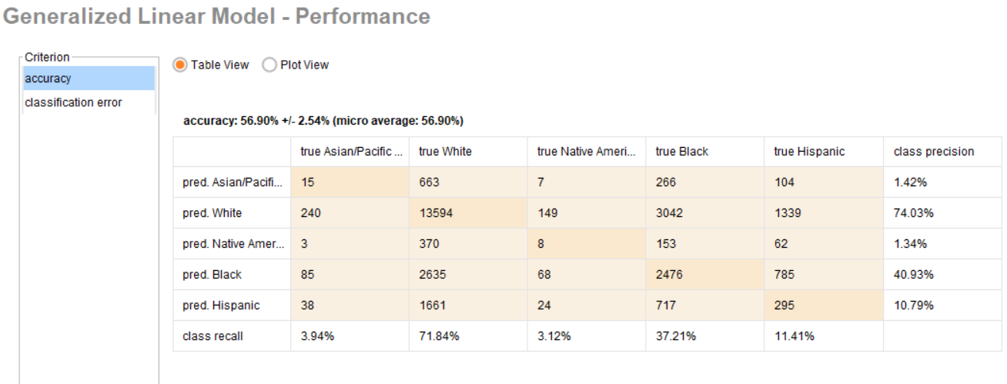
Predictive Analytics
Between the three models, the Naive Bayes Model performs the best. However, we note that if we are trying to predict victim races that are Asian or Native American, the Naive Bayes and the Fast Large Margin Models will not do us much good. This is most likely due to the limited data we have on gun deaths against these races.

Slide 5
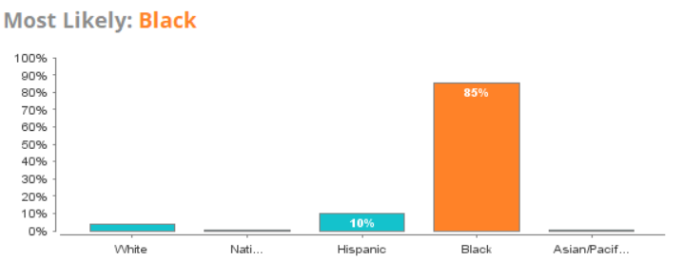
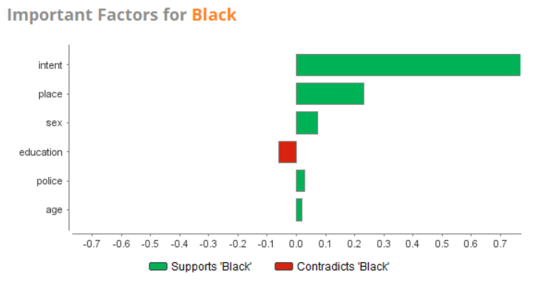
Prescriptive Analytics
With respect to Prescriptive Analytics, we attempted to Optimize the Naive Bayes Model with respect to victims who were Black.
When running the Naive Bayes Simulator for the following data: Age: 37; Education: 1.786; Intent: Homicide; Place: Street; Police: 0.000; Sex: M, the Simulator predicted the following:
Interestingly enough, we note that intent seems to be a very important factor in predicting race.
Notes:
Concluding Remarks:
Based on this study, we have learned a few interesting things about our data from 2012-2014. We have learned that our data seems to indicate that a lot of the gun deaths experienced in the United States are due to Suicide. However, with different age groups, the trend is different. For younger people, the majority of gun deaths experienced is homicide instead of suicide.
We have also learned that when comparing the race of victims gun deaths to race of the population in the United States, there seems to be a rather large number of black victims. And in analyzing the race of the victims of gun deaths, we note that there is a large correlation with intent. This leads us question why intent is so closely linked with the race of the victims. With more data over time, and more characteristics considered, we can identify a lot of relevant factors.
Based on this study alone, we are able to gain the knowledge of knowing how these various factors analyzed here, including education, age, intent, and race, have an affect on predicting the race of the victim.

Slide 6
References
Howard, J. T. (2019). To Protect and Serve? New Data on Police-Related Deaths Reveal a Persistent American Dilemma. American Journal of Public Health, 109(3), 349–350. https://doi.org/10.2105/AJPH.2018.304936
McGroarty, M. (2019). Mental health crises significant factor in police shootings.Chicago Policy Review (Online), Retrieved from https://search.proquest.com/docview/2220771713?accountid=25283
U.S. Census Bureau Fact Finder (June 2014), Annual Estimates of Resident Population by Sex, Race, and Hispanic Origin for the United States, States, and Counties, April 1, 2010 to July 1, 2013. Retrieved from: https://factfinder.census.gov/bkmk/table/1.0/en/PEP/2013/PEPSR6H?slice=Hisp~tothisp!Year~est72013

