Slide 1
Cloud Process Execution Engine
Demo
Stefanie Rinderle-Ma
Juergen Mangler
University of Vienna, Austria
Workflow Systems and Technology Group (WST)
stefanie.rinderle-ma@univie.ac.at

Slide 2
CPEE – Cloud Process Execution Engine
It is a RESTful Service.
It has been designed to be flexible to foster the trying out of new ideas (in a research context).
It has been designed to be lightweight.
  ~700 lines of code. Small is easy to maintain.
It has been designed as a teaching tool.
It is easy to use, self-contained and runs on all major platforms.
  Windows, Linux, OSX
  Android, iOS
It is efficient.
  Startup in less than 10 ms.
  After startup it consumes ~ 17 MiB memory
  Per running instance it consumes less than 2 MiB memory.
It beats all major workflow engines when it comes to control-flow patterns.
  http://arxiv.org/abs/1003.3330
It is heavily multi-threaded and hence scales well on multicore architectures.

Slide 3
CPEE – Cloud Process Execution Engine
Process Languages:
  Supports YAML and BPEL
  Allows to use arbitrary Process Languages by transformation.
Extensible Communication Mechanism
  Pluggable at runtime
  Currently handlers for REST, SOAP and mixed REST/SOAP
CPEE Cockpit:
  Pure HTML + JavaScript (no server side components) + SVG. AJAX, WebSockets to communicate with CPEE.
  Allows to model, execute, change and monitor instances running on a CPEE.

Slide 4
CPEE – Extend Every Aspect Through Services
REMUS - a REstful Marketplace for Unified Services:
  Independent of technical properties (REST/SOAP)
  Concentrate on semantic aspects of interacting with services
REMAR - Runtime Event Monitoring, Analysis and Response Library
  Analyse events from CPEE (or any RESTful service) and trigger operations.
Service 1
Unified
Service
Service 2

Slide 5
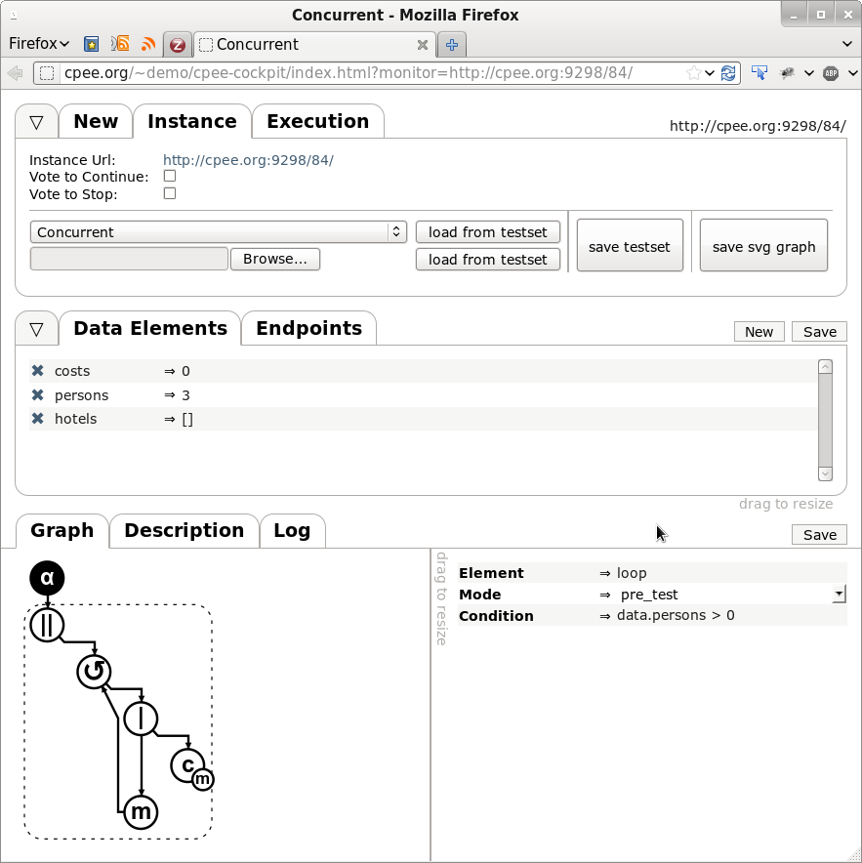
http://cpee.org

Slide 6
CPEE – Adaptive Demo
Cinemas in Vienna
  Different Technologies (REST, SOAP, Static Webpages)
  Different Interfaces
  Same notion (semantic) how to do things
  High Level Book / Search + per Cinema specialization
Worklist
CPEE
Injector
Cinema
Repository
Cinemas

Slide 7
Fin.
stefanie-rinderle-ma@univie.ac.at
juergen.mangler@univie.ac.at

