Slide 1
KEEP UP WITH YOURSELF
Rasztovits Levente

Slide 2
Testing
SWOT Analysis
Project Roadmap
Problem Statement
Solution Overview
Project Requirements
Technology Stack
System Architecture
Database design
Flowcharts
Pseudocode
Cloud functions
Security
AGENDA

Slide 3
PROBLEM STATEMENT
USERS OFTEN LOSE TRACK OF TASKS
EXISTING PRODUCTIVITY TOOLS ARE FREQUENTLY TOO COMPLEX
MANAGING PERSONAL WORKFLOWS EFFICIENTLY IS DIFFICULT
MANY SYSTEMS CONTAIN UNNECESSARY FEATURES
MAIN PROBLEM

Slide 4
Proposed solution
TASK MANAGEMENT
TASK TYPE CATEGORIZATION
STATUS TRACKING
AUTHENTICATION SYSTEM
DEADLINE MANAGEMENT
AUTOMATED TASK EXPIRATION
USER-SPECIFIC SECURE DATA STORAGE

Slide 5
PROJECT REQUIREMENTS
FUNCTIONAL REQUIREMENTS
NON-FUNCTIONAL REQUIREMENTS
REQUIREMENT
CRUD OPERATION
AUTOMATION
IMPLEMENTATION
FIRESTORE
VALIDATION LAYER
FIRESTORE SECURITY RULES
VALIDATION
DATA ISOLATION
CLOUD FUNCTIONS
REQUIREMENT
MAINTAINABALITY
PERFORMANCE
IMPLEMENTATION
LAYERED ARCHITECTURE
FIRESTORE SUBCOLLECTION
AUTOMATED TESTING
SCALABILITY
RELIABLITY
VITE BUILD SYSTEM
USER AUTHENTICATION
FIREBASE AUTHENTICATION
SECURITY
FIRESTORE RULES

Slide 6
TECHNOLOGY STACK
FRONTEND
TYPESCRIPT
AUTHENTICATION
FIREBASE AUTH
BUILD SYSTEM
VITE
HOSTING
FIREBASE HOSTING
BACKEND
FIREBASE
AUTOMATION
CLOUD FUNCTIONS
DATABASE
FIRESTORE
TESTING
VITEST

Slide 7
SYSTEM ARCHITECTURE
UI
SCRIPT
VALIDATION
SERVICE
SDK
FIRESTORE

Slide 8
DATABASE DESIGN
users
userID
profileData
tasks
taskTypes
taskDocuments
typeDocuments

Slide 9
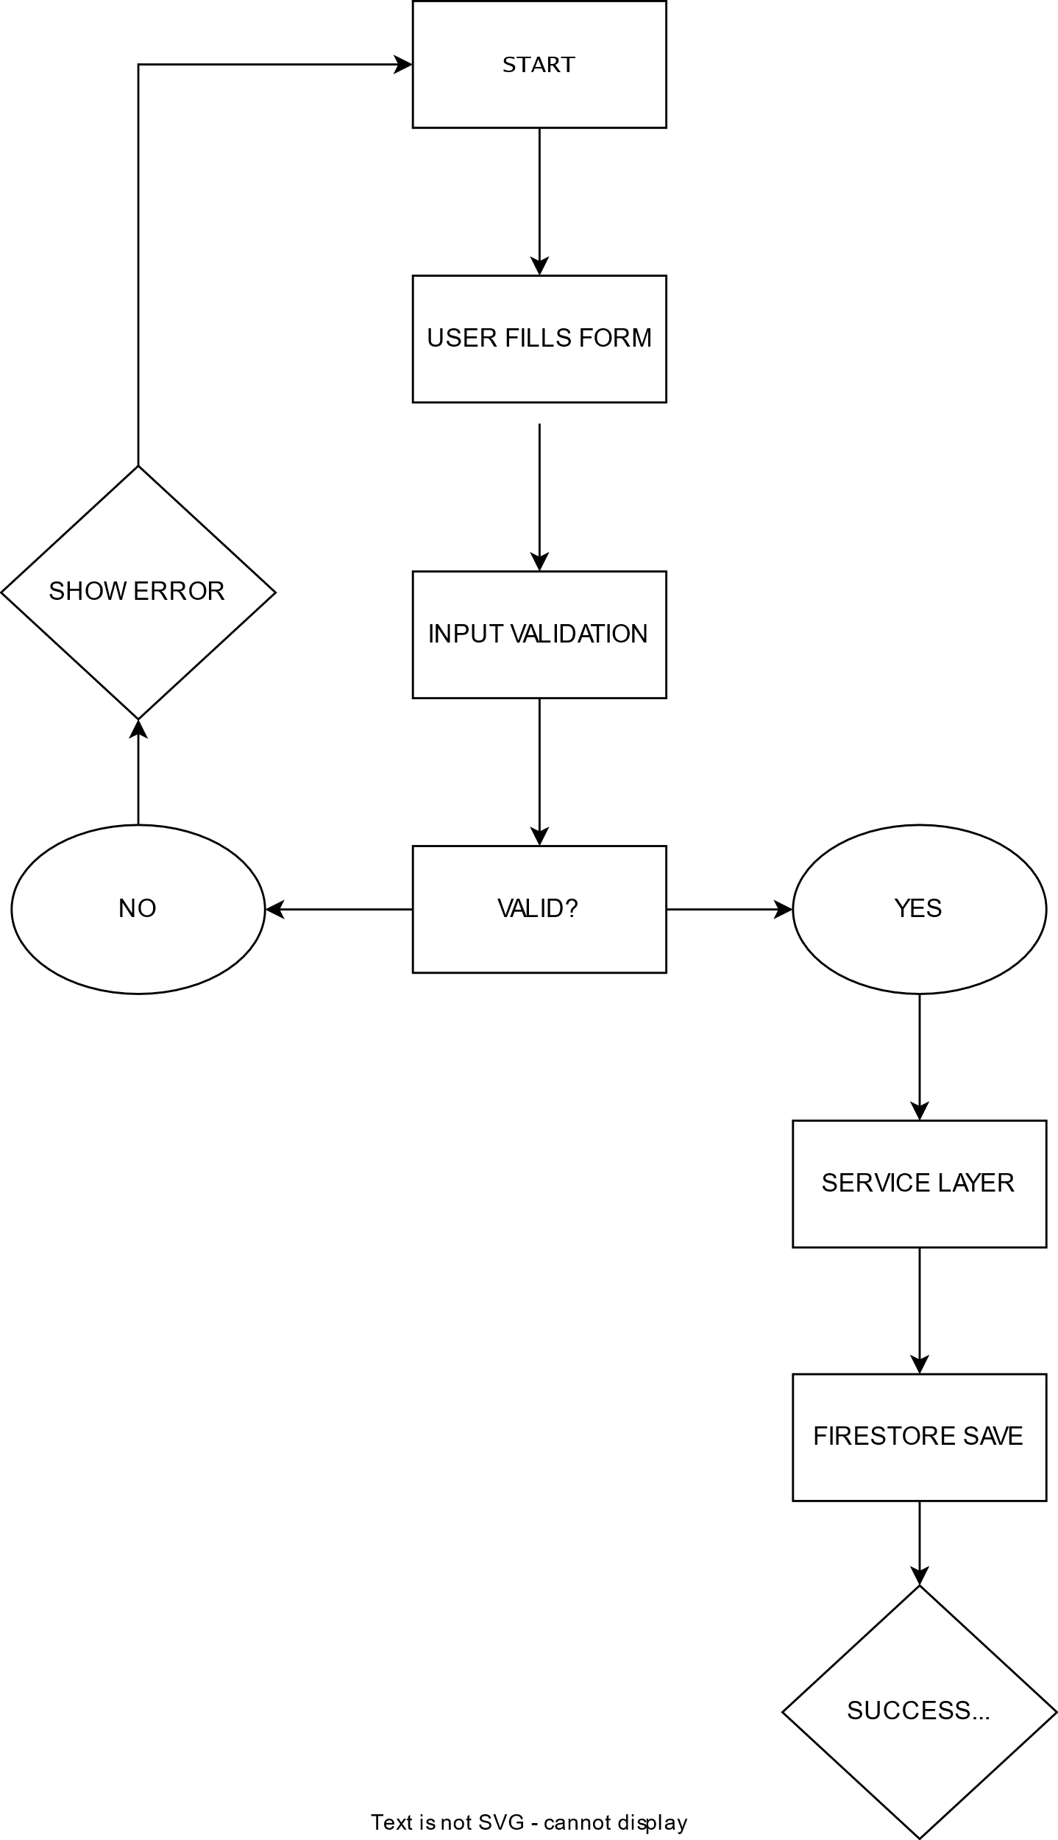
MAIN WORKFLOWs

Slide 10
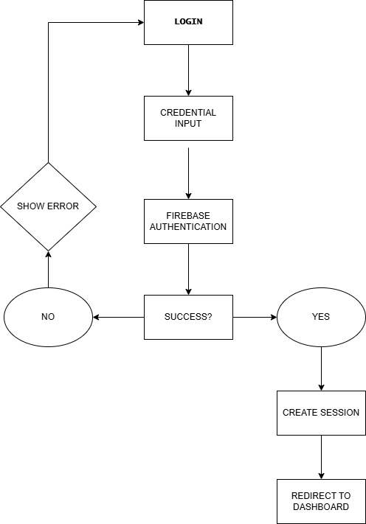
auth WORKFLOWs

Slide 11
PSEUDOCODE
FOR each user
GET active tasks
FOR each task
IF deadline < currentDate THEN
status = "Expired"
UPDATE database
ENDIF
ENDFOR
ENDFOR

Slide 12
Cloud functions
TRIGGER
SCHEDULER
FUNCTION
CLOUD FUNCTION
QUERY
UPDATE
UPDATE EXPIRES TASKS
FIRESTOR QUERY

Slide 13
Security system
AUTHENTICATION REQUIRED
USER SPECIFIC ACCESS
UNAUTHORIZED WRITES BLOCKED
CONTROLLED UPDATES

Slide 14
Testing system
VALIDATOR TESTS
AUTHENTICATION VALIDATION
CRUD TESTS
FIRESTORE OPERATIONS
INTEGRATION TESTS
SERVICE WORKFLOWS

Slide 15
Error handling
INVALID AUTHENTICATION
INVALID TASK DATA
FIRESTORE ERRORS
ASYNC OPERATION HANDLING

Slide 16
SWOT
strengths
MODULAR ARCHITECTURE
weaknesses
FIREBASE VENDOR LOCK IN
THREATS
OPPORTUNITIES
SECURITY RULES
AUTOMATED TESTING
CLOUD AUTOMATION
REQUIRES INTERNET CONNECTION
BASIC ANALYTICS
GAMIFICATION
AI INTEGRATION
PRODUCTIVITY ANALYTICS
MOBILE APPLICATION
STRONG COMPETITORS
FIREBASE PRICING CHANGES
DATA PRIVACY REGULATIONS
SCALING COSTS

Slide 17
ROADMAP
AUTHENTICATION
REGISTER
LOGIN
FRONTEND
BASE CSS
LANDING
SIGNED IN
TASKS
PROFILE
SERVICES
VALIDATORS
SERVICES
AUTOMATED TESTING
UNIT
INTEGRATION
FUTURE IMPROVEMENTS

Slide 18
Thank you

