Slide 1
Moke Foods
Group 3
Neo Rei Siang Edward (S10204829)
Yang Molei (S10202940)
Sng Wei Liang Jeremy (S10204529)
Evan Ong Shui Fu (S10194040)
Chiang Jun Han (S10205166)
Notes:
Edward - Good Morning Mr Tan! Today I will be presenting on our Assignment. I am Edward Neo and my group members are Jeremy, Molei, Jun han and Evan. So before we begin, I will give a quick overview of the whole ordering and delivery process

Slide 2
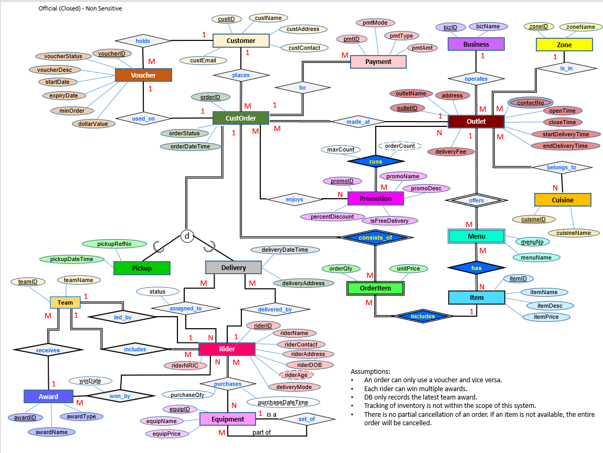
ER Model
Notes:
This is the ER Model we plan to use for the online food delivery platform. It has a total of 18 entities, including weak entities and disjointed entities.

Slide 3
Additional Assumptions
Delivery Fee is standardised for all outlets and for each business

Slide 4
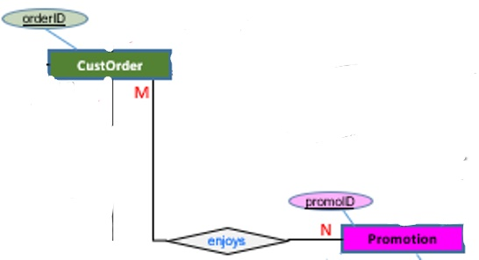
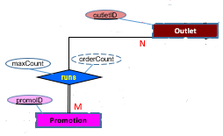
Changes Made
Added New Relation, Enjoys (<orderID>, <promoID>)
Added New Relation, Runs (<promoID>, <outletID>, maxCount)
Notes:
We have made a total of 8 changes made. I will go through the first 2. The first one is we added a new relation called “Enjoys” where it links the entities CustOrder and Promotion. Due to the Many - Many relationship between these 2 entities, a new relation had to be created. Enjoys has 2 foreign key attributes, orderID and promoID. Likewise, due to the Many - Many relations Outlet and Promotion entities, we created another relation called Runs. Runs has a composite key of promoID and OutletID which acts as its primary key and an additional attribute, maxCount.

Slide 5
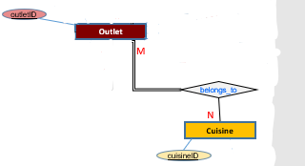
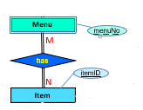
Changes Made
Added New Relation, Belongs (<outletID>, <cuisineID>)
Added New Relation, Has (<outletID, menuNo>, <itemID>)
Notes:
The next 2 changes made is the creation of a new relation, Belongs, for the entities Outlet and Cuisine due to the Many-Many relations, and a relation, Has, for the entity Item and the weak entity Menu. For the Belongs relation, it has a composite key of outletID and cuisine ID. For the Has relation, it has a composite key using the composite key of Menu and primary key of Item.

Slide 6
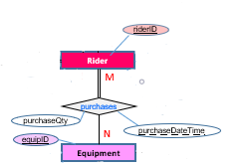
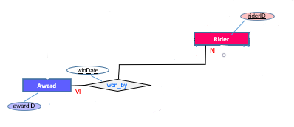
Changes Made
Added New Relation, Purchase (<riderID, purchaseDateTime>, <equipID>, purchaseQty)
Added New Relation, Achieve (<riderID, winDate>, <awardID>)
Notes:
For the next 2 changes made, 2 new relations, Purchase and Achieve were made. These 2 relations were again created due to the Many-Many relations between 2 entities. For the Purchase relation, it has a composite key with riderID and its partial key, purchaseDateTime, combined with equipID to form its primary key. It also has another attribute called purchaseQty. For the achieve relation, it has a composite key with riderID and its partial key, winDate, and awardID.

Slide 7
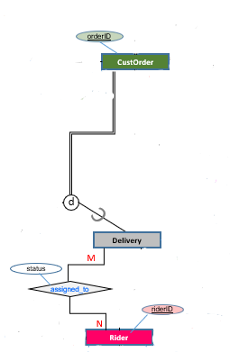
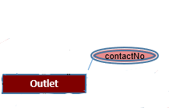
Changes Made
Added New Relation, Assign (<orderID>, <riderID>, status)
Added New Relation, OutletContact (<outletID>, ContactNo)
Notes:
For our last 2 relation, they are Assign and OutletContact. Assign is formed due to the Many - Many relation between the Delivery entity and Rider entity. It has a composite key with orderID and riderID as its primary key, and an additional attribute of status. For OutletContact, it is formed due to the multi-value attribute of contactNo in the outlet entity. It has a composite key with outletID and Contact No.

Slide 8
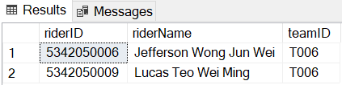
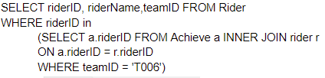
Individual Queries(Edward)
How many Individuals in team ''T006'' won individual awards
Identify riders who have worked hard
Provide more incentives to such riders
encourage the other riders as well to work harder
Notes:
Since the Achieve Relation represents riders that won individual awards, as long as the riderID in achieve matches with the riderIDs in rider entity. And only those riderIDs in the selected team, in this case “T006” was selected. I felt that this query can be used to identify workers who have worked hard, so as to provide more incentives to these riders, which can also encourage other riders to work harder as well so as to gain such incentives.

Slide 9



Individual Queries(Edward)
Out of all the orders, which item was ordered more than or equals to 4 times.
Identify popular food items
Have more promotions for the food items
Encourage users to buy more, increasing sales
Business can focus on these type of items due to popularity
Notes:
I used a subquery here to identify which item from the list of orderItem has a count of 4 or more times. The ItemID in the list of orderItems have to be group by according to their itemID so as to identify the number of orders per itemID.
I felt that this query can be used to identify popular food items, which can result in having more promotions for the specific food item, encouraging users to buy more, making more sales. The business can also focus more on these types of items as it is more popular.

Slide 10
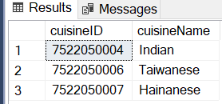

Individual Queries(Edward)
Out of all the outlets, which Cuisine belongs to less than 3 Outlets
Identify which cuisines are lacking
Can plan to have more outlets selling food items belonging to these cuisines
Increasing variety of such items
Notes:
Belongs shows all the cuisineIDs available in all outlets, and so by grouping them together, i would then be able to identify the number of cuisines available in the business as of now. This can be used to identify which cuisines are lacking, so that businesses can plan to have more outlets selling more food items belonging to these cuisines so as to have a greater variety of such items.

Slide 11
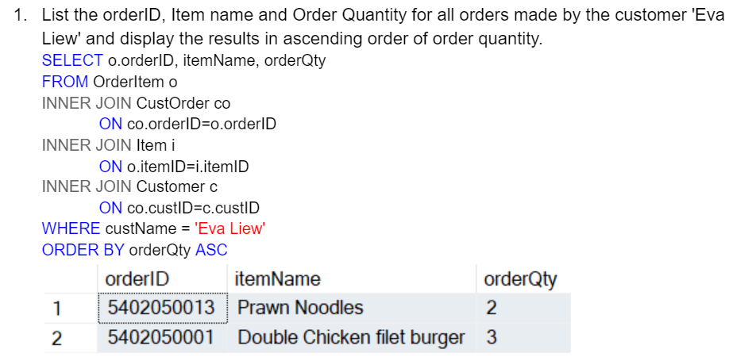
Individual Queries(Molei)
Purpose:
-Checking a particular customer’s orders (Customer Support)
-Personalised ads/recommendation/offers

Slide 12
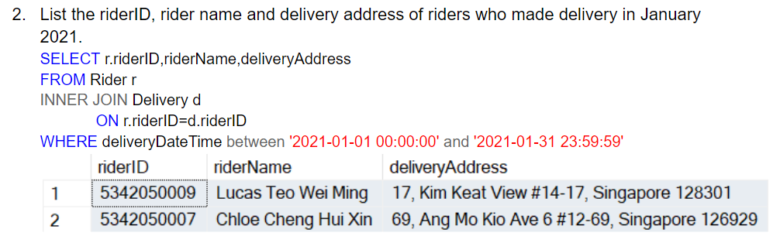
Individual Queries(Molei)
Purpose:
-Record keeping
-Get total number of deliveries in January

Slide 13
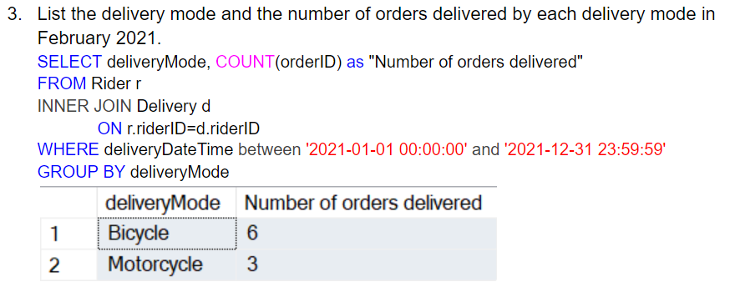
Individual Queries(Molei)
Purpose:
-To see which delivery mode has made the most number of orders in February.
-Find the most effective mode of delivery.

Slide 14
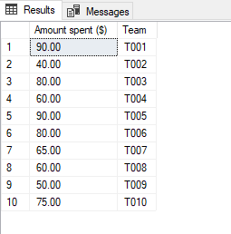
Individual Queries(Jeremy)
How much has each team spent on equipment in total?
SELECT SUM(e.equipPrice*p.PurchaseQty) AS 'Amount spent ($)',r.teamID AS 'Team' FROM Equipment e INNER JOIN Purchase p ON e.equipID = p.equipID INNER JOIN Rider r ON r.RiderID = p.riderID GROUP BY r.teamID
Purpose:
Find out how much each team spends
Data can be used to show how much equipment is lost

Slide 15
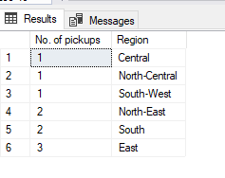
Individual Queries(Jeremy)
2. Which region has the least pickups?
SELECT COUNT(p.orderID) AS 'No. of pickups', z.zoneName AS 'Region' FROM Pickup p INNER JOIN CustOrder cO ON p.OrderID = cO.OrderID INNER JOIN Outlet o ON cO.outletID = o.outletID INNER JOIN Zone z ON o.ZoneID = z.ZoneID GROUP BY z.zoneName ORDER BY COUNT(p.orderID) ASC
Purpose:
Find out which regions require lesser riders compared to others.
Able to make certain promotions to regions with more pickups

Slide 16
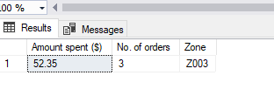
Individual Queries(Jeremy)
3. What is the total amount spent and number of orders from outlets in zone “Z003”?
SELECT SUM(p.pmtAmt) AS 'Amount spent ($)', COUNT(p.pmtID) AS 'No. of orders', o.zoneID AS 'Zone' FROM Payment p INNER JOIN CustOrder cO ON p.orderID = cO.orderID INNER JOIN Outlet o ON o.outletID = cO.outletID WHERE o.zoneID = 'Z003' GROUP BY o.zoneID
Purpose:
Shows the activity of zone 3
Find out how much revenue zone 3 brings in.
Able to give attention to zone 3 if sales are lacking or thriving.

Slide 17
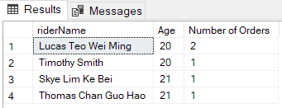
Individual Queries(Evan)
How many orders are delivered by riders at the age of 25 and below?
Select r.riderName, DATEDIFF(YEAR, r.riderDOB, GETDATE()) AS 'Age', COUNT(d.orderID) AS 'Number of Orders'
FROM Rider r INNER JOIN Delivery d ON r.riderID = d.riderID
WHERE DATEDIFF(YEAR, r.riderDOB, GETDATE()) <= 25
GROUP BY r.riderName, DATEDIFF(YEAR, r.riderDOB, GETDATE())
Purpose:
Check on the productivity of young riders
Keep track of the progress of the young drivers
Allow MokeFood to look out for them and give them more orders

Slide 18
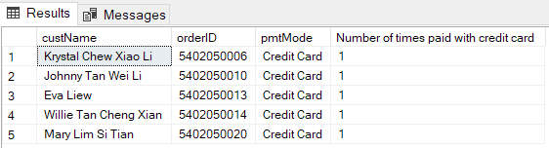
Individual Queries(Evan)
2. Which customers made payment using ‘Credit Card’ and how many times did they pay with it?
SELECT c.custName, o.orderID, p.pmtMode, COUNT(p.pmtID) AS 'Number of times paid with credit card'
FROM Customer c INNER JOIN CustOrder o ON c.custID = o.custID
INNER JOIN Payment p ON o.orderID = p.orderID
WHERE p.pmtMode = 'Credit Card'
GROUP BY c.custName, o.orderID, p.pmtMode
Purpose:
Find out the number of customers paying with credit card
Data can be used for MokeFood to collaborate with banks to provide rebates to customers
Encourage customers to buy more with credit card

Slide 19

Individual Queries(Evan)
3. Display the total number of customers and orders MokeFood had and their total earnings for the month of January 2021
SELECT COUNT(DISTINCT(c.custName)) AS 'Number of customers', COUNT(co.orderID) AS 'Number of orders', SUM(p.pmtAmt) AS 'Total Earnings ($)'
FROM Customer c INNER JOIN CustOrder co ON c.custID = co.custID
INNER JOIN Payment p ON co.orderID = p.orderID
WHERE DATEPART(MONTH, co.orderDateTime) = '1' AND DATEPART(YEAR, co.orderDateTime) = '2021'
AND p.pmtType = 'Order Payment'
Purpose:
Identify the total number of customers and orders for the month of January 2021
Find out the profits for the month of January 2021 MokeFood had
Data can be used in the future to calculate average spendings and orders of customers

Slide 20
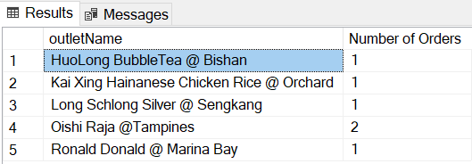
Individual Queries(Jun Han)
Which food outlet has at least 1 order in January 2021?
SQL Query:
SELECT o.outletName, COUNT(c.orderID) AS 'Number of Orders' FROM
Outlet o INNER JOIN CustOrder c ON c.outletID = o.outletID
WHERE DATEPART(YEAR,c.orderDateTime) = 2021 AND
DATEPART(MONTH,c.orderDateTime) = 1
GROUP BY o.outletName
Purpose:
Owner of businesses might want to check if their
outlets are receiving orders for that month and
how many orders they are receiving

Slide 21
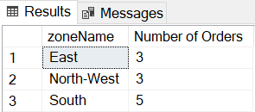
Individual Queries(Jun Han)
2. Which zone has 3 or more orders and how many orders are there for that zone?
SQL Query:
SELECT z.zoneName, COUNT(c.orderID) AS 'Number of Orders' FROM
Zone z INNER JOIN Outlet o ON z.zoneID = o.zoneID
INNER JOIN CustOrder c ON o.outletID = c.outletID
GROUP BY z.zoneName HAVING COUNT(c.orderID)>=3
Purpose:
Identify which zone receives more orders
Suggest to businesses to set up new outlets
in these zones
Help businesses gain more revenue

Slide 22
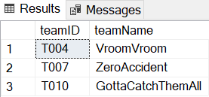
Individual Queries(Jun Han)
3. Which team has riders that are above the age of 50?
SQL Query:
SELECT DISTINCT(t.teamID), t.teamName FROM
Team t INNER JOIN Rider r ON t.teamID = r.teamID
WHERE DATEDIFF(YEAR,r.riderDOB, GETDATE()) >50
Purpose:
Find out which teams are these riders in
Assign younger riders to those teams
Reason: Younger riders may have more time so
they can deliver more orders and help
increase the chances of obtaining awards
for the team

