Slide 1
DL ASSIGNMENT 1
Edward Neo S10204829
Notes:
Good Morning Maam, and students. I am Edward Neo and I will be presenting on my assignment today.

Slide 2
Overview
Purpose :
Build two multi-image classification model to recognise and classify 10 different classes of foods
Compare and use the better of the two to classify random images online
Approach:
Load the training, validation, and testing images
Create a model built from scratch, and another utilising a pre-built model.
Test both models and use the better one
Use the better model to perform classification of random online images
Notes:
Let us first go through the overview of the assignment. Firstly, the purpose of this assignment is to Build two multi-image classification model to recognise and classify 10 different classes of foods. These two models would then be compared and the better of the two would be use to classify random images online. The approach I will be taking to do the assignment is to firstly load the training, validation and testing images into Jupyter Notebook. Second is to create a model built from scratch and another built utilising a pre-built model. Next, I would test both models and compare both of them. Lastly, using the better model, classification would be performed. The universal Machine Learning Workflow will be followed closely to. There are 7 steps in the Universal Machine Learning Workflow. Define the problem and assemble the dataset, choose a measure of success and evaluation protocol, prepare the data, develop a model that does better than baseline, Scale up the Model and Regularise the model

Slide 3
Data Preprocessing And Data Loading
Data Preprocessing:
Requires two packages, “import os” and “import shutil”
Training, Validation, Test Directories created
Copies the images into their relevant directories
Data Loading:
Requires the package, “import os”
Specify the training, validation, and test images directory in the program
Images are set to have a standard size of 150 by 150
Notes:
Data Preprocessing uses two packages, Os and shutil. OS is used to create training, validation and test Directories. The text file containing food classes names assigned to me are extracted and the names are stored in a list. For each name in the list, the training images and validation images are copied into relevant directories. For Data loading, Os is used to specify training, validation and test images directory in the program. Images are also set to have a standard size of 150 by 150

Slide 4
Model Built From Scratch
01
04
BaseLine Model
Adjusting Learning Rate
02
05
Data Augmentation
Changing Network
03
06
Scaling Up the Model
Implementing Dropout And Regularizers
Default Parameters Were Used
Adjusted To Overfit And Improve The Model
Training Data Was Augmented
Changed Size And Complexity Of Network
Increasing Number Of Dense Layers And Increasing Epochs
Hyper Parameters Adjusted to Regularise the model
Notes:
Model Built From Scratch

Slide 5
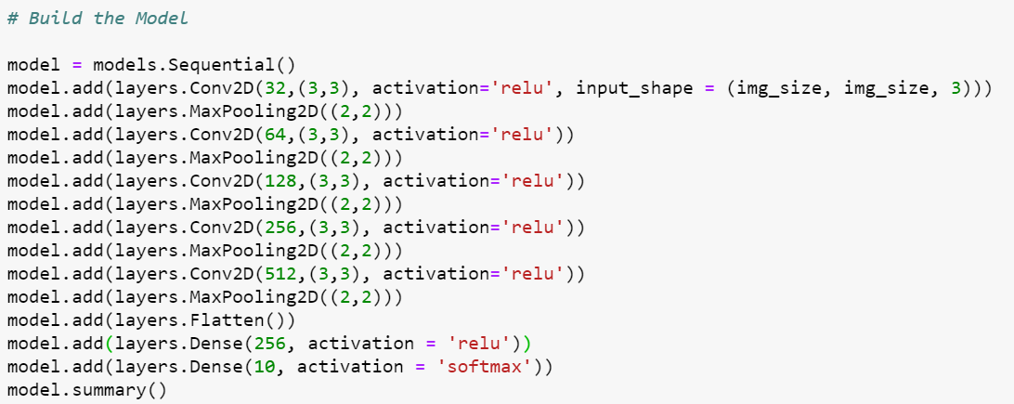
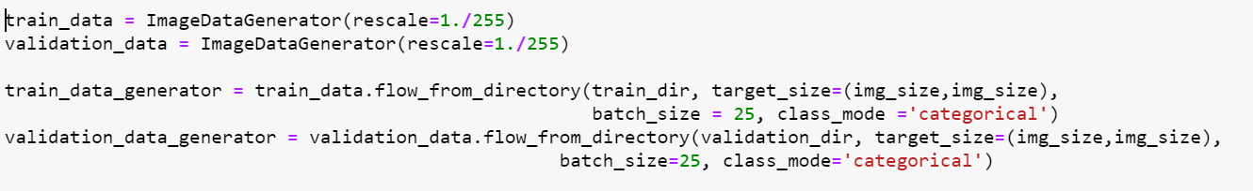
Building the Base Model
Five Conv2D Layers
Five Maxpooling2D
One Flatten Layer
Two Dense Layers, 256 neurons and 10 neurons
ImageDataGenerator(Rescale =1./255)
Batch Size = 25
Class Mode = Categorical
Notes:
Building Base Model, 5 conv2D layers from 32 to 512 number of filters, Five MaxPooling2D layers, one flatten layer, Two Dense Layers, one with 256 neurons and the other 10 neurons. For training, both training and validation images are rescaled to transform image pixels from the range 0 to 255 to 0 to 1. Images are extracted from the directories 25 at a time and categorical is used as there are 10 classes

Slide 6
Building the Base Model
Optimizer = “rmsprop”
Loss = “categorical_crossentropy”
Metrics = [“acc”]
Steps_per_epoch = 300
Validation_steps = 80
Epochs = 30
Notes:
For compiling of the model, optimiser was set to default at rmsprop, loss was set to categorical _crossentropy for multiple classes. Metrics is acc as model is performing classification. Since there are 7500 training images, 300 batches of training images are extracted at a time. Since there are 2000 validation images, 80 batches of validation images are extracted a time. Epochs was set to 30

Slide 7
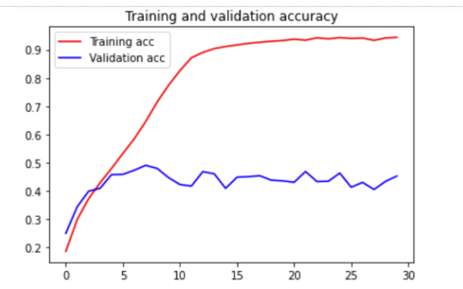
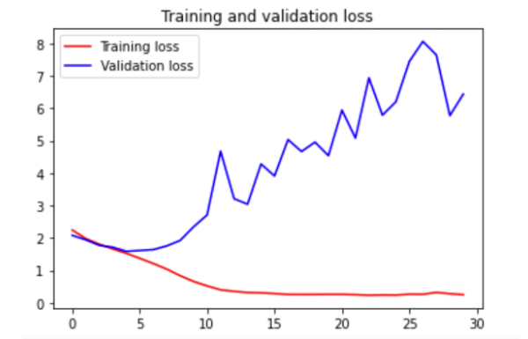
Base Model
Accuracy Graph of Base Model
Loss Graph of Base Model

Slide 8
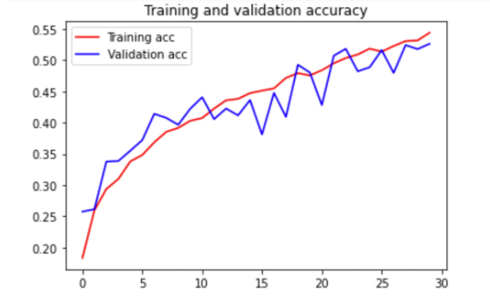
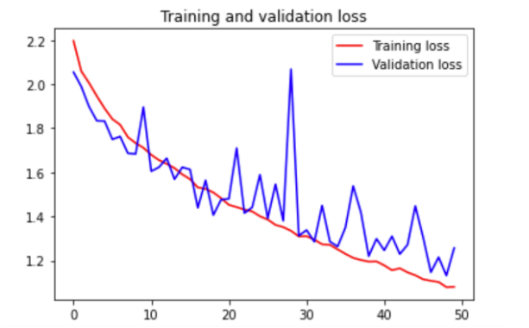
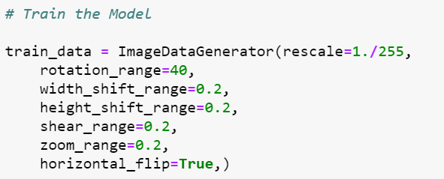
Data Augmentation
Training dataset was augmented
A model better than baseline was developed

Slide 9
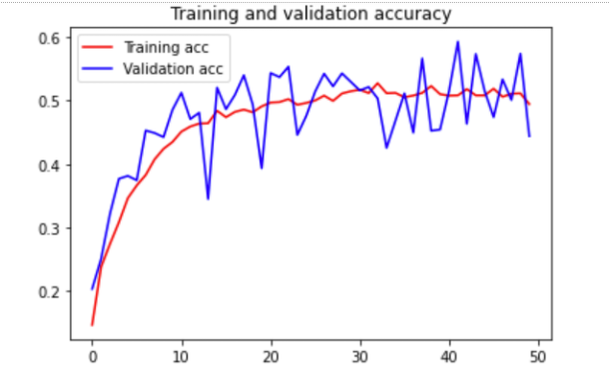
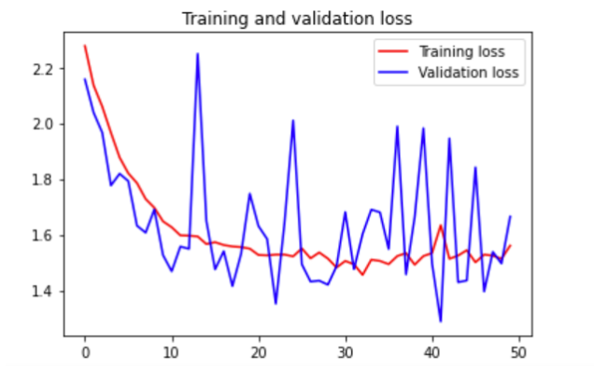
Scaling The Model Up
Added one Dense Layer to the network size
Increased Number of Epochs to 50

Slide 10
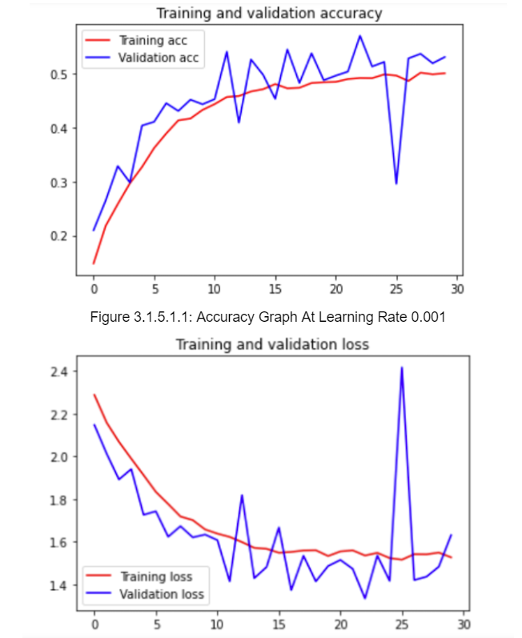
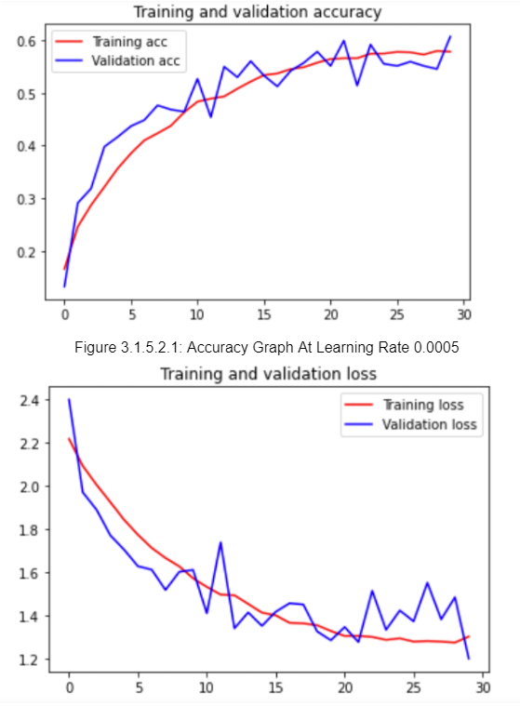
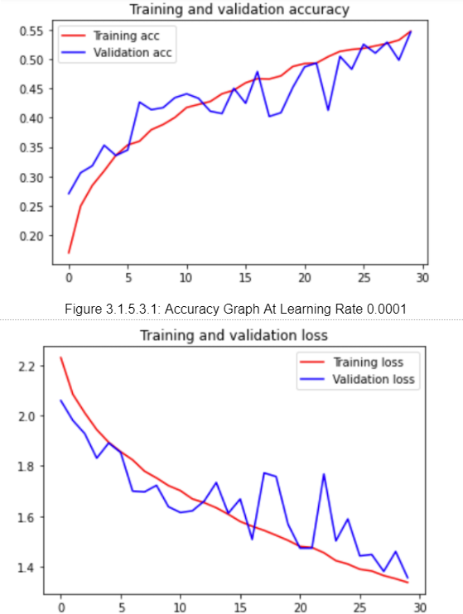
Adjusting learning rate
Learning Rate - 0.001
Learning Rate - 0.0005
Learning Rate - 0.0001
Model did not change much
Both training and validation accuracy increased
Validation Accuracy decreased

Slide 11
Selected Learning Rate
Comparing all three learning rates used, the best learning rate is 0.0005
Achieved the highest validation and training accuracy

Slide 12
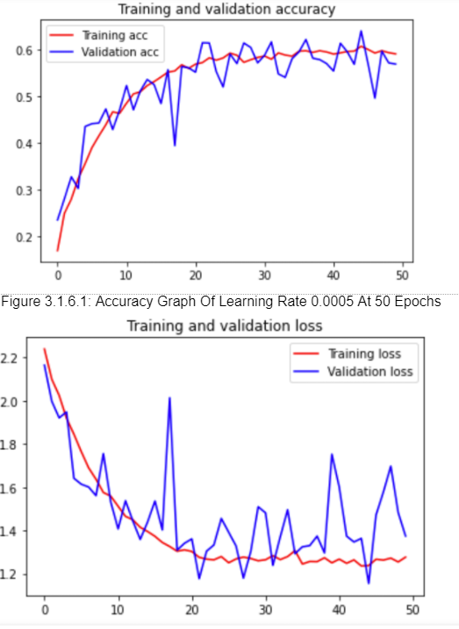
Increase Epochs
Check for overfitting
However, training accuracy became stagnant at 0.6
Model was too simple

Slide 13
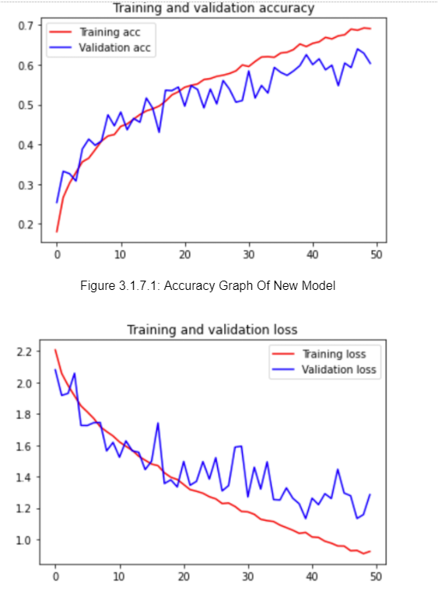
Change Network
Number of filters increased
Followed the steps above with new network
Found out best learning rate for new model was 0.0001
Started to ovefit from 25th epoch

Slide 14
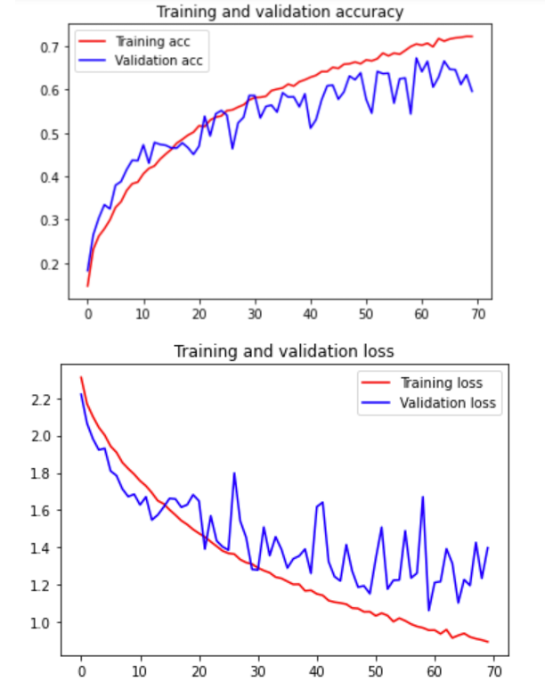
Added Regularizations And Dropout
2 Dropout at 0.3
3 L2 Regularizers at 0.0001
70 Epochs were used to maximise the graph

Slide 15
Model Built Using Pre-Built
01
04
VGG16 + BaseLine Model
Adjusting Learning Rate
02
05
Data Augmentation
Fine-Tuning Network
03
06
Scaling Up the Model
Implementing Dropout And Regularizers
Default Parameters Were Used
Adjusted To Overfit And Improve The Model
Training Data Was Augmented
Train VGG16 Layers
Increasing Number Of Dense Layers
Hyper Parameters Adjusted to Regularise the model

Slide 16
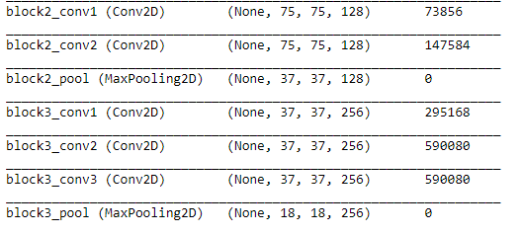

Building VGG16 Model
Weights = “imagnet”
Include_top = “False”
Input_shape = 150 by 150 by 3
Consists of blocks, with each block having two to three Conv2D layers and 1 MaxPooling2D layer
Notes:
Building of VGG16 model. Weights was set to “imagnet”, Include_Top = “False” as we are only using 10 of our own classes, Input_shape = 150 by 150 by 3. The VGG16 Model consist of 4 blocks, with each block having two to three Conv2D layers and 1 MAxpooling Layer

Slide 17
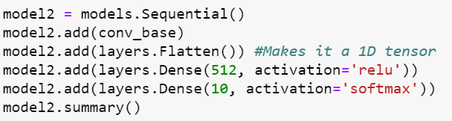
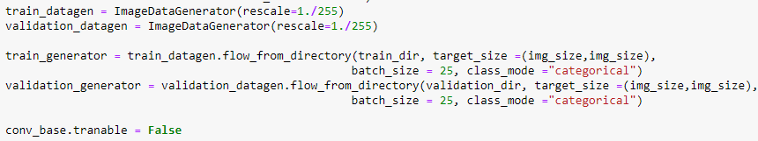
Building Base Model
Two Dense Layers, 512 and 10 Neurons
ImageDataGenerator(Rescale =1./255)
Batch size = 25
Class Mode = Categorical
Conv_base.trainable = False
Notes:
For building of base model, two dense layers were used. One with 512 neurons and one with 10. The training of the data is the same as the one with the scratch model and I will not go through it to save time. conv_base was frozen by the command conv_base.trainable = False so as to not train the VGG16 Models

Slide 18
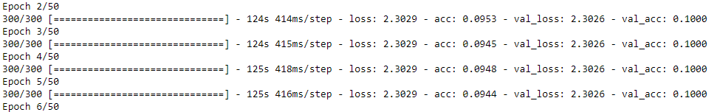
Building Base Model
Validation accuracy constant at 0.100 when optimizer = “rmsprop”
Optimizer = ‘rmsprop’ did not work
Loss = “categorical_crossentropy”
Metrics = [“acc”]
Steps_per_epoch = 300
Validaiton_steps = 80
Epochs = 30
Code use for compiling the model
Code use for fitting the model
Notes:
For optimiser of the model, every paramatere is the same as the scratch model except for the optimiser. Since default optimiser did not work, I had to adjust it and the first model that produced a proper graph was with a value of 0.0005

Slide 19
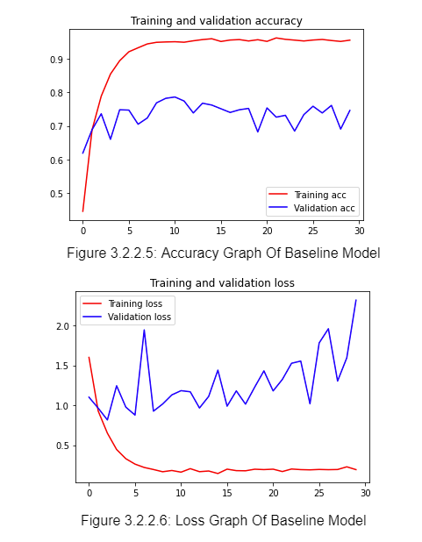
Base Model
Accuracy Graph of Base Model
Loss Graph of Base Model

Slide 20
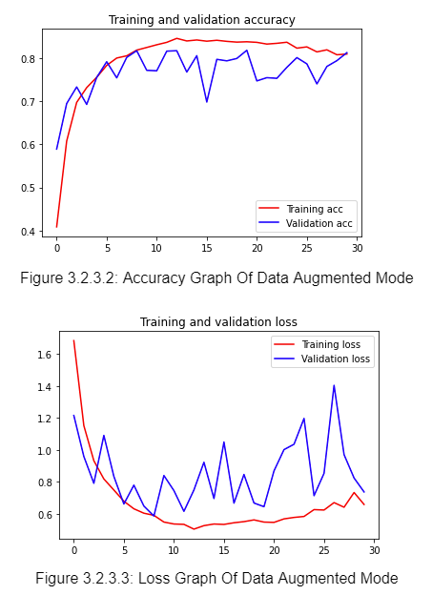
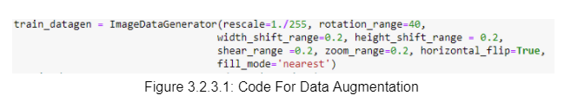
Data Augmentation
Training dataset was augmented
A model better than baseline was developed
same as scratch model except for “fill_mode”

Slide 21
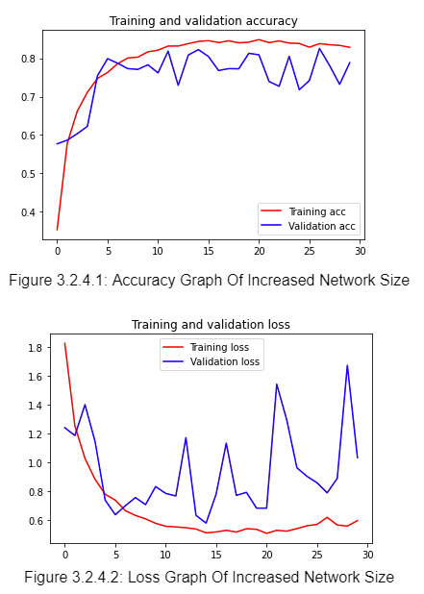
Scaling Up the Model
Added one Dense layer, 512 Neurons
Epochs not raised due to training accuracy being limited at 0.8

Slide 22
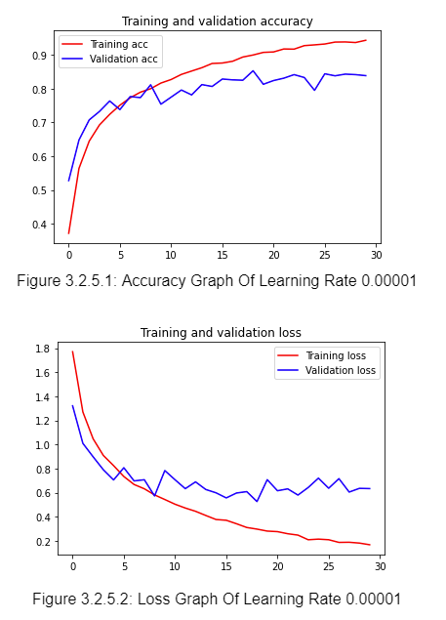
Adjusted Learning Rate
Adjusted Learning Rate to 0.0001
Validation Accuracy increased and was more consistent
Training Accuracy increased to 0.95
Not a need to decrease learning rate further due to high Training Accuracy reached

Slide 23
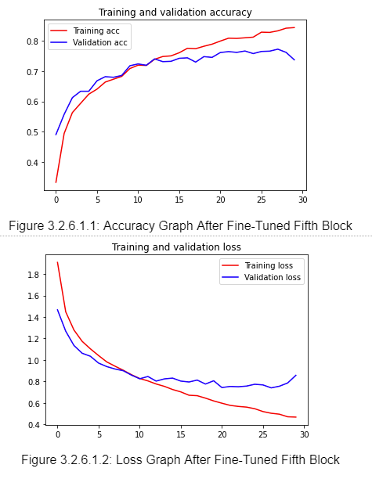
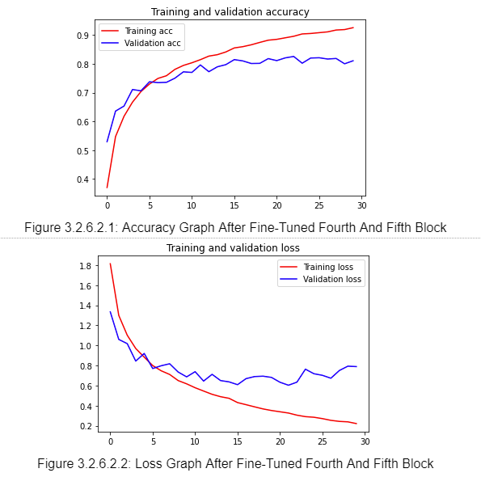
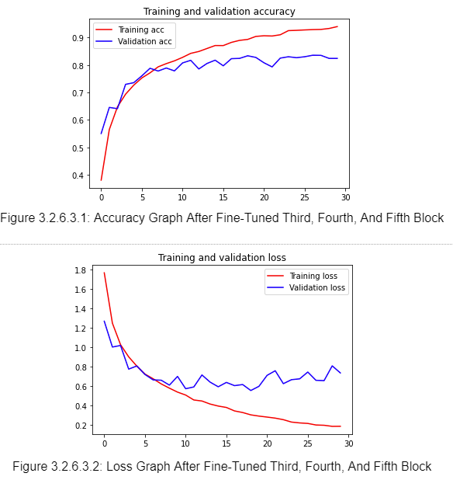
Fine-Tuning VGG16’s Blocks
Trained Fifth Block
Trained Fourth And Fifth Block
Trained Third, Fourth, And Fifth Block
Both Accuracy Decreased
Validation Accuracy More Consistent
Both training and validation accuracy increased
Overfitting Occured From Fifth Epoch
Validation Accuracy More Consistent In the 0.8 Range

Slide 24
Fine-Tuned Selection
Best Performed When All Three Blocks Were Trained
Did Not Train The Earlier Blocks As They Encode More Generic And Reusable Features
Fine-tuning Earlier Layers Will Result In Fast-Decreasing Returns Which Should Be Avoided

Slide 25
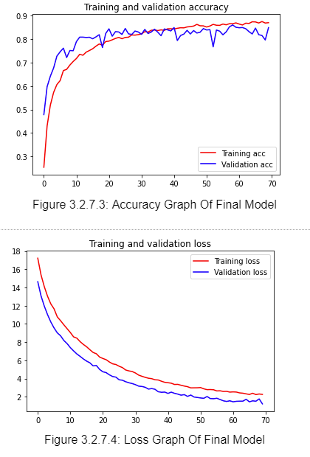
Implementing Dropout And Regularization
Two Dropout Values At 0.2
One Dropout Value At 0.1
Three Regularizations At 0.01
Increased Epochs To 70 To Flatten Out Lost

Slide 26
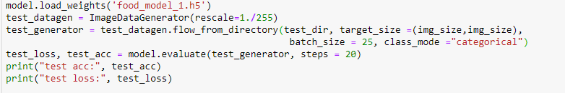
Evaluating Using Test Images
Both Model’s Weights Were Saved And Loaded
ImageDataGenerator(Rescale =1./255)
Batch size = 25
Images Are Set To Have A Size Of 150 by 150
Class Mode = “Categorical”
Steps = 20
Notes:
Both models’ weights were saved and loaded. LIkewise for validation and training images, Test Images Data are rescaled, extracted 25 images at a time . The class_mode is categorical as there are 10 classes. 20 Sets of test image batches are extracted.

Slide 27


Comparing Model’s Performance
Scratch Model
Pre-Built Model
Test Accuracy: 0.576
Test Accuracy: 0.806

Slide 28
Reasons For Better Performance
First Difference: Addition of “fill_mode” In Data Augmentation For Pre-Built
Second Difference: Different Learning Rate Was Used
Third Difference: Model’s Network Sizes Were Different
One reason For Pre-Built Performing Better: Due To Difference In Network, The Pre-Built Could Learn Better.
Second reason For Pre-Built Performing Better: The layers in Pre-Built Were Also Fine-Tuned, Suggesting That The Layers Underwent Further Training
Notes:
Test Images Data Set Are Rescaled To Transform Every Pixel Value From The Range Of 0 To 255, To 0 to 1

Slide 29
Performing Classification
Weights Of The Best Model Were Saved And Loaded
Food Classes Names Were Extracted and stored in a list
Two Functions were created to process the images downloaded online and to perform prediction of the images

Slide 30
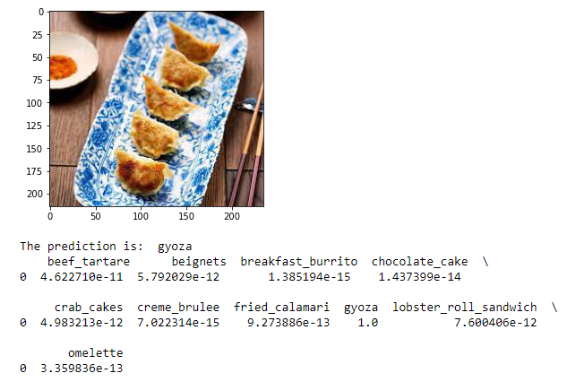
—Classification Of FIrst Image

Slide 31
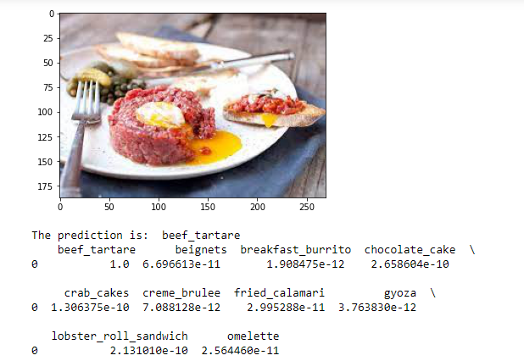
—Classification Of Second Image

Slide 32
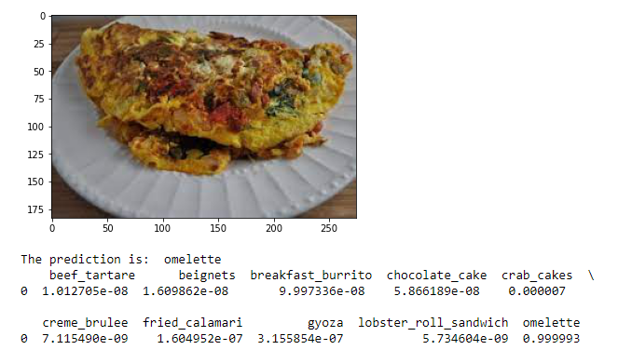
—Classification Of Third Image

Slide 33
Summary
Was Quite Happy With the Pre-Built Model as it had a high testing accuracy
Pre-built Model was able to classify the three images correctly, fulfilling the aim of the assignment
However, the Scratch Model had a rather low accuracy of 0.576
Points Of Improvement
- Could have been using a different optimiser
- Could compare different types of Prebuilt Model
- Could tried out more network sizes for Scratch Model

Slide 34
THANKS!
Does anyone have any question?
addyouremail@freepik.com

