Slide 1
Python Automation Basics II

Slide 2
Agenda
Data Structures
Lists
Dicts (dictionaries)
Sets
Loops
For Loops
While Loops
Exit Conditions
Group Programming Exercise

Slide 3
Data Structures

Slide 4
Lists
Lists are collections of objects.
They are convenient because we can store items as well as items of different data types in them.
Lists are formed by values between two brackets:
my_list = [3, 4, 6, 2, 1]
my_list = [] # empty list
my_list = list() # also empty list
We can access values in a list via an index. Since Python is “zero-indexed” we access values like this:
my_list[0] would be equal to 3
my_list[2] would be equal to 6

Slide 5
Dicts (dictionaries)
Dicts are collections of key-value pairs.
Convenient because we can use them to split data into different buckets.
Dicts are formed by key-value pairs between two braces:
my_dict = {3: “hello”, 10: “there”}
my_dict = {} # empty dict
my_dict = dict() # also empty dict
We can access values in a list via key key:
my_dict[3] would be equal to “hello”

Slide 6
Sets
Sets are collections of unique items.
Similar to dicts but only hold the keys.
Values cannot be accessed using an index.
Sets are formed by creating them with values or the direct function:
my_set = {“here”, “is”, “my”, “set”}
my_set = set() # empty set

Slide 7
Loops

Slide 8
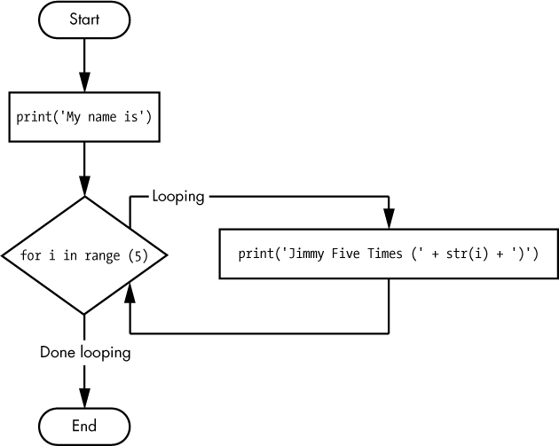
For Loops
You can think of a for loop as “walking” through a group of items.
Here's a sentence that describes it:
for each item in a collection of items, (do something).

Slide 9
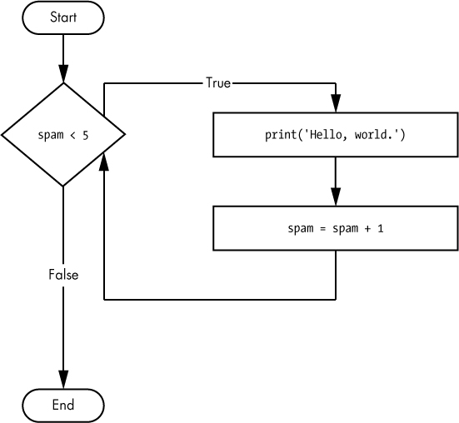
While Loops
A while loop expects some condition to change. We can describe it this way:
while some condition is true keep doing something.
While loops are useful in some circumstances, but it's generally best to avoid them until you've got a strong grasp of exit conditions.

Slide 10
Exit Conditions
While you can have other exit conditions in a for loop, the main condition is that you've run out of items to iterate through.
In a while loop, exit conditions are very important otherwise the loop will continue on forever or until you manually stop it by exiting the program or by halting the task. This is called an “infinite loop”.

Slide 11
Group Programming Exercise

