Slide 1
CE 530 Molecular Simulation
Lecture 10
Simple Biasing Methods
David A. Kofke
Department of Chemical Engineering
SUNY Buffalo
kofke@eng.buffalo.edu

Slide 2

Review
Monte Carlo simulation
  Markov chain to generate elements of ensemble with proper distribution
Metropolis algorithm
  relies on microscopic reversibility
  two parts to a Markov step
    generate trial move (underlying transition probability matrix)
    decide to accept move or keep original state
Determination of acceptance probabilities
  detailed analysis of forward and reverse moves
  we examined molecule displacement and volume-change trials

Slide 3
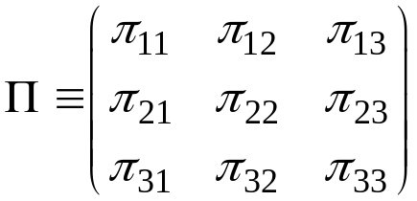
Performance Measures
How do we improve the performance of a MC simulation?
  characterization of performance
  means to improve performance
Return to our consideration of a general Markov process
  fixed number of well defined states
  fully specified transition-probability matrix
  use our three-state prototype
Performance measures
  rate of convergence
  variance in occupancies

Slide 4
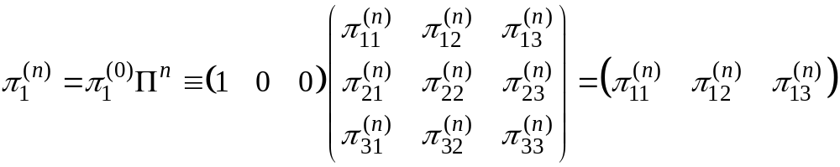


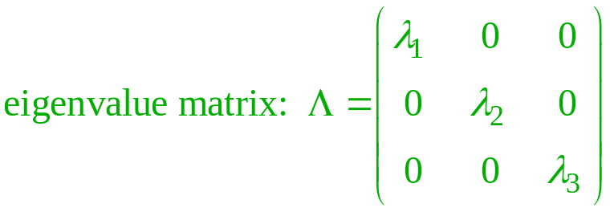
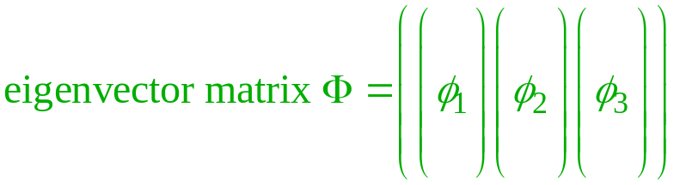
Rate of Convergence 1.
What is the likely distribution of states after a run of finite length?
  Is it close to the limiting distribution?
  We can apply similarity transforms to understand behavior of
    eigenvector equation
Probability of being in state 3 after n moves, beginning in state 1

Slide 5
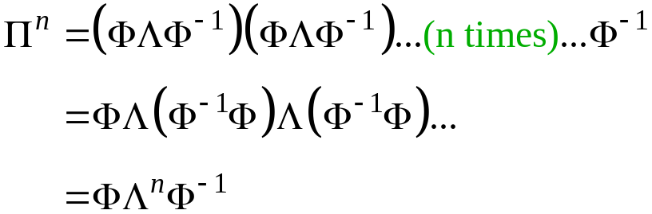
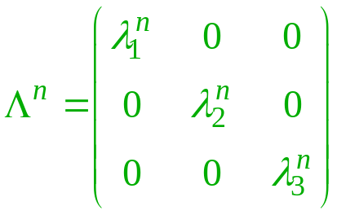
Rate of Convergence 1.
What is the likely distribution of states after a run of finite length?
  Is it close to the limiting distribution?
  We can apply similarity transforms to understand behavior of
    eigenvector equation
Probability of being in state 3 after n moves, beginning in state 1

Slide 6

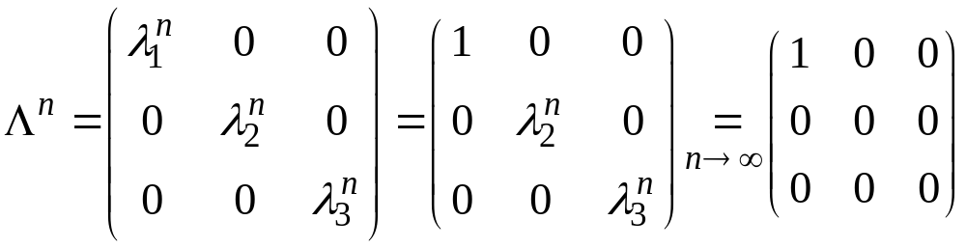
Rate of Convergence 2.
Likely distribution after finite run
Convergence rate determined by magnitude of other eigenvalues
  very close to unity indicates slow convergence

Slide 7
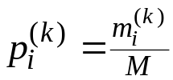
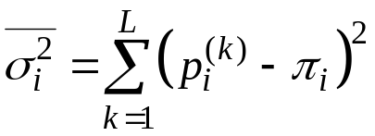
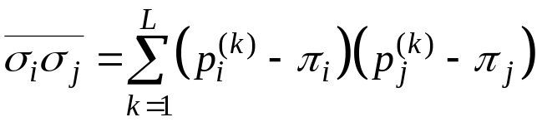

Occupancy Variance 1.
Imagine repeating Markov sequence many times (L→∞), each time taking a fixed number of steps, M
  tabulate histogram for each sequence;
  examine variances in occupancy fraction
  through propagation of error, the occupancy (co)variances sum to give the variances in the ensemble averages; e.g. (for a 2-state system)
  we would like these to be small
1
2
3
4
...
L

Slide 8
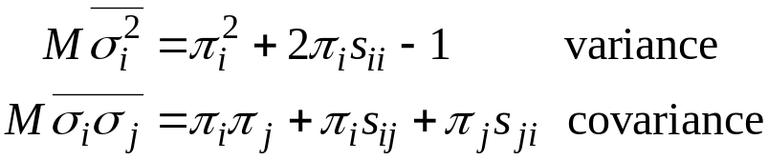


Occupancy Variance 2.
A formula for the occupancy (co)variance is known
  right-hand sides independent of M
  standard deviation decreases as

Slide 9

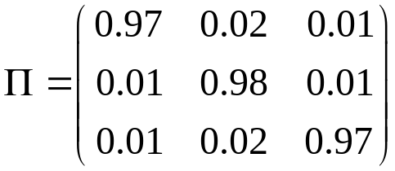
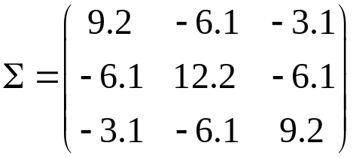

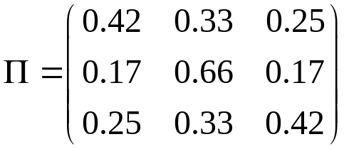
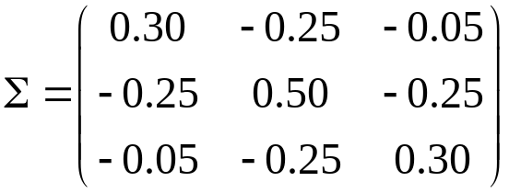

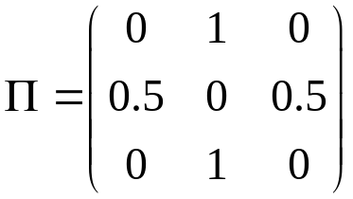
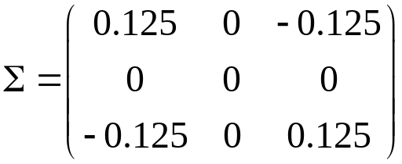

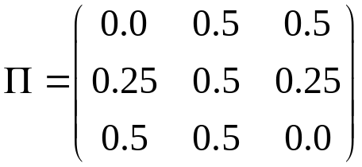
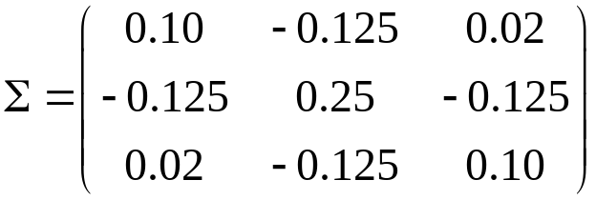

Example Performance Values
Limiting distribution
Inefficient
Barker
Most efficient
Metropolis

Slide 10
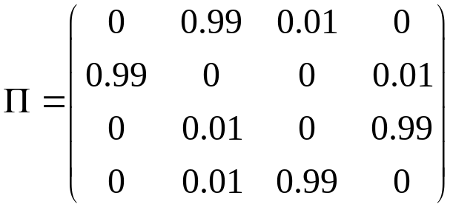


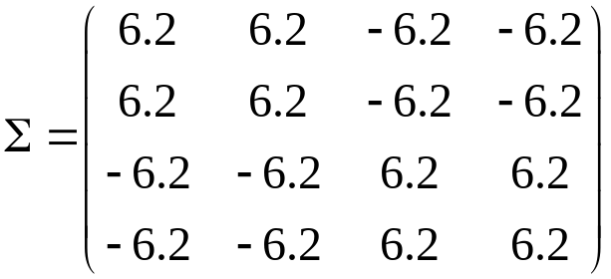
Example Performance Values
Lots of movement 1 → 2; 3 → 4
Little movement (1,2) → (3,4)
Limiting distribution
Eigenvalues
Covariance matrix

Slide 11
Heuristics to Improve Performance
Keep the system moving
  minimize diagonal elements of probability matrix
  avoid repeated transitions among a few states
Typical physical situations where convergence is poor
  large number of equivalent states with poor transitions between regions of them
    entangled polymers
  large number of low-probability states and a few high-probability states
    low-density associating systems
Low, nonzero probability region
High probability region
Bottleneck
Γ
Phase space

Slide 12

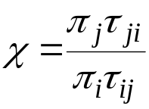
Biasing the Underlying Markov Process
Detailed balance for trial/acceptance Markov process
Often it happens that τ_{ij} is small while χ is large (or vice-versa)
  even if product is of order unity, π_{ij} will be small because of min()
The underlying TPM can be adjusted (biased) to enhance movement among states
  bias can be removed in reverse trial probability, or acceptance
  require in general
  ideally, χ will be unity (all trials accepted) even for a “large” change
    rarely achieve this level of improvement
  requires coordination of forward and reverse moves

Slide 13

Example: Biased Insertion in GCMC
Grand-canonical Monte Carlo (∝VT)
  fluctuations in N require insertion/deletion trials
  at high density, insertions may be rarely accepted
    τ_{ij} is small for j a state having additional but non-overlapping molecule
  at high chemical potential, limiting distribution strongly favors additional molecules
    χ is large for (N+1) state with no overlap
  apply biasing to improve acceptance
  first look at unbiased algorithm

Slide 14
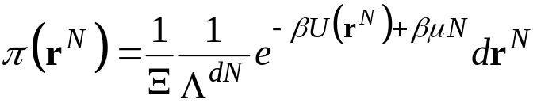
Insertion/Deletion Trial Move
1. Specification
Gives new configuration of same volume but different number of molecules
Choose with equal probability:
  insertion trial: add a molecule to a randomly selected position
  deletion trial: remove a randomly selected molecule from the system
Limiting probability distribution
  grand-canonical ensemble

Slide 15
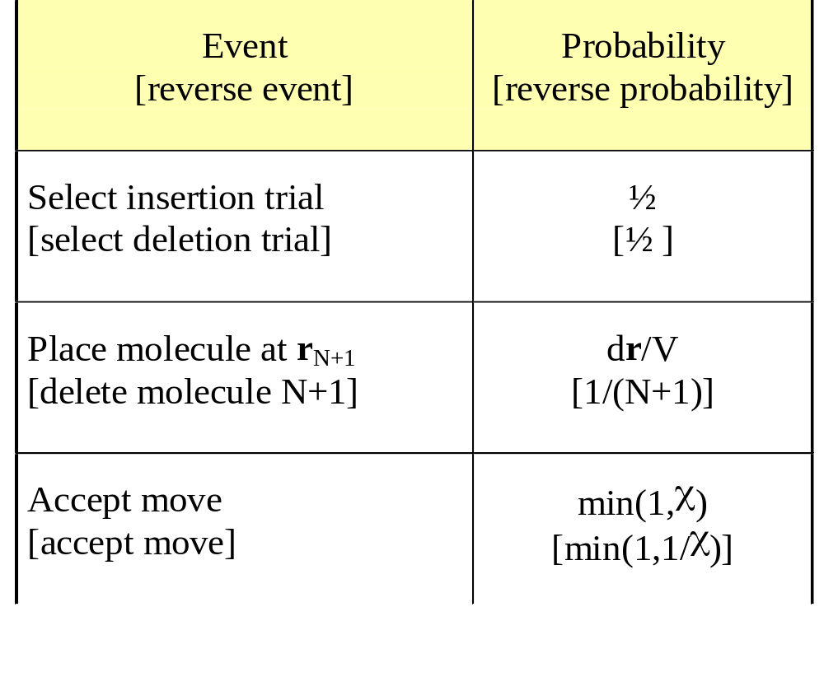
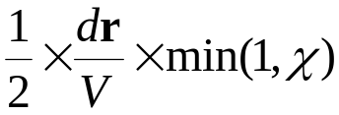
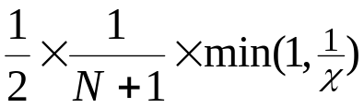
Insertion/Deletion Trial Move
2. Analysis of Trial Probabilities
Detailed specification of trial moves and and probabilities
Forward-step trial probability
Reverse-step trial probability
χ is formulated to satisfy detailed balance

Slide 16
Insertion/Deletion Trial Move
3. Analysis of Detailed Balance
Forward-step trial probability
Reverse-step trial probability
Detailed balance
π_{i}
π_{ij}
=
π_{j}
π_{ji}
Limiting distribution

Slide 17
Insertion/Deletion Trial Move
3. Analysis of Detailed Balance
Forward-step trial probability
Reverse-step trial probability
Detailed balance
π_{i}
π_{ij}
=
π_{j}
π_{ji}
Limiting distribution

Slide 18
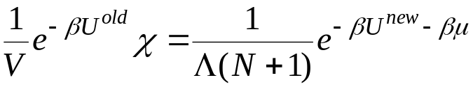
Insertion/Deletion Trial Move
3. Analysis of Detailed Balance
Forward-step trial probability
Reverse-step trial probability
Detailed balance
π_{i}
π_{ij}
=
π_{j}
π_{ji}
Remember
insert: (N+1) = N_{old}+1
delete: (N+1) = N_{old}
Acceptance probability

Slide 19
Biased Insertion/Deletion Trial Move
1. Specification
Insertable region
Trial-move algorithm. Choose with equal probability:
  Insertion
    identify region where insertion will not lead to overlap
    let the volume of this region be εV
    place randomly somewhere in this region
  Deletion
    select any molecule and delete it

Slide 20
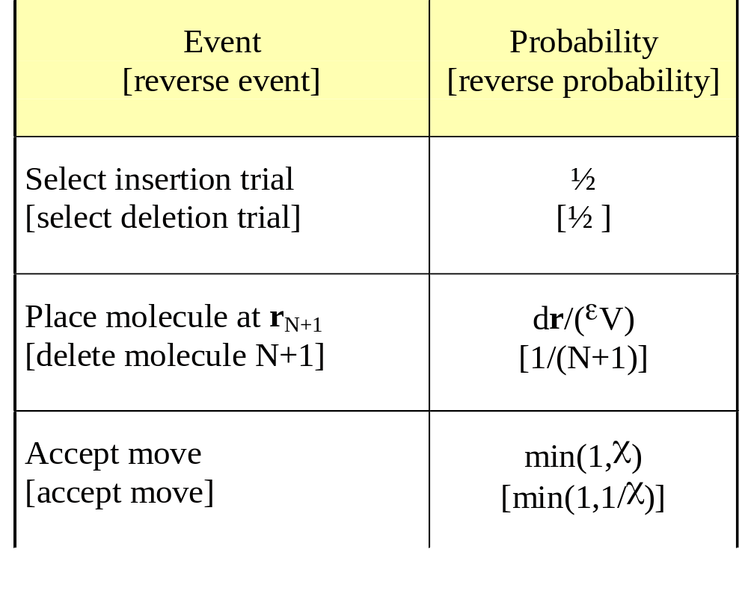
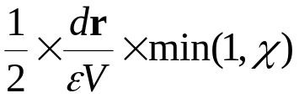
Biased Insertion/Deletion Trial Move
2. Analysis of Trial Probabilities
Detailed specification of trial moves and and probabilities
Forward-step trial probability
Reverse-step trial probability
Only difference from unbiased algorithm

Slide 21
Biased Insertion/Deletion Trial Move
3. Analysis of Detailed Balance
Detailed balance
π_{i}
π_{ij}
=
π_{j}
π_{ji}
Remember
insert: (N+1) = N_{old}+1
delete: (N+1) = N_{old}
Acceptance probability
  ε must be computed even when doing a deletion, since χ depends upon it
    for deletion, ε is computed for configuration after molecule is removed
    for insertion, ε is computed for configuration before molecule is inserted

Slide 22




Biased Insertion/Deletion Trial Move
4. Comments
Advantage is gained when ε is small and is large
  for hard spheres near freezing
    (difficult to accept deletion without bias)
    (difficult to find acceptable insertion without bias)
Identifying and characterizing (computing ε) the non-overlap region may be difficult

Slide 23



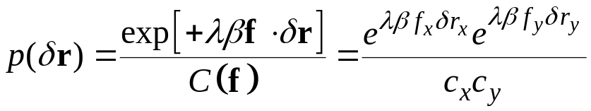
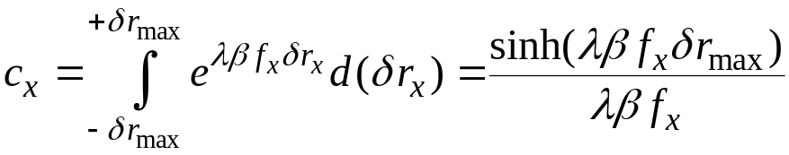
Force-Bias Trial Move
1. Specification
Move atom in preferentially in direction of lower energy
  select displacement in a cubic volume centered on present position
  within this region, select with probability
  C = c_{x}c_{y} is a normalization constant
f
Favors δr_{y} in same direction as f_{y}
Pangali, Rao, and Berne, Chem. Phys. Lett. 47 413 (1978)

Slide 24

An Aside: Sampling from a Distribution
Rejection method for sampling from a complex distribution p(x)
  write p(x) = Ca(x)b(x)
    a(x) is a simpler distribution
    b(x) lies between zero and unity
  recipe
    generate a uniform random variate U on (0,1)
    generate a variate X on the distribution a(x)
    if U < b(X) then keep X
    if not, try again with a new U and X
We wish to sample from p(x) = e^{qx} for x = (-δ,+δ)
  we know how to sample on e^{q(x-x0)} for x = (x₀,∞)
  use rejection method with
    a(x) = e^{q(x-δ)}
    b(x) = 0 for x < -δ or x > +δ; 1 otherwise
      i.e., sample on a(x) and reject values outside desired range

Slide 25
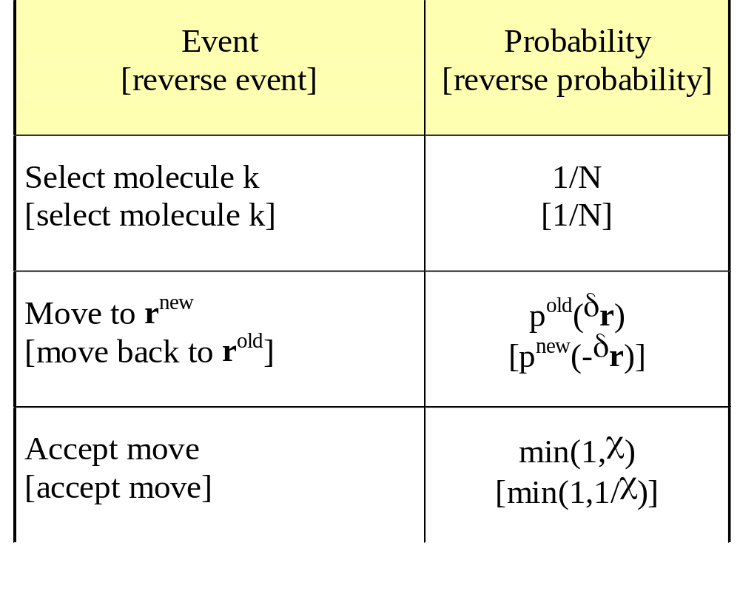
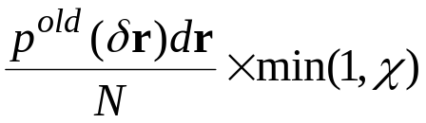
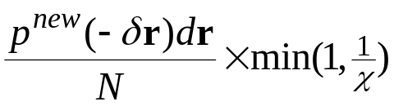
Force-Bias Trial Move
2. Analysis of Trial Probabilities
Detailed specification of trial moves and and probabilities
Forward-step trial probability
Reverse-step trial probability

Slide 26
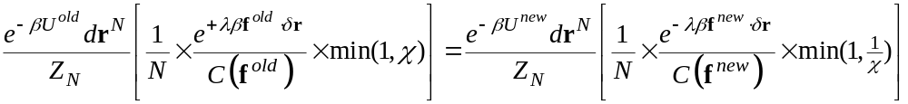
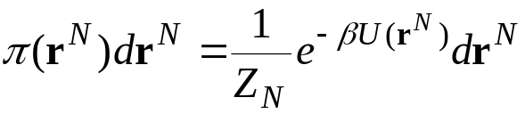
Force-Bias Trial Move
3. Analysis of Detailed Balance
Forward-step trial probability
Reverse-step trial probability
Detailed balance
π_{i}
π_{ij}
=
π_{j}
π_{ji}
Limiting distribution

Slide 27
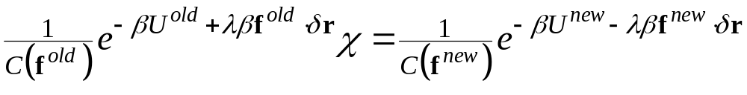
Force-Bias Trial Move
3. Analysis of Detailed Balance
Forward-step trial probability
Reverse-step trial probability
Detailed balance
π_{i}
π_{ij}
=
π_{j}
π_{ji}
Acceptance probability

Slide 28


Force-Bias Trial Move
4. Comments
Necessary to compute force both before and after move
From definition of force
  λ = 1/2 makes argument of exponent nearly zero
  λ = 0 reduces to unbiased case
Force-bias makes Monte Carlo more like molecular dynamics
  example of hybrid MC/MD method
Improvement in convergence by factor or 2-3 observed
  worth the effort?

Slide 29
Association-Bias Trial Move
1. Specification
Low-density, strongly attracting molecules
  when together, form strong associations that take long to break
  when apart, are slow to find each other to form associations
  performance of simulation is a problem
Perform moves that put one molecule preferentially in vicinity of another
  suffer overlaps, maybe 50% of time
  compare to problem of finding associate only 1 time in (say) 1000
Must also preferentially attempt reverse move
Attempt placement in this region, of volume εV

Slide 30
Association-Bias Trial Move
1. Specification
With equal probability, choose a move:
  Association
    select a molecule that is not associated
    select another molecule (associated or not)
    put first molecule in volume εV in vicinity of second
  Dis-association
    select a molecule that is associated
    move it to a random position anywhere in the system

Slide 31
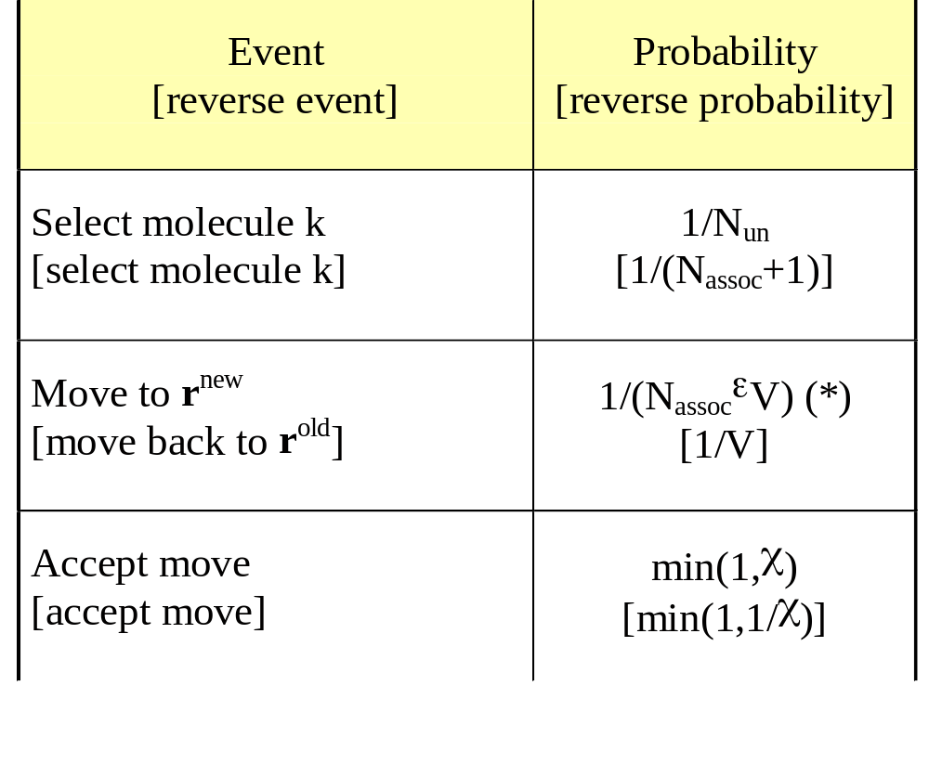
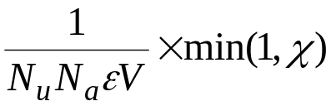
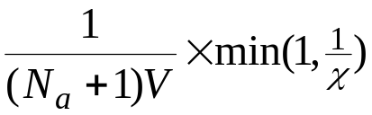
Association-Bias Trial Move
2. Analysis of Trial Probabilities
Detailed specification of trial moves and and probabilities
Forward-step trial probability
Reverse-step trial probability
(*) incorrect

Slide 32
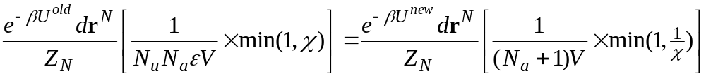
Association-Bias Trial Move
3. Analysis of Detailed Balance
Forward-step trial probability
Reverse-step trial probability
Detailed balance
π_{i}
π_{ij}
=
π_{j}
π_{ji}
Acceptance probability

Slide 33
Association-Bias Trial Move
4. Comments
This is incorrect!
Need to account for full probability of positioning in r^{new}
  must look in local environment of trial position to see if it lies also in the neighborhood of other atoms
    add a 1/εV for each atom
Algorithm requires to identify or keep track of number of associated/unassociated molecules
This region has extra probability of being selected (in vicinity of two molecules)

Slide 34
Using an Approximation Potential
1. Specification
Evaluating the potential energy is the most time-consuming part of a simulation
Some potentials are especially time-consuming, e.g.
  three-body potentials
  Ewald sum
Idea:
  move system through Markov chain using an approximation to the real potential (cheaper to compute)
  at intervals, accept or reject entire subchain using correct potential
True potential
Approximate
True potential

Slide 35

Approximation Potential
2. Analysis of Trial Probabilities
What are π_{ij} and π_{ji}?
Given that each elementary Markov step obeys detailed balance for the approximate potential…
  …one can show that the “super-step” i → j also obeys detailed balance (for the approximate potential)
  very hard to analyze without this result
    would have to consider all paths from i to j to get transition probability
1
2
3
n
State i
State j

Slide 36

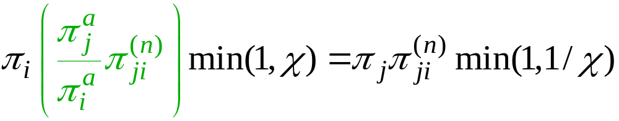

Approximation Potential
3. Analysis of Detailed Balance
Formulate acceptance criterion to satisfy detailed balance for the real potential
Approximate-potential detailed balance
1
2
3
n
State i
State j

Slide 37
Approximation Potential
3. Analysis of Detailed Balance
Formulate acceptance criterion to satisfy detailed balance for the real potential
Approximate-potential detailed balance
1
2
3
n
State i
State j

Slide 38
Approximation Potential
3. Analysis of Detailed Balance
Formulate acceptance criterion to satisfy detailed balance for the real potential
Close to 1 if approximate potential is good description of true potential
1
2
3
n
State i
State j

Slide 39
Summary
Good Monte Carlo keeps the system moving among a wide variety of states
At times sampling of wide distribution is not done well
  many states of comparable probability not easily reached
  few states of high probability hard to find and then escape
Biasing the underlying transition probabilities can remedy problem
  add bias to underlying TPM
  remove bias in acceptance step so overall TPM is valid
Examples
  insertion/deletion bias in GCMC
  force bias
  association bias
  using an approximate potential

