Slide 1
CE 530 Molecular Simulation
Lecture 11
Molecular Dynamics Simulation
David A. Kofke
Department of Chemical Engineering
SUNY Buffalo
kofke@eng.buffalo.edu

Slide 2
Review and Preview
MD of hard disks
  intuitive
  collision detection and impulsive dynamics
Monte Carlo
  convenient sampling of ensembles
  no dynamics
  biasing possible to improve performance
Molecular dynamics
  equations of motion
  integration schemes
  evaluation of dynamical properties
  extensions to other ensembles
  focus on atomic systems for now

Slide 3

Classical Equations of Motion
Several formulations are in use
  Newtonian
  Lagrangian
  Hamiltonian
Advantages of non-Newtonian formulations
  more general, no need for “fictitious” forces
  better suited for multiparticle systems
  better handling of constraints
  can be formulated from more basic postulates
Assume conservative forces
Gradient of a scalar potential energy

Slide 4
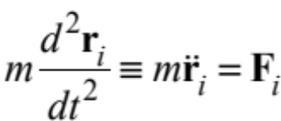
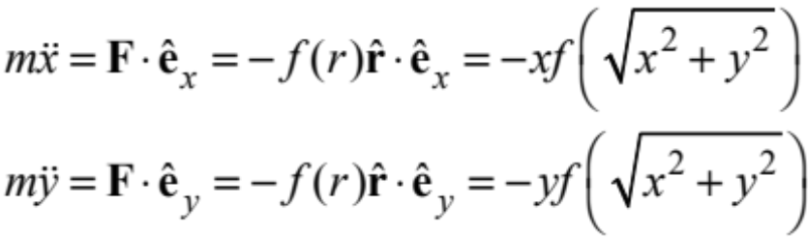

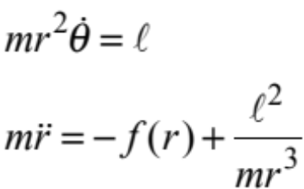
Newtonian Formulation
Cartesian spatial coordinates r_{i} = (x_{i},y_{i},z_{i}) are primary variables
  for N atoms, system of N 2nd-order differential equations
Sample application: 2D motion in central force field
  Polar coordinates are more natural
  and convenient
r
constant angular momentum
fictitious (centrifugal) force

Slide 5

Generalized Coordinates
Any convenient coordinates for description of particular system
  use q_{i} as symbol for general coordinate
  examples
    diatomic {q₁,…,q₆} = {x_{com}, y_{com}, z_{com}, r₁₂, θ, φ}
    2-D motion in central field {q₁, q₂} = {r, θ}
Kinetic energy
  general quadratic form
  examples
    rotating diatomic
    2-D central motion
θ
r
φ
usually vanish

Slide 6

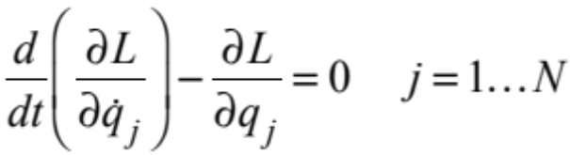

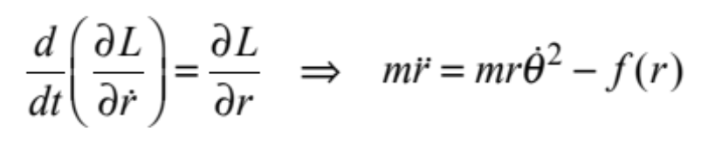
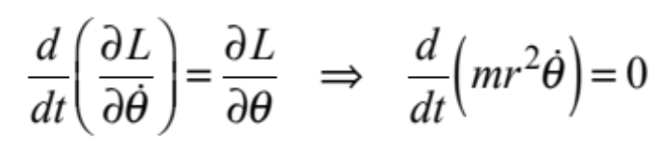

Lagrangian Formulation
Independent of coordinate system
Define the Lagrangian
Equations of motion
  N second-order differential equations
Central-force example

Slide 7

Hamiltonian Formulation 1. Motivation
Appropriate for application to statistical mechanics and quantum mechanics
Newtonian and Lagrangian viewpoints take the q_{i} as the fundamental variables
  N-variable configuration space
  appears only as a convenient shorthand for dq/dt
  working formulas are 2nd-order differential equations
Hamiltonian formulation seeks to work with 1st-order differential equations
  2N variables
  treat the coordinate and its time derivative as independent variables
  appropriate quantum-mechanically

Slide 8


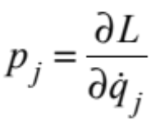
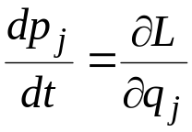
Hamiltonian Formulation 2. Preparation
Mathematically, Lagrangian treats q and as distinct
  identify the generalized momentum as
  e.g.
  Lagrangian equations of motion
We would like a formulation in which p is an independent variable
  p_{i} is the derivative of the Lagrangian with respect to , and we’re looking to replace with p_{i}
  we need …?

Slide 9
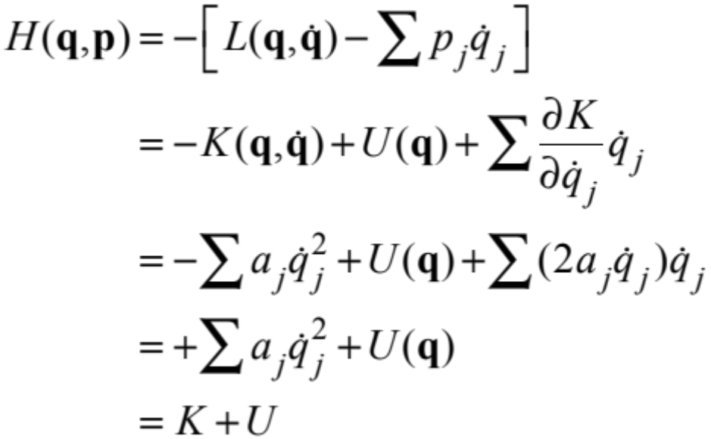
Hamiltonian Formulation 3. Defintion
…a Legendre transform!
Define the Hamiltonian, H
H equals the total energy (kinetic plus potential)

Slide 10
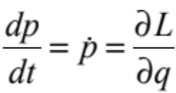
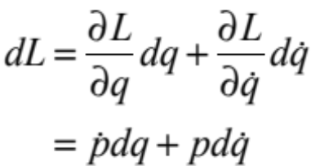
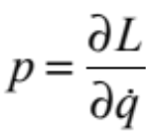
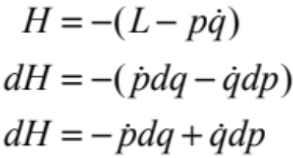
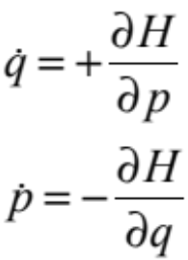
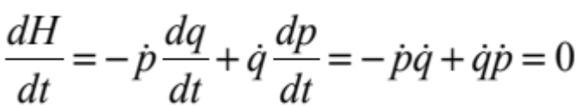
Hamiltonian Formulation 4. Dynamics
Hamilton’s equations of motion
  From Lagrangian equations, written in terms of momentum
Differential change in L
Lagrange’s equation of motion
Definition of momentum
Legendre transform
Hamilton’s equations of motion
Conservation of energy

Slide 11
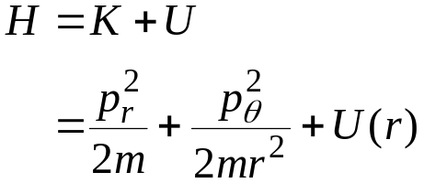
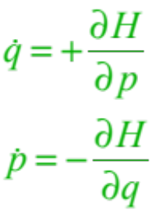
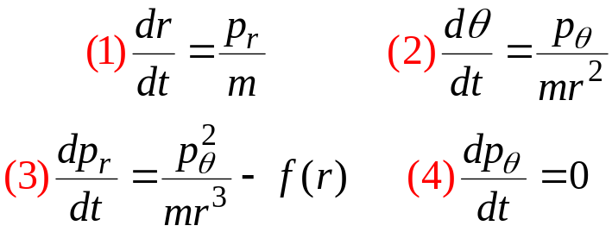

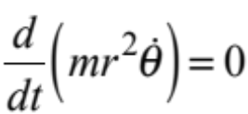
Hamiltonian Formulation 5. Example
Particle motion in central force field
Equations no simpler, but theoretical basis is better
r
Lagrange’s equations

Slide 12
Phase Space (again)
Return to the complete picture of phase space
  full specification of microstate of the system is given by the values of all positions and all momenta of all atoms
    Γ = (p^{N},r^{N})
  view positions and momenta as completely independent coordinates
    connection between them comes only through equation of motion
Motion through phase space
  helpful to think of dynamics as “simple” movement through the high-dimensional phase space
    facilitate connection to quantum mechanics
    basis for theoretical treatments of dynamics
    understanding of integrators
Γ

Slide 13
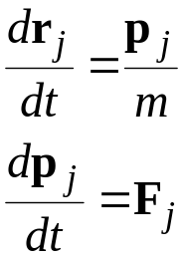
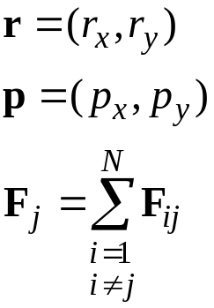
Integration Algorithms
Equations of motion in cartesian coordinates
Desirable features of an integrator
  minimal need to compute forces (a very expensive calculation)
  good stability for large time steps
  good accuracy
  conserves energy and momentum
  time-reversible
  area-preserving (symplectic)
2-dimensional space (for example)
pairwise additive forces
F
More on these later

Slide 14
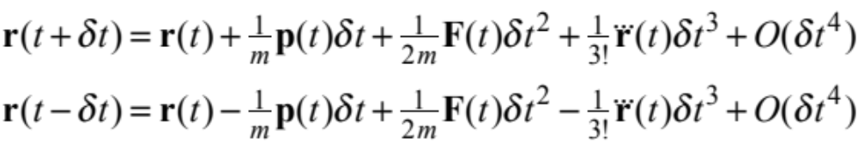
Verlet Algorithm
1. Equations
Very simple, very good, very popular algorithm
Consider expansion of coordinate forward and backward in time
Add these together
Rearrange
  update without ever consulting velocities!

Slide 15
Verlet Algorithm 2. Flow diagram
One MD Cycle
Configuration r(t)
Previous configuration r(t-δt)
Entire Simulation
Initialization
One force evaluation per time step
Compute forces F(t)
on all atoms using r(t)
Reset block sums
New configuration
Advance all positions according to
r(t+δt) = 2r(t)-r(t-δt)+F(t)/m δt²
1 move per cycle
Add to block sum
cycles per block
Compute block average
Add to block sum
blocks per simulation
End of block?
Compute final results
No
Yes
Block
averages

Slide 16
Verlet Algorithm 2. Flow Diagram
t-δt t t+δt
r
v
F
Given current position and position at end of previous time step
Schematic from Allen & Tildesley, Computer Simulation of Liquids

Slide 17
Verlet Algorithm 2. Flow Diagram
t-δt t t+δt
r
v
F
Compute the force at the current position
Schematic from Allen & Tildesley, Computer Simulation of Liquids

Slide 18
Verlet Algorithm 2. Flow Diagram
t-δt t t+δt
r
v
F
Compute new position from present and previous positions, and present force
Schematic from Allen & Tildesley, Computer Simulation of Liquids

Slide 19
Verlet Algorithm 2. Flow Diagram
t-2δt t-δt t t+δt
r
v
F
Advance to next time step,
repeat
Schematic from Allen & Tildesley, Computer Simulation of Liquids

Slide 20
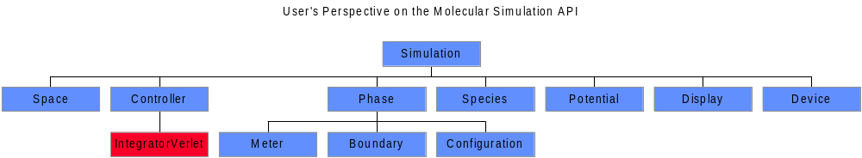
Verlet Algorithm 3. Java Code

Slide 21
Verlet Algorithm
3. Relevant Methods in Java Code
public class IntegratorVerlet extends Integrator
//Performs one timestep increment in the Verlet algorithm
public void doStep(double tStep) {
atomIterator.reset();
while(atomIterator.hasNext()) { //zero forces on all atoms
((Agent)atomIterator.next().ia).force.E(0.0); //integratorVerlet.Agent keeps a force Vector
}
pairIterator.allPairs(forceSum); //sum forces on all pairs
double t2 = tStep*tStep;
atomIterator.reset();
while(atomIterator.hasNext()) { //loop over all atoms, moving according to Verlet
Atom a = atomIterator.next();
Agent agent = (Agent)a.ia;
Space.Vector r = a.position(); //current position of the atom
temp.E(r); //save it
r.TE(2.0); //2*r
r.ME(agent.rLast); //2*r-rLast
agent.force.TE(a.rm()*t2); // f/m dt^2
r.PE(agent.force); //2*r - rLast + f/m dt^2
agent.rLast.E(temp); //rLast gets present r
}
return;
}

Slide 22
Verlet Algorithm
3. Relevant Methods in Java Code
public class IntegratorVerlet extends Integrator
//(anonymous) class for incrementing the sum of the forces on each atom
forceSum = new AtomPair.Action() {
private Space.Vector f = simulation().space.makeVector();
public void action(AtomPair pair) {
PotentialSoft potential = (PotentialSoft)simulation().getPotential(pair) //identify pot’l
f.E(potential.force(pair)); //compute force of atom1 on atom2
((Agent)pair.atom1().ia).force.PE(f); //increment atom1 force
((Agent)pair.atom2().ia).force.ME(f); //increment atom2 force
}
};
//Agent class for IntegratorVerlet; stores useful quantities in each Atom
public final static class Agent implements Integrator.Agent {
public Atom atom;
public Space.Vector force; //used to accumulate the force on the atom
public Space.Vector rLast; //holds the position of the atom at the last step
public Agent(Atom a) { //constructor
atom = a;
force = atom.parentMolecule().parentPhase().parentSimulation.space.makeVector();
rLast = atom.parentMolecule().parentPhase().parentSimulation.space.makeVector();
}
}

Slide 23
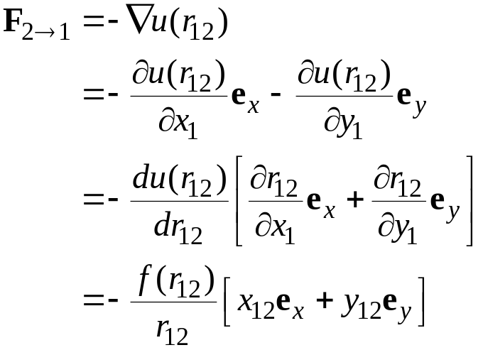
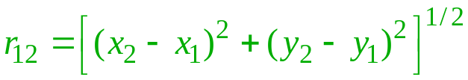
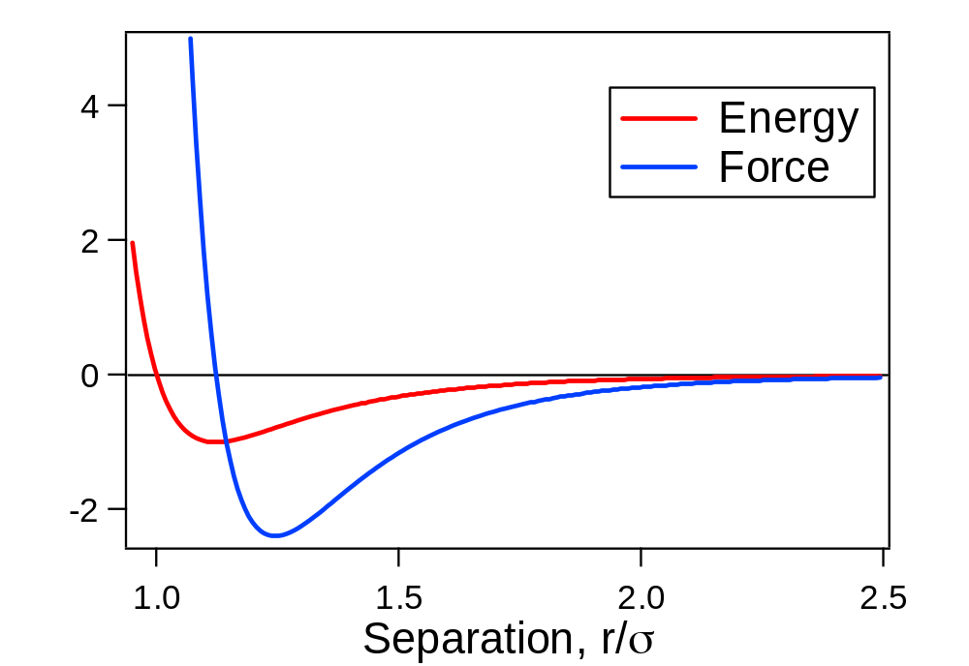

Forces 1. Formalism
x₁₂
1
Force is the gradient of the potential
y₁₂
r₁₂
2
Force on 1, due to 2

Slide 24
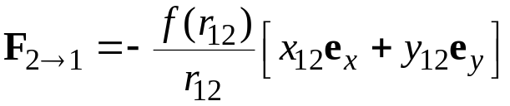
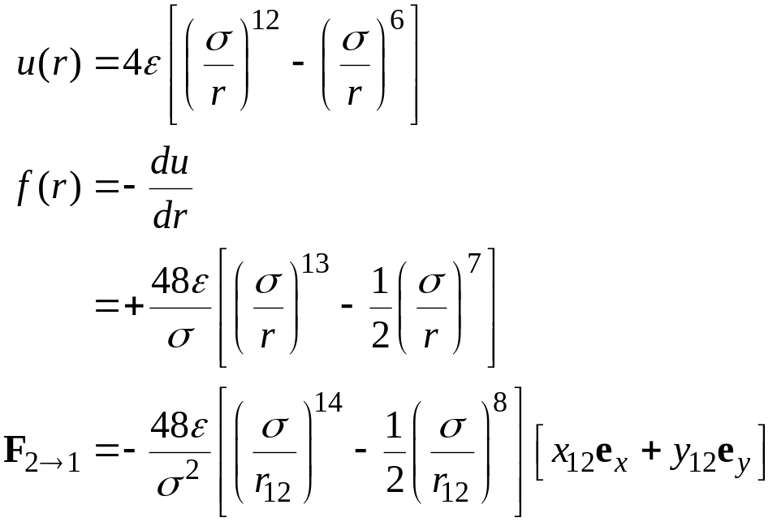
Forces 2. LJ Model
x₁₂
1
Force is the gradient of the potential
y₁₂
r₁₂
2
e.g., Lennard-Jones model

Slide 25
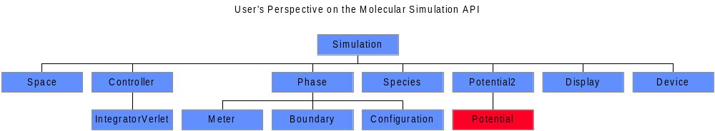
Forces 3. Java Code

Slide 26
Forces
3. Relevant Methods from Java Code
public class PotentialLJ implements PotentialSoft
//Space.Vector used to compute and return a force
private Space.Vector force = Simulation.space.makeVector();
public Space.Vector force(AtomPair pair) {
double r2 = pair.r2(); //squared distance between pair of atoms
if(r2 > cutoffDiameterSquared) {force.E(0.0);} //outside cutoff; no interaction
else {
double s2 = sigmaSquared/r2; // (sigma/r)^2
double s6 = s2*s2*s2; // (sigma/r)^6
force.E(pair.dr()); // f = (x12 ex + y12 ey) (vector)
force.TE(-48*s2*s6*(s6-0.5)/sigmaSquared);
// f *= -48*(sigma/r)^8 * [(sigma/r)^6 - 1/2] / sigma^2
}
return force;
}

Slide 27

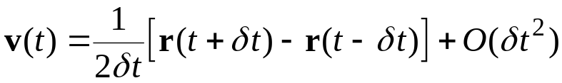
Verlet Algorithm. 4. Loose Ends
Initialization
  how to get position at “previous time step” when starting out?
  simple approximation
Obtaining the velocities
  not evaluated during normal course of algorithm
  needed to compute some properties, e.g.
    temperature
    diffusion constant
  finite difference

Slide 28

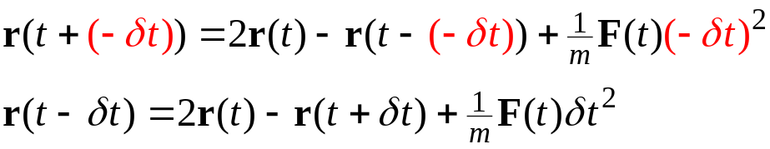
Verlet Algorithm 5. Performance Issues
Time reversible
  forward time step
  replace δt with −δt
  same algorithm, with same positions and forces, moves system backward in time
Numerical imprecision of adding large/small numbers
O(δt¹)
O(δt¹)
O(δt⁰)
O(δt⁰)
O(δt²)

Slide 29



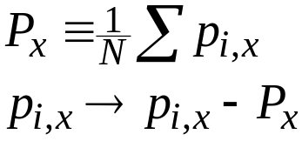
Initial Velocities
(from Lecture 3)
Random direction
  randomize each component independently
  randomize direction by choosing point on spherical surface
Magnitude consistent with desired temperature. Choices:
  Maxwell-Boltzmann:
  Uniform over (-1/2,+1/2), then scale so that
  Constant at
  Same for y, z components
Be sure to shift so center-of-mass momentum is zero

Slide 30
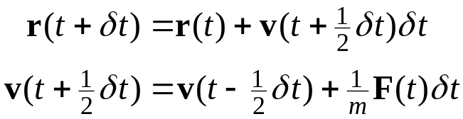
Leapfrog Algorithm
Eliminates addition of small numbers O(δt²) to differences in large ones O(δt⁰)
Algorithm

Slide 31
Leapfrog Algorithm
Eliminates addition of small numbers O(δt²) to differences in large ones O(δt⁰)
Algorithm
Mathematically equivalent to Verlet algorithm

Slide 32

Leapfrog Algorithm
Eliminates addition of small numbers O(δt²) to differences in large ones O(δt⁰)
Algorithm
Mathematically equivalent to Verlet algorithm
r(t) as evaluated from previous time step

Slide 33
Leapfrog Algorithm
Eliminates addition of small numbers O(δt²) to differences in large ones O(δt⁰)
Algorithm
Mathematically equivalent to Verlet algorithm
r(t) as evaluated from previous time step

Slide 34
Leapfrog Algorithm
Eliminates addition of small numbers O(δt²) to differences in large ones O(δt⁰)
Algorithm
Mathematically equivalent to Verlet algorithm
r(t) as evaluated from previous time step
original algorithm

Slide 35
Leapfrog Algorithm 2. Flow Diagram
t-δt t t+δt
r
v
F
Given current position, and velocity at last half-step
Schematic from Allen & Tildesley, Computer Simulation of Liquids

Slide 36
Leapfrog Algorithm 2. Flow Diagram
t-δt t t+δt
r
v
F
Compute current force
Schematic from Allen & Tildesley, Computer Simulation of Liquids

Slide 37
Leapfrog Algorithm 2. Flow Diagram
t-δt t t+δt
r
v
F
Compute velocity at next half-step
Schematic from Allen & Tildesley, Computer Simulation of Liquids

Slide 38
Leapfrog Algorithm 2. Flow Diagram
t-δt t t+δt
r
v
F
Compute next position
Schematic from Allen & Tildesley, Computer Simulation of Liquids

Slide 39
Leapfrog Algorithm 2. Flow Diagram
t-2δt t-δt t t+δt
r
v
F
Advance to next time step,
repeat
Schematic from Allen & Tildesley, Computer Simulation of Liquids

Slide 40

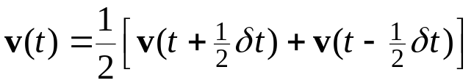
Leapfrog Algorithm. 3. Loose Ends
Initialization
  how to get velocity at “previous time step” when starting out?
  simple approximation
Obtaining the velocities
  interpolate

Slide 41
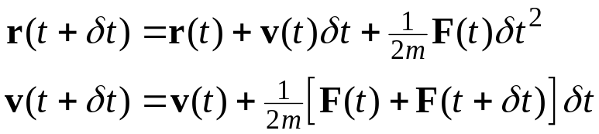
Velocity Verlet Algorithm
Roundoff advantage of leapfrog, but better treatment of velocities
Algorithm
Implemented in stages
  given current force
  compute r at new time
  add current-force term to velocity (gives v at half-time step)
  compute new force
  add new-force term to velocity
Also mathematically equivalent to Verlet algorithm
(in giving values of r)

Slide 42
Velocity Verlet Algorithm
2. Flow Diagram
t-δt t t+δt
r
v
F
Given current position, velocity, and force
Schematic from Allen & Tildesley, Computer Simulation of Liquids

Slide 43
Velocity Verlet Algorithm
2. Flow Diagram
t-δt t t+δt
r
v
F
Compute new position
Schematic from Allen & Tildesley, Computer Simulation of Liquids

Slide 44
Velocity Verlet Algorithm
2. Flow Diagram
t-δt t t+δt
r
v
F
Compute velocity at half step
Schematic from Allen & Tildesley, Computer Simulation of Liquids

Slide 45
Velocity Verlet Algorithm
2. Flow Diagram
t-δt t t+δt
r
v
F
Compute force at new position
Schematic from Allen & Tildesley, Computer Simulation of Liquids

Slide 46
Velocity Verlet Algorithm
2. Flow Diagram
t-δt t t+δt
r
v
F
Compute velocity at full step
Schematic from Allen & Tildesley, Computer Simulation of Liquids

Slide 47
Velocity Verlet Algorithm
2. Flow Diagram
t-2δt t-δt t t+δt
r
v
F
Advance to next time step,
repeat
Schematic from Allen & Tildesley, Computer Simulation of Liquids

Slide 48
Other Algorithms
Predictor-Corrector
  not time reversible
  easier to apply in some instances
    constraints
    rigid rotations
Beeman
  better treatment of velocities
Velocity-corrected Verlet

Slide 49
Summary
Several formulations of mechanics
  Hamiltonian preferred
    independence of choice of coordinates
    emphasis on phase space
Integration algorithms
  Calculation of forces
  Simple Verlet algorithms
    Verlet
    Leapfrog
    Velocity Verlet
Next up: Calculation of dynamical properties

