Slide 1
CE 530 Molecular Simulation
Lecture 13
Molecular Dynamics in Other Ensembles
David A. Kofke
Department of Chemical Engineering
SUNY Buffalo
kofke@eng.buffalo.edu

Slide 2
Review
Molecular dynamics is a numerical integration of the classical equations of motion
Total energy is strictly conserved, so MD samples the NVE ensemble
Dynamical behaviors can be measured by taking appropriate time averages over the simulation
  Spontaneous fluctuations provide non-equilibrium condition for measurement of transport in equilibrium MD
  Non-equilibrium MD can be used to get less noisy results, but requires mechanism to remove energy via heat transfer
Two equivalent formalisms for EMD measurements
  Einstein equation
  Green-Kubo relation
    time correlation functions

Slide 3
Molecular Dynamics in Other Ensembles
Standard MD samples the NVE ensemble
There is need enable MD to operate at constant T and/or P
  with standard MD it is very hard to set initial positions and velocities to give a desired T or P with any accuracy
    NPT MD permits control over state conditions of most interest
  NEMD and other advanced methods require temperature control
Two general approaches
  stochastic coupling to a reservoir
  feedback control
Good methods ensure proper sampling of the appropriate ensemble

Slide 4
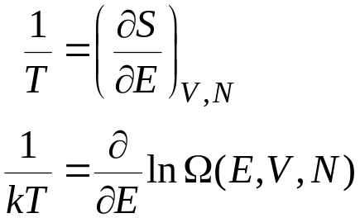

What is Temperature?
Thermodynamic definition
  temperature describes how much more disordered a system becomes when a given amount of energy is added to it
    high temperature: adding energy opens up few additional microstates
    low temperature: adding energy opens up many additional microstates
Thermal equilibrium
  entropy is maximized for an isolated system at equilibrium
  total entropy of two subsystems is sum of entropy of each:
  consider transfer of energy from one subsystem to another
    if entropy of one system goes up more than entropy of other system goes down, total entropy increases with energy transfer
    equilibrium established when both rates of change are equal (T₁=T₂)
      (temperature is guaranteed to increase as energy is added)
Disordered: more ways to arrange system and have it look the same
Number of microstates having given E
1
2
Q

Slide 5

Momentum and Configurational Equilibrium
Momentum and configuration coordinates are
in thermal equilibrium
  momentum and configuration coordinates must be “at same temperature” or there will be net energy flux from one to other
An arbitrary initial condition (p^{N},r^{N}) is unlikely to have equal momentum and configurational temperatures
  and once equilibrium is established, energy will fluctuate back and forth between two forms
  ...so temperatures will fluctuate too
Either momentum or configurational coordinates (or both) may be thermostatted to fix temperature of both
  assuming they are coupled
p^{N}
r^{N}
Q

Slide 6




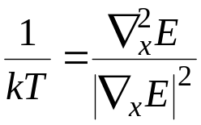
An Expression for the Temperature 1.
Consider a space of two variables
  schematic representation of phase space
Contours show lines of constant E
  standard MD simulation moves along corresponding 3N dimensional hypersurface
Length of contour E relates to Ω(Ε)
While moving along the E_{A} contour, we’d like to see how much longer the E_{B} contour is
Analysis yields
Relates to gradient and rate of change of gradient

Slide 7
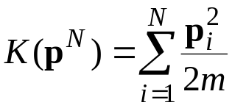
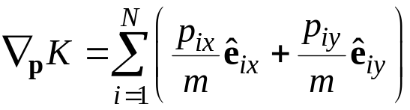
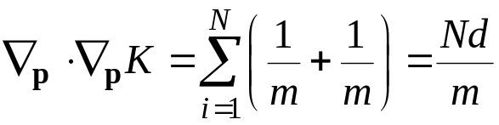
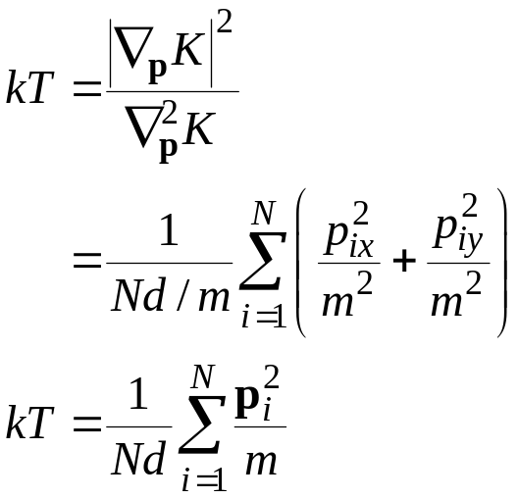
Momentum Temperature
Kinetic energy
Gradient
Laplacian
Temperature
d = 2
The standard canonical-ensemble “equipartition” result
Notes:
Have class work out this derivation before presenting this result

Slide 8

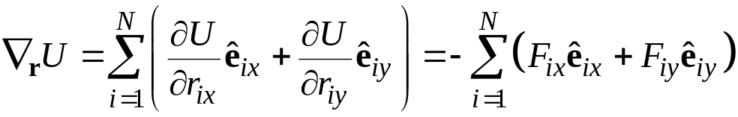
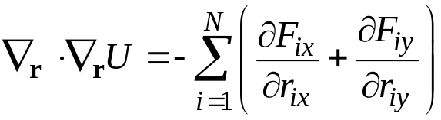
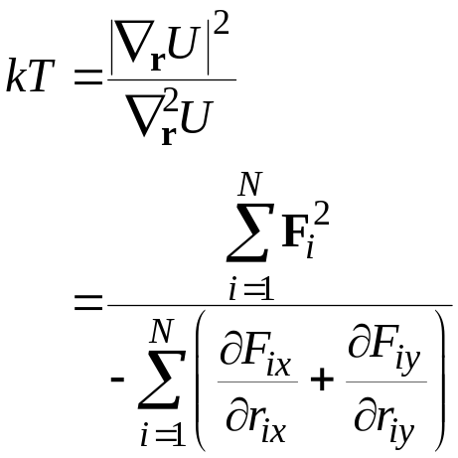
Configurational Temperature
Potential energy
Gradient
Laplacian
Temperature
Butler, B. D., G. Ayton, O. G. Jepps, and D. J. Evans. 1998. Configurational temperature: verification of Monte Carlo simulations. J. Chem. Phys. 109, 6519.

Slide 9
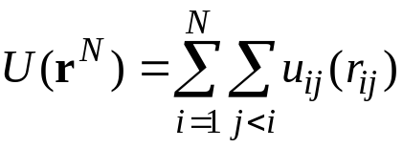
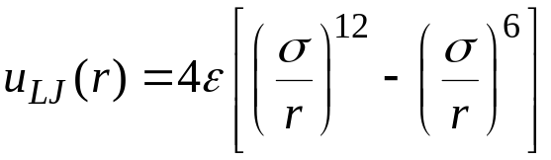
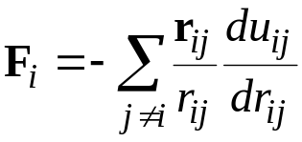
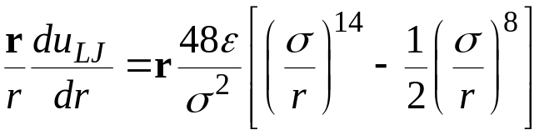
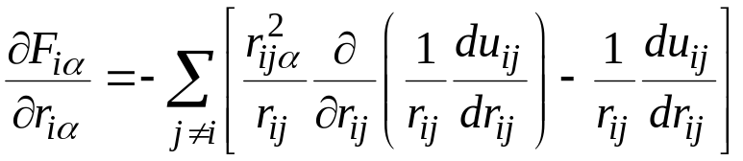
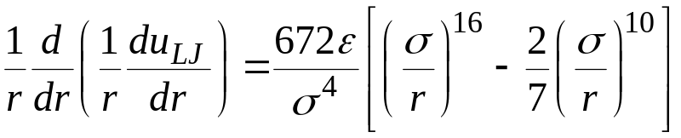
Lennard-Jones
Configurational Temperature
Spherically-symmetric, pairwise additive model
Force
Laplacian
N.B. Formulas not verified

Slide 10
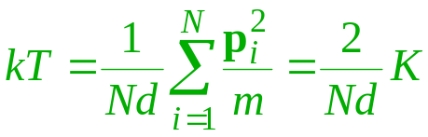
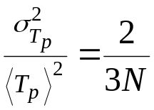
Thermostats
All NPT MD methods thermostat the momentum temperature
Proper sampling of the canonical ensemble requires that the momentum temperature fluctuates
  momentum temperature is proportional to total
  kinetic energy
  energy should fluctuate between K and U
  variance of momentum-temperature fluctuation
  can be derived from Maxwell-Boltzmann
    fluctuations vanish at large N
    rigidly fixing K affects fluctuation quantities,
    but may not matter much to other averages
All thermostats introduce unphysical features to the dynamics
  EMD transport measurements best done with no thermostat
    use thermostat equilibrate r and p temperatures to desired value, then remove
p^{N}
r^{N}
Q

Slide 11

Isokinetic Thermostatting 1.
Force momentum temperature to remain constant
One (bad) approach
  at each time step scale momenta to force K to desired value
    advance positions and momenta
    apply p^{new} = λp with λ chosen to satisfy
    repeat
  “equations of motion” are irreversible
    “transition probabilities” cannot satisfy detailed balance
  does not sample any well-defined ensemble

Slide 12
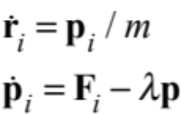
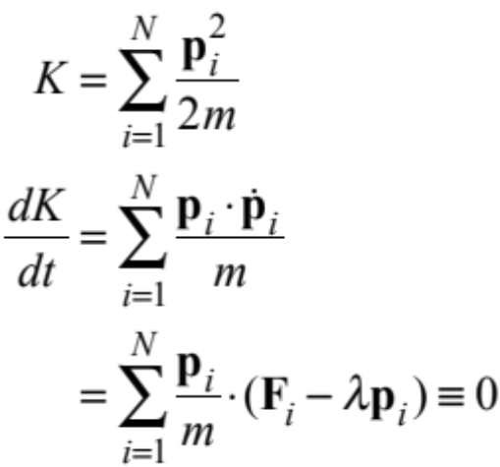
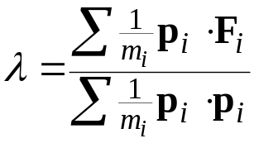
Isokinetic Thermostatting 2.
One (good) approach
  modify equations of motion to satisfy constraint
  λ is a friction term selected to force constant momentum-temperature
Time-reversible equations of motion
  no momentum-temperature fluctuations
  configurations properly sample NVT ensemble (with fluctuations)
  temperature is not specified in equations of motion!

Slide 13
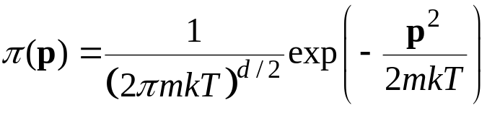
Thermostatting via Wall Collisions
Wall collision imparts random velocity to molecule
  selection consistent with (canonical-ensemble) Maxwell-Boltzmann distribution at desired temperature
Advantages
  realistic model of actual process of heat transfer
  correctly samples canonical ensemble
Disadvantages
  can’t use periodic boundaries
  wall may give rise to unacceptable finite-size effects
    not a problem if desiring to simulate a system in confined space
  not well suited for soft potentials
Gaussian
random p
Wall can be made as realistic as desired

Slide 14


Andersen Thermostat
Wall thermostat without the wall
Each molecule undergoes impulsive “collisions” with a heat bath at random intervals
Collision frequency ν describes strength of coupling
  Probability of collision over time dt is νdt
  Poisson process governs collisions
Simulation becomes a Markov process
  Π_{NVE} is a “deterministic” TPM
    it is not ergodic for NVT, but Π is
Click here to see the Andersen thermostat in action
random p

Slide 15
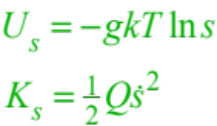
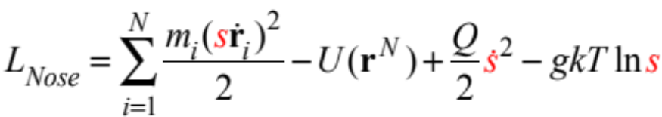
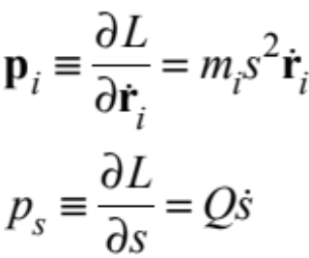
Nosé Thermostat 1.
Modification of equations of motion
  like isokinetic algorithm (differential feedback control)
  but permits fluctuations in the momentum temperature
  integral feedback control
Extended Lagrangian equations of motion
  introduce a new degree of freedom, s, representing reservoir
  associate kinetic and potential energy with s
  momenta
effective mass

Slide 16
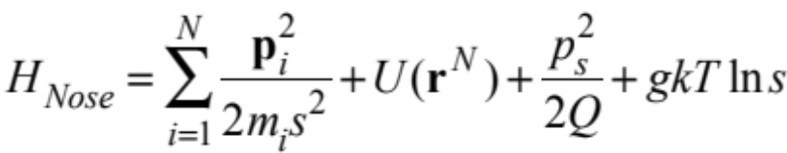

Nosé Thermostat 2.
Extended-system Hamiltonian is conserved
Thus the probability distribution can be written
  it can be shown that the molecular positions and momenta follow a canonical (NVT) distribution if g = 3N+1
s can be interpreted as a time-scaling factor
  Δt_{true} = Δt_{sim}/s
  since s varies during the simulation, each “true” time step is of varying length

Slide 17
Nosé Thermostat 2.
Extended-system Hamiltonian is conserved
Thus the probability distribution can be written
What does this mean for the sampling of coordinates and momenta? How does this ensure a canonical distribution?

Slide 18
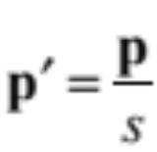
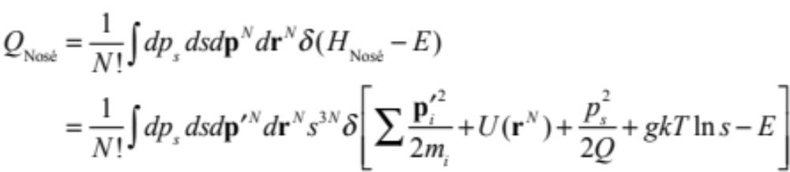
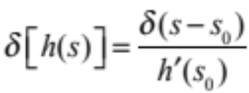
Nosé Thermostat 3.
Get canonical ensemble for s, p' if g = 3(N+1)
s can be interpreted as a time-scaling factor
  Δt_{true} = Δt_{sim}/s
  s varies during simulation, so“true” time step is of varying length

Slide 19
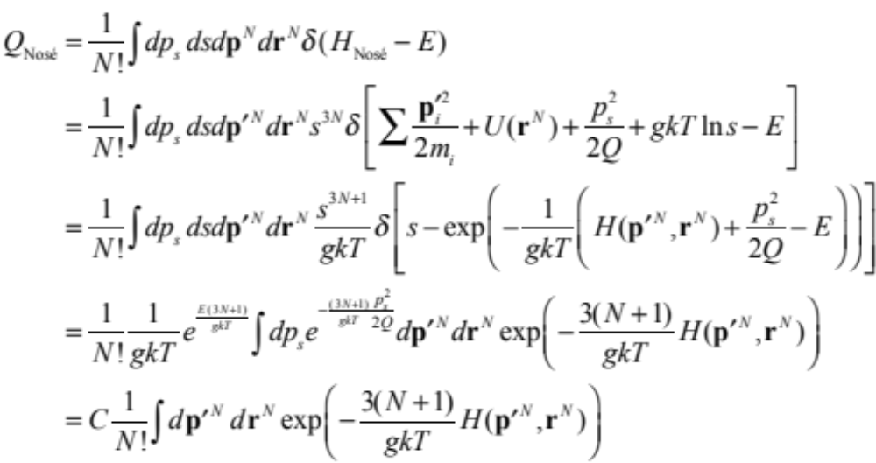
Nosé Thermostat 3.
Get canonical ensemble for s, p' if g = 3(N+1)
s can be interpreted as a time-scaling factor
  Δt_{true} = Δt_{sim}/s
  s varies during simulation, so“true” time step is of varying length

Slide 20
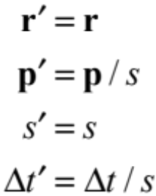
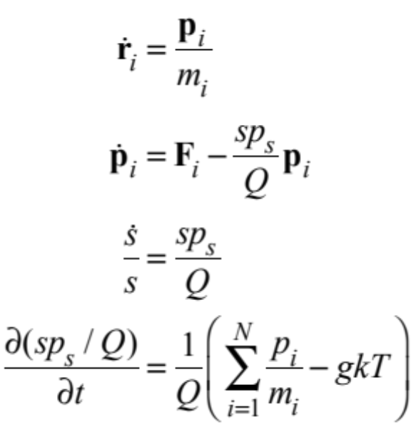
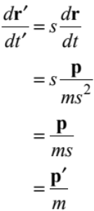
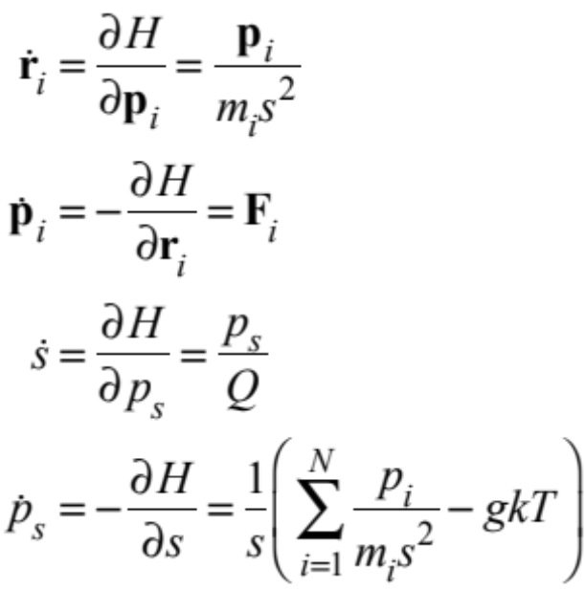
Nosé-Hoover Thermostat 1.
Advantageous to work with non-fluctuating time step
Scaled-variables equations of motion
  constant simulation Δt
  fluctuating real Δt
Real-variables (' removed) equation of motion

Slide 21
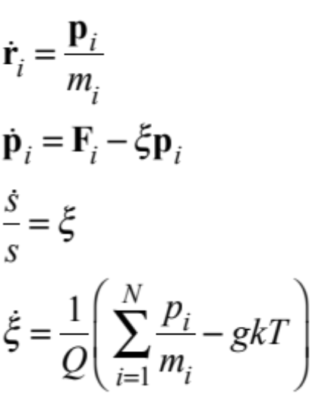
Nosé-Hoover Thermostat 2.
Real-variable equations are of the form
Compare to isokinetic equations
Difference is in the treatment of the friction coefficient
  Nosé-Hoover correctly samples NVT ensemble for both momentum and configurations; isokinetic does NVT properly only for configurations
(redundant; s is not present in other equations)

Slide 22
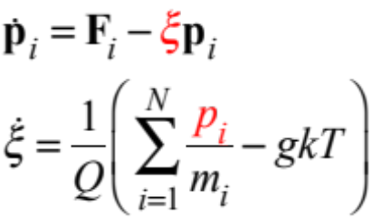
Nosé-Hoover Thermostat 3.
Equations of motion
Integration schemes
  predictor-corrector algorithm is straightforward
  Verlet algorithm is feasible, but tricky to implement
t-δt t t+δt
r
v
F
At this step, update of ξ depends on p; update of p depends on ξ

Slide 23
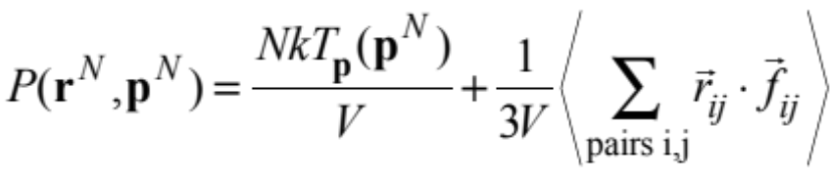
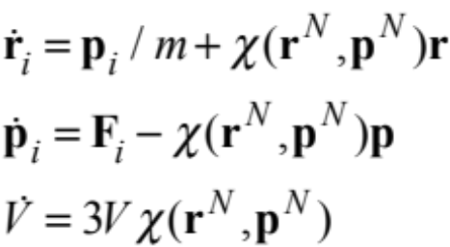
Barostats
Approaches similar to that seen in thermostats
  constraint methods
  stochastic coupling to a pressure bath
  extended Lagrangian equations of motion
Instantaneous virial takes the role of the momentum temperature
Scaling of the system volume is performed to control pressure
Example: Equations of motion for constraint method
χ(t) is set to ensure dP/dt = 0

Slide 24
Summary
Standard MD simulations are performed in the NVE ensemble
  initial momenta can be set to desired temperature, but very hard to set configuration to have same temperature
  momentum and configuration coordinates go into thermal equilibrium at temperature that is hard to predict
Need ability to thermostat MD simulations
  aid initialization
  required to do NEMD simulations
Desirable to have thermostat generate canonical ensemble
Several approaches are possible
  stochastic coupling with temperature bath
  constraint methods
  more rigorous extended Lagrangian techniques
Barostats and other constraints can be imposed in similar ways

