Slide 1
CE 530 Molecular Simulation
Lecture 14
Molecular Models
David A. Kofke
Department of Chemical Engineering
SUNY Buffalo
kofke@eng.buffalo.edu

Slide 2
Review
Monte Carlo
  ensemble averaging, no dynamics
  easy to select independent variables
  lots of flexibility to improve performance
Molecular dynamics
  time averaging, yields dynamical properties
  extended Lagrangians permit extension to other ensembles
Models
  atomic systems only
    hard sphere, square well
    Lennard-Jones

Slide 3
Modeling Molecules
Quantitative calculations require more realistic treatment of molecular interactions
Quantum mechanical origins
Intermolecular forces
Intramolecular forces
Effects of long-range interactions on properties
Multibody interactions

Slide 4
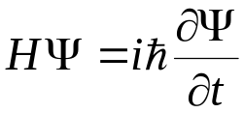



Quantum Mechanical Origins
Fundamental to everything is the Schrödinger equation
  wave function
  H = Hamiltonian operator
  time independent form
Born-Oppenheimer approximation
  electrons relax very quickly compared to nuclear motions
  nuclei move in presence of potential energy obtained by solving electron distribution for fixed nuclear configuration
    it is still very difficult to solve for this energy routinely
  usually nuclei are heavy enough to treat classically
Nuclear coordinates
Electronic coordinates

Slide 5
Force Field Methods
Too expensive to solve QM electronic energy for every nuclear configuration
Instead define energy using simple empirical formulas
  “force fields” or “molecular mechanics”
Decomposition of the total energy
Force fields usually written in terms of pairwise additive interatomic potentials
  with some exceptions
Neglect 3- and higher-order terms
Single-atom energy
(external field)
Atom-pair contribution
3-atom contribution

Slide 6
Contributions to Potential Energy
Total pair energy breaks into a sum of terms
Intramolecular only
U_{str} stretch
U_{bend} bend
U_{tors} torsion
U_{cross} cross
U_{vdW} van der Waals
U_{el} electrostatic
U_{pol} polarization

Slide 7
Contributions to Potential Energy
Total pair energy breaks into a sum of terms
Intramolecular only
U_{str} stretch
U_{bend} bend
U_{tors} torsion
U_{cross} cross
U_{vdW} van der Waals
U_{el} electrostatic
U_{pol} polarization

Slide 8
Contributions to Potential Energy
Total pair energy breaks into a sum of terms
Intramolecular only
U_{str} stretch
U_{bend} bend
U_{tors} torsion
U_{cross} cross
U_{vdW} van der Waals
U_{el} electrostatic
U_{pol} polarization

Slide 9
Contributions to Potential Energy
Total pair energy breaks into a sum of terms
Intramolecular only
U_{str} stretch
U_{bend} bend
U_{tors} torsion
U_{cross} cross
U_{vdW} van der Waals
U_{el} electrostatic
U_{pol} polarization

Slide 10
Contributions to Potential Energy
Total pair energy breaks into a sum of terms
Intramolecular only
U_{str} stretch
U_{bend} bend
U_{tors} torsion
U_{cross} cross
U_{vdW} van der Waals
U_{el} electrostatic
U_{pol} polarization

Slide 11
Contributions to Potential Energy
Total pair energy breaks into a sum of terms
Intramolecular only
U_{str} stretch
U_{bend} bend
U_{tors} torsion
U_{cross} cross
U_{vdW} van der Waals
U_{el} electrostatic
U_{pol} polarization

Slide 12
Contributions to Potential Energy
Total pair energy breaks into a sum of terms
Intramolecular only
Repulsion
U_{str} stretch
U_{bend} bend
U_{tors} torsion
U_{cross} cross
U_{vdW} van der Waals
U_{el} electrostatic
U_{pol} polarization
Mixed terms

Slide 13
Contributions to Potential Energy
Total pair energy breaks into a sum of terms
Intramolecular only
Repulsion
U_{str} stretch
U_{bend} bend
U_{tors} torsion
U_{cross} cross
U_{vdW} van der Waals
U_{el} electrostatic
U_{pol} polarization
Mixed terms

Slide 14
Contributions to Potential Energy
Total pair energy breaks into a sum of terms
Intramolecular only
Repulsion
U_{str} stretch
U_{bend} bend
U_{tors} torsion
U_{cross} cross
U_{vdW} van der Waals
U_{el} electrostatic
U_{pol} polarization
-
+
-
+
Attraction
Mixed terms

Slide 15
Contributions to Potential Energy
Total pair energy breaks into a sum of terms
Intramolecular only
Repulsion
U_{str} stretch
U_{bend} bend
U_{tors} torsion
U_{cross} cross
U_{vdW} van der Waals
U_{el} electrostatic
U_{pol} polarization
+
-
+
-
Attraction
Mixed terms

Slide 16
Contributions to Potential Energy
Total pair energy breaks into a sum of terms
Intramolecular only
Repulsion
U_{str} stretch
U_{bend} bend
U_{tors} torsion
U_{cross} cross
U_{vdW} van der Waals
U_{el} electrostatic
U_{pol} polarization
+
-
+
-
Attraction
+
+
-
+
-
Mixed terms

Slide 17
Contributions to Potential Energy
Total pair energy breaks into a sum of terms
Intramolecular only
Repulsion
U_{str} stretch
U_{bend} bend
U_{tors} torsion
U_{cross} cross
U_{vdW} van der Waals
U_{el} electrostatic
U_{pol} polarization
u⁽²⁾
Attraction
+
-
+
-
+
+
+
-
+
u⁽²⁾
-
-
+
+
u^{(N)}
+
+
-
+
+
-
Mixed terms

Slide 18
Contributions to Potential Energy
Total pair energy breaks into a sum of terms
Intramolecular only
Repulsion
U_{str} stretch
U_{bend} bend
U_{tors} torsion
U_{cross} cross
U_{vdW} van der Waals
U_{el} electrostatic
U_{pol} polarization
u⁽²⁾
Attraction
+
-
+
-
+
+
+
-
+
u⁽²⁾
-
+
-
u^{(N)}
+
+
+
-
+
-
Mixed terms

Slide 19
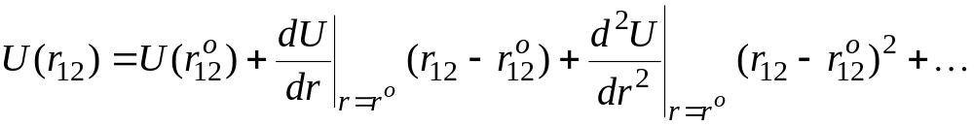

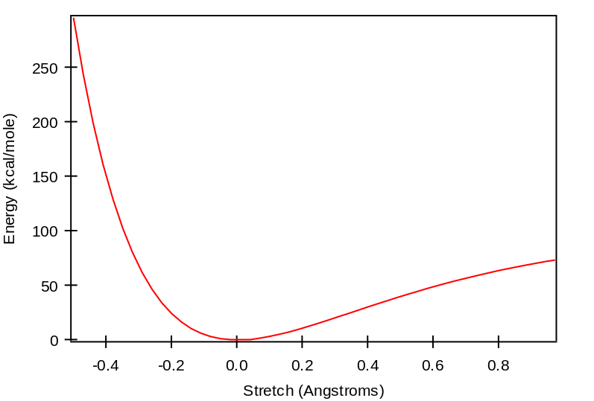
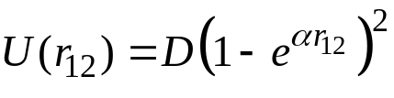
Stretch Energy
Expand energy about equilibrium position
Model fails in strained geometries
  better model is the Morse potential
(neglect)
define
minimum
harmonic
Morse
dissociation energy
force constant

Slide 20
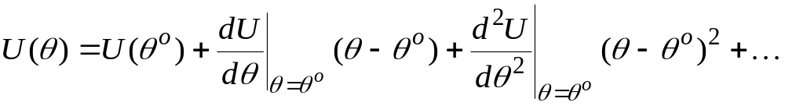


Bending Energy
θ
Expand energy about equilibrium position
  improvements based on including higher-order terms
Out-of-plane bending
(neglect)
define
minimum
harmonic
u⁽⁴⁾
χ

Slide 21

Torsional Energy
φ
Two new features
  periodic
  weak (Taylor expansion in φ not appropriate)
Fourier series
  terms are included to capture appropriate minima/maxima
    depends on substituent atoms
      e.g., ethane has three mimum-energy conformations
        n = 3, 6, 9, etc.
    depends on type of bond
      e.g. ethane vs. ethylene
  usually at most n = 1, 2, and/or 3 terms are included

Slide 22
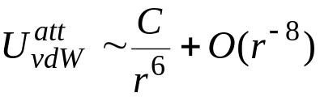
Van der Waals Attraction
Correlation of electron fluctuations
Stronger for larger, more polarizable molecules
  CCl₄ > CH₄ ; Kr > Ar > He
Theoretical formula for long-range behavior
Only attraction present between nonpolar molecules
  reason that Ar, He, CH₄, etc. form liquid phases
a.k.a. “London” or “dispersion” forces
+
-
+
-
-
+
-
+

Slide 23
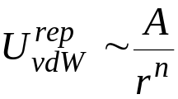

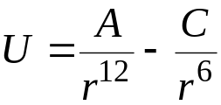
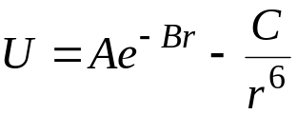
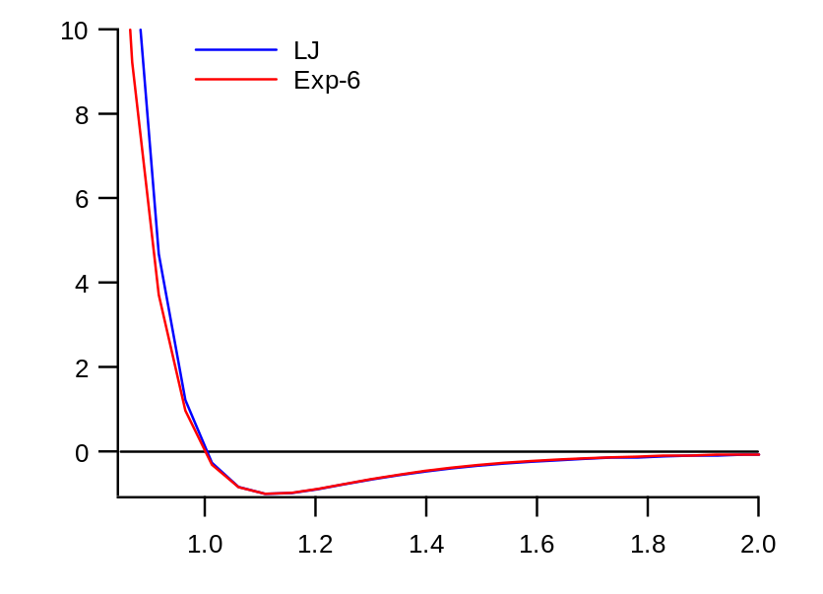
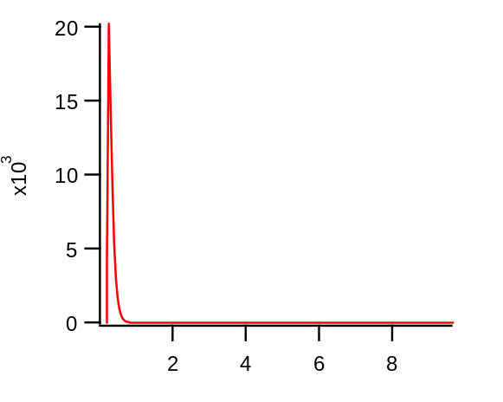
Van der Waals Repulsion
Overlap of electron clouds
Theory provides little guidance on form of model
Two popular treatments
  inverse power exponential
    typically n ~ 9 - 12 two parameters
Combine with attraction term
  Lennard-Jones model Exp-6
a.k.a. “Buckingham” or “Hill”
Beware of anomalous Exp-6 short-range attraction
Exp-6 repulsion is slightly softer

Slide 24

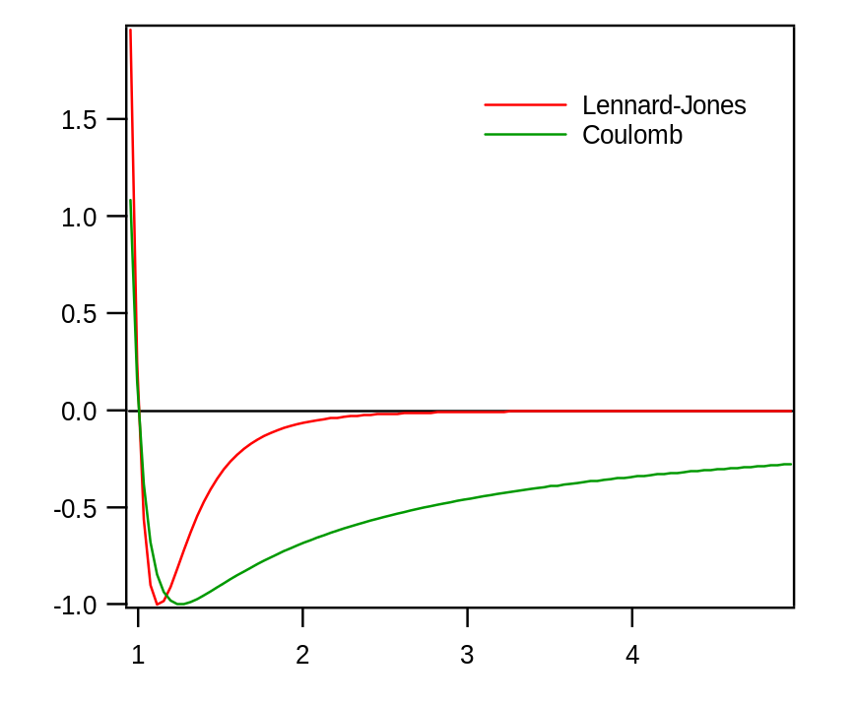
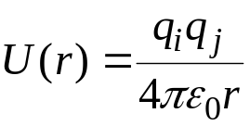
Electrostatics 1.
Interaction between charge inhomogeneities
Modeling approaches
  point charges
  point multipoles
Point charges
  assign Coulombic charges to several points in the molecule
  total charge sums to charge on molecule (usually zero)
  Coulomb potential
    very long ranged

Slide 25






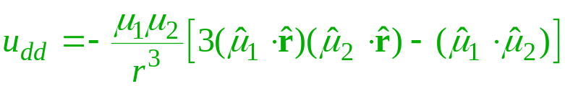
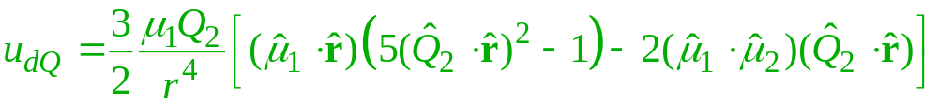
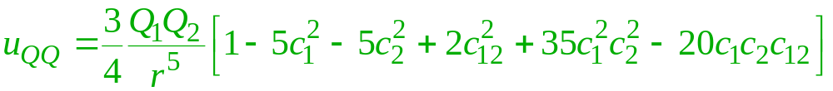
Electrostatics 2.
At larger separations, details of charge distribution are less important
Multipole statistics capture basic features
  Dipole
  Quadrupole
  Octopole, etc.
Point multipole models based on long-range behavior
  dipole-dipole
  dipole-quadrupole
  quadrupole-quadrupole
Vector
Tensor
Axially symmetric quadrupole

Slide 26
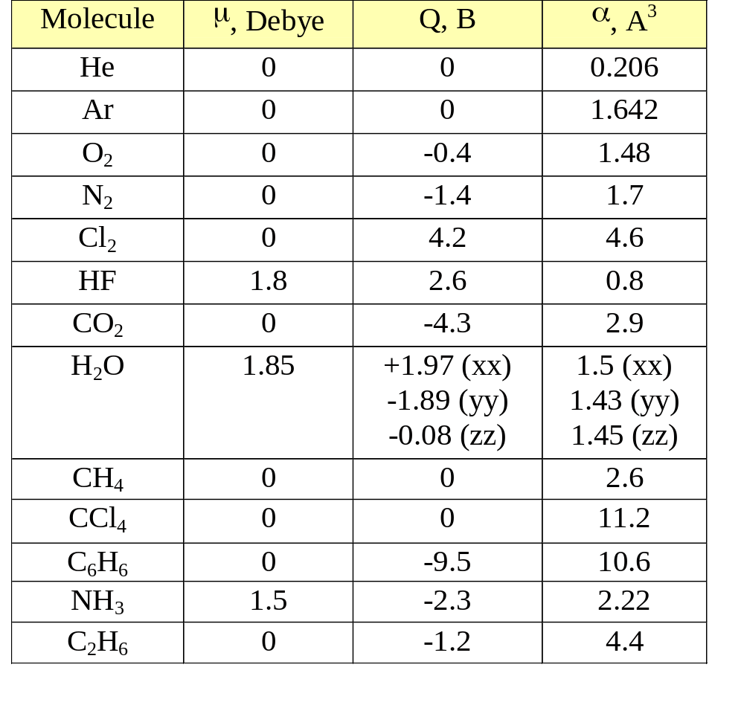
Electrostatics 3.
Some Experimental/Theoretical Values

Slide 27
Polarization
Charge redistribution due to influence of surrounding molecules
  dipole moment in bulk different
  from that in vacuum
Modeled with polarizable charges or multipoles
Involves an iterative calculation
  evaluate electric field acting on each charge due to other charges
  adjust charges according to polarizability and electric field
  re-compute electric field and repeat to convergence
Re-iteration over all molecules required if even one is moved
-
+
+
+
-
+
+
+
+
+
-
+
+
-
+
-
-

Slide 28
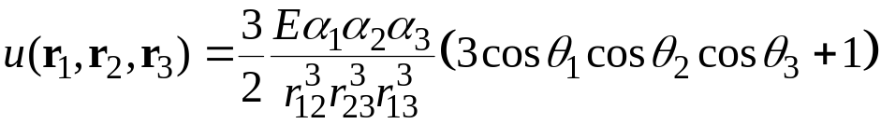

Explicit Multibody Interactions
Axilrod-Teller
  consider response of atoms 2 and 3 to fluctuation in dipole moment of atom 1
  average over all fluctuations in 1
u⁽³⁾
1
2
3

Slide 29
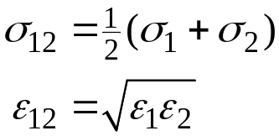
Unlike-Atom Interactions
“Mixing rules” give the potential parameters for interactions of atoms that are not the same type
  no ambiguity for Coulomb interaction
  for effective potentials (e.g., LJ) it is not clear what to do
Lorentz-Berthelot is a widely used choice
Treatment is a very weak link in quantitative applications of molecular simulation

Slide 30
Common Approximations in Molecular Models
Rigid intramolecular degrees of freedom
  fast intramolecular motions slow down MD calculations
Ignore hydrogen atoms
  united atom representation
Ignore polarization
  expensive n-body effect
Ignore electrostatics
Treat whole molecule as one big atom
  maybe anisotropic
Model vdW forces via discontinuous potentials
Ignore all attraction
Model space as a lattice
  especially useful for polymer molecules
Qualitative models

Slide 31
Summary
Intermolecular forces arise from quantum mechanics
  too complex to include in lengthy simulations of bulk phases
Empirical forms give simple formulas to approximate behavior
  intramolecular forms: bend, stretch, torsion
  intermolecular: van der Waals, electrostatics, polarization
Unlike-atom interactions weak link in quantitative work

