Slide 1
CE 530 Molecular Simulation
Lecture 15
Long-range forces and Ewald sum
David A. Kofke
Department of Chemical Engineering
SUNY Buffalo
kofke@eng.buffalo.edu

Slide 2
Review
Intermolecular forces arise from quantum mechanics
  too complex to include in lengthy simulations of bulk phases
Empirical forms give simple formulas to approximate behavior
  intramolecular forms: bend, stretch, torsion
  intermolecular: van der Waals, electrostatics, polarization
Unlike-atom interactions weak link in quantitative work

Slide 3
Truncating the Potential
Bulk system modeled via periodic boundary condition
  not feasible to include interactions with all images
  must truncate potential at half the box length (at most) to have all separations treated consistently
Contributions from distant separations may be important
These two are same distance from central atom, yet:
Black atom interacts
Green atom does not
These two are nearest images for central atom
Only interactions considered

Slide 4
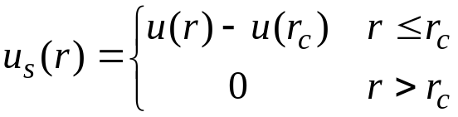
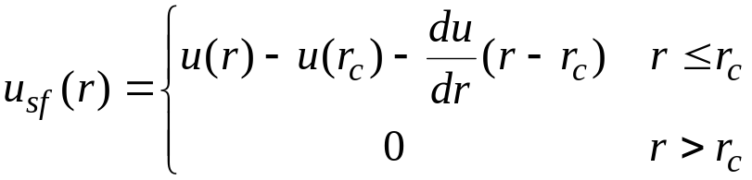
Truncating the Potential
Potential truncation introduces discontinuity
  Corresponds to an infinite force
  Problematic for MD simulations
    ruins energy conservation
Shifted potentials
  Removes infinite force
  Still discontinuity in force
Shifted-force potentials
  Routinely used in MD
For quantitative work need to re-introduce long-range interactions

Slide 5
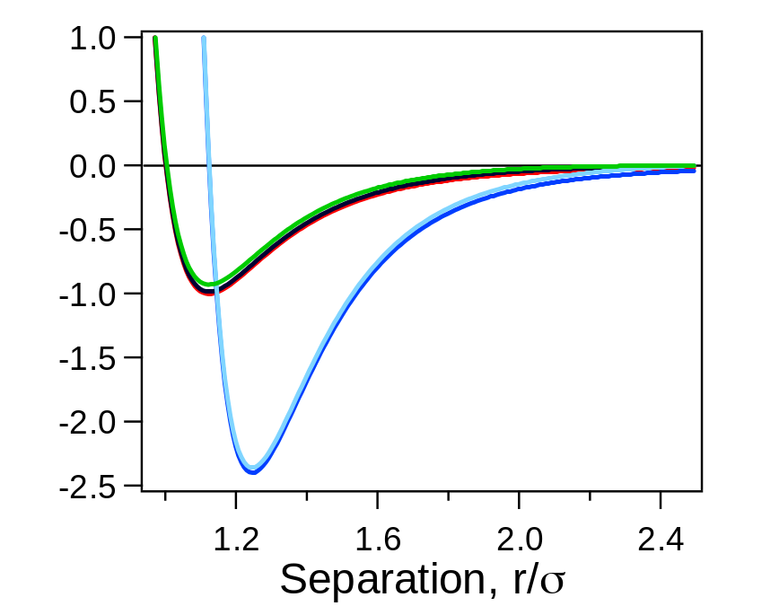
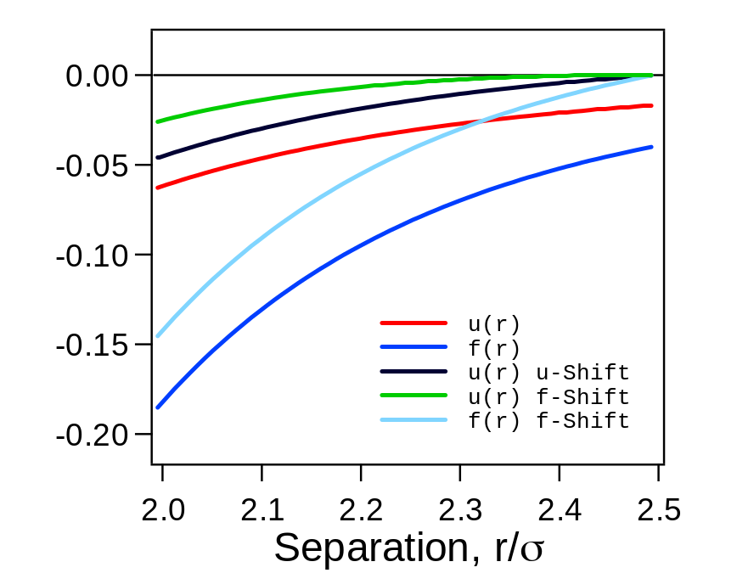
Truncating the Potential
Lennard-Jones example
  r_{c} = 2.5σ

Slide 6
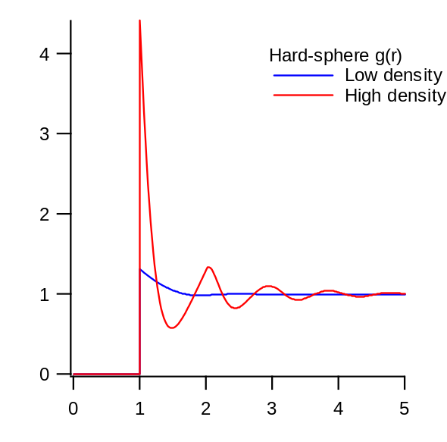
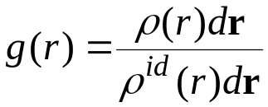

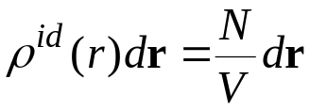
Radial Distribution Function
Radial distribution function, g(r)
  key quantity in statistical mechanics
  quantifies correlation between atom pairs
Definition
Here’s an applet that computes g(r)
Number of atoms at r in actual system
Number of atoms at r for ideal gas

Slide 7
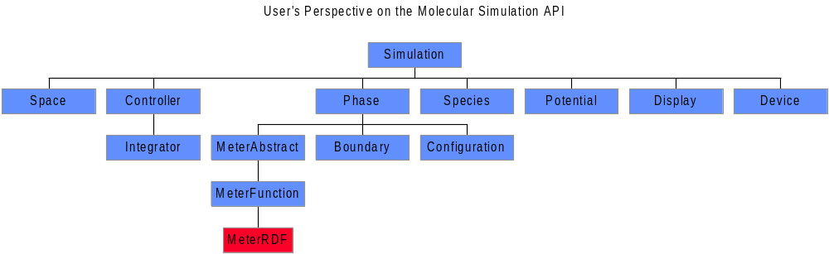
Radial Distribution Function. API

Slide 8
Radial Distribution Function. Java Code
public class MeterRDF extends MeterFunction
/**
* Computes RDF for the current configuration
*/
public double[] currentValue() {
iterator.reset(); //prepare iterator of atom pairs
for(int i=0; i<nPoints; i++) {y[i] = 0.0;} //zero histogram
while(iterator.hasNext()) { //loop over all pairs in phase
double r = Math.sqrt(iterator.next().r2()); //get pair separation
if(r < xMax) {
int index = (int)(r/delr); //determine histogram index
y[index]+=2; //add once for each atom
}
}
int n = phase.atomCount(); //compute normalization: divide by
double norm = n*n/phase.volume(); //n, and density*(volume of shell)
for(int i=0; i<nPoints; i++) {y[i] /= (norm*vShell[i]);}
return y;
}

Slide 9
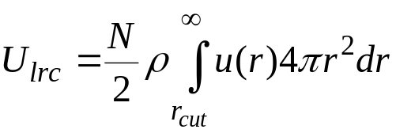
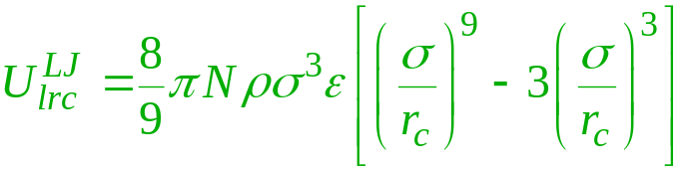
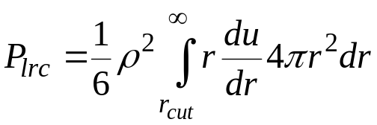
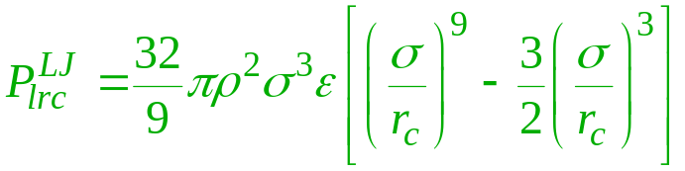
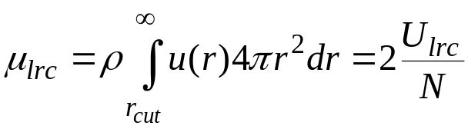
Simple Long-Range Correction
Approximate distant interactions by assuming uniform distribution beyond cutoff: g(r) = 1 r > r_{cut}
Corrections to thermodynamic properties
  Internal energy
  Virial
  Chemical potential
Expression for Lennard-Jones model
For r_{c}/σ = 2.5, these are about 5-10% of the total values

Slide 10
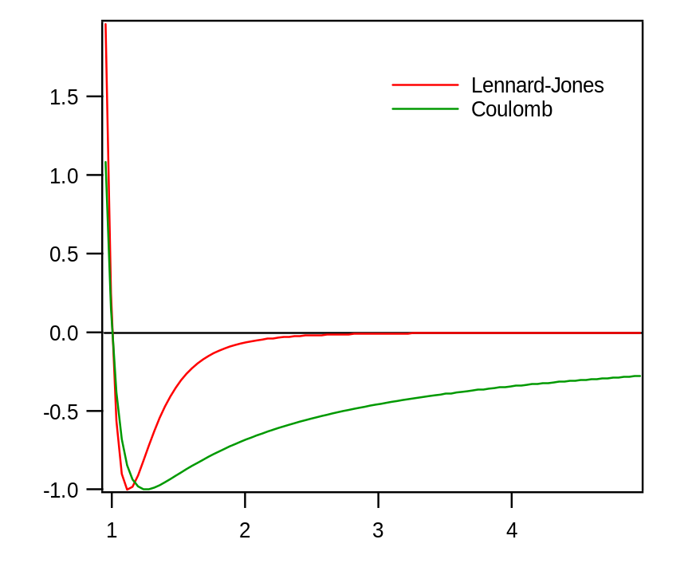
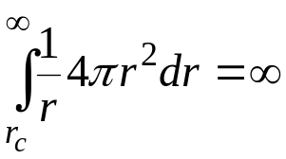
Coulombic Long-Range Correction
Coulombic interactions must be treated specially
  very long range
  1/r form does not die off as quickly as volume grows
  finite only because + and – contributions cancel
Methods
  Full lattice sum
    Here is an applet demonstrating direct approach
    Ewald sum
  Treat surroundings as dielectric continuum

Slide 11
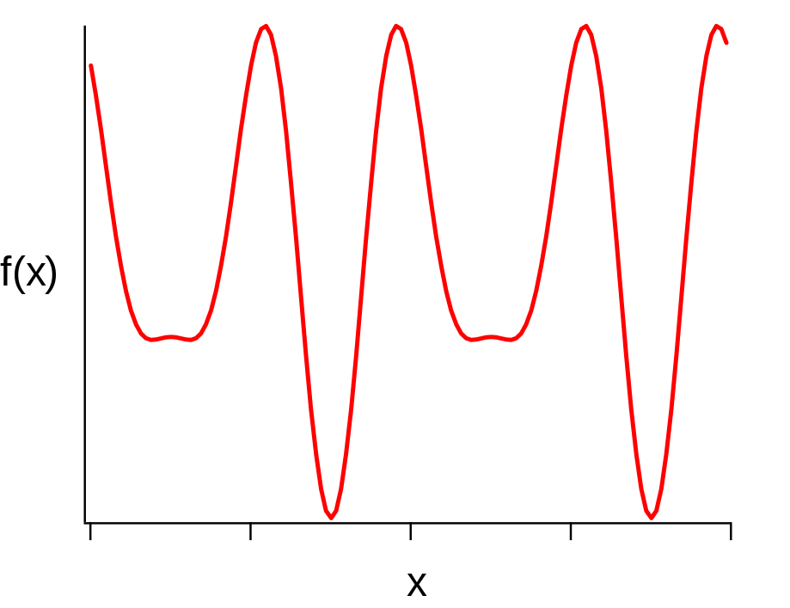
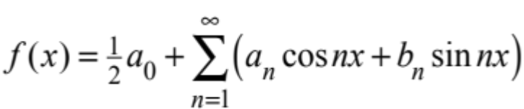
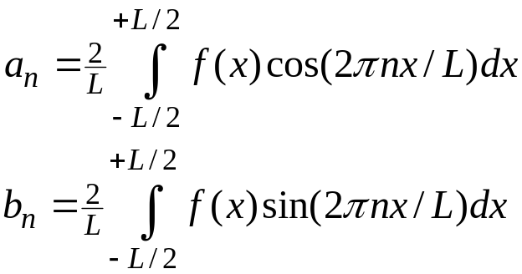


Aside: Fourier Series
Consider periodic function on -L/2, +L/2
A Fourier series provides an equivalent representation of the function
The coefficients are
One period

Slide 12
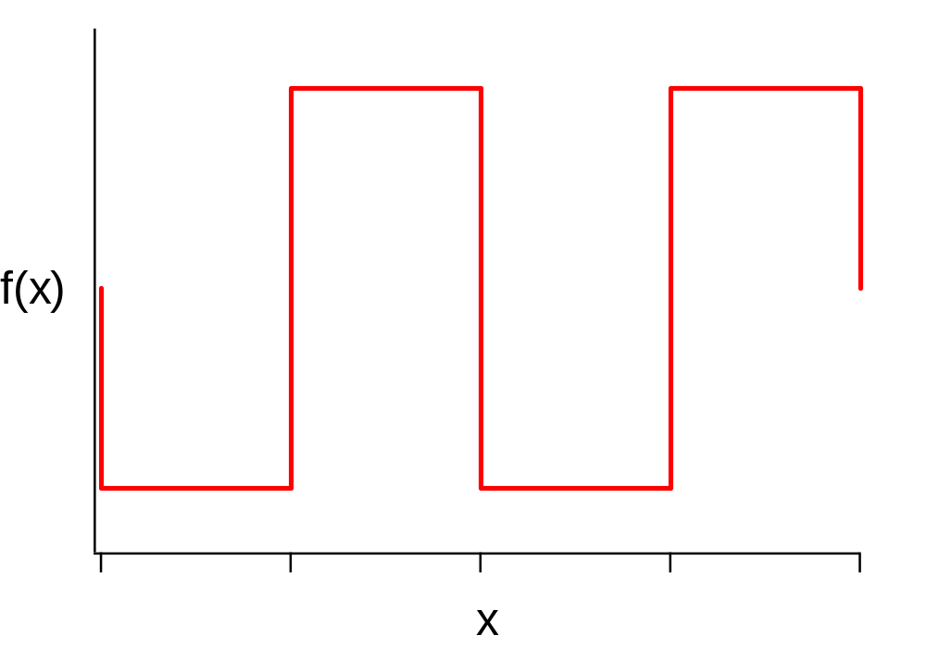
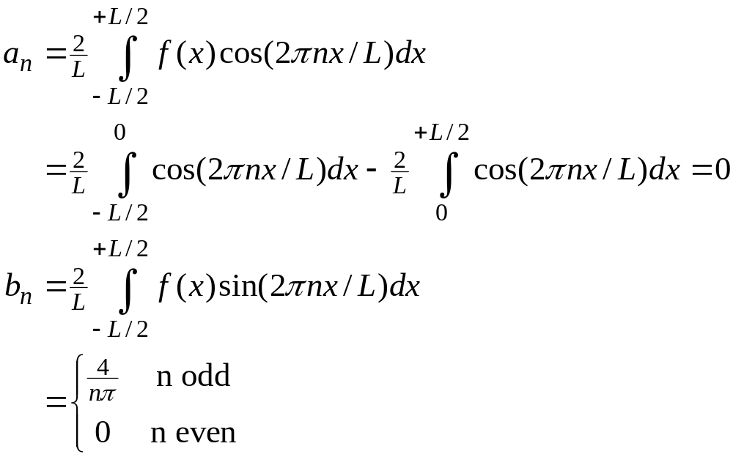
Fourier Series Example
f(x) is a square wave

Slide 13
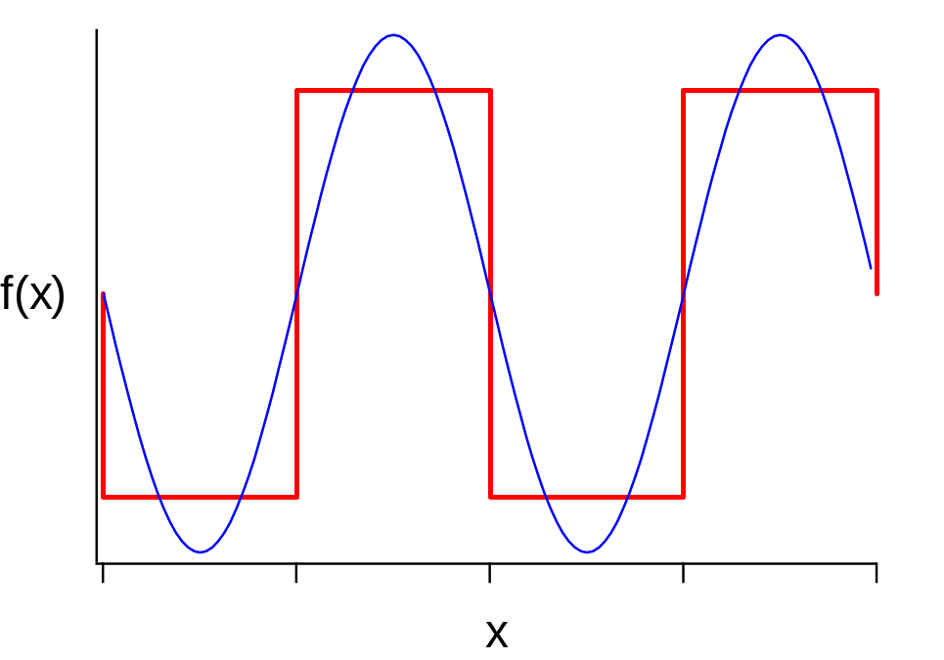
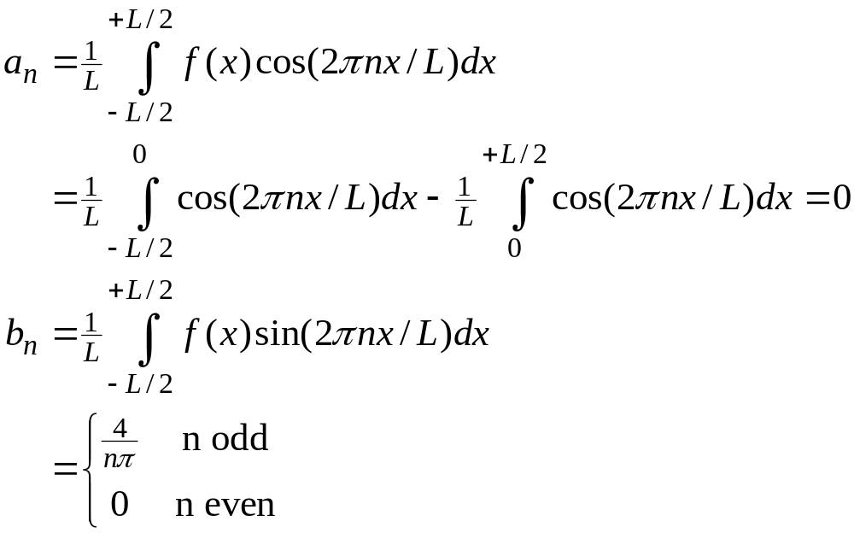
Fourier Series Example
f(x) is a square wave
n = 1

Slide 14
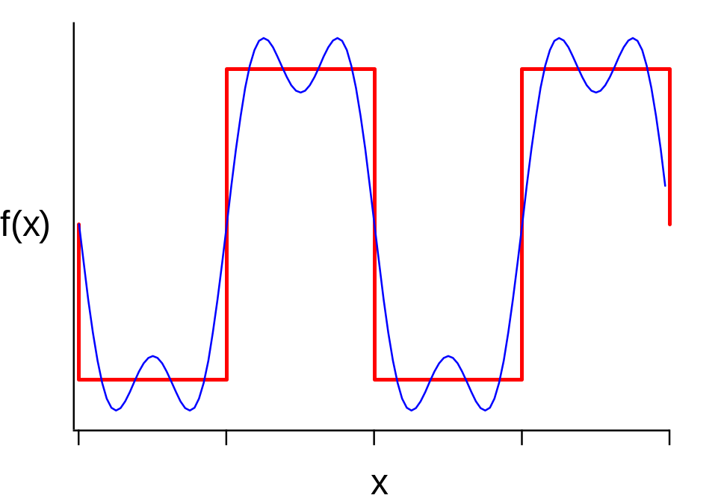
Fourier Series Example
f(x) is a square wave
n = 1, 3

Slide 15
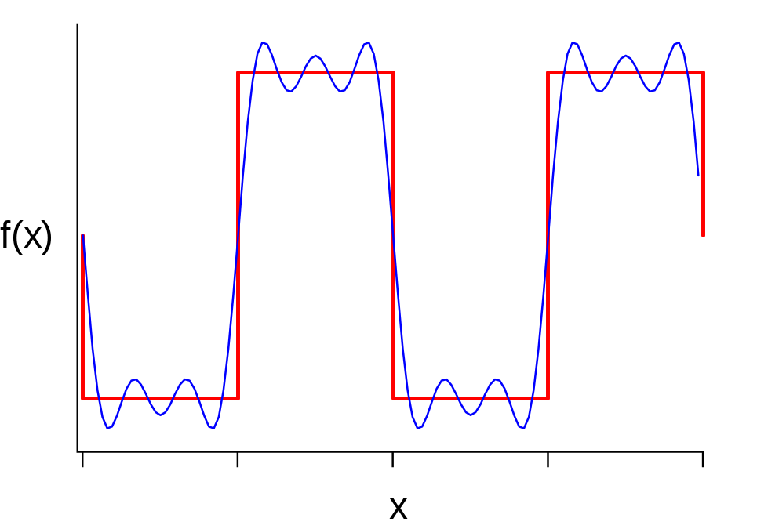
Fourier Series Example
f(x) is a square wave
n = 1, 3, 5

Slide 16
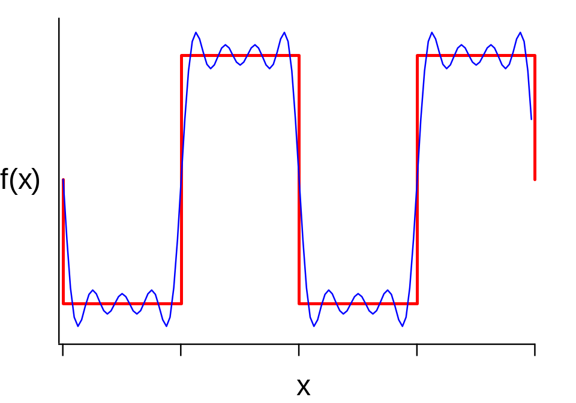
Fourier Series Example
f(x) is a square wave
n = 1, 3, 5, 7

Slide 17
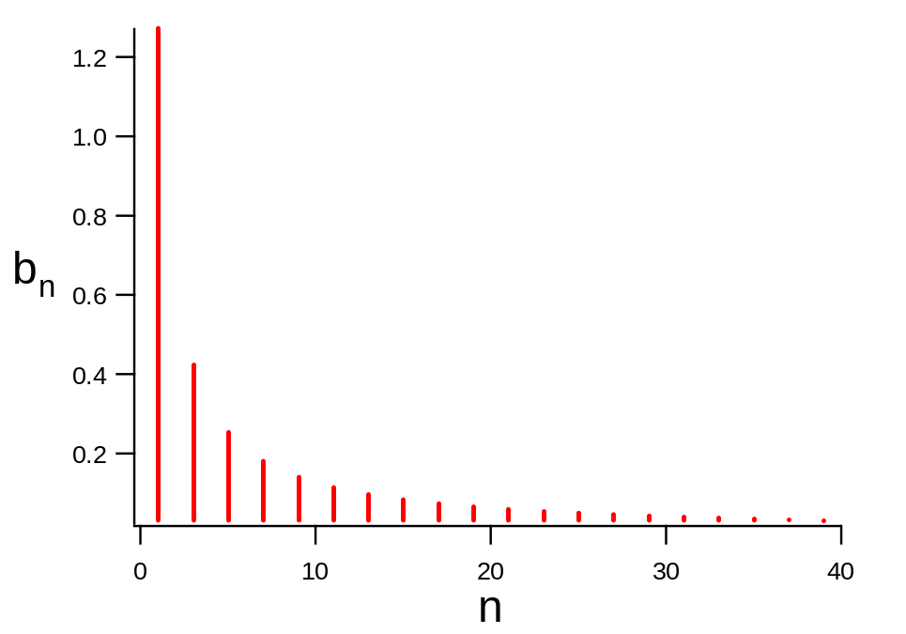
Fourier Representation
The set of Fourier-space coefficients b_{n} contain complete information about the function
Although f(x) is periodic to infinity, b_{n} is non-negligible over only a finite range
Sometimes the Fourier representation is more convenient to use

Slide 18
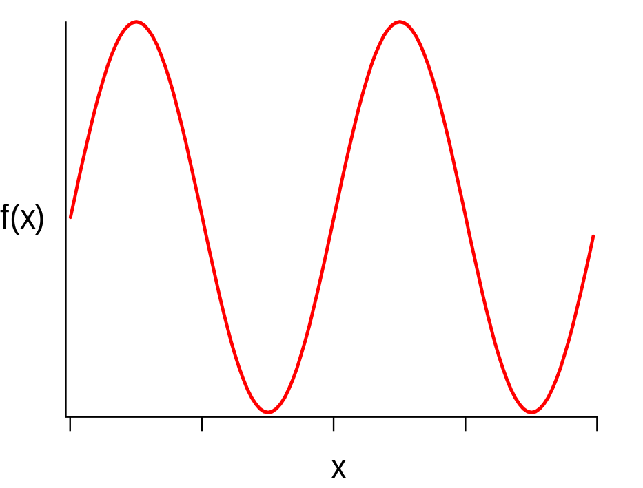
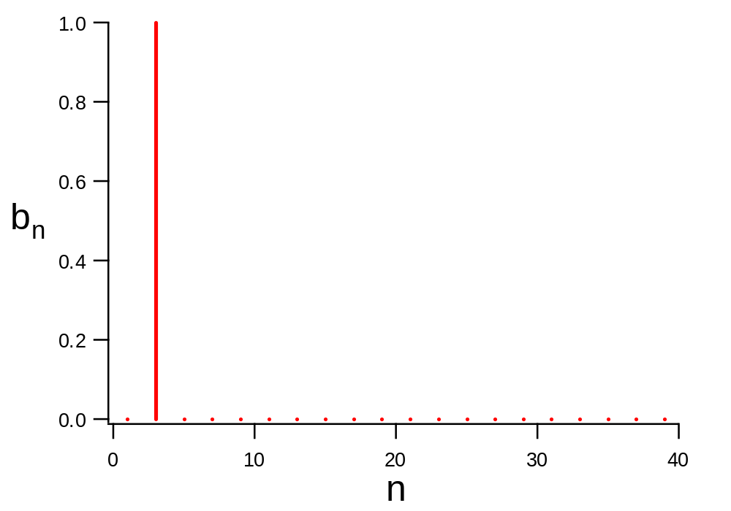
Convergence of Fourier Sum
If f(x) = sin(2πkx/L), transform is simple
  b_{n} = 1 for n = k
  b_{n} = 0 otherwise
Converges very quickly!

Slide 19
Observations on Fourier Sum
Smooth functions f(x) require few coefficients b_{n}
Sharp functions (square wave) require more coefficients
Large-n coefficients describe high-frequency behavior of f(x)
  large n = short wavelength
Small-n coefficients describe low-frequency behavior
  small n = long wavelength
  e.g., n = 0 coefficient is simple average of f(x)

Slide 20

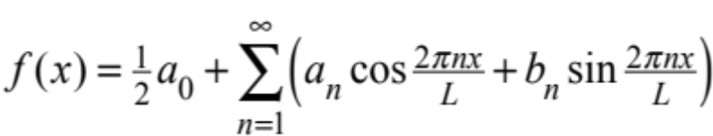
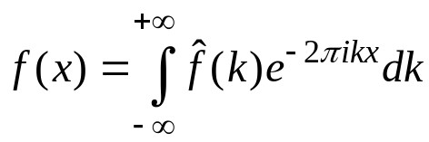
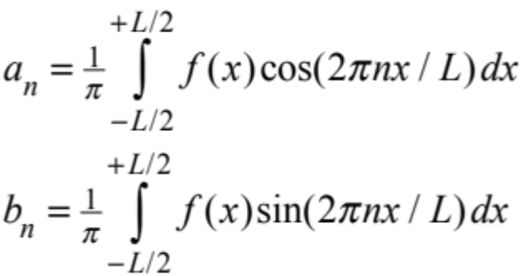
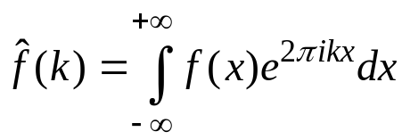


Fourier Transform
As L increases, f(x) becomes less periodic
Fourier transform arrives in limit of L → ∞
Compact form obtained with exponential form of cos/sin
Useful relations
  derivative
  convolution
inverse
forward
a_{n} = real part of transform
b_{n} = imaginary part

Slide 21
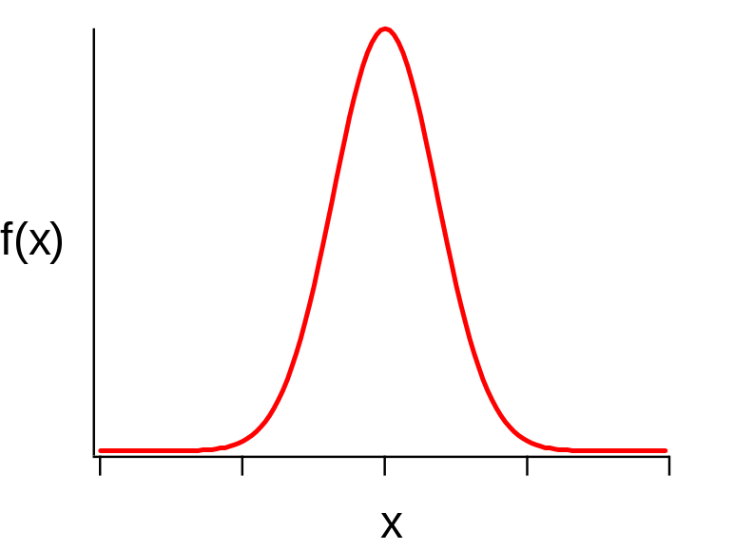
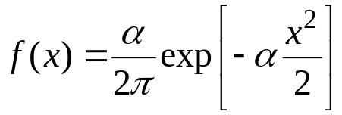
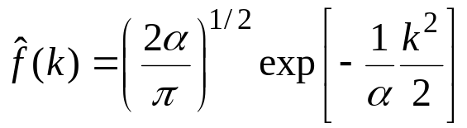
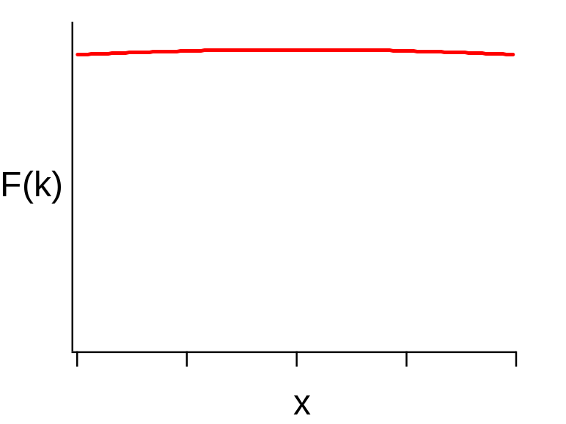

Fourier Transform Example
Gaussian
Transform is also a Gaussian!
Width of transform is reciprocal of width of function
  k-space is “reciprocal” space
  sharp f(x) requires more values of F(k) for good representation
  δ(x-x_{o}) transforms into a sine/cosine wave of frequency x_{o}:
k

Slide 22
Fourier Transform Relevance
Many features of statistical-mechanical systems are described in k-space
  structure
  transport behavior
  electrostatics
This description focuses on the correlations shown over a particular length scale (depending on k)
Macroscopic observables are recovered in the k → 0 limit
Corresponding treatment is applied in the time/frequency domains

Slide 23
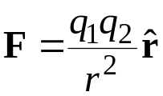

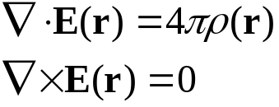




Review of Basic Electrostatics
Force between charges
In terms of electric field
Static electric field satisfies
Charge density ρ(r)
  for point charge q₂:
Electrostatic potential
  zero curl implies E can be written
  potential energy of charge q₁ at r, relative to position at infinity
Poisson’s equation
Mass analogy: u(z) = m × gz = mφ(z)

Slide 24
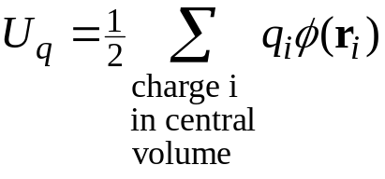
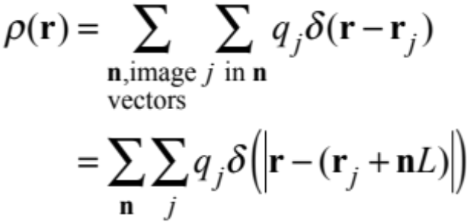
Ewald Sum
We want to sum the interaction energy of each charge in the central volume with all images of the other charges
  express in terms of electostatic potential
  the charge density creating the
  potential is
  this is a periodic function (of period L), but it is very sharp
    Fourier representation would never converge
-
+
-
+
-
+
-
+
-
+
-
+
-
+
-
+
-
+
-
+
-
-
-
-
-
+
+
+
+
+
-
+
-
+
-
+
-
+
-
+
-
+
-
+
-
+
-
+
-
+
-
-
-
-
-
+
+
+
+
+
-
+
-
+
-
+
-
+
-
+
-
+
-
+
-
+
-
+
-
+
-
-
-
-
-
+
+
+
+
+
-
+
-
+
-
+
-
+
-
+
-
+
-
+
-
+
-
+
-
+
-
-
-
-
-
+
+
+
+
+
-
+
-
+
-
+
-
+
-
+
-
+
-
+
-
+
-
+
-
+
-
-
-
-
-
+
+
+
+
+

Slide 25
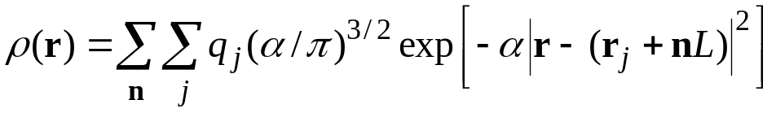


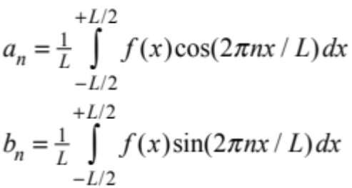
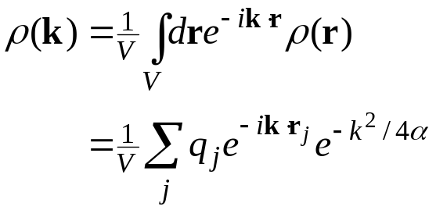
Ewald Sum: Fourier 1.
Compute field instead by smearing all the charges
Electrostatic potential via Poisson equation
  direct space form
  reciprocal space
Discrete Fourier transform the charge density
include n = 0
Large α takes ρ back to δ function

Slide 26
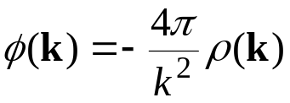
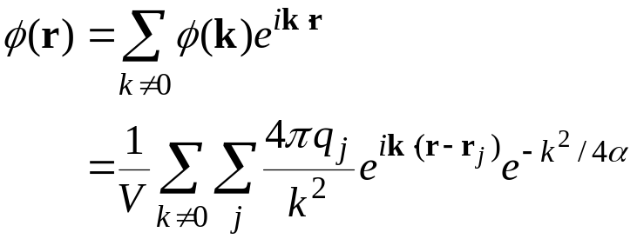
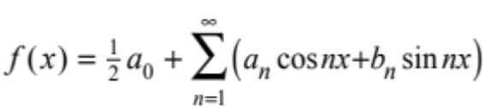
Ewald Sum. Fourier 2.
Use Poisson’s equation for electrostatic potential
Invert transform to recover real-space potential
  in principle requires sum over infinite number of wave vectors k
  but reciprocal Gaussian goes to zero quickly if α is small (broad Gaussian, large smearing of charge)

Slide 27
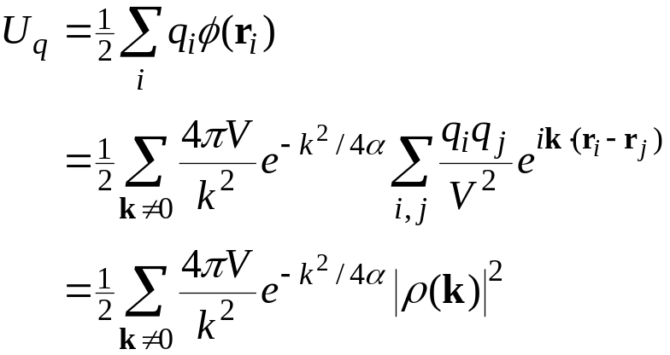
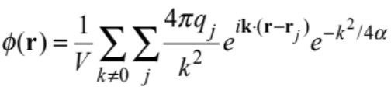
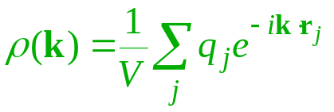
Ewald Sum. Fourier 3.
The electrostatic energy can now be obtained
  for point charges in potential of smeared charges
Two corrections are needed
  self interaction
  correct for smearing
product of identical sums

Slide 28

Ewald Sum. Self Interaction 1.
In Ewald sum, each point charge is replaced by smeared Gaussian centered on that charge
  this is done to estimate the electrostatic potential field
All point charges interact with the resulting field to yield the potential energy
  This means that the point charge
  interacts with its smeared
  representation
  We need to subtract this

Slide 29
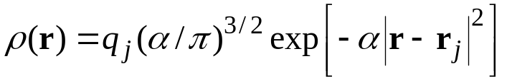




Ewald Sum. Self Interaction 2.
We work in real space to deal with the self term
  Poisson’s equation for the electrostatic potential due to a single smeared charge
  The solution is
  In particular, at r = 0
  The self-correction subtracts this for each charge
independent of configuration

Slide 30

Ewald Sum. Smearing Correction 1.
We add the correct field and subtract the approximate one to correct for the smearing
This field is short ranged for large α (narrow Gaussians)
  can view as point charges surrounded by shielding countercharge distribution

Slide 31


Ewald Sum. Smearing Correction 2.
Sum interaction of all charges with field correction
  convenient to stay in real space
  Usually α is chosen so that sum converges within central image
Total Coulomb energy
  each term depends on α, but the sum is independent of it
    if enough lattice vectors are used in the reciprocal- and real-space sums
Here is an applet that demonstrate the Ewald method

Slide 32
Ewald Method. Comments
Basic form requires an O(N²) calculation
  efficiency can be introduced to reduce to O(N^{3/2})
  good value of α is 5L, but should check for given application
  can be extended to sum point dipoles
Other methods are in common use
  reaction field
  particle-particle/particle mesh
  fast multipole

Slide 33
Summary
Contributions from distant interactions cannot be neglected
  potential truncated at no more than half box length
  treat long-range assuming uniform radial distribution function
Coulombic interactions require explicit summing of images
  too costly to perform direct sum
  Ewald method is more efficient
    smear charges to approximate electrostatic field
    simple correction for self interaction
    real-space correction for smearing

