Slide 1
CE 530 Molecular Simulation
Lecture 17
Beyond Atoms: Simulating Molecules
David A. Kofke
Department of Chemical Engineering
SUNY Buffalo
kofke@eng.buffalo.edu

Slide 2
Review
Fundamentals
  units, properties, statistical mechanics
Monte Carlo and molecular dynamics as applied to atomic systems
  simulating in various ensembles
  biasing methods for MC
Molecular models for realistic (multiatomic) systems
  inter- and intra- atomic potentials
  electrostatics
Now examine differences between simulations of monatomic and multiatomic molecules

Slide 3
Truncating the Potential
Many molecular models employ point charges for electrostatic interactions
Potential-truncation schemes must be careful not to split the charges
For a 9Å truncation distance, using water-like charges, the interaction energy for a molecule with bare charge is (huge)
Always use cutoff based on molecule separation, not atom
  for large molecules, OK to split molecule but do not split subgroups
+
+
-
+
+
+
+
+
+
-
+
-
+
-
+
-
+
+
+
+
+
-
+
+
+
-
+
-
+
+
-
+
+
-
-
-
-
+
+
+
+
-
+
+
+
+
+
-
+
-
-
+
+
-
+
-
+
+
-
+
+
+
+
+
+
-
+
+
+
-
-
+
+
-
+
+
-
-
-
+
+
+
+
-
+
+
+
+
-
-

Slide 4
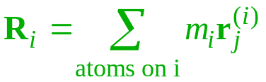




Volume-Scaling Moves
Scaling atom displacements leads to large strain on intramolecular bonds
Instead perform volume scaling moves using molecule centers-of-mass (or something similar)
  Let R_{i} be COM of molecule i
  q_{j}^{(i)} be position of atom j w.r.t. R_{i}
  For size scaling s, L^{new} = sL^{old}
  Acceptance based on change in
Number of molecules (not atoms)

Slide 5
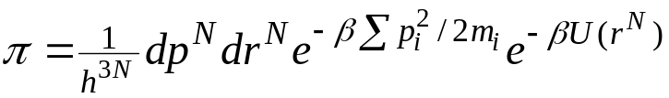
Rigid vs. Nonrigid Molecules
MC and MD can be performed on molecules as already described
  MD moves advance atom positions based on current forces
  MC moves translate atoms and accepts based on energy change
  both are done considering inter- and intra-molecular forces
  limiting distribution has same form
  if this is all that is done, there is nothing more to say
Often it is much more efficient to use a rigid-bond model
  MD integration then doesn’t have to deal with fast intramolecular dynamics, so a larger time step can be used
  MC can sample configurations more efficiently using rigid-body moves (even if model does not have rigid bonds)
    but much care is needed to do this properly
N = Number of atoms

Slide 6

Molecule Coordinate Frame
Molecule-frame coordinates are defined w.r.t. molecule COM with molecule in a reference orientation
Simulation-frame coordinate is determined by molecule COM R and orientation ω
For rigid molecules, the molecule-frame coordinates never change
q_{j}

Slide 7


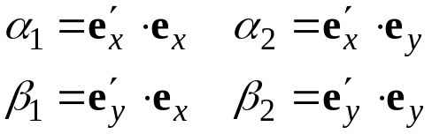



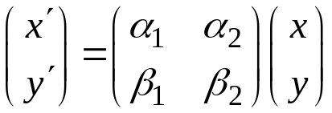

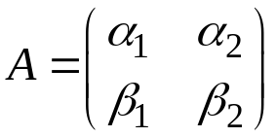



Orientation 1.
Orientation described in terms of rotation of molecule frame
Direction cosines can be used to describe rotation
Relation between same point in two frames
Rotation matrix
Kinematics of rigid-molecule rotation described in terms of rotation of the molecule coordinate frame (i.e. the direction cosines)
  r' never changes in a rigid molecule

Slide 8

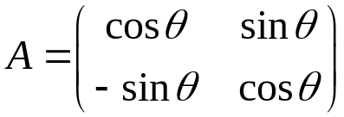
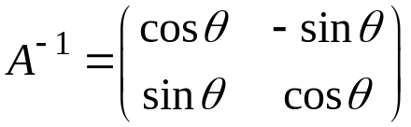

Orientation 2.
We also need to invert the relation
  get the simulation-frame coordinate from the molecule frame value
Direction cosines are not independent
  in 2D, all can be described by just one parameter
  use rotation angle θ
  inverse can be viewed as replacing θ with -θ

Slide 9














Euler Angles
The picture in 3D is similar: (x, y, z) → (x', y', z')
Nine direction cosines
Three independent coordinates specify orientation
Euler angles are the conventional choice
  three rotations give the simulation-frame orientation

Slide 10
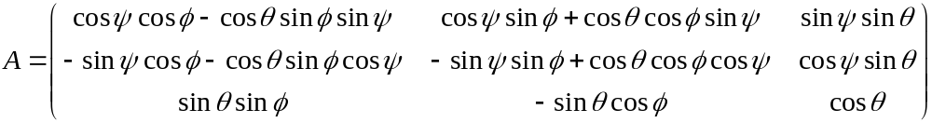

3D Rotation Matrix
Rotation matrix expressed in terms of Euler angles
To get space-fixed coordinate, multiply molecule-fixed vector by A⁻¹
  again, A⁻¹ = A^{T}

Slide 11


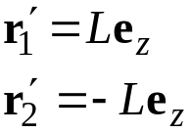
Transforming Coordinates 1.
Consider a simple diatomic
  positions of two atoms described by
  can instead describe by molecule COM
  and stretch/orientation coordinates
  in molecule frame, each atom position is given by
2L

Slide 12
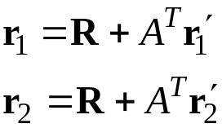

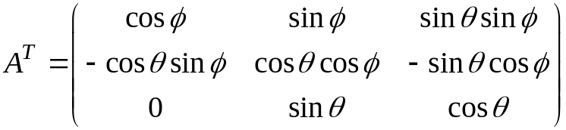
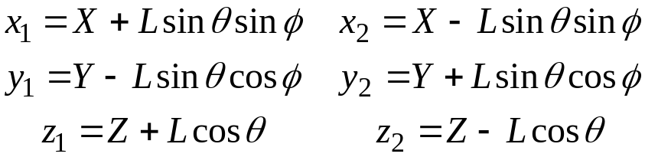
Transforming Coordinates 2.
To get space-fixed coordinates, use rotation matrix
  matrix
  the result is
2L

Slide 13
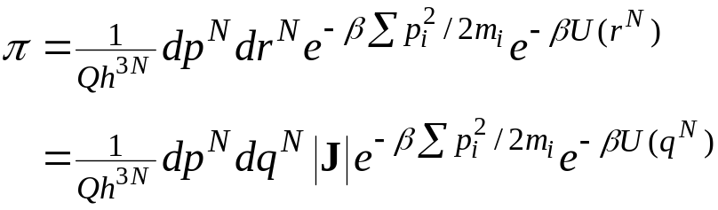
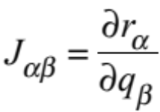
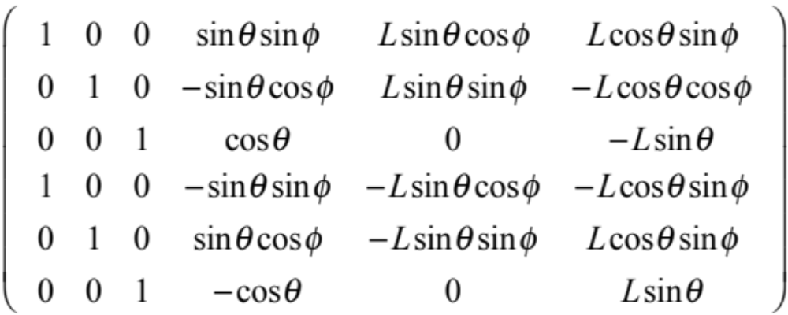
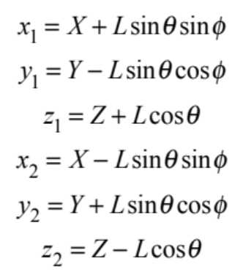

Transforming Coordinates 3.
The ensemble distribution for the transformed coordinates is obtained via the Jacobian
  the elements of J are the derivatives
  For this transformation
But we also need to transform the momenta
X Y Z L φ θ
x₁ y₁ z₁ x₂ y₂ z₂

Slide 14
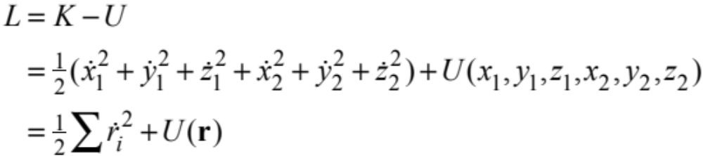
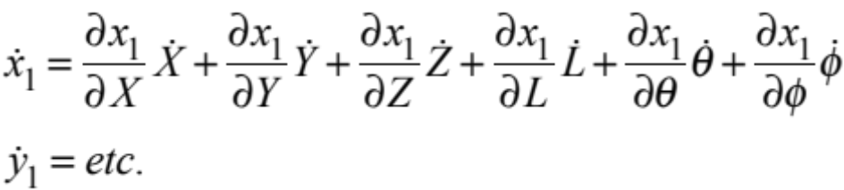
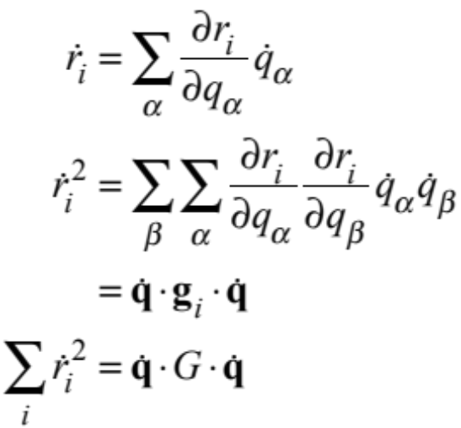
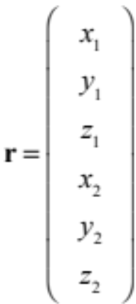
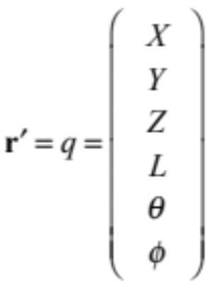
Transforming Coordinates 4.
Begin with the Lagrangian
  in the original coordinate system
  transform to new coordinates
  in general
assume m=1

Slide 15

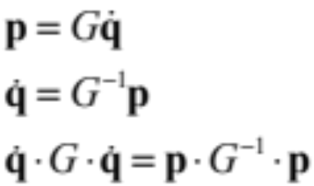
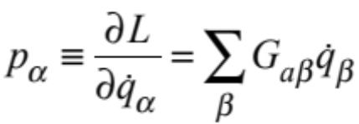
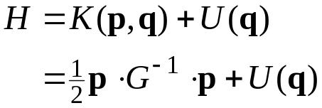
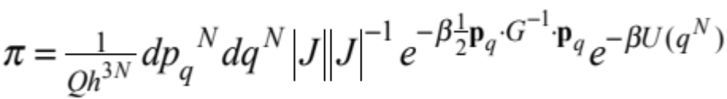
Transforming Coordinates 5.
Derive momenta
The Hamiltonian is
The Jacobian for the momentum transformation is the reciprocal of the Jacobian for the coordinate transformation
  we don’t have to worry about the Jacobian with the full transform
Uses G and thus G⁻¹ are symmetric

Slide 16
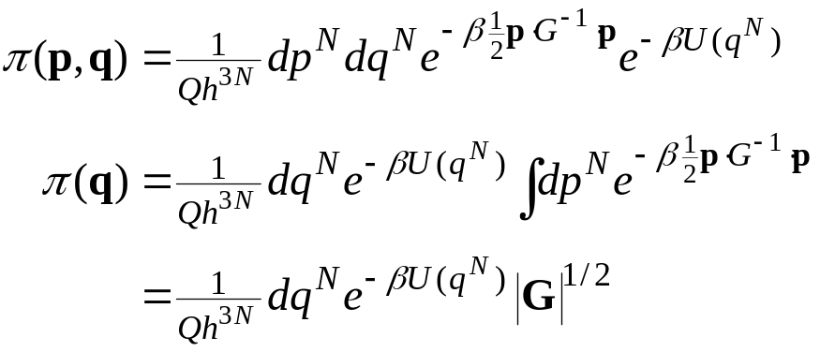

Integrating Over Momenta
If we integrate out the momentum coordinates, the Jacobian again arises
For the diatomic, this term is
In MC simulation, the terms must be included in the construction of the transition-probability matrix
c = constant

Slide 17
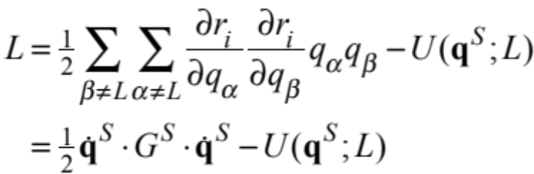
Averages with Constraints 1.
Very stiff coordinates are sometimes treated as rigidly constrained
  e.g., the bond length L in the diatomic may be held at a constant value
MC and MD have different ways to enforce this constraint
Regardless of simulation technique, the constrained-system ensemble average may differ from the unconstrained value
  even when compared to the limit of an infinitely stiff bond!
Why the difference?
  A rigid constraint implies no kinetic energy in vibration
  Examine the Lagrangian
s = “soft” coordinate

Slide 18
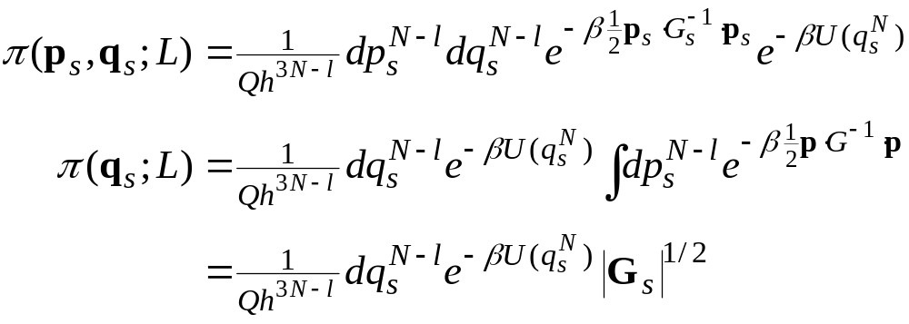
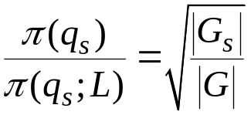
Averages with Constraints 2.
The Jacobian for the coordinate transform is the same as for the unconstrained average
But the momentum Jacobian no longer has the term for the constrained coordinate
Thus, in general, the distribution of unconstrained coordinates differs
The difference is

Slide 19
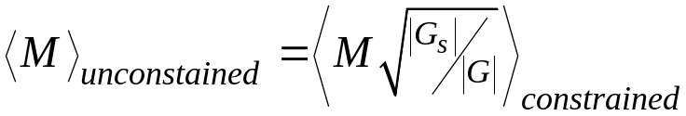
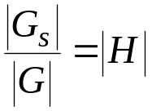
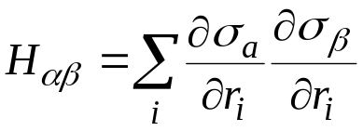
Averages with Constraints 3.
To get correct (unconstrained-system) averages from a simulation using constraints, averages should be multiplied by this factor
Evaluating this quantity could be tedious
  but there is a simplification
  the ratio of determinants (of N-by-N and (N-l)-by-(N-l) matrices) can be given in terms of the determinant of an l-by-l matrix
  for the diatomic with L constrained, H = 1

Slide 20

Rotational Dynamics
For completely rigid molecules, only translation and rotation are performed
Translational dynamics uses methods described previously, but now applied to the COM
Rotational dynamics must consider angular velocities and accelerations
Can treat via rotation of the molecule-frame coordinates in the spaced-fixed frame
  changes in angular velocity are given via torque on molecule
Angular velocity

Slide 21
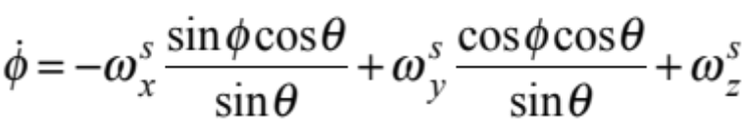
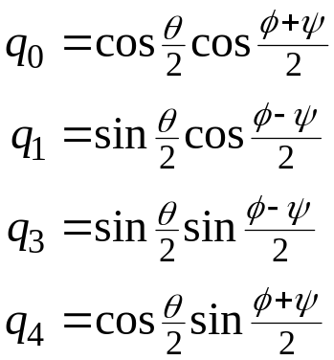

Quaternions
Rate of change of the Euler angles looks like this
A problem arises when θ is near 0
  no physical significance, but very inconvenient to integration of equations of motion
Quaternions can be used to circumvent the problem
  describe orientation with 4 (non-independent) variables
  rotation matrix, equations of motion simply
  expressed in terms of these quantities
  note:

Slide 22

Monte Carlo Rotations
MC simulations of molecules include rotation moves
  must do this to sample orientations of rigid molecules
  not strictly necessary for non-rigid molecules, but very helpful
  very easy to do this incorrectly
Trial rotation of a linear molecule
  Let present orientation be given by vector u
  Generate a unit vector v with random orientation
  Let new trial orientation be given by
  where γ is a fixed scale factor that sets the size of the perturbation
Nonlinear molecule
  same procedure, but do perturbation on the 4-dimensional vector of quaternions

Slide 23
Random Vector on a Sphere
Acceptance-rejection method of von Neumann
Iterate
  (a) Generate 3 uniform random variates, r₁, r₂, r₃ on (0,1)
  (b) Calculate z_{i} = 1-2r_{i}, i=1,3, so that the vector z is distributed uniformly in a cube of side 2, centered on the origin
  (c) Form the sum z² = z₁² + z₂² + z₃²
  (d) If z² < 1, take the random vector as (z₁/z, z₂/z, z₃/z) and quit
  (e) Otherwise, reject the vector and return to (a)
Alternative algorithms are possible

