Slide 1
CE 530 Molecular Simulation
Lecture 18
Free-energy calculations
David A. Kofke
Department of Chemical Engineering
SUNY Buffalo
kofke@eng.buffalo.edu

Slide 2
Free-Energy Calculations
Uses of free energy
  Phase equilibria
  Reaction equilibria
  Solvation
  Stability
  Kinetics
Calculation methods
  Free-energy perturbation
  Thermodynamic integration
  Parameter-hopping
  Histogram interpolation

Slide 3

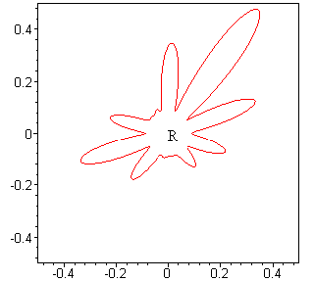
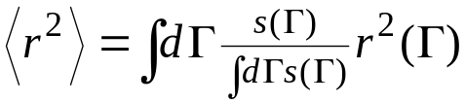
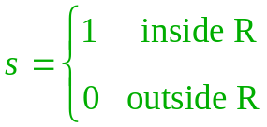
Ensemble Averages
Simple ensemble averages are of the form
To evaluate:
  sample points in phase space with probability π(Γ)
  at each point, evaluate M(Γ)
  simple average of all values gives <M>
Previous example
  mean square distance from origin in region R
  sample only points in R, average r²
Principle applies to both MD and MC
Γ

Slide 4
Ensemble Volumes
Entropy and free energy relate to the size of the ensemble
  e.g., S = k lnΩ(E,V,N)
No effective way to measure the size of the ensemble
  no phase-space function that gives size
  of R while sampling only R
    imagine being place repeatedly at random
    points on an island
    what could you measure at each point to
    determine the size of the island?
Volume of ensemble is numerically
unwieldy
  e.g. for 100 hard spheres
    ρ = 0.1, Ω = 5 × 10¹³³
    ρ = 0.5, Ω = 3 × 10⁷
    ρ = 0.9, Ω = 5 × 10⁻¹⁴²
Shape of important region is very complex
  cannot apply methods that exploit some simple geometric picture
Ω = number of states of given E,V,N
Γ

Slide 5
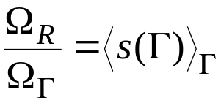

Reference Systems
All free-energy methods are based on calculation of free-energy differences
Example
  volume of R can be measured as a fraction of the total volume
    sample the reference system
    keep an average of the fraction of time occupying target system
  what we get is the difference
Usefulness of free-energy difference
  it may be the quantity of interest anyway
  if reference is simple, its absolute free
  energy can be evaluated analytically
    e.g., ideal gas, harmonic crystal
Γ

Slide 6
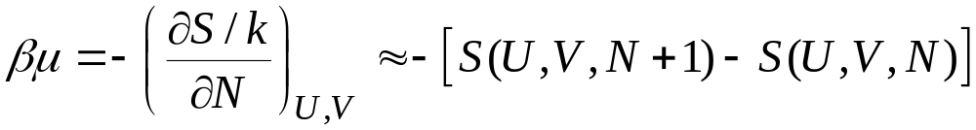

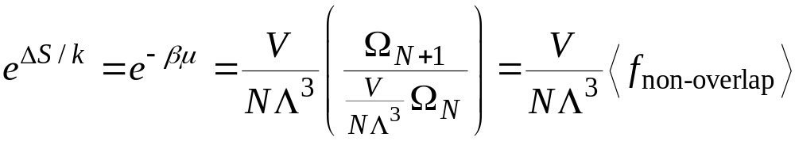
Hard Sphere Chemical Potential
Chemical potential is an entropy difference
For hard spheres, the energy is zero or infinity
  any change in N that does not cause overlap will be change at constant U
To get entropy difference
  simulate a system of N+1 spheres, one non-interacting “ghost”
  occasionally see if the ghost sphere overlaps another
  record the fraction of the time it does not overlap
Here is an applet demonstrating this calculation
N+1
N

Slide 7
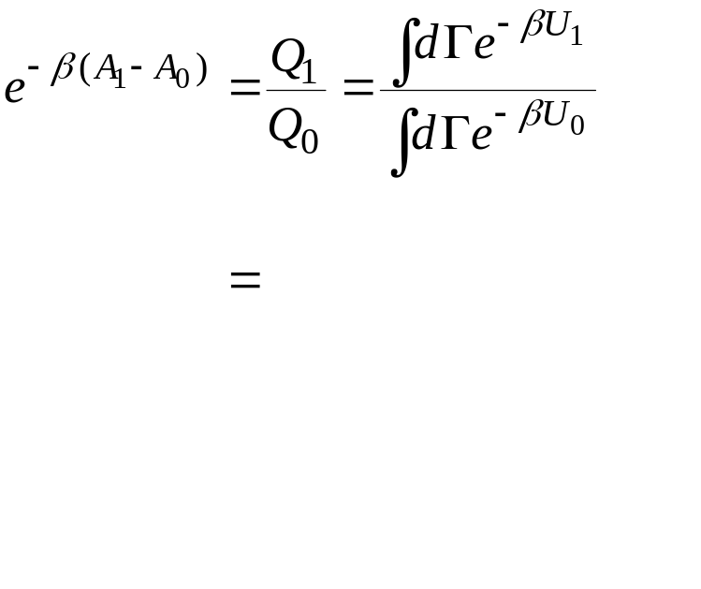
Free-Energy Perturbation
Widom method is an example of a free-energy perturbation (FEP) technique
FEP gives free-energy difference between two systems
  labeled 0, 1
Working equation
Free-energy difference is a ratio of partition functions
1
0
Γ

Slide 8
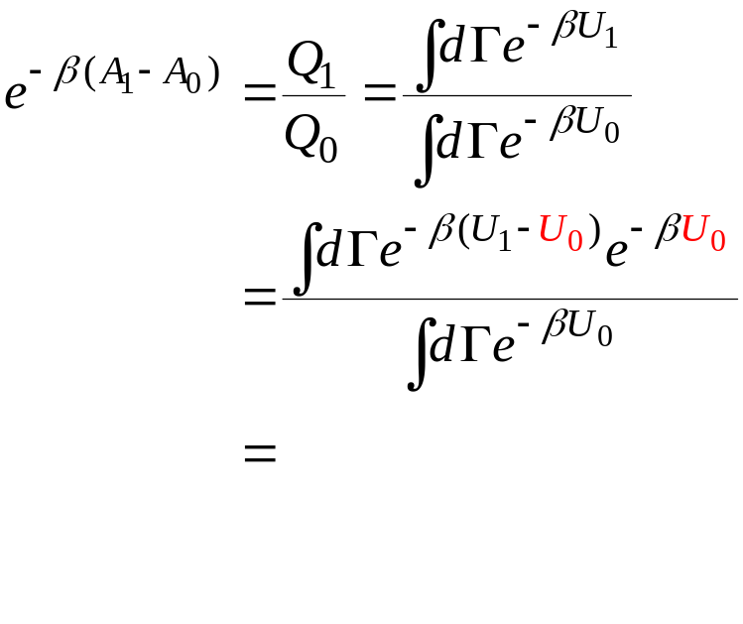
Free-Energy Perturbation
Widom method is an example of a free-energy perturbation (FEP) technique
FEP gives free-energy difference between two systems
  labeled 0, 1
Working equation
Add and subtract reference-system energy
1
0
Γ

Slide 9
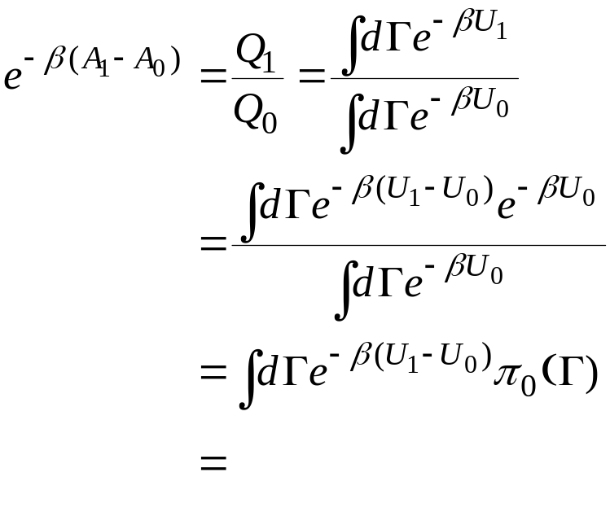
Free-Energy Perturbation
Widom method is an example of a free-energy perturbation (FEP) technique
FEP gives free-energy difference between two systems
  labeled 0, 1
Working equation
1
Identify reference-system probability distribution
0
Γ

Slide 10
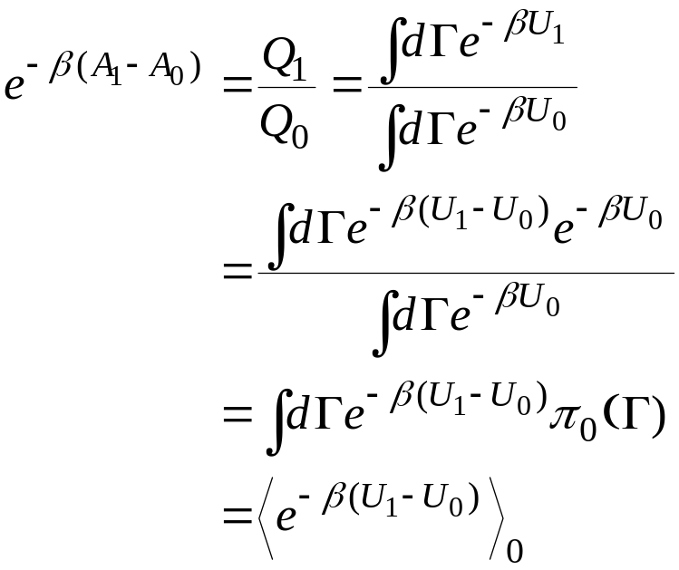
Free-Energy Perturbation
Widom method is an example of a free-energy perturbation (FEP) technique
FEP gives free-energy difference between two systems
  labeled 0, 1
Working equation
Sample the region important to 0 system, measure properties of 1 system
1
Write as reference-system ensemble average
0
Γ

Slide 11
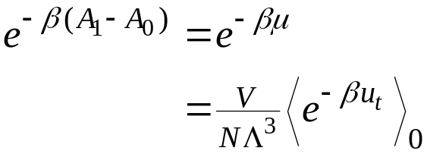
Chemical potential
For chemical potential, U₁ - U₀ is the energy of turning on the ghost particle
  call this u_{t}, the “test-particle” energy
  test-particle position may be selected at random in simulation volume
  for hard spheres, e^{-βu}t is 0 for overlap, 1 otherwise
    then (as before) average is the fraction of configurations with no overlap
This is known as Widom’s insertion method

Slide 12
Widom’s Method. Java Code
public class MeterWidomInsertion extends Meter
/**
* Performs insertion average used in chemical-potential calculation
*/
public double currentValue() {
double sum = 0.0; //zero sum for insertion average
phase.addMolecule(molecule,speciesAgent); //place molecule in phase
for(int i=nInsert; i>0; i--) { //perform nInsert insertions
molecule.translateTo(phase.randomPosition()); //select random position
double u = phase.potentialEnergy.currentValue(molecule); //compute energy
if(u < Double.MAX_VALUE) //add to test-particle average
sum += Math.exp(-u/(phase.integrator().temperature()));
}
phase.deleteMolecule(molecule); //remove molecule from phase
if(!residual) sum *= speciesAgent.moleculeCount/phase.volume(); //multiply by Ni/V
return sum/(double)nInsert; //return average
}
//Method to identify species for chemical-potential calculation by this meter
//Normally called only once in a simulation
public void setSpecies(Species s) {
species = s;
molecule = species.getMolecule();
if(phase != null) speciesAgent = species.getAgent(phase);
}

Slide 13
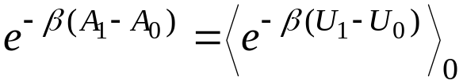
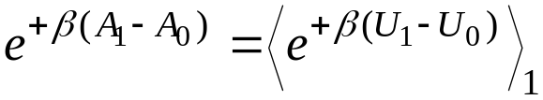
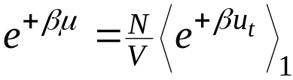
Deletion Method
The FEP formula may be used also with the roles of the reference and target system reversed
  sample the 1 system, evaluate properties of 0 system
Consider application to hard spheres
  e^{βu}t is infinity for overlap, 0 otherwise
  but overlaps are never sampled
  true average is product of 0 × ∞
    technically, formula is correct
  in practice simulation average is always zero
    method is flawed in application
    many times the flaw with deletion is not as obvious as this
Original: 0 → 1
Modified: 1 → 0
1
0
Γ

Slide 14
Other Types of Perturbation
Many types of free-energy differences can be computed
Thermodynamic state
  temperature, density, mixture composition
Hamiltonian
  for a single molecule or for entire system
  e.g., evaluate free energy difference for hard spheres with and without electrostatic dipole moment
Configuration
  distance/orientation between two solutes
  e.g, protein and ligand
Order parameter identifying phases
  order parameter is a quantity that can be used to identify the thermodynamic phase a system is in
  e.g, crystal structure, orientational order, magnetization

Slide 15
General Numerical Problems
Sampling problems limit range of FEP calculations
Target system configurations must be encountered when sampling reference system
Two types of problem arise
  first situation is more common
    although deletion FEP provides an avoidable example of the latter
target-system space very small
target system outside of reference
1
1
0
0
Γ
Γ

Slide 16

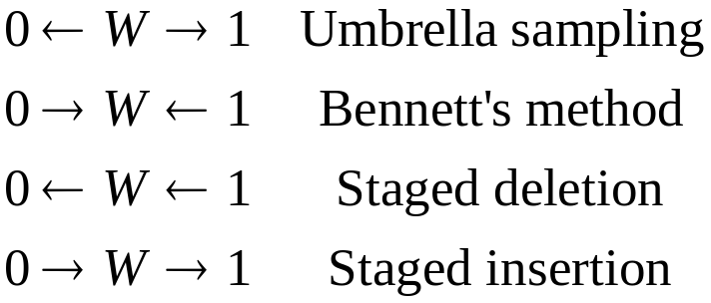
Staging Methods
Multistage FEP can be used to remedy the sampling problem
  define a potential U_{w} intermediate between 0 and 1 systems
  evaluate total free-energy difference as
Each stage may be sampled in
either direction
  yielding four staging schemes
  choose to avoid deletion calculation
Use staged insertion
Use umbrella sampling
Use Bennett’s method
1
1
W
1
W
W
0
0
0
Γ
Γ
Γ

Slide 17
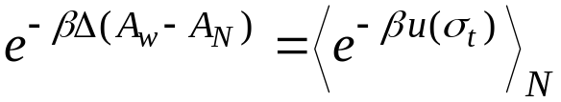
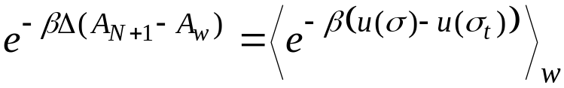
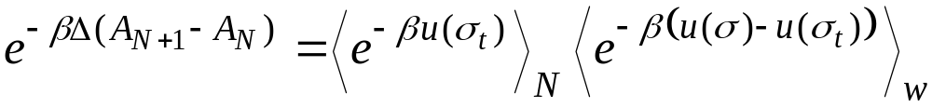
Example of Staging Method
Hard-sphere chemical potential
Use small-diameter sphere as intermediate
In first stage, measure fraction of time random insertion of small sphere finds no overlap
In second stage, small sphere moves around with others. Measure fraction of time no overlap is found when it is grown to full-size sphere
Γ

Slide 18



Multiple Stages
W₃
W₃
W₃
1
W₁
1
1
W₂
W₂
W₂
W₁
W₁
0
0
0
Γ
Γ
Γ
Multistage insertion
Multistage umbrella sampling
Multistage Bennett’s method

Slide 19
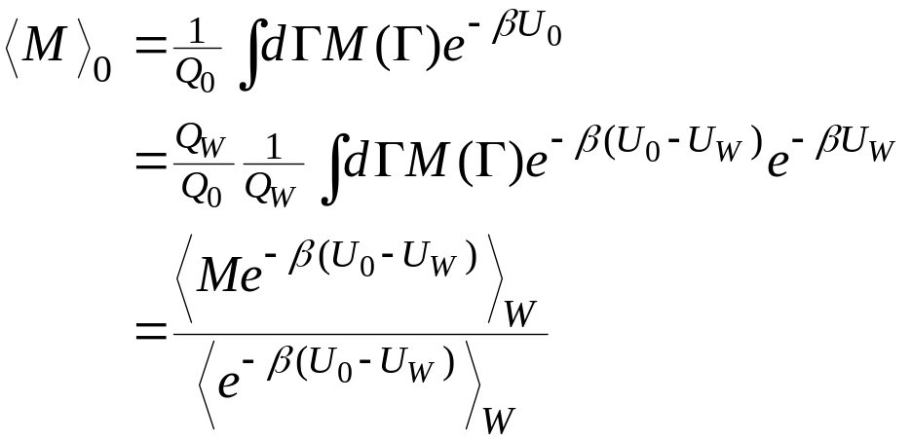
Non-Boltzmann Sampling
The FEP methods are an instance of a more general technique that aims to improve sampling
Unlike biasing methods, improvement entails a change in the limiting distribution
Apply a formula to recover the correct
average
0
W
0
Γ

Slide 20

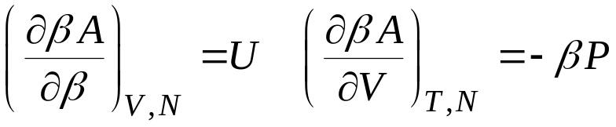
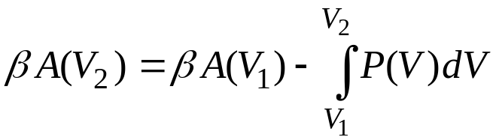
Thermodynamic Integration 1.
Thermodynamics gives formulas for variation of free energy with state
These can be integrated to obtain a free-energy difference
  derivatives can be measured as normal ensemble averages
  this is usually how free energies are “measured” experimentally

Slide 21
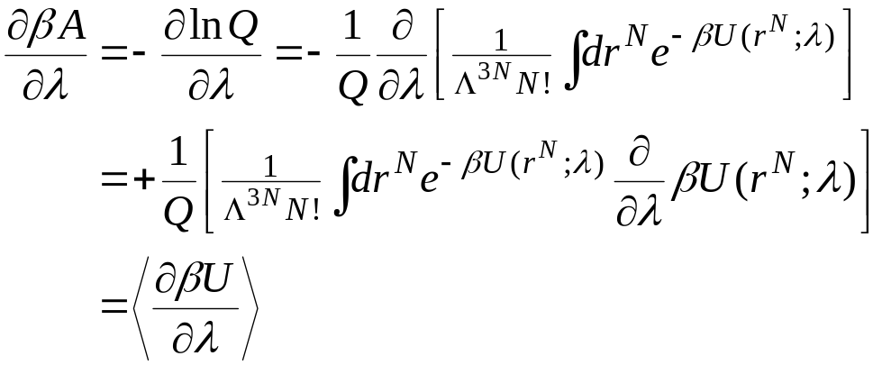
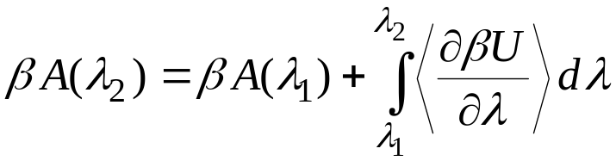
Thermodynamic Integration 2.
TI can be extended to follow uncommon (or unphysical) integration paths
  much like FEP, can be applied for any type of free-energy change
Formalism
  Let λ be a parameter describing the path
  the potential energy is a function of λ
  ensemble formula for the derivative
  then

Slide 22
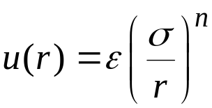
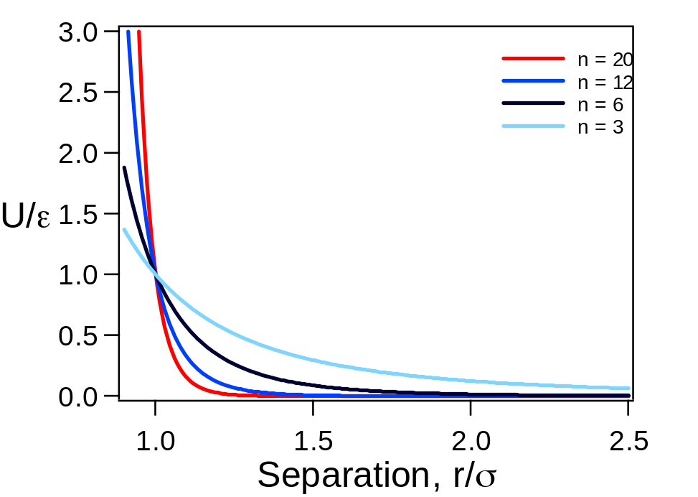
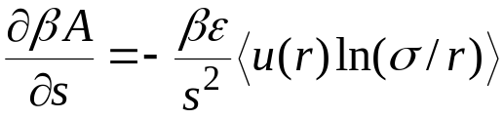
Thermodynamic Integration Example
The soft-sphere pair potential is given by
Softness and range varies with n
  large n limit leads to hard spheres
  small n leads to Coulombic behavior
Thermodynamic integration can be used to measure free energy as a function of softness s = 1/n
  Integrand is
Exhibits simplifying behavior because εσ^{n} is the only potential parameter

Slide 23



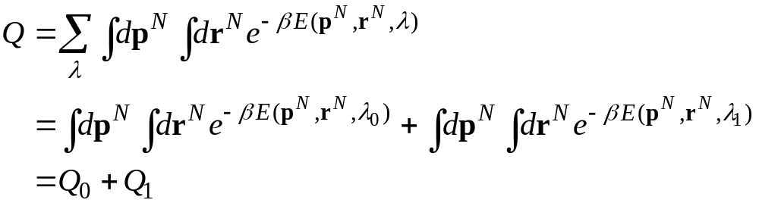
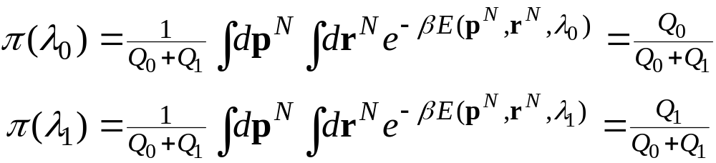
Parameter Hopping. Theory
View free-energy parameter λ as another dimension in phase space
Partition function
Monte Carlo trials include changes in λ
Probability that system has λ = λ₀ or λ = λ₁
Γ

Slide 24
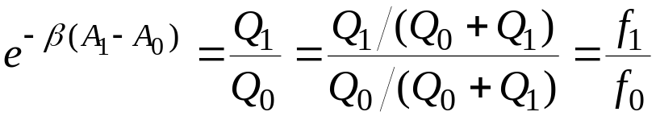
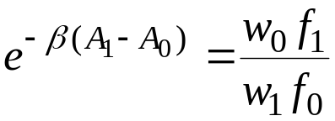
Parameter Hopping. Implementation
Monte Carlo simulation in which λ-change trials are attempted
Accept trials as usual, with probability min[1,e^{-βΔU}]
Record fractions f₀, f₁ of configurations spent in λ = λ₀ and λ = λ₁
Free energy is given by ratio
In practice, system may spend almost no time in one of the values
  Can apply weighting function w(λ) to encourage it to sample both
  Accept trials with probability min[1,(w^{n}/wº) e^{-βΔU}]
  Free energy is
  Good choice for w has f₁ = f₀
Multivalue extension is particularly effective
  λ takes on a continuum of values

Slide 25
Summary
Free energy calculations are needed to model the most interesting physical behaviors
  All useful methods are based on computing free-energy difference
Four general approaches
  Free-energy perturbation
  Thermodynamic integration
  Parameter hopping
  Distribution-function methods
FEP is asymmetric
  Deletion method is awful
Four approaches to basic multistaging
  Umbrella sampling, Bennett’s method, staged insertion/deletion
Non-Boltzmann methods improve sampling

