Slide 1
CE 530 Molecular Simulation
Lecture 19
Free-energy calculations:
Distribution functions, precision and accuracy
David A. Kofke
Department of Chemical Engineering
SUNY Buffalo
kofke@eng.buffalo.edu

Slide 2
Review
All useful free-energy methods compute free-energy differences
Several approaches have been developed
FEP gives free-energy difference via an ensemble average
  Asymmetric
    Deletion method is awful
Four approaches to basic multistaging
  Umbrella sampling, Bennett’s method, staged insertion/deletion
Thermodynamic integration uses dA/dλ = <dU/dλ>
  Symmetric
Parameter hopping treats perturbation variable as an extension of phase space
  time spent at different values relates to their free-energy difference

Slide 3
Free-Energy Perturbation
Each stage of a FEP method should be used only for “encompassing systems”
  important configurations of one system form a subset of the configurations that are important to the other
  staging may be needed to bring this about
The superset will have a higher entropy
  use “H” and “L” to distinguish high-
  and low-entropy systems
Remember hard-sphere with test particle
  Every configuration of non-overlap is
  important to the N+1 particle (L) system
  But every one of these configurations is
  of uniform importance in the N-particle
  (H) system
L
H
Γ

Slide 4
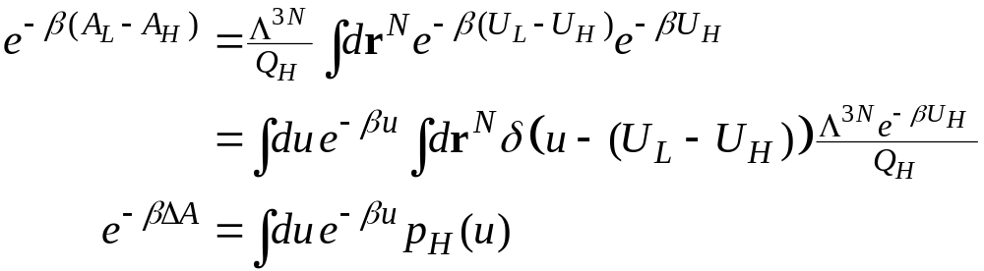

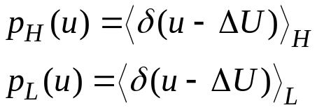
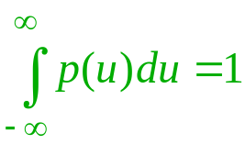
Distribution Functions
The FEP average can be cast as a simple one-dimensional integral
Likewise
Energy distributions
reference is the high-entropy system
reference is the low-entropy system
Nomenclature
Free-energy difference: ΔA ≡ A_{L}-A_{H}
Entropy difference: ΔS ≡ S_{L}-S_{H} < 0
Energy difference: u ≡ U_{L}(r^{(N)})-U_{H}(r^{(N)})
normalized

Slide 5
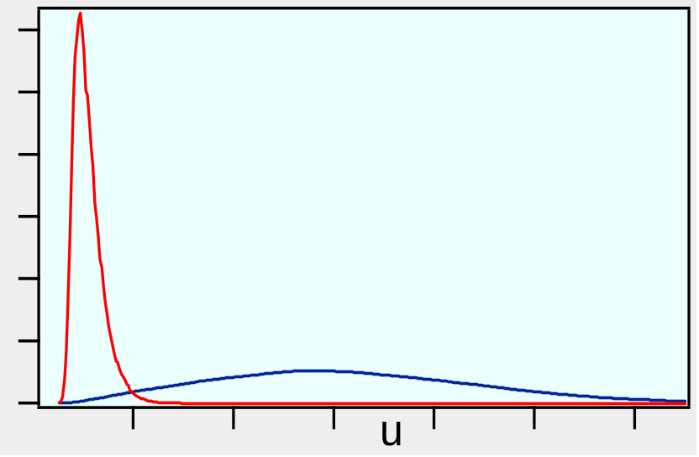
Interpretation
Consider in the context of particle insertion (ghost → real)
High-S system is ghost, Low-S is real
u is the difference in energy U_{real} - U_{ghost}
p_{H} is the distribution of energies (virtual energy changes) experienced by molecule acting as a ghost (insertion energy)
  many overlaps, so energy will tend to be large
p_{L} is the distribution of energies experienced by a molecule interacting with the others
(deletion energy)
  no overlap, favorable interactions,
  so energy will be small
Typical behaviors
p_{L}
p_{H}

Slide 6
Generalized Insertion and Deletion
Widom insertion samples high-S system, perturbs to low-S system
Widom deletion does the opposite
Define
  Generalized insertion: FEP calculation in which high-entropy system governs sampling
  Generalized deletion: FEP calculation in which low-entropy system governs sampling
L
H
Γ
L
H
Γ

Slide 7
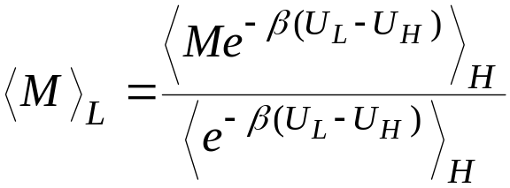
Distribution-Function Relations
Previously we derived this result
Non-Boltzmann averaging formula
(used 0 and W to designate systems)

Slide 8
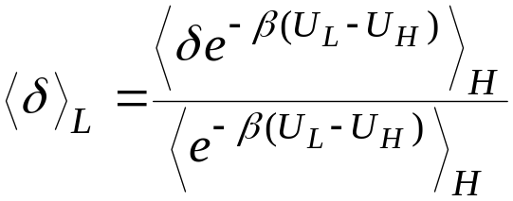
Distribution-Function Relations
Previously we derived this result
Take M ≡ δ[u-(U_{L}-U_{H})]

Slide 9
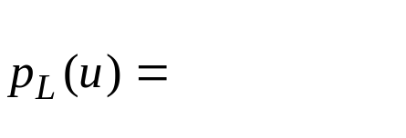
Distribution-Function Relations
Previously we derived this result
Take M ≡ δ[u-(U_{L}-U_{H})]
Use definitions of p_{H} and p_{L}
This is
definition of p_{L}

Slide 10
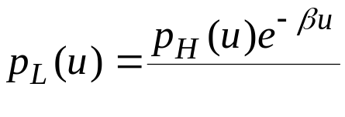
Distribution-Function Relations
Previously we derived this result
Take M ≡ δ[u-(U_{L}-U_{H})]
Use definitions of p_{H} and p_{L}
This is u; the delta function lets us take it outside the average

Slide 11
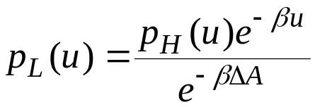
Distribution-Function Relations
Previously we derived this result
Take M ≡ δ[u-(U_{L}-U_{H})]
Use definitions of p_{H} and p_{L}
This is the free-energy difference

Slide 12

Distribution-Function Relations
Previously we derived this result
Take M ≡ δ[u-(U_{L}-U_{H})]
Use definitions of p_{H} and p_{L}
rearrange

Slide 13
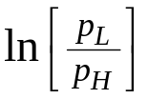
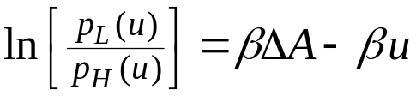



Using the p_{H},p_{L} Relation
Relation:
This can be used to obtain the free-energy difference
  Several equivalent formulations
More sophisticated methods are available
  Examine them later; present interest is using distributions to understand FEP performance
Plot ln[p_{L}/p_{H}] vs u; slope -β, intercept βΔA
Requires that distributions have region of overlap
Plot lnp_{L}+βu/2 and lnp_{H} - βu/2 vs. u on same plot; constant difference between is βΔA
Can be applied to nonoverlapping distributions if interpolating form is known

Slide 14
Accuracy and Precision
Consider performance of FEP calculations from two perspectives
Precision
  reproducibility of the result
Accuracy
  correctness of the result
Example
  hard-sphere deletion
  calculation
    good precision
    terrible accuracy
Precise, but not accurate
Accurate, but less precise

Slide 15

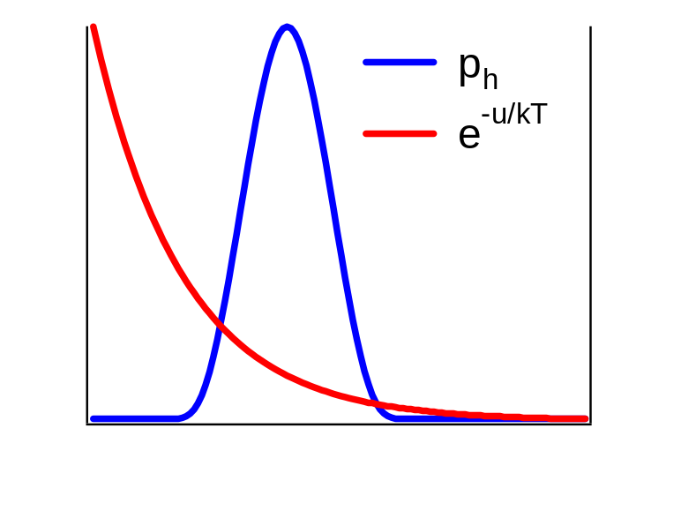
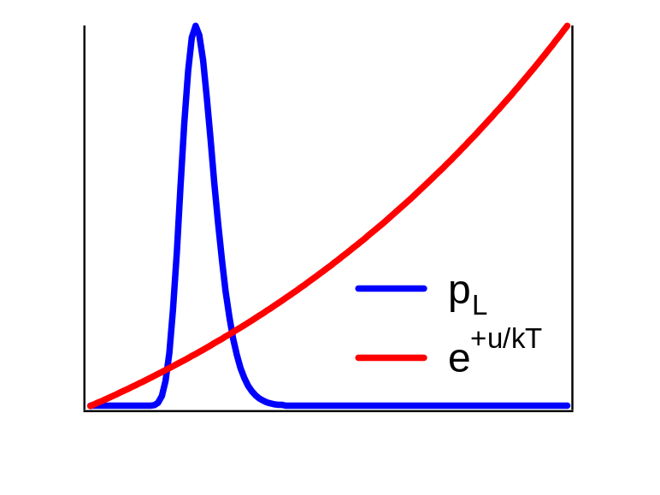
Tail Contributions in FEP Calculations
Examine contributions to FEP averages
Generalized insertion
Generalized deletion
Large contribution from tail at small u
Large contribution from tail at large u

Slide 16
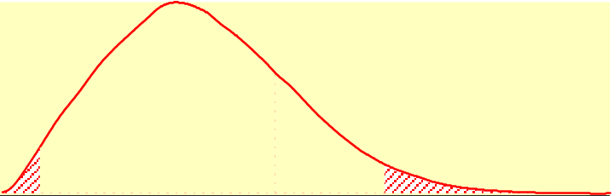
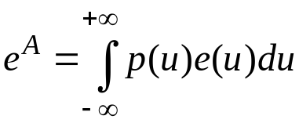
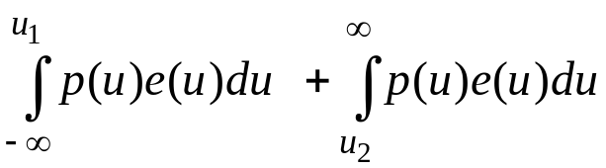
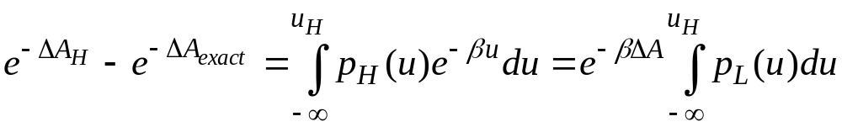
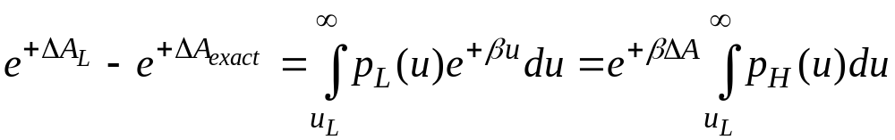
Inaccuracy in FEP Calculations 1.
Main source of inaccuracy is inadequate sampling of tails
Model inaccuracy by assuming all error is due to missing tail contribution
p(u)
u₁
u₂
Largest contribution to insertion inaccuracy
Largest contribution to deletion inaccuracy
Inaccuracy in each method is given by area under curve for other method

Slide 17
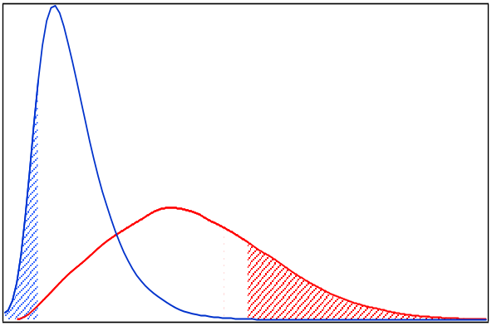
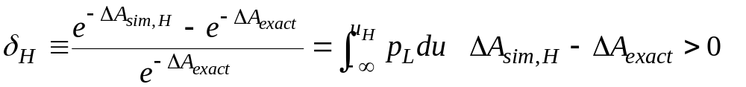
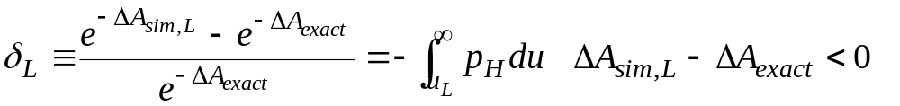
Inaccuracy in FEP Calculations 2.
Missing tail contributions
Relative inaccuracy
Inaccuracy in each method is given by area under curve for other method
p_{L}
inaccuracy
p_{H}
u_{H}
u_{L}
Insertion overestimates
Deletion underestimates

Slide 18
Asymmetry of the Inaccuracy 1.
The opposite tendency of the insertion/deletion inaccuracy leads to statements like these
  “The forward and reverse [inaccuracy] should be of the same magnitude and opposite sign” J. Phys. Chem., 98, 1487-1493,1999
  “The free energy change was taken as the average of the forward and reverse free energies.” J Comp. Chem., 20, 499-510, 1999
Remember the asymmetry of the hard-sphere insertion/deletion methods
  for insertion, e^{-βμ} is zero until a non-overlap is completed
  for deletion e^{+βμ} is always unity
  averaging the insertion and deletion μ’s would be bad

Slide 19
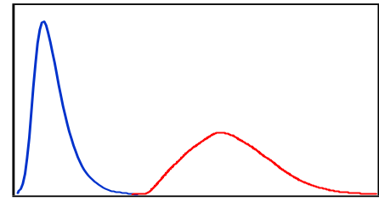
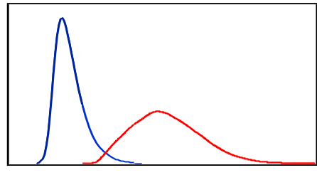
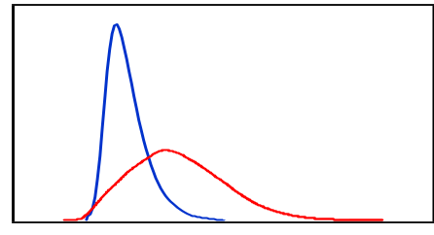
Asymmetry of the Inaccuracy 2.
p_{H} and p_{L} have different variances
Reference with
broader distribution
gives more
accurate result
Large entropy
reference has larger
variance hence
gives more
accurate result
Insertion is more reliable than deletion
Improvement of accuracies as length of simulation grows
p_{H} inaccuracy
p_{L} inaccuracy

Slide 20
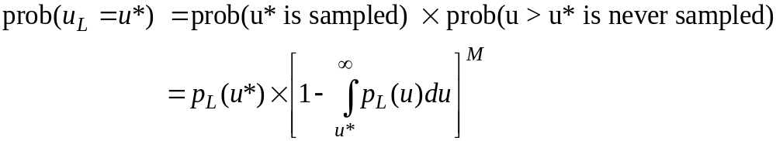
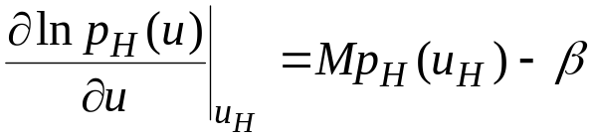
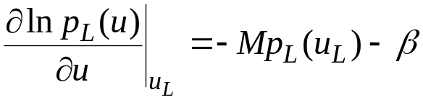
Predicting Inaccuracy
Maximum likelihood analysis
  consider most likely outcome for
  simulation with length M
Need most likely values for u_{H}, u_{L}
Consider probability that largest
deletion energy is some value, u*,
after M attempted deletions
Maximize with respect to u*
p_{L}
inaccuracy
p_{H}
u_{H}
u_{L}
Similar formula derived for insertion

Slide 21
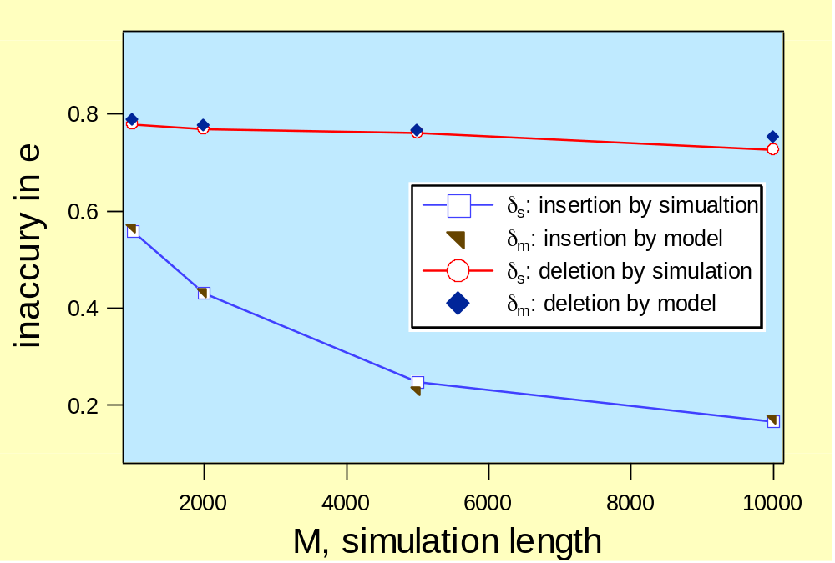
Testing Inaccuracy Model
MC Simulation
  NVT
  (N-1) LJ + 1 HS ←→ N LJ
  HS diameter = 0.8
  T = 2.0; ρ = 0.9
  simulation repeats
  up to 200 runs

Slide 22
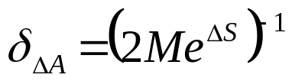
Knowing Your Inaccuracy
How can the accuracy of a simulation result be assessed if the simulation is inaccurate?
Compare to precision calculation where simulation data (variance) are used to provide confidence limits
Consider most-likely inaccuracy for HS insertion
Postulate δ_{ΔA} ~ (Me^{ΔS})⁻¹ for continuous distributions
  evaluate ΔA accuracy using simulation ΔS
But simulation gives ‘incorrect’ ΔS
  generally, simulation ΔS < true ΔS (e^{-ΔS(sim)} > e^{-ΔS(true)})
  thus ‘incorrect’ ΔS indicates larger error
  safe estimate of inaccuracy
  gives (probabilistic) upper bound of ΔA inaccuracy
Insertion only (ΔS < 0)

Slide 23
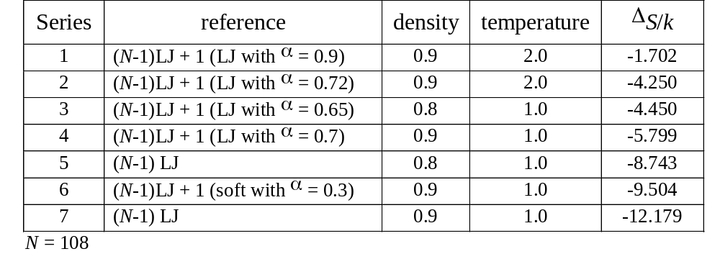
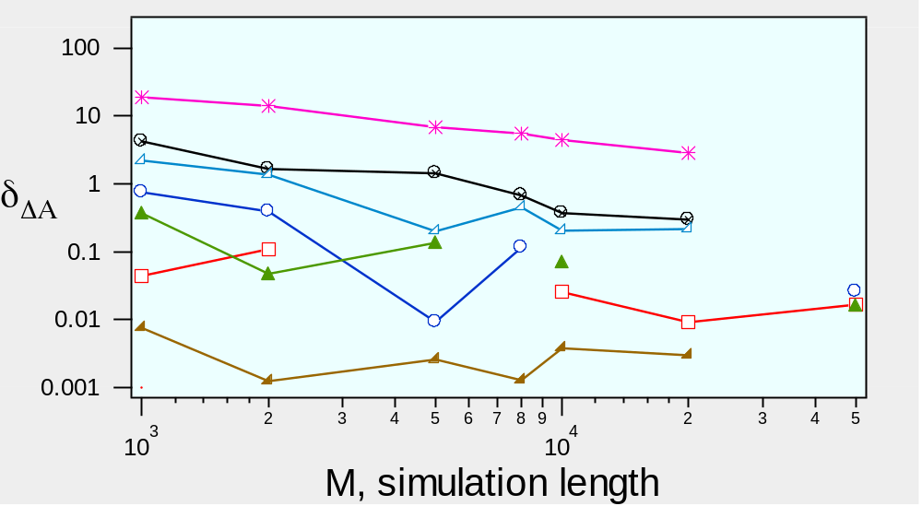
Test of Postulated Form 1.
  MC simulations with various conditions
  repeat simulations for up to 100 independent runs
  very long simulation generates pseudo true ΔA
  calculate entropy change, error-bar, inaccuracy etc.

Slide 24
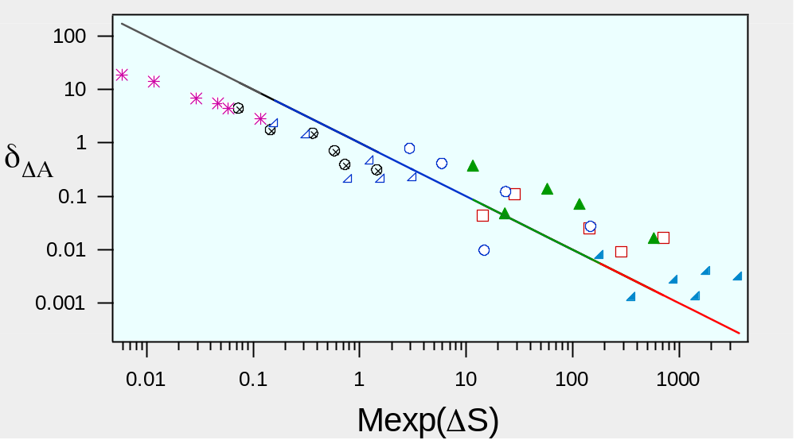
Test of Postulated Form 2.
  MC simulations with various conditions
  repeat simulations for up to 100 independent runs
  very long simulation generates pseudo true ΔA
  calculate entropy change, error-bar, inaccuracy etc.
Appropriate group, perhaps incorrect exponent

Slide 25
Precision of FEP Calculations 1.
Consider L simulations, each doing M insertions
  1,2,3,4,5,...,M
  1,2,3,4,5,...,M
  . L times
  .
  .
  1,2,3,4,5,...,M
Each M-length run gives a value for ΔA
Variance of these averages for the L runs describes the precision of the calculation

Slide 26
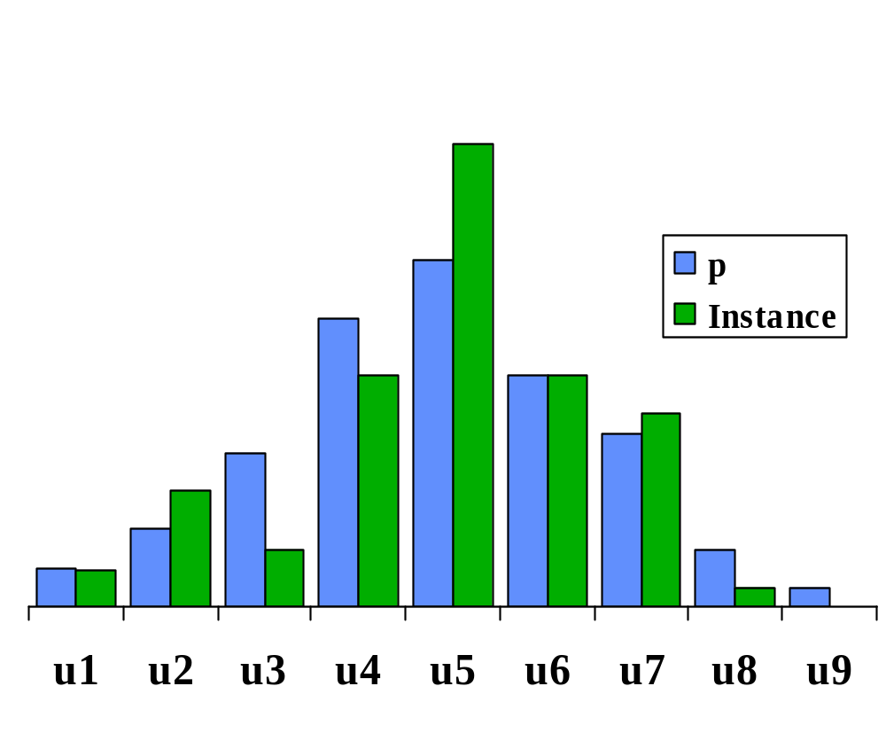
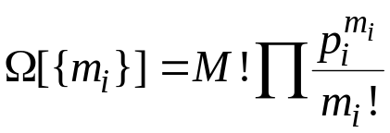

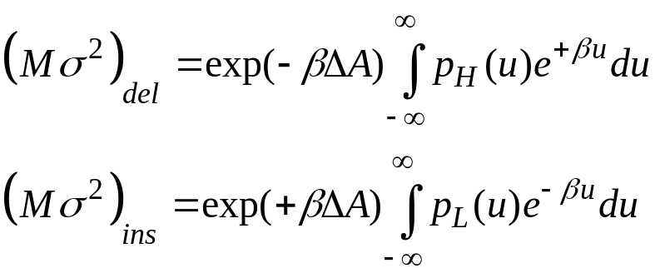
Precision of FEP Calculations 2.
Discretize p_{H}
Consider probability of observing any
given distribution of FEP energy
values in a simulation of length M
Follows binomial distribution
Variance in FEP average given in terms of variance of this distribution
Return to
continuum
formulation,
rewrite
Note that exponents have signs opposite those for averages

Slide 27
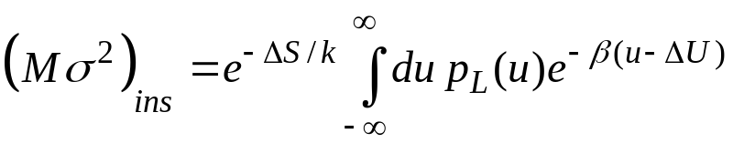
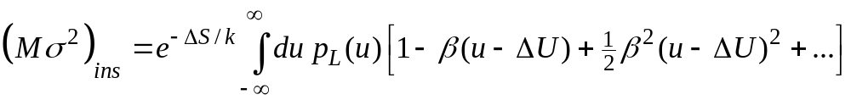

Precision of FEP Calculations 3.
Decompose into entropic and energetic contributions
  focus on insertion form
  expand
  finally
  entropy difference is key
Variance of energy in L system (independent of M);
O(1) quantity

Slide 28




Optimal Staging
Apply precision model to optimize choice of intermediate in staged insertion
  how best to define U_{W}?
Overall variance is the sum of variances of all stages
Choose W:
  minimize
  subject to
  obtain
  ζ _{j}/ζ_{i}: order of unity
Heuristic: Δ(ΔS) = 0
  equal entropy difference
  compare to unjustified rule-of-thumb
  equal free-energy difference
  Δ(ΔA/k) = 0
  new rule greatly improves the precision
1
W
0
Γ

Slide 29
Example Application
System H
N-1 LJ particles
System W
N-1 Lennard-Jones particles
1 Hard sphere of diameter α
System L
N LJ particles
Optimize with respect to intermediate-HS diameter α

Slide 30
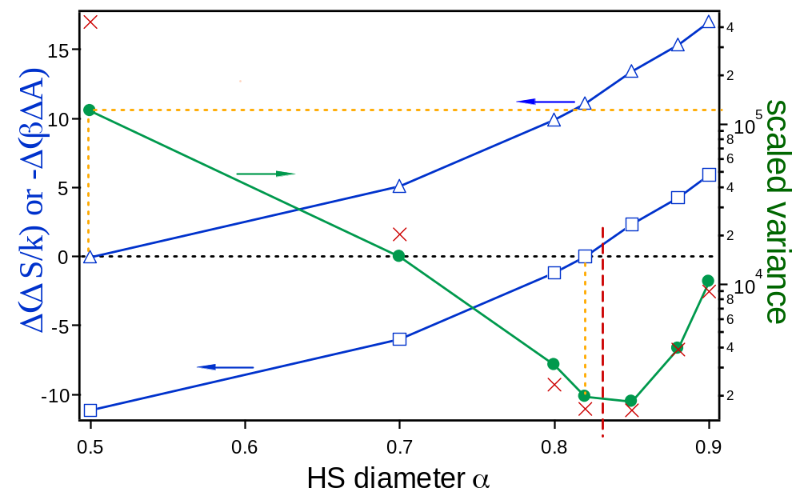
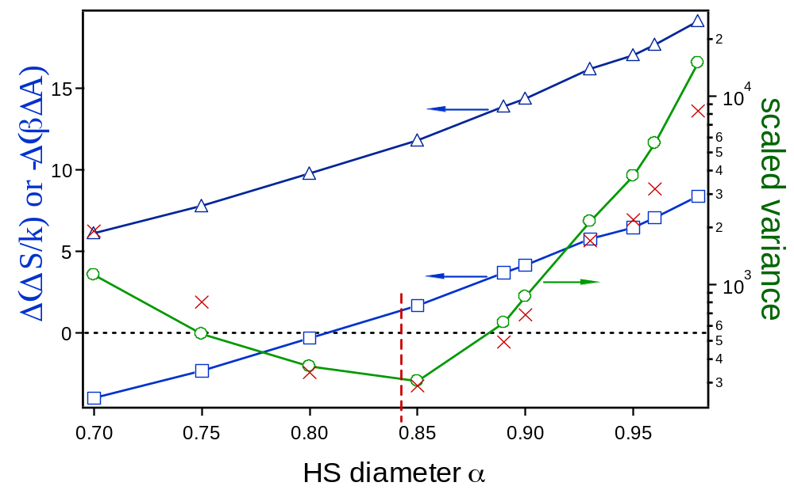
Example Results
N=108
T=1.0
ρ=0.9
−Δ(ΔβΑ)
Overall variance
zero line
−Δ(ΔS/k)
N=200
T=1.0
ρ=0.8
−Δ(ΔβΑ)
−Δ(ΔS/k)

Slide 31
Summary
FEP energy distributions provide detailed information regarding free-energy differences
Relation between insertion and deletion distribution can be used to measure free-energy differences
Distributions can be used to understand precision and accuracy of FEP calculations
Insertion usually gives too-high value, deletion too low
  but not equally so; deletion is much worse
Formulated way to estimate inaccuracy using inaccurate data
Both accuracy and precision strongly depend on entropy difference between states
Can use precision analysis to optimize staged insertions

