Slide 1
CE 530 Molecular Simulation
Lecture 2
Physical quantities; Hard-sphere MD
David A. Kofke
Department of Chemical Engineering
SUNY Buffalo
kofke@eng.buffalo.edu

Slide 2
Physical Quantities in Molecular Simulation
State variables
  each variable has an associated “conjugate” variable
    temperature, energy (kT,E)
    pressure, volume (P,V)
    chemical potential, number of molecules (∝,N)
  specification of state requires fixing one of each pair
  the dependent variable can be measured by the simulation
Configuration variables
  position, orientation, momentum of each atom or molecule
  energy, forces and torques
  time
Properties
  transport coefficients, free energies, structural quantities, etc.
Molecular model parameters
  characteristic energy, size, charge

Slide 3
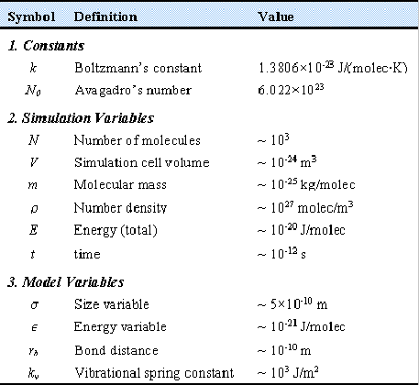
Dimensions and Units 1.
Magnitudes
Typical simulation size very small
  100 - 1000 atoms
Important extensive quantities small in magnitude
  when expressed
  in macroscopic units
Small numbers are inconvenient
Two ways to magnify them
  work with atomic-scale units
    ps, amu, nm or Å
  make dimensionless with characteristic values
    model values of size, energy, mass

Slide 4
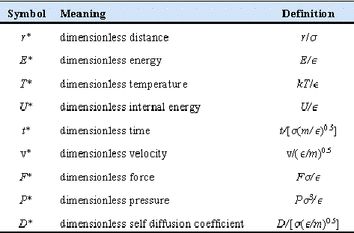
Dimensions and Units 2.
Scaling
Scaling by model parameters
  Size σ
  Energy ε
  Mass m
Choose values for one atom/molecule pair potential arbitrarily
Other model parameters given in terms of reference values
  e.g., ε₂/ε₁ = 1.2
Physical magnitudes less transparent
Sometimes convenient to scale coordinates differently

Slide 5
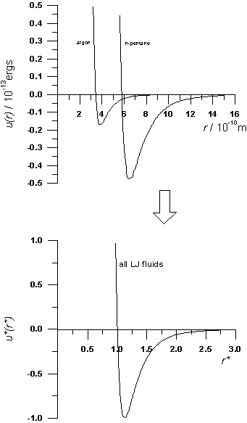
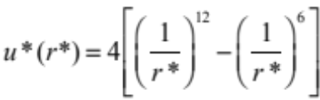
Dimensions and Units 3.
Corresponding States
Lennard-Jones potential in dimensionless form
Parameter independent!
Dimensionless properties must also be parameter independent
  convenient to report properties in this form, e.g. P*(ρ*,T*)
  select model values to get actual values of properties
  Basis of corresponding states
Equivalent to selecting unit value for parameters

Slide 6
Dimensions and Units 4.
Corresponding States Example
Want pressure for methane at 0.0183 mol/cm³ and 167 K
LJ model parameters are σ = 0.3790 nm, ε/k = 142.1 K
Dimensionless state parameters
  ρ* = ρσ³ = (0.0183 mol/cm³)(3.790 × 10⁻⁸ cm)³(6.022 × 10²³ molecules/mole) = 0.6
  T* = T/(ε/k) = (167 K)/(142.1 K) = 1.174
From LJ equation of state
  P* = Pσ³/ε= 0.146
Corresponding to a pressure
  P = 0.146 (142.1 K)(13.8 MPa-Å³/molecule )/(3.790Å)³ = 5.3 MPa
  53 bars

Slide 7
Dimensions and Units 5.
Hard Potentials
u(r)
Special case
  u(r) = 0, r > d
  u(r) = ∞, r < d
No characteristic energy!
Temperature (kT) provide the only characteristic energy
All dimensionless properties (e.g., Pd³/kT), independent of temperature!
d
r

Slide 8
Hard Sphere Molecular Dynamics
Prototype of a molecular simulation
  basis for discussion
Introduce features common to all simulations
  dimensions and units
  atom looping
  boundary conditions
  averaging and error estimation
  initialization
For later consideration:
  integrators for soft potentials
  Monte Carlo methods

Slide 9
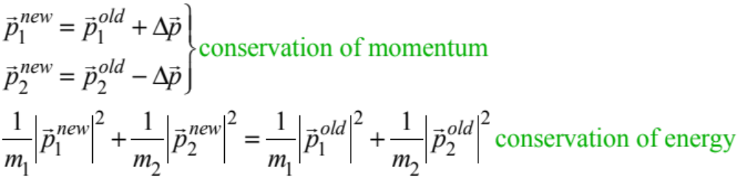
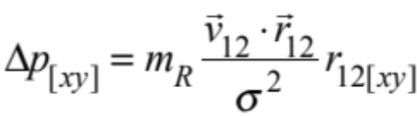
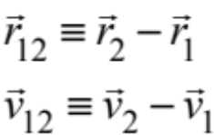
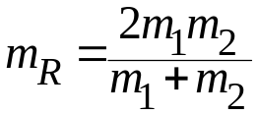
Hard Sphere Dynamics
F₁
Impulsive, pairwise collisions
  infinite force exerted over an infinitesimal time
    impulse = force × time = finite change in momentum Δ p
  force directed along line joining centers of atoms
  magnitude of impulse governed by conservation of energy
  thus
    consider glancing collision
    consider head-on collision
F₂
reduced mass

Slide 10




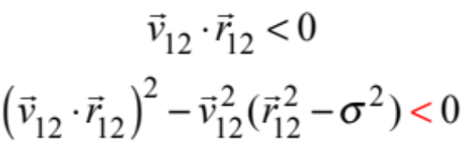

Hard Sphere Kinematics
Free flight between collisions
Collision time for any pair solved analytically
  Find Δt such that
  leads to quadratic equation
  three cases
separating
approaching, but miss
approaching, and hit

Slide 11
Integration Strategy
Choose a time interval, Δt; do the following to advance the system across this interval, bringing the system to time t_{n+1}= t_{n} +Δt
  Loop over all pairs ij, computing collision time t_{ij}
  Identify minimum t_{ij}^{min} as next colliding pair
  If t_{ij}^{min} < t_{n+1}, advance all spheres to positions at t_{ij}^{min}
  Perform collision dynamics on colliding pair
  Identify next colliding pair, repeat until t_{ij}^{min} < t_{n+1}, then advance to t_{n+1}.
  Accumulate averages, repeat for next time interval
Click here for applet highlighting collision pairs
Δt
t₁
t₂
t₃
t₄
t₅
t₆
time
= collision

Slide 12
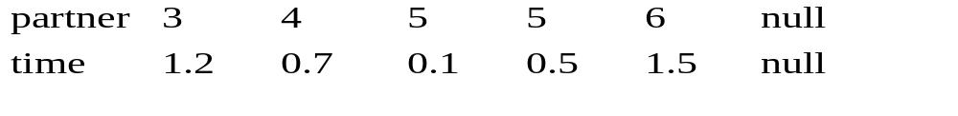
Ordering the Atoms
Atoms are placed in an arbitrary order
Each atom links to the next one up and next one down the list
Atom looks only up list to find collision partner
  collisions with down-list atoms monitored by down-list atoms
Example
  atoms 3 and 5 next to collide
1
2
3
4
5
6
Down list
Up list
1
2
3
4
5
6

Slide 13
Collision Update Requirements
No need to re-identify all collisions with each step
Upon collision, must update (check all atoms up-list of)
  collider
  partner
  (downlist) atoms expecting to collide with collider or partner
Also check if downlist atoms of collider or partner will now collide with either of them next
3 collides with 5...
…interrupting anticipated collision of 1 with 3
4
4
…causing 3 to intervene in anticipated collision between 2 and 4
2
3
3
2
1
3
5
2
1

