Slide 1
CE 530 Molecular Simulation
Lecture 20
Phase Equilibria
David A. Kofke
Department of Chemical Engineering
SUNY Buffalo
kofke@eng.buffalo.edu

Slide 2
Thermodynamic Phase Equilibria
Certain thermodynamic states find that two (or more) phases may be equally stable
  thermodynamic phase coexistence
Phases are distinguished by an order parameter; e.g.
  density
  structural order parameter
  magnetic or electrostatic moment
Intensive-variable requirements of phase coexistence
  T^{α} = T^{β}
  P^{α} = P^{β}
  ∝_{i}^{α} = ∝_{i}^{β}, i = 1,…,C

Slide 3
Phase Diagrams
Phase behavior is described via phase diagrams
Gibbs phase rule
  F = 2 + C – P
    F = number of degrees of freedom
      independently specified thermodynamic state variables
    C = number of components (chemical species) in the system
    P = number of phases
  Single component, F = 3 – P
two-phase regions
two-phase lines
isobar
Field variable
e.g., temperature
critical point
critical point
Field variable
(pressure)
L
tie line
V
L+V
L
V
L+S
S
S
triple point
S+V
Density variable
Field variable
(temperature)

Slide 4
Approximate Methods for Phase Equilibria by Molecular Simulation 1.
Adjust field variables until crossing of phase transition is observed
  e.g., lower temperature until condensation/freezing occurs
Problem: metastability may obsure location of true transition
Try it out with the LJ NPT-MC applet
isobar
Temperature
Pressure
L
V
Hysteresis
L
V
L+V
L+S
S
S
Metastable region
S+V
Density
Temperature

Slide 5
Approximate Methods for Phase Equilibria by Molecular Simulation 2.
Select density variable inside of two-phase region
  choose density between liquid and vapor values
Problem: finite system size leads to large surface-to-volume ratios for each phase
  bulk behavior not modeled
Metastability may still be a problem
Try it out with the SW NVT MD applet
Temperature
V
L
L+V
L+S
S
S+V
Density

Slide 6
Rigorous Methods for Phase Equilibria by Molecular Simulation
Search for conditions that satisfy equilibrium criteria
  equality of temperature, pressure, chemical potentials
Difficulties
  evaluation of chemical potential often is not easy
  tedious search-and-evaluation process
T constant
Simulation data
Chemical potential
Simulation data or
equation of state
Pressure

Slide 7
Rigorous Methods for Phase Equilibria by Molecular Simulation
Search for conditions that satisfy equilibrium criteria
  equality of temperature, pressure, chemical potentials
Difficulties
  evaluation of chemical potential often is not easy
  tedious search-and-evaluation process
T constant
Chemical potential
Simulation data or
equation of state
Pressure

Slide 8
Rigorous Methods for Phase Equilibria by Molecular Simulation
Search for conditions that satisfy equilibrium criteria
  equality of temperature, pressure, chemical potentials
Difficulties
  evaluation of chemical potential often is not easy
  tedious search-and-evaluation process
T constant
Chemical potential
Simulation data or
equation of state
Pressure

Slide 9
Rigorous Methods for Phase Equilibria by Molecular Simulation
Search for conditions that satisfy equilibrium criteria
  equality of temperature, pressure, chemical potentials
Difficulties
  evaluation of chemical potential often is not easy
  tedious search-and-evaluation process
T constant
Chemical potential
Simulation data or
equation of state
Pressure

Slide 10
Rigorous Methods for Phase Equilibria by Molecular Simulation
Search for conditions that satisfy equilibrium criteria
  equality of temperature, pressure, chemical potentials
Difficulties
  evaluation of chemical potential often is not easy
  tedious search-and-evaluation process
Coexistence
T constant
Chemical potential
×
Simulation data or
equation of state
Pressure

Slide 11
Rigorous Methods for Phase Equilibria by Molecular Simulation
Search for conditions that satisfy equilibrium criteria
  equality of temperature, pressure, chemical potentials
Difficulties
  evaluation of chemical potential often is not easy
  tedious search-and-evaluation process
Many simulations to get one point on phase diagram
Coexistence
T constant
Pressure
+
Chemical potential
×
L
S
V
Simulation data or
equation of state
Pressure
Temperature

Slide 12
Gibbs Ensemble 1.
Panagiotopoulos in 1987 introduced a clever way to simulate coexisting phases without an interface
Thermodynamic contact without physical contact
  How?
Two simulation volumes

Slide 13
Gibbs Ensemble 2.
MC simulation includes moves that couple the two simulation volumes
Try it out with the LJ GEMC applet
Particle exchange equilibrates chemical potential
Volume exchange equilibrates pressure
Incidentally, the coupled moves enforce mass and volume balance

Slide 14
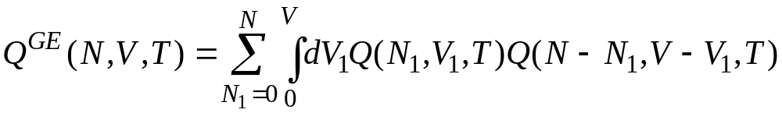
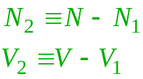
Gibbs Ensemble Formalism
Partition function
Limiting distribution
General algorithm. For each trial:
  with some pre-specified probability, select
    molecules displacement/rotation trial
    volume exchange trial
    molecule exchange trial
  conduct trial move and decide acceptance

Slide 15
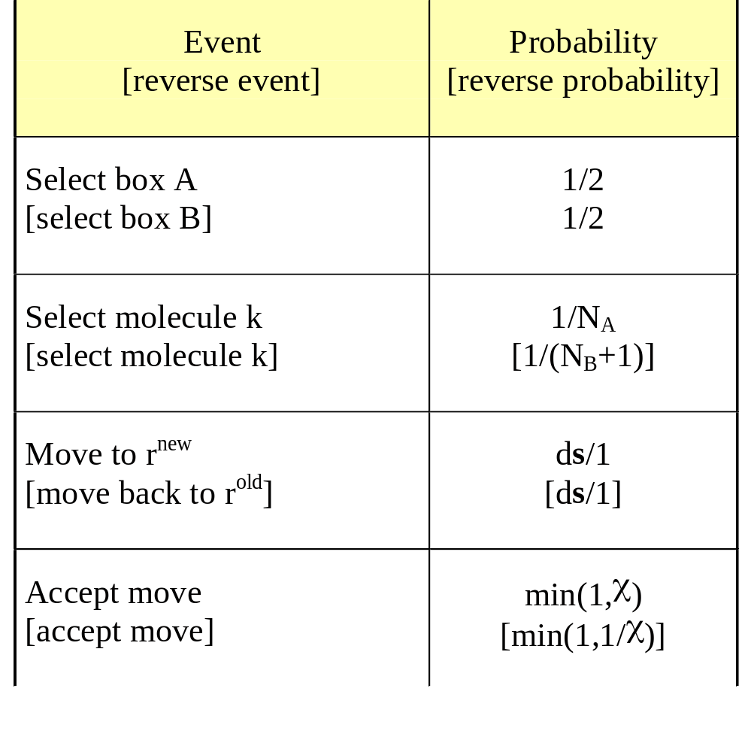
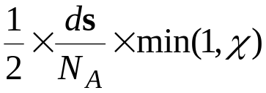
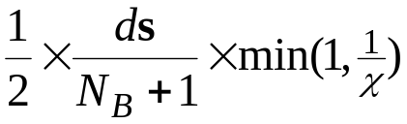
Molecule-Exchange Trial Move
Analysis of Trial Probabilities
Detailed specification of trial moves and probabilities
Forward-step trial probability
Reverse-step trial probability
Scaled volume
χ is formulated to satisfy detailed balance

Slide 16
Molecule-Exchange Trial Move
Analysis of Detailed Balance
Forward-step trial probability
Reverse-step trial probability
Detailed balance
π_{i}
π_{ij}
=
π_{j}
π_{ji}
Limiting distribution

Slide 17
Molecule-Exchange Trial Move
Analysis of Detailed Balance
Forward-step trial probability
Reverse-step trial probability
Detailed balance
π_{i}
π_{ij}
=
π_{j}
π_{ji}
Limiting distribution

Slide 18
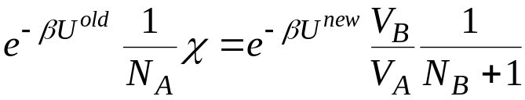
Molecule-Exchange Trial Move
Analysis of Detailed Balance
Forward-step trial probability
Reverse-step trial probability
Detailed balance
π_{i}
π_{ij}
=
π_{j}
π_{ji}
Acceptance probability

Slide 19
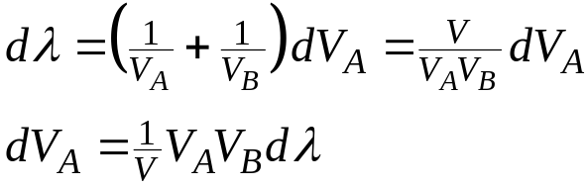
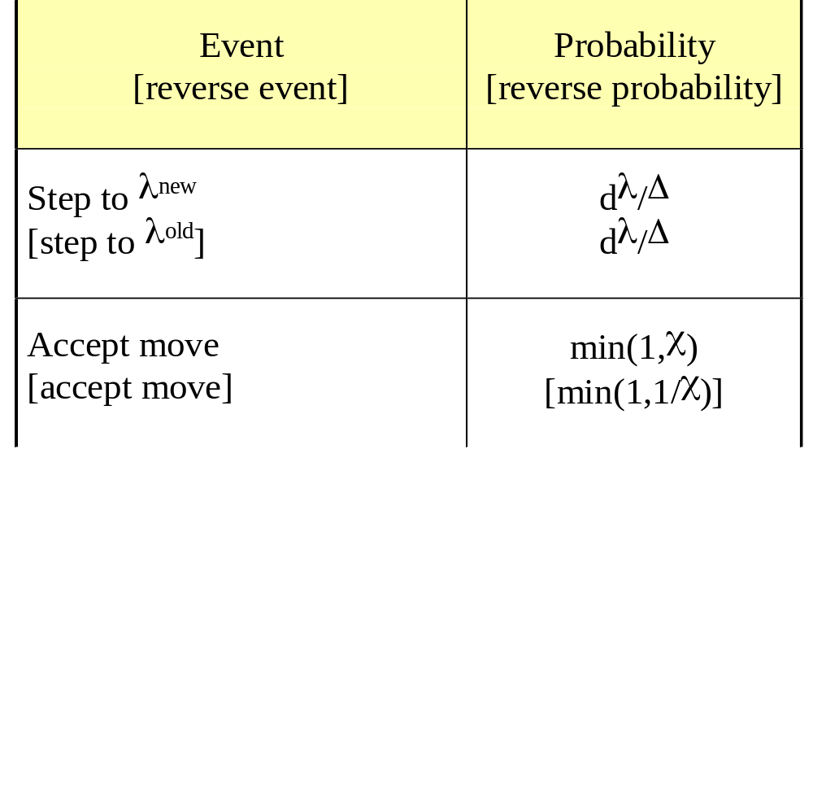
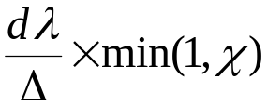
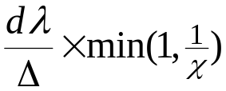
Volume-Exchange Trial Move
Analysis of Trial Probabilities
Take steps in λ = ln(V_{A}/V_{B})
Detailed specification of trial moves and probabilities
Forward-step trial probability
Reverse-step trial probability

Slide 20
Volume-Exchange Trial Move
Analysis of Detailed Balance
Forward-step trial probability
Reverse-step trial probability
Detailed balance
π_{i}
π_{ij}
=
π_{j}
π_{ji}
Limiting distribution

Slide 21
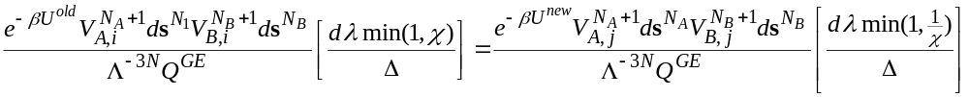
Volume-Exchange Trial Move
Analysis of Detailed Balance
Forward-step trial probability
Reverse-step trial probability
Detailed balance
π_{i}
π_{ij}
=
π_{j}
π_{ji}
Limiting distribution

Slide 22

Volume-Exchange Trial Move
Analysis of Detailed Balance
Forward-step trial probability
Reverse-step trial probability
Detailed balance
π_{i}
π_{ij}
=
π_{j}
π_{ji}
Acceptance probability

Slide 23
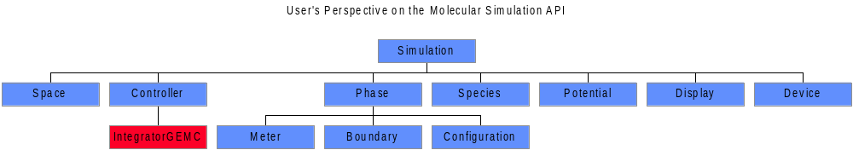
Gibbs Ensemble in the Molecular Simulation API

Slide 24
Gibbs Ensemble MC
Examination of Java Code. General
public class IntegratorGEMC extends Integrator
//Performs basic GEMC trial
//At present, suitable only for single-component systems
public void doStep() {
int i = (int)(rand.nextDouble()*iTotal); //select type of trial to perform
if(i < iDisplace) { //displace a randomly selected atom
if(rand.nextDouble() < 0.5) {atomDisplace.doTrial(firstPhase);}
else {atomDisplace.doTrial(secondPhase);}
}
else if(i < iVolume) { //volume exchange
trialVolume();
}
else { //molecule exchange
if(rand.nextDouble() < 0.5) {
trialExchange(firstPhase,secondPhase,firstPhase.parentSimulation.firstSpecies);
}
else {
trialExchange(secondPhase,firstPhase,firstPhase.parentSimulation.firstSpecies);
}
}
}

Slide 25
Gibbs Ensemble MC
Examination of Java Code. Molecule Exchange
public class IntegratorGEMC extends Integrator
/**
* Performs a GEMC molecule-exchange trial
*/
private void trialExchange(Phase iPhase, Phase dPhase, Species species) {
Species.Agent iSpecies = species.getAgent(iPhase); //insertion-phase speciesAgent
Species.Agent dSpecies = species.getAgent(dPhase); //deletion-phase species Agent
double uNew, uOld;
if(dSpecies.nMolecules == 0) {return;} //no molecules to delete; trial is over
Molecule m = dSpecies.randomMolecule(); //select random molecule to delete
uOld = dPhase.potentialEnergy.currentValue(m); //get its contribution to energy
m.displaceTo(iPhase.randomPosition()); //place at random in insertion phase
uNew = iPhase.potentialEnergy.insertionValue(m); //get its new energy
if(uNew == Double.MAX_VALUE) { //overlap; reject
m.replace(); //put it back
return;
}
double bFactor = dSpecies.nMolecules/dPhase.volume()//acceptance probability
* iPhase.volume()/(iSpecies.nMolecules+1)
* Math.exp(-(uNew-uOld)/temperature);
if(bFactor > 1.0 || bFactor > rand.nextDouble()) { //accept
iPhase.addMolecule(m,iSpecies); //place molecule in phase
}
else { //reject
m.replace(); //put it back
}
}

Slide 26
Gibbs Ensemble MC
Examination of Java Code. Volume Exchange
public class IntegratorGEMC extends Integrator
private void trialVolume() {
double v1Old = firstPhase.volume();
double v2Old = secondPhase.volume();
double hOld = firstPhase.potentialEnergy.currentValue()
+ secondPhase.potentialEnergy.currentValue();
double vStep = (2.*rand.nextDouble()-1.)*maxVStep; //uniform step in volume
double v1New = v1Old + vStep;
double v2New = v2Old - vStep;
double v1Scale = v1New/v1Old;
double v2Scale = v2New/v2Old;
double r1Scale = Math.pow(v1Scale,1.0/(double)Simulation.D);
double r2Scale = Math.pow(v2Scale,1.0/(double)Simulation.D);
firstPhase.inflate(r1Scale); //perturb volumes
secondPhase.inflate(r2Scale);
double hNew = firstPhase.potentialEnergy.currentValue() //acceptance probability
+ secondPhase.potentialEnergy.currentValue();
if(hNew >= Double.MAX_VALUE ||
Math.exp(-(hNew-hOld)/temperature
+ firstPhase.moleculeCount*Math.log(v1Scale)
+ secondPhase.moleculeCount*Math.log(v2Scale))
< rand.nextDouble())
{ //reject; restore volumes
firstPhase.inflate(1.0/r1Scale);
secondPhase.inflate(1.0/r2Scale);
}
//accept; nothing more to do
}

Slide 27
Gibbs Ensemble Limitations
Limitations arise from particle-exchange requirement
  Molecular dynamics (polarizable models)
  Dense phases, or complex molecular models
  Solid phases
    N = 4n³ (fcc)
and sometimes from the volume-exchange requirement too
?

Slide 28

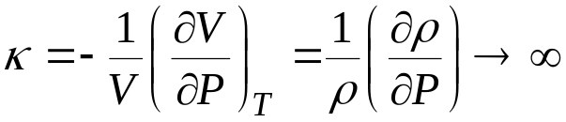

Approaching the Critical Point
Critical phenomena are difficult to capture by molecular simulation
Density fluctuations are related to compressibility
Correlations between fluctuations important to behavior
  in thermodynamic limit correlations have infinite range
  in simulation correlations limited by system size
  surface tension vanishes
isotherm
Pressure
C
V
L+V
L
L+S
S
S+V
Density

Slide 29
Critical Phenomena and the Gibbs Ensemble
Phase identities break down as critical point is approached
  Boxes swap “identities” (liquid vs. vapor)
  Both phases begin to appear in each box
    surface free energy goes to zero

Slide 30
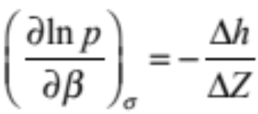
Gibbs-Duhem Integration
GD equation can be used to derive Clapeyron equation
  equation for coexistence line
Treat as a nonlinear first-order ODE
  use simulation to evaluate
  right-hand side
Trace an integration path the coincides
with the coexistence line
critical point
Field variable
(pressure)
L
S
V
Field variable
(temperature)

Slide 31
GDI Predictor-Corrector Implementation
Given initial condition and slope
(= –Δh/ΔZ), predict new (p,T) pair.
Evaluate slope at new state condition…
…and use to correct estimate of new (p,T) pair
lnp
β
lnp
β
lnp
β

Slide 32
GDI Simulation Algorithm
Estimate pressure and temperature from predictor
Begin simultaneous NpT simulation of both phases at the estimated conditions
As simulation progresses, estimate new slope from ongoing simulation data and use with corrector to adjust p and T
Continue simulation until the iterations and the simulation averages converge
Repeat for the next state point
Each simulation yields a coexistence point.
Particle insertions are never attempted.

Slide 33
GDI Sources of Error
Three primary sources of error in GDI method
Stochastic error
Finite step of integrator
Stability
1
1
Incorrect initial condition
lnp
1
?
Uncertainty in slopes due to uncertainty in simulation averages
2
True curve
2
2
β
Quantify via propagation of error using confidence limits of simulation averages
Smaller step
Integrate series with every-other datum
Compare predictor and corrector values
Stability can be quantified
Error initial condition can be corrected even after series is complete

Slide 34
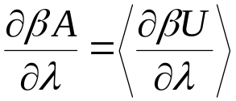
GDI Applications and Extensions
Applied to a pressure-temperature phase equilibria in a wide variety of model systems
  emphasis on applications to solid-fluid coexistence
Can be extended to describe coexistence in other planes
  variation of potential parameters
    inverse-power softness
    stiffness of polymers
    range of attraction in square-well and triangle-well
    variation of electrostatic polarizability
  as with free energy methods, need to identify and measure variation of free energy with potential parameter
  mixtures

Slide 35

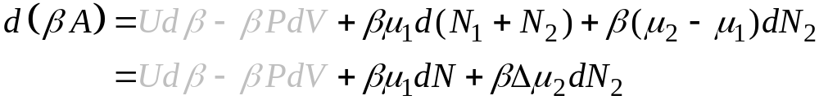
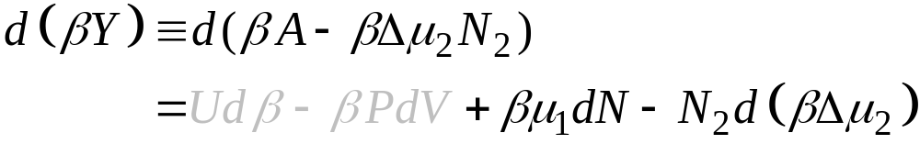
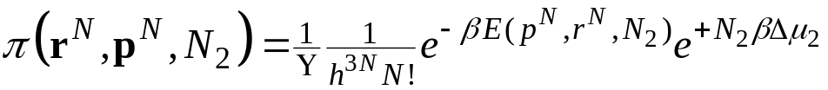
Semigrand Ensemble
Thermodynamic formalism for mixtures
Rearrange
Legendre transform
  Independent variables include N and Δ∝₂
  Dependent variables include N₂
    must determine this by ensemble average
    ensemble includes elements differing in composition at same total N
Ensemble distribution

Slide 36
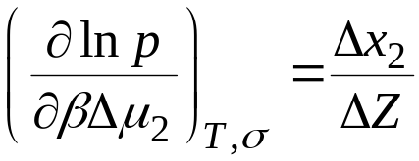
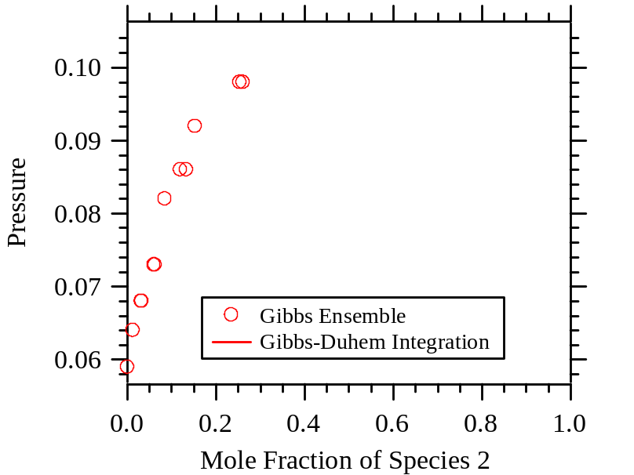
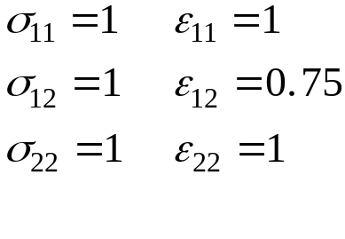
GDI/GE with the Semigrand Ensemble
Governing differential equation (pressure-composition plane)
Simple LJ Binary

Slide 37
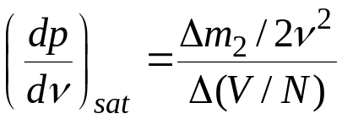
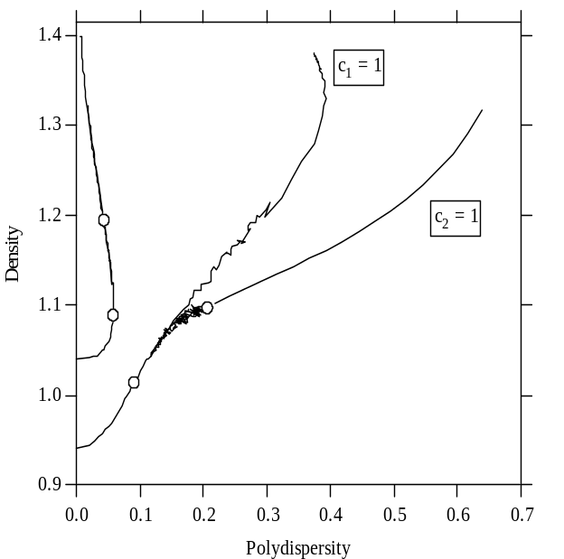
GDI with the Semigrand Ensemble
Freezing of polydisperse hard spheres
  appropriate model for colloids
Integrate in pressure-polydispersity plane
Findings
  upper polydisersity bound to freezing
  re-entrant melting
Composition
(Fugacity)
solid
m₂
(ν)
fluid
Diameter

Slide 38
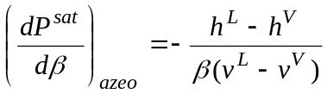
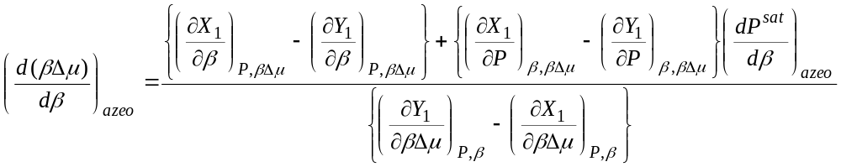
Other Views of Coexistence Surface
Dew and bubble lines
Residue curves
Azeotropes
  semigrand ensemble
  formulate appropriate differential equation
  integrate as in standard GDI method
    right-hand side involves partial molar properties

Slide 39
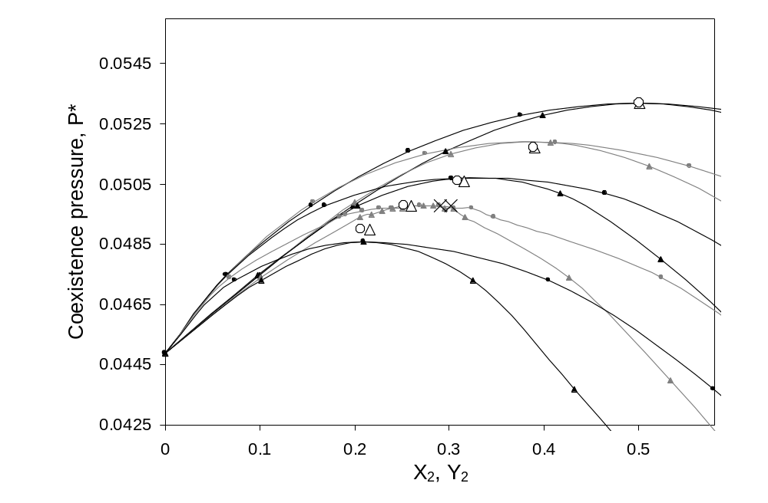
Tracing of Azeotropes
Lennard-Jones binary, variation with intermolecular potential
  σ₁₁ = 1.0; σ₁₂ = 1.05; σ₂₂ = variable
  ε₁₁ = 1.0; ε₁₂ = 0.90; ε₂₂ = 1.0
  T = 1.10

Slide 40
Summary
Thermodynamic phase behavior is interesting and useful
Obvious methods for evaluating phase behavior by simulation are too approximate
Rigorous thermodynamic method is tedious
Gibbs ensemble revolutionized methodology
  two coexisting phases without an interface
Gibbs-Duhem integration provides an alternative to use in situations where GE fails
  dense and complex fluids
  solids
Semigrand ensemble is useful formalism for mixtures
GDI can be extended in many ways

