Slide 1
CE 530 Molecular Simulation
Lecture 21
Histogram Reweighting Methods
David A. Kofke
Department of Chemical Engineering
SUNY Buffalo
kofke@eng.buffalo.edu

Slide 2
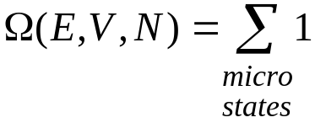
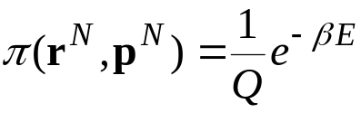
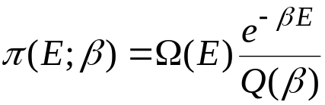
Histogram Reweighting
Method to combine results taken at different state conditions
Microcanonical ensemble
Canonical ensemble
The big idea:
  Combine simulation data at different temperatures to improve quality of all data via their mutual relation to Ω(E)
Probability of a microstate
Probability of an energy
Number of microstates having this energy
Probability of each microstate

Slide 3
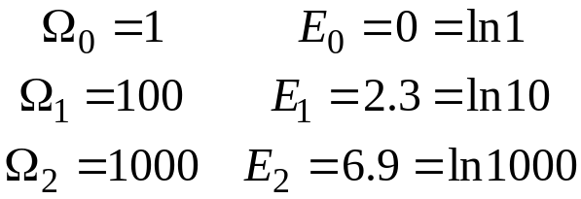
In-class Problem 1.
Consider three energy levels
What are Q, distribution of states and <E> at β = 1?

Slide 4
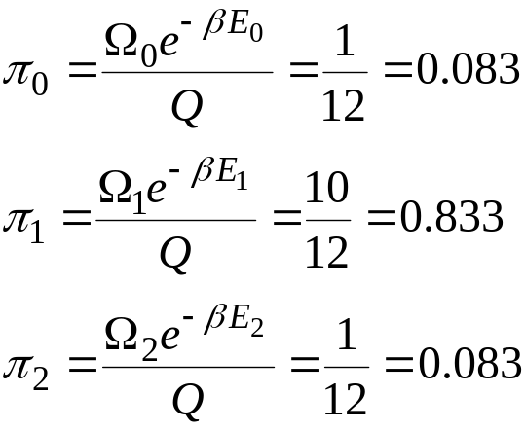
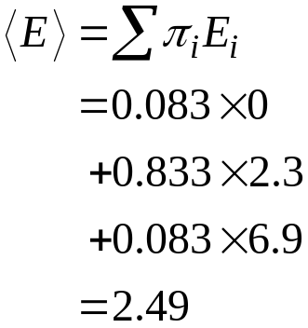
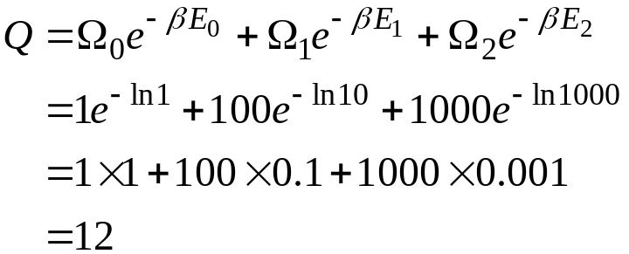
In-class Problem 1A.
Consider three energy levels
What are Q, distribution of states and <E> at β = 1?

Slide 5
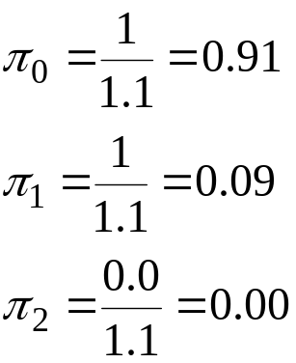
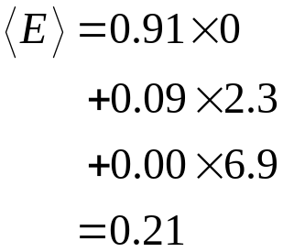
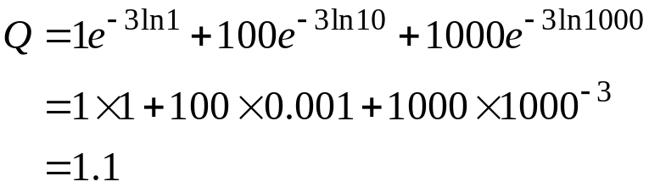
In-class Problem 1A.
Consider three energy levels
What are Q, distribution of states and <E> at β = 1?
And at β = 3?

Slide 6
Histogram Reweighting Approach
Knowledge of Ω (E) can be used to obtain averages at any temperature
Simulations at different temperatures probe different parts of Ω (E)
But simulations at each temperature provides information over a range of values of Ω (E)
Combine simulation data taken at different temperatures to obtain better information for each temperature
Ω(E)
β₁
β₂
β₃
E

Slide 7
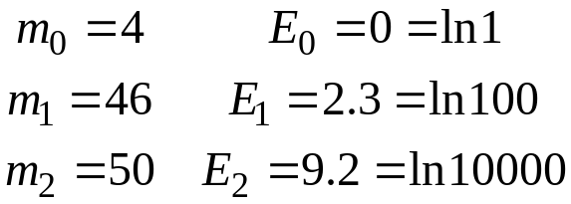
In-class Problem 2.
Consider simulation data from a system having three energy levels
  M = 100 samples taken at β = 0.5
  m_{i} times observed in level i
What is Ω (E)?

Slide 8
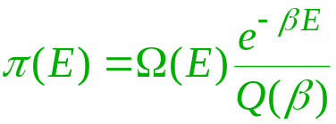
In-class Problem 2.
Consider simulation data from a system having three energy levels
  M = 100 samples taken at β = 0.5
  m_{i} times observed in level i
What is Ω (E)?
Reminder

Slide 9
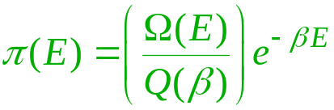
In-class Problem 2.
Consider simulation data from a system having three energy levels
  M = 100 samples taken at β = 0.5
  m_{i} times observed in level i
What is Ω (E)?
Can get only relative values!
Hint

Slide 10
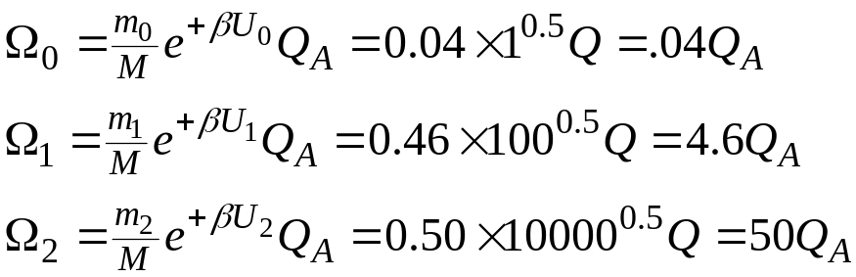

In-class Problem 2A.
Consider simulation data from a system having three energy levels
  M = 100 samples taken at β = 0.5
  m_{i} times observed in level i
What is Ω (E)?

Slide 11
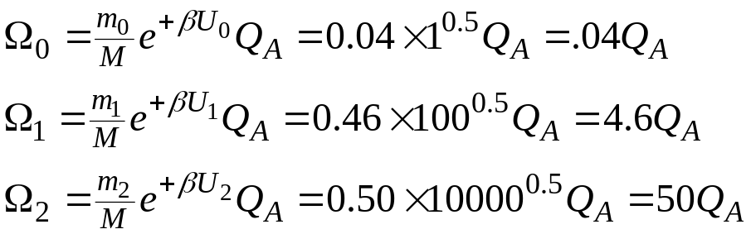

In-class Problem 3.
Consider simulation data from a system having three energy levels
  M = 100 samples taken at β = 0.5
  m_{i} times observed in level i
What is Ω (E)?
Here’s some more data, taken at β = 1
  what is Ω(E)?

Slide 12
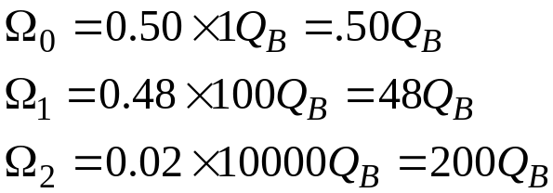

In-class Problem 3.
Consider simulation data from a system having three energy levels
  M = 100 samples taken at β = 0.5
  m_{i} times observed in level i
What is Ω (E)?
Here’s some more data, taken at β = 1
  what is Ω (E)?

Slide 13
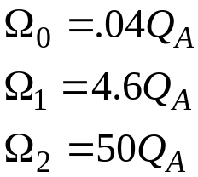
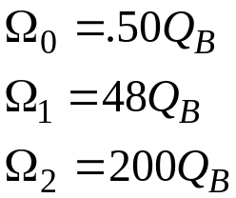
Reconciling the Data
We have two data sets
Questions of interest
  what is the ratio Q_{A}/Q_{B}? (which then gives us ΔA)
  what is the best value of Ω₁/Ω₀, Ω₂/Ω₀?
  what is the average energy at β = 2?
In-class Problem 4
  make an attempt to answer these questions

Slide 14
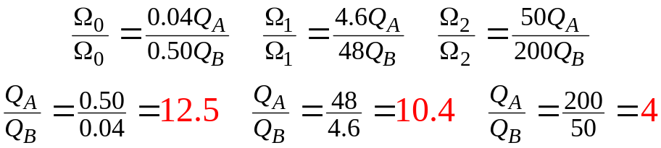
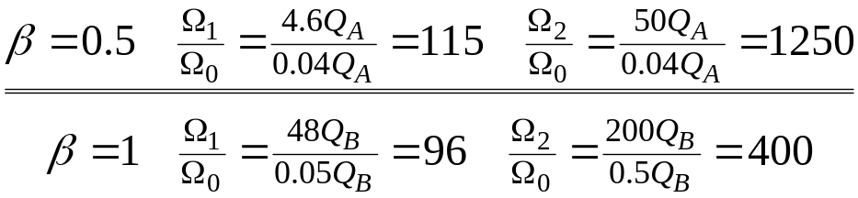
In-class Problem 4A.
We have two data sets
What is the ratio Q_{A}/Q_{B}? (which then gives us ΔA)
  Consider values from each energy level
What is the best value of Ω₁/Ω₀, Ω₂/Ω₀?
  Consider values from each temperature
What to do?

Slide 15
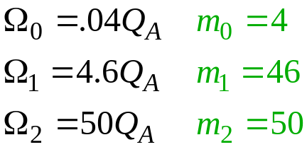
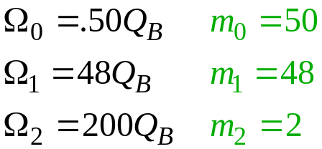
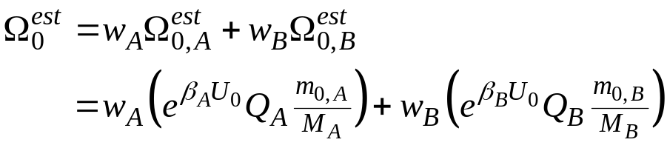
Accounting for Data Quality
Remember the number of samples that went into each value
  We expect the A-state data to be good for levels 1 and 2
  …while the B-state data are good for levels 0 and 1
Write each Ω as an average of all values, weighted by quality of result

Slide 16
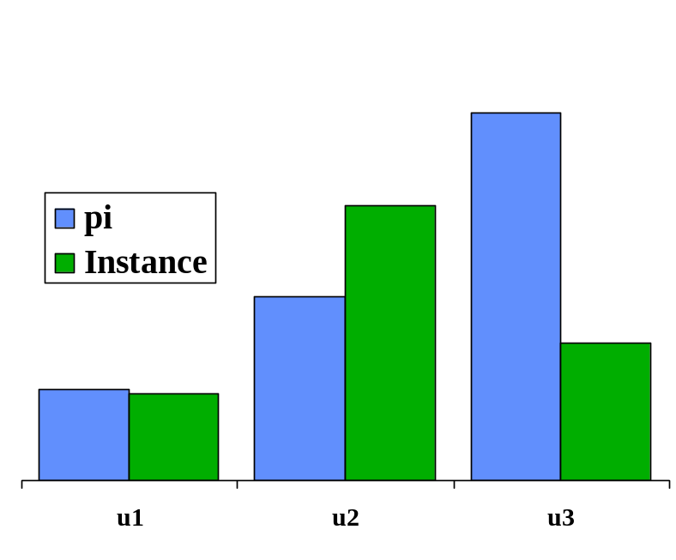
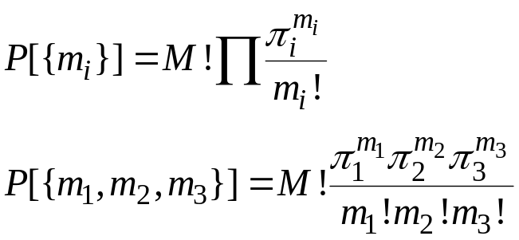

Histogram Variance
Estimate confidence in each simulation result
Assume each histogram follows a Poisson distribution
  probability P to observe any given instance of distribution
  the variance for each bin is

Slide 17
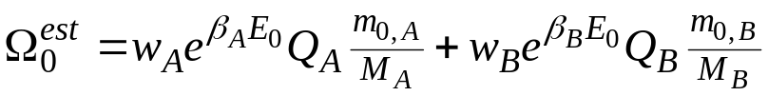
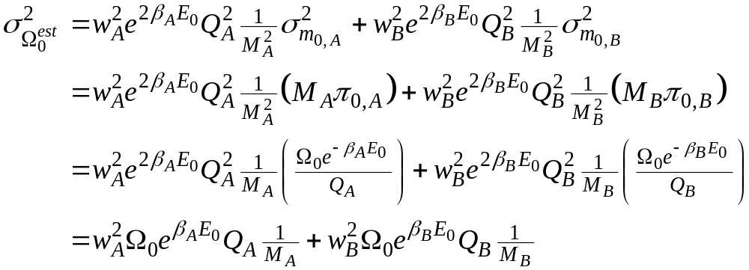
Variance in Estimate of Ω
Formula for estimate of Ω
Variance

Slide 18

Optimizing Weights
Variance
Minimize with respect to weight, subject to normalization
  In-class Problem 5
    Do it!

Slide 19
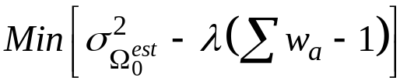
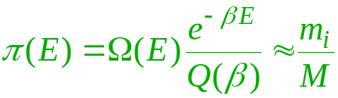

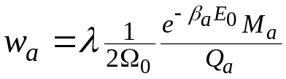
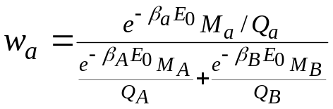
Optimizing Weights
Variance
Minimize with respect to weight, subject to normalization
  Lagrange multiplier
Equation for each weight is
Rearrange
Normalize

Slide 20
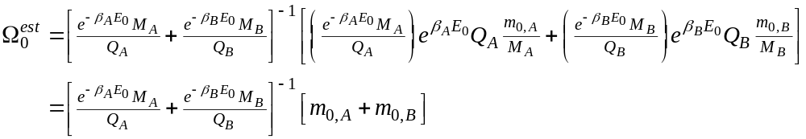
Optimal Estimate
Collect results
Combine

Slide 21
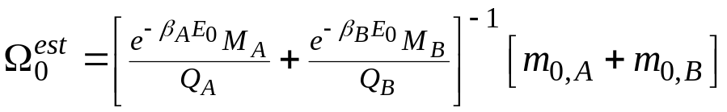
Calculating Ω
Formula for Ω
In-class Problem 6
  explain why this formula cannot yet be used

Slide 22
Calculating Ω
Formula for Ω
We do not know the Q partition functions
One equation for each Ω
Each equation depends on all Ω
Requires iterative solution

Slide 23
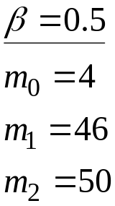
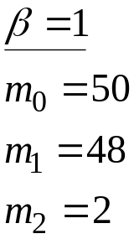
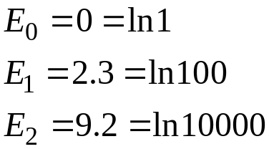

In-class Problem 7
Write the equations for each Ω using the example values

Slide 24
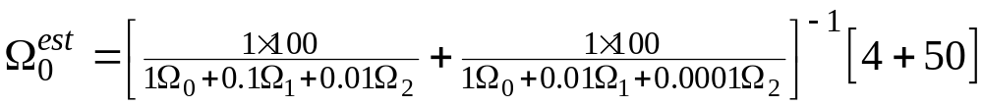
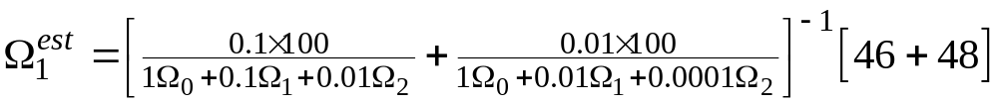
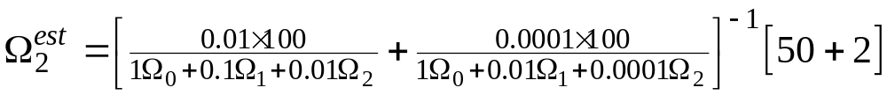
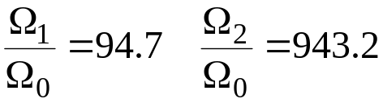
In-class Problem 7
Write the equations for each Ω using the example values
Solution

Slide 25
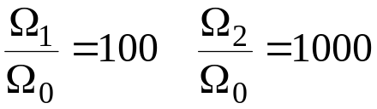
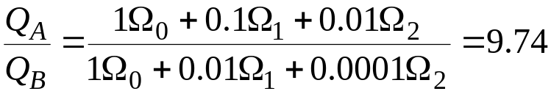
In-class Problem 7A.
Solution
Compare
“Exact” solution
Free energy difference
(?)
“Design value” = 10

Slide 26
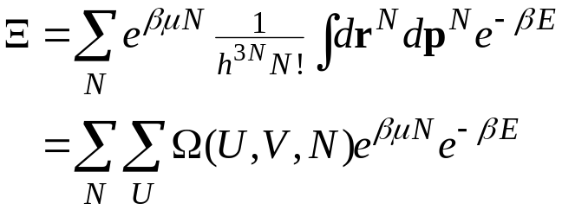
Extensions of Technique
Method is usually used in multidimensional form
Useful to apply to grand-canonical ensemble
Can then be used to relate simulation data at different temperature and chemical potential
Many other variations are possible

