Slide 1
CE 530 Molecular Simulation
Lecture 23
Symmetric MD Integrators
David A. Kofke
Department of Chemical Engineering
SUNY Buffalo
kofke@eng.buffalo.edu

Slide 2
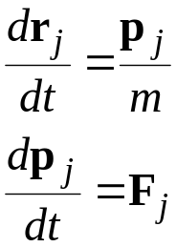
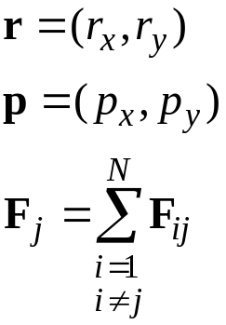
Molecular Dynamics Integration
Equations of motion in cartesian coordinates
Previously, we examined basic MD integrators
  Verlet family
    Verlet; Leap-frog; Velocity Verlet
  Popular because of their simplicity and effectiveness
Today we will consider
  Symmetry features that make the Verlet methods work so well
  Multiple-timestep extensions of the Verlet algorithms
2-dimensional space (for example)
pairwise additive forces
F

Slide 3
Integration Algorithms
Features of a good integrator
  minimal need to compute forces (a very expensive calculation)
  good stability for large time steps
  good accuracy
  conserves energy and momentum
    noise less important than drift
The true (continuum) equations of motions display certain symmetries
  time-reversible
  area-preserving (symplectic)
Good integrators can be constructed by paying attention to these features

Slide 4
Symmetry
An object displays symmetry if some transformation leaves it (or something about it) unaltered
Original shape
90º rotation
Horizontal reflection

Slide 5
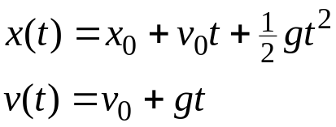
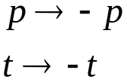
Time Symmetry
Path traced by a mechanical system is unchanged upon reversal of momenta or time
  e.g., motion in a constant gravitational field
Another view
  Substitution
  leaves equations
  of motion unchanged

Slide 6
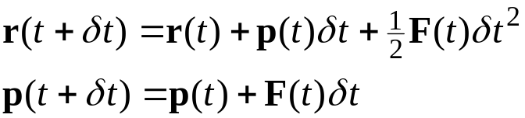

An Irreversible Integrator
Forward Euler
  well known to be quite bad
Examine time reversibility
  Assume we have progressed forward in time an increment δt; positions and momenta are now
unit mass

Slide 7
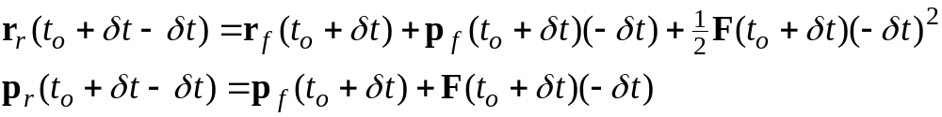
An Irreversible Integrator
Forward Euler
  well known to be quite bad
Examine time reversibility
  Assume we have progressed forward in time an increment δt; positions and momenta are now
  Reverse time, and step back to original condition
unit mass

Slide 8

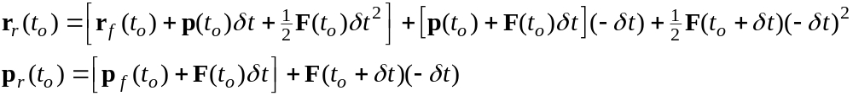
An Irreversible Integrator
Forward Euler
  well known to be quite bad
Examine time reversibility
  Assume we have progressed forward in time an increment δt; positions and momenta are now
  Reverse time, and step back to original condition
  Insert from above for
unit mass

Slide 9

An Irreversible Integrator
Forward Euler
  well known to be quite bad
Examine time reversibility
  Assume we have progressed forward in time an increment δt; positions and momenta are now
  Reverse time, and step back to original condition
  Insert from above for ; Cancel
unit mass

Slide 10
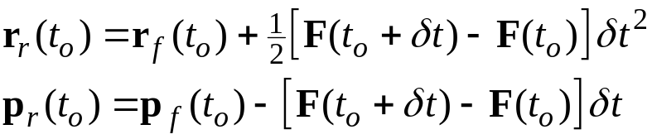



An Irreversible Integrator
Forward Euler
  well known to be quite bad
Examine time reversibility
  Assume we have progressed forward in time an increment δt; positions and momenta are now
  Reverse time, and step back to original condition
  Insert from above for ; Simplify
  Equal only in limit of zero time step
    Inequality indicates lack of time reversibility
    Verlet integrators are time reversible
unit mass

Slide 11

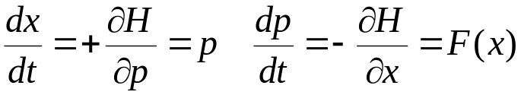


Symplectic Symmetry 1.
Consider motion of a single particle in 1D
  Described using a 2D phase space (x,p)
  Hamiltonian
  Equations of motion
  Phase space
  Forthcoming result are easily generalized to higher dimensional phase space, but hard to visualize
unit mass
{p(t),x(t)} trajectory

Slide 12
Symplectic Symmetry 2.
Consider motion of a differential element through phase space
  Shape of element is distorted by motion
  Area of the element is preserved
This is a manifestation of the symplectic symmetry of the equations of motion

Slide 13

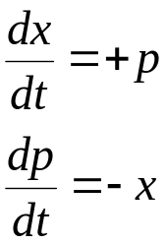
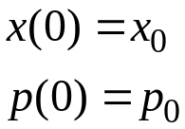
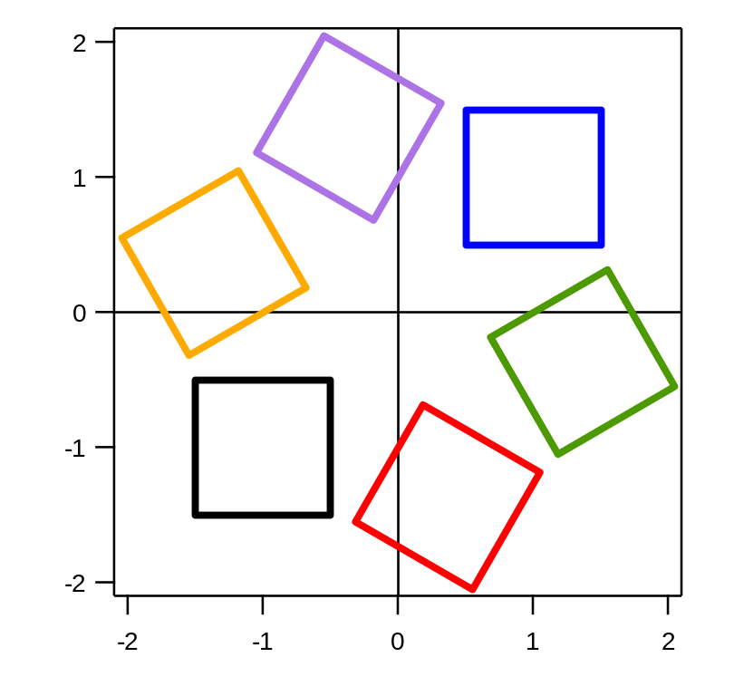
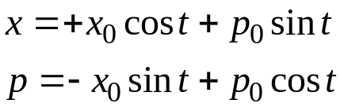

Classical Harmonic Oscillator
Exactly solvable example
Solution

Slide 14


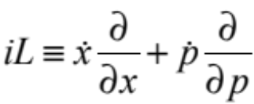

Liouville Formulation 1.
Operator-based view of mechanics
Very useful for deriving symplectic, time-reversible integration schemes
Consider an arbitrary function of phase-space coordinates
  and thereby a function of time
  time derivative is
Define the Liouville operator
So

Slide 15
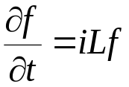


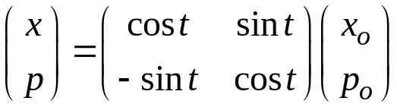
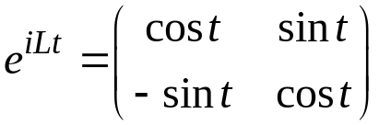
Liouville Formulation 2.
Operator form
This has the solution
  in principle this gives f at any time t
  in practice it is not directly useful
Let f be the phase-space vector
  then the solution gives the trajectory through phase space
Harmonic oscillator

Slide 16
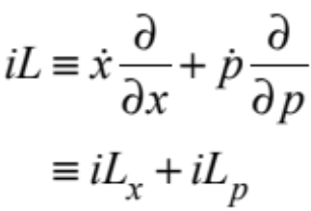
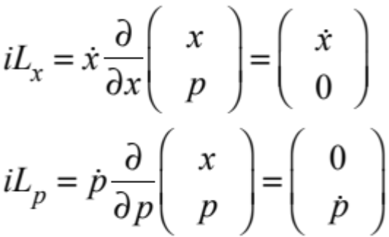
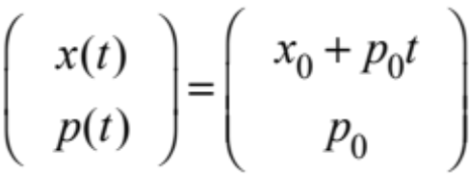
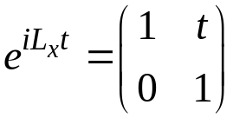
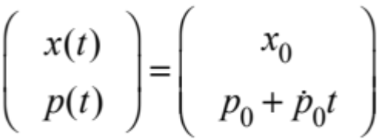
Separation of Liouville Operator 1.
Position and momentum parts
Propagator of either part can be solved analytically by itself

Slide 17


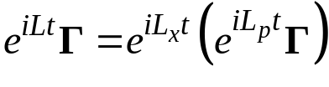
Separation of Liouville Operator 2.
Liouville components do not commute
  result differs depending on order in which they are applied
Otherwise we could write
We could then apply each propagator in sequence to move the system ahead in time
This is incorrect
Advance momentum
Advance position

Slide 18
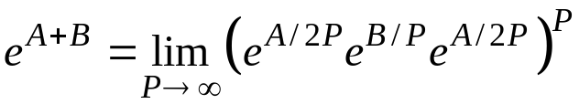
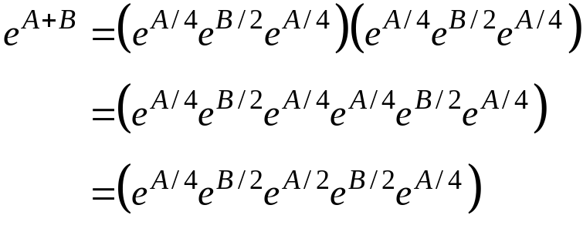
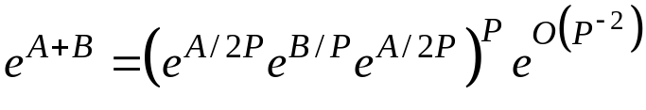
Trotter Expansion
The following relation does hold
  for example, if P = 2
We cannot work with infinite P
  but for large P
…plus a correction

Slide 19
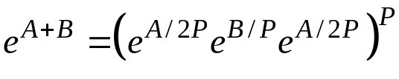

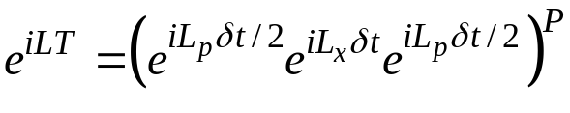

Formulating an Integrator
Using the large-P approximation
To advance the system over the time interval T
  break Liouville operator into displacement parts iL_{x} + iL_{p}
  write
  apply the Trotter expansion, and interpret T/P as a discretized time δt
  application of P times advances the system (approximately) through T
An integrator formulated this way will be both time-reversible and symplectic

Slide 20
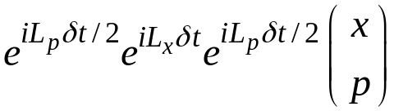
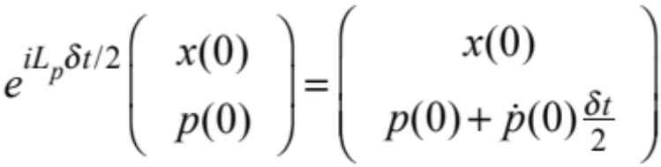
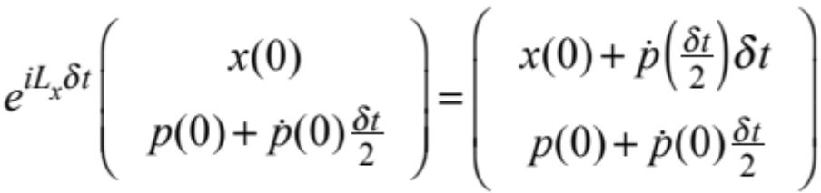
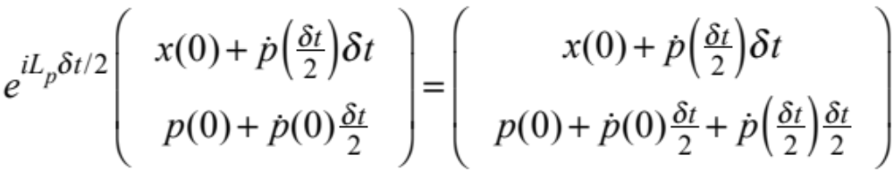
Examination of Integrator 1.
Consider effect of one time step on positions and momenta
First apply exp(iL_{p}δt/2)
Then apply exp(iL_{x}δt)
Finally apply exp(iL_{p}δt/2) again

Slide 21
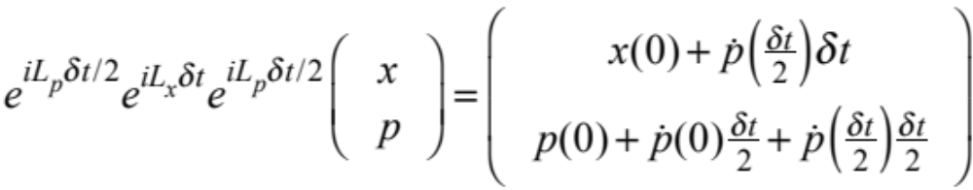
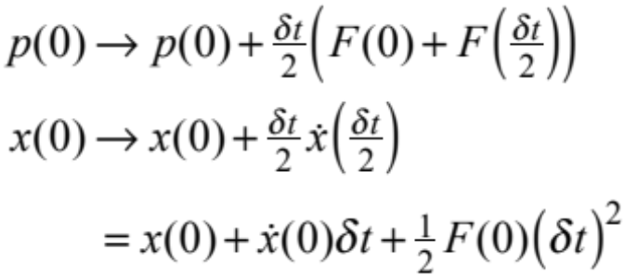
Examination of Integrator 2.
One time step
Examine effect on coordinate and momentum
It’s the Velocity Verlet integrator!
Higher-order algorithms can be derived systematically by including higher orders in the Trotter factorization
  Not appealing because introduces derivatives of forces

Slide 22


A Deep Truth
Verlet integrator replaces the true Liouville propagator by an approximate one
We can make these equal by saying the approximate propagator is obtained as the propagator of an approximate Liouville operator
or
This corresponds to some unknown Hamiltonian
  and this Hamiltonian is conserved by the Verlet propagator
  the Verlet algorithm will not likely give rise to drift in the true Hamiltonian, since this “shadow” Hamiltonian is conserved

Slide 23
Other Decompositions
Other choices for the decomposition of the Liouville operator can be worthwhile
Some choices:
  Separation of short- and long-ranged forces
  Separation of fast and slow time-scale motions
Approach involves defining a reference system that is solved more precisely (more frequently)
Difference between real and reference is updated over a longer time scale
RESPA
  (Reversible) REference System Propagator Algorithm
  Uses numerical solution of reference
NAPA
  Numerical Analytical Propagator Algorithm
  Uses a reference that can be solved analytically
Martyna, Tuckerman, Berne

Slide 24
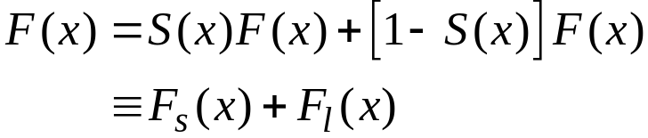
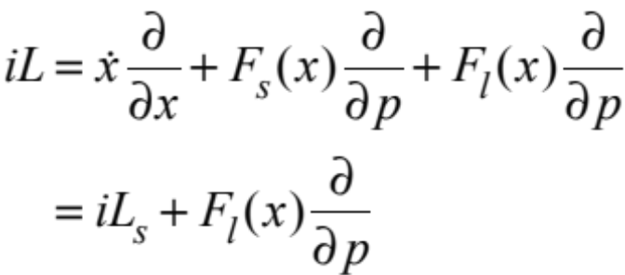
RESPA: Force Decomposition 1.
Decompose force into short (F_{s}) and long (F_{l}) range contributions
  S(x) is a switching function that turns off the force at some distance
Liouville operator

Slide 25
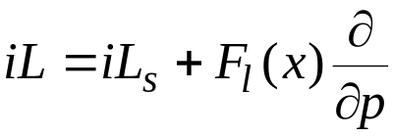
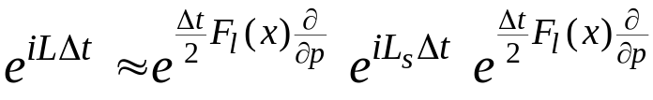
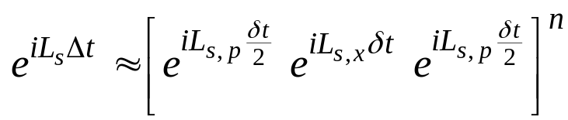
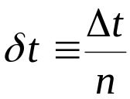
RESPA: Force Decomposition 2.
Liouville operator
Trotter factorization of propagator
Decompose term treating short-range forces
Long-range forces are computed n times less frequently than short-range ones
  Long-range forces vary more slowly
  They are more expensive to calculate, because more pairs

Slide 26
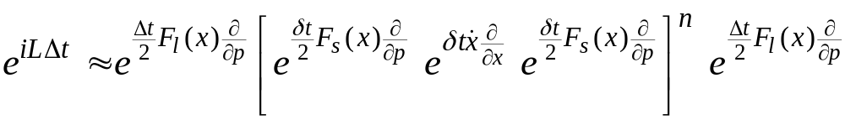
RESPA: Force Decomposition 3.
Full RESPA propagator
Procedure
  Repeat for n steps
    update short-range force, evaluate new momenta
    evaluate new positions
  Evaluate long-range forces, update momenta
  Repeat

Slide 27
RESPA: Time-Scale Decomposition
Many systems display disparate time scales of motion
  Massive particles interacting with light ones
    helium in argon
  Stiff and loose potentials
    intramolecular and intermolecular forces
Approach works as before
  Integrate fast motions (degrees of freedom) using short time step
  Integrate slow motions using long time step

