Slide 1
CE 530 Molecular Simulation
Lecture 24
Non-Equilibrium Molecular Dynamics
David A. Kofke
Department of Chemical Engineering
SUNY Buffalo
kofke@eng.buffalo.edu

Slide 2
Summary from Lecture 12
Dynamical properties describe the way collective behaviors cause macroscopic observables to redistribute or decay
Evaluation of transport coefficients requires non-equilibrium condition
  NEMD imposes macroscopic non-equilibrium steady state
  EMD approach uses natural fluctuations from equilibrium
Two formulations to connect macroscopic to microscopic
  Einstein relation describes long-time asymptotic behavior
  Green-Kubo relation connects to time correlation function
Several approaches to evaluation of correlation functions
  direct: simple but inefficient
  Fourier transform: less simple, more efficient
  coarse graining: least simple, most efficient, approximate

Slide 3
Limitations of Equilibrium Methods
Response to naturally occurring (small) fluctuations
Signal-to-noise particularly bad at long times
  but may have significant contributions to transport coefficient here
Finite system size limits time that correlations can be calculated reliably
correlations between these two…
…lose meaning once they’ve traveled the length of the system

Slide 4
Non-Equilibrium Molecular Dynamics
Introduce much larger fluctuation artificially
  dramatically improve signal-to-noise of response
Measure steady-state response
Corresponds more closely to experimental procedure
  create flow of momentum, energy, mass, etc. to measure…
  …shear viscosity, thermal conductivity, diffusivity, etc.
Advantages
  better quality of measurement
  can also examine nonlinear response
Disadvantages
  limited to one transport process at a time
  may need to extrapolate to linear response

Slide 5
One (Disfavored) Approach
Introduce boundaries in which molecules interact with inhomogeneous momentum/mass/energy reservoirs
Disadvantages
  incompatible with PBC
  introduces surface effects
  inhomogeneous
  difficult to analyze to obtain transport coefficients correctly
Have a look with a thermal conductivity applet
Better methods rely on linear response theory

Slide 6


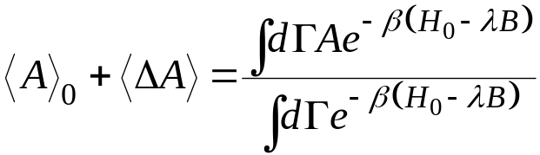
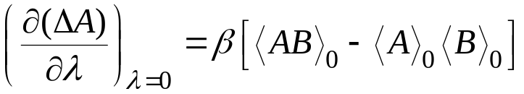
Linear Response Theory: Static
Linear Response Theory forms the theoretical basis for evaluation of transport properties by molecular simulation
Consider first a static linear response
Examine how average of a mechanical property A changes in the presence of an external perturbation f
  Unperturbed value
  Apply perturbation to Hamiltonian
  New value of A
  Linearize
Susceptibility describes first-order static response to perturbation

Slide 7




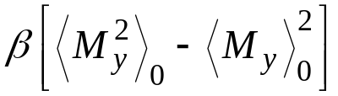
Example of Static Linear Response
Dielectric response to an external electric field
  coupling to dipole moment of system, M_{y}
  interest in net polarization induced by field
  thus A = B = M_{y}
  susceptibility
No field
Field on
E

Slide 8
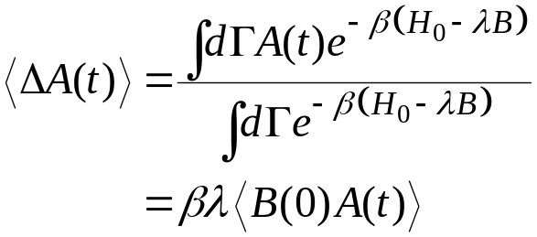
Linear Response Theory: Dynamic 1.
Time-dependent perturbation F_{e}(t)
Consider situation in which F_{e} is non-zero for t < 0, then is switched off at t = 0
Response ΔA decays to zero
Ensemble average over (perturbation-weighted) initial conditions

Slide 9
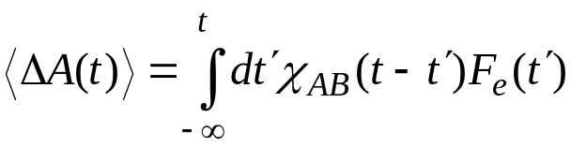
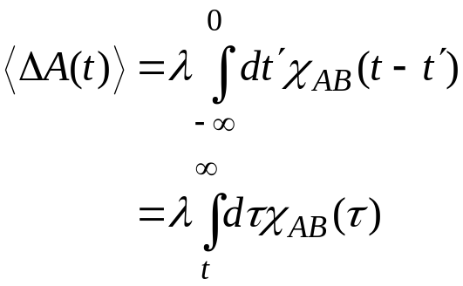
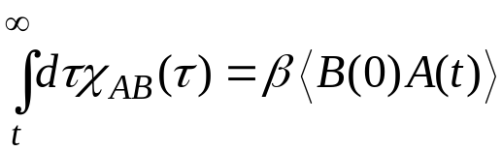

Linear Response Theory: Dynamic 2.
Now consider a more general time-dependent perturbation F_{e}(t)
Simplest general form of linear response
For the protocol previously discussed (shut off field at t = 0)
  thus
Value at time t is a sum of the responses to the perturbation over the entire history of the system

Slide 10
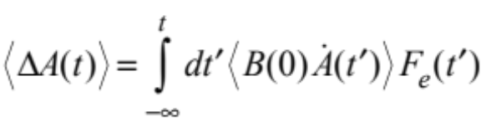
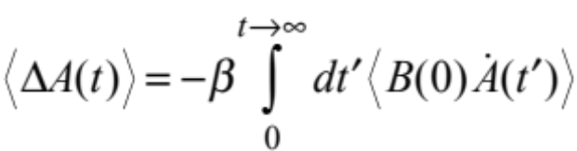

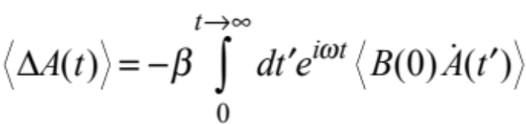
Perturbation-Response Protocols
Turn on perturbation at t = 0, and keep constant thereafter
  measured response is proportional to integral of time-integrated correlation function
Apply as δ-function pulse at t = 0, subsequent evolution proceeding normally
  measured response proportional to time correlation function itself
Use a sinusoidally oscillating perturbation
  measured response proportional to Fourier-Laplace transformed correlation functions at the applied frequency
  extrapolate results from several frequencies to zero-frequency limit

Slide 11
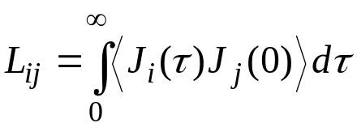
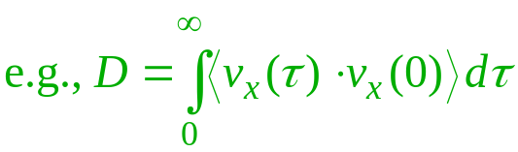


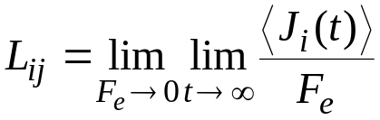
Synthetic NEMD
Perturb usual equations of motion in some way
  Artificial “synthetic” perturbation need not exist in nature
For transport coefficient of interest L_{ij}, J_{i} = L_{ij}X_{j}
  Identify the Green-Kubo relation for the transport coefficient
  Invent a fictitious field F_{e}, and its coupling to the system such that the dissipative flux is J_{j}
  ensure that
    equations of motion correspond to an incompressible phase space
    equations of motion are consistent with periodic boundaries
    equations of motion do not introduce inhomogeneities
  apply a thermostat
  couple F_{e} to the system and compute the steady-state average
  then

Slide 12


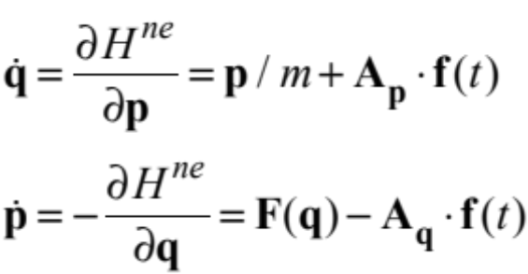
Phase Space
Underlying development assumes that equations of motion correspond to an incompressible phase space
This can be ensured by having the perturbation derivable from a Hamiltonian
Most often the equations of motion are not derivable from a Hamiltonian
  but are still formulated to be compatible with an incompressible phase space

Slide 13
Diffusion: An Inhomogeneous Approach
Artificially distinguish particles by “color”
Introduce a species-changing plane
Molecules moving this way across wall get colored red
Those crossing this way get blue

Slide 14
Diffusion: An Inhomogeneous Approach
Artificially distinguish particles by “color”
Introduce a species-changing plane
Problems
  Difficult to know form of inhomogeneity in color profile
  Cannot be extended to multicomponent diffusion
Considering periodic boundaries, this creates a color gradient

Slide 15
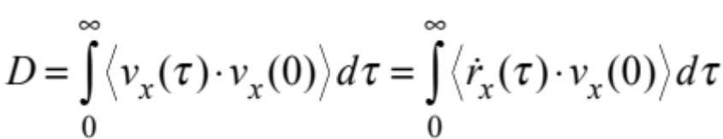
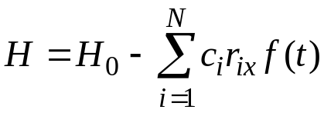
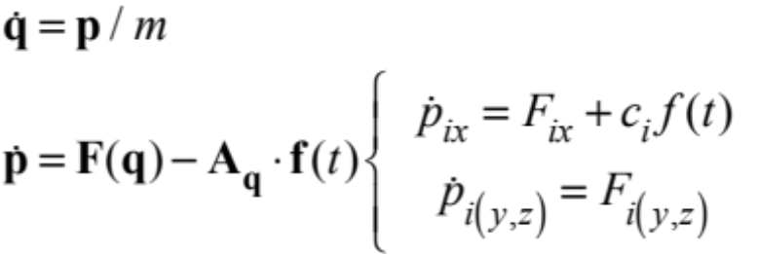
Self-Diffusion: Perturbation
Green-Kubo relation
Label each molecule with one of two “colors”
  each color given to half the molecules
Apply Hamiltonian perturbation
New equations of motion
System remains homogeneous
f
f

Slide 16
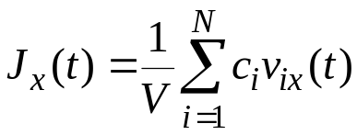
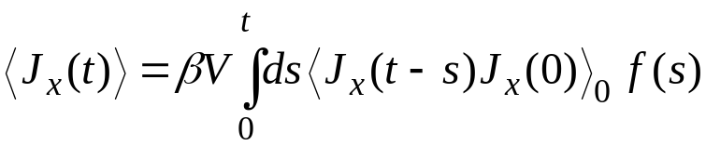
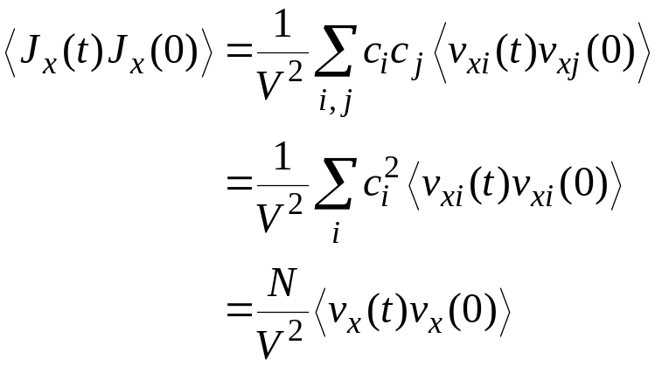
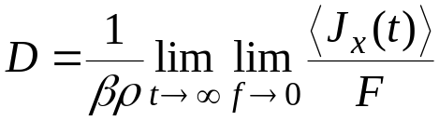
Self-Diffusion: Response
Appropriate response variable is the “color current”
According to linear response theory
In the canonical ensemble
Back to Green-Kubo relation
f
f

Slide 17
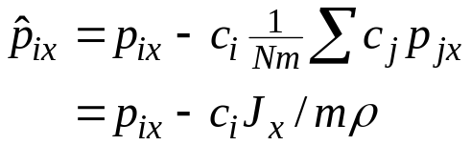

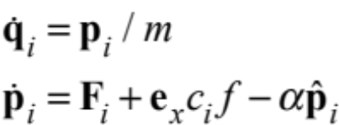
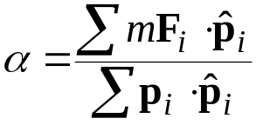
Thermostatting
External field does work on the system
  this must be dissipated to reach steady state
Thermostat based on velocity relative to total current density
  “peculiar velocity”
  constrain kinetic energy
  modified equations of motion
  thermostatting multiplier

Slide 18
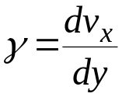



Shear Viscosity:
Boundary-Driven Algorithm
Homogeneous algorithm for boundary-driven shear is possible
  unique to shear viscosity
Lees-Edwards shearing periodic boundaries (sliding brick)
  Image cells in plane above and below central cell move
  Image velocity given by shear rate
  Peculiar velocity of all images equal

Slide 19
Shear Viscosity:
Boundary-Driven Algorithm
Homogeneous algorithm for boundary-driven shear is possible
  unique to shear viscosity
Lees-Edwards shearing periodic boundaries (sliding brick)
  Image cells in plane above and below central cell move
  Image velocity given by shear rate
  Peculiar velocity of all images equal

Slide 20
Shear Viscosity:
Boundary-Driven Algorithm
Homogeneous algorithm for boundary-driven shear is possible
  unique to shear viscosity
Lees-Edwards shearing periodic boundaries (sliding brick)
  Image cells in plane above and below central cell move
  Image velocity given by shear rate
  Peculiar velocity of all images equal

Slide 21
Shear Viscosity:
Boundary-Driven Algorithm
Homogeneous algorithm for boundary-driven shear is possible
  unique to shear viscosity
Lees-Edwards shearing periodic boundaries (sliding brick)
  Image cells in plane above and below central cell move
  Image velocity given by shear rate
  Peculiar velocity of all images equal
Try the applet

Slide 22


Lees-Edwards Boundary Conditions
Molecule exiting here, in middle of central cell

Slide 23
Lees-Edwards Boundary Conditions
Is replaced by one here, shifted over toward the edge of the cell
Shift distance = γLt

Slide 24
Lees-Edwards Boundary Conditions
And with a velocity that is modified according to the shear rate

Slide 25
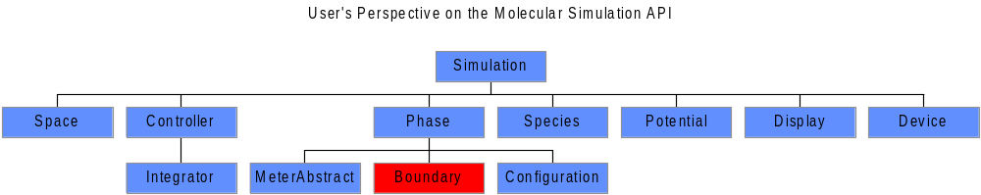
Lees-Edwards Boundary: API

Slide 26
Lees-Edwards Boundary: Java Code
public class Space2D.BoundarySlidingBrick extends
Space2D.BoundaryPeriodicSquare
public void nearestImage(Vector dr) {
double delrx = delvx*timer.currentValue();
double cory;
cory = (dr.y > 0.0) ? Math.floor(dr.y/dimensions.y+0.5):Math.ceil(dr.y/dimensions.y-0.5);
dr.x -= cory*delrx;
dr.x -= dimensions.x * ((dr.x > 0.0) ? Math.floor(dr.x/dimensions.x+0.5) :
Math.ceil(dr.x/dimensions.x-0.5));
dr.y -= dimensions.y * cory;
}
public void centralImage(Coordinate c) {
Vector r = c.r;
double cory = (r.y > 0.0) ? Math.floor(r.y/dimensions.y) : Math.ceil(r.y/dimensions.y-1.0);
double corx = (r.x > 0.0) ? Math.floor(r.x/dimensions.x) : Math.ceil(r.x/dimensions.x-1.0);
if(corx==0.0 && cory==0.0) return;
double delrx = delvx*timer.currentValue();
Vector p = c.p;
r.x -= cory*delrx;
r.x -= dimensions.x * corx;
r.y -= dimensions.y * cory;
p.x -= cory*delvx;
}

Slide 27
Limitations of Boundary-Driven Shear
No external field in equations of motion
  cannot employ response theory to link to viscosity
Lag time in response of system to initiation of shear
  cannot be used to examine time-dependent flows
A fictitious-force method is preferable

Slide 28
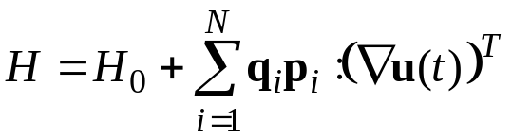
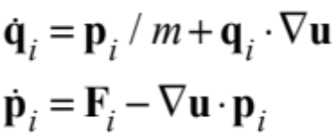
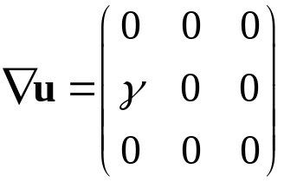
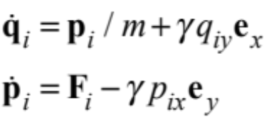
DOLLS-Tensor Hamiltonian: Perturbation
An arbitrary fictitious shear field can be imposed via the DOLLS-tensor Hamiltonian
Equations of motion
  must be implemented with compatible PBC
Example: Simple Couette shear

Slide 29
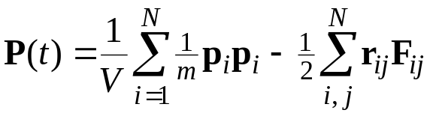
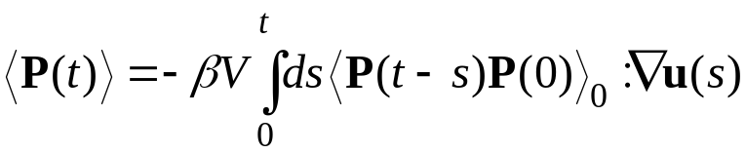
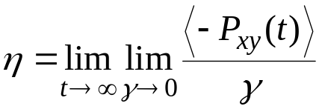
DOLLS-Tensor Hamiltonian: Response
Appropriate response variable is the pressure tensor
According to linear response theory
Shear viscosity, via Green-Kubo

Slide 30
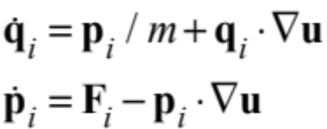
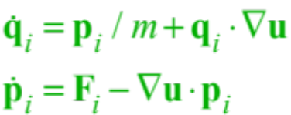

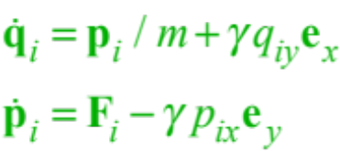

SLLOD Formulation
DOLLS-tensor formulation fails in more complex situations
  non-linear regime
  evaluation of normal-stress differences
  a simple change fixes things up
SLLOD Equations of motion
Example: Simple Couette shear
Methods equivalent for irrotational flows
DOLLS
Only change

Slide 31
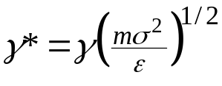


Application
NEMD usually introduces exceptionally large strain rates
  10⁸ sec⁻¹ or greater
  dimensionless strain rate
  thus, e.g.,
    m = 30g/mol; σ = 3A; ε/k = 100K; γ* = 1.0 → γ = 5×10¹¹ sec⁻¹
Shear-thinning observed even in simple fluids at these rates
Very important to extrapolate to zero shear
Newtonian

