Slide 1
CE 530 Molecular Simulation
Lecture 25
Efficiencies and Parallel Methods
David A. Kofke
Department of Chemical Engineering
SUNY Buffalo
kofke@eng.buffalo.edu

Slide 2
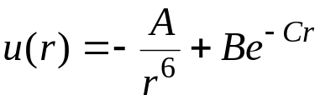
Look-Up Tables
Evaluation of interatomic potential can be time-consuming
  For example, consider the exp-6 potential
  Requires a square root and an exponential
Simple idea:
  Precompute a table of values at the beginning of the simulation and use it to evaluate the potential via interpolation

Slide 3





















Interpolation
Many interpolation schemes could be used
e.g., Newton-Gregory forward difference method
  equally spaced values δs of s = r²
  given u₁ = u(s₁), u₂ = u(s₂), etc.
  define first difference and second difference
  to get u(s) for s_{k} < s < s_{k+1}, interpolate
  forces, virial can be obtained using finite differences

Slide 4
Finding Neighbors Efficiently
Evaluation of all pair interactions is an O(N²) calculation
Very expensive for large systems
Not all interactions are relevant
  potential attenuated or even truncated beyond some distance
Worthwhile to have efficient methods to locate neighbors of any molecule
Two common approaches
  Verlet neighbor list
  Cell list
r_{c}

Slide 5
Verlet List
Maintain a list of neighbors
  Set neighbor cutoff radius as potential cutoff plus a “skin”
Update list whenever a molecule travels a distance greater than the skin thickness
Energy calculation is O(N)
Neighbor list update is O(N²)
  but done less frequently
r_{n}
r_{c}

Slide 6
Cell List
Partition volume into a set of cells
Each cell keeps a list of the atoms inside it
At beginning of simulation set up neighbor list for each cell
  list never needs updating
r_{c}

Slide 7
Cell List
Partition volume into a set of cells
Each cell keeps a list of the atoms inside it
At beginning of simulation set up neighbor list for each cell
  list never needs updating
r_{c}

Slide 8
Cell List
Partition volume into a set of cells
Each cell keeps a list of the atoms inside it
At beginning of simulation set up neighbor list for each cell
  list never needs updating
r_{c}

Slide 9
Cell List
Partition volume into a set of cells
Each cell keeps a list of the atoms inside it
At beginning of simulation set up neighbor list for each cell
  list never needs updating
Fewer unneeded pair interactions for smaller cells
r_{c}

Slide 10
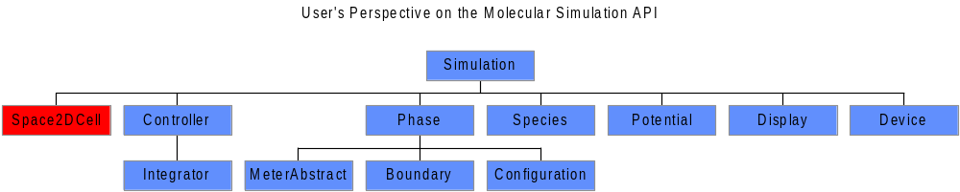
Cell Neighbor List: API
Key features of cell-list Space class
  Holds a Lattice object that forms the array of cells
  Each cell has linked list of atoms it contains
  Defines Coordinate to let each atom keep a pointer to its cell
  Defines Atom.Iterators that enumerate neighbor atoms

Slide 11
Cell Neighbor List: Java Code
public class Space2DCell.Coordinate extends Space2D.Coordinate
public class Coordinate extends Space2D.Coordinate implements Lattice.Occupant {
Coordinate nextNeighbor, previousNeighbor; //next and previous coordinates in neighbor list
public LatticeSquare.Site cell; //cell currently occupied by this coordinate
public Coordinate(Space.Occupant o) {super(o);} //constructor
public final Lattice.Site site() {return cell;} //Lattice.Occupant interface method
public final void setNextNeighbor(Coordinate c) {
nextNeighbor = c;
if(c != null) {c.previousNeighbor = this;}
}
public final void clearPreviousNeighbor() {previousNeighbor = null;}
public final Coordinate nextNeighbor() {return nextNeighbor;}
public final Coordinate previousNeighbor() {return previousNeighbor;}
//Determines appropriate cell and assigns it
public void assignCell() {
LatticeSquare cells = ((NeighborIterator)parentPhase().iterator()).cells;
LatticeSquare.Site newCell = cells.nearestSite(this.r);
if(newCell != cell) {assignCell(newCell);}
}
//Assigns atom to given cell; if removed from another cell, repairs tear in list
public void assignCell(LatticeSquare.Site newCell) {
if(previousNeighbor != null) {previousNeighbor.setNextNeighbor(nextNeighbor);}
else {
if(cell != null) cell.setFirst(nextNeighbor);
if(nextNeighbor != null) nextNeighbor.clearPreviousNeighbor();} //removing first atom in cell
cell = newCell;
if(newCell == null) return;
setNextNeighbor((Space2DCell.Coordinate)cell.first());
cell.setFirst(this);
clearPreviousNeighbor();
}
public class LatticeSquare
public final Site nearestSite(Space2D.Vector r) {
int ix = (int)Math.floor(r.x * dimensions[0]);
int iy = (int)Math.floor(r.y * dimensions[1]);
return sites[ix][iy];}

Slide 12
Cell Neighbor List: Java Code
public class Space2DCell.AtomIterator.UpNeighbor implements Atom.Iterator
//Returns next atom from iterator
public Atom next() {
nextAtom = (Atom)coordinate.parent(); //atom to be returned
coordinate = coordinate.nextNeighbor; //prepare for next atom
if(coordinate == null) {advanceCell();} //cell is empty; get atom from next cell
return nextAtom;
}
//Advances up through list of cells until an occupied one is found
private void advanceCell() {
while(coordinate == null) { //loop while on an empty cell
cell = cell.nextSite(); //next cell
if(cell == null) { //no more cells
allDone();
return;
}
coordinate = (Coordinate)cell.first; //coordinate of first atom in cell (possibly null)
}
}
1
2
a
3
b
4
5
6

Slide 13
Parallelizing Simulation Codes
Two parallelization strategies
  Domain decomposition
    Each processor focuses on fixed region of simulation space (cell)
    Communication needed only with adjacent-cell processors
    Enables simulation of very large systems for short times
  Replicated data
    Each processor takes some part in advancing all molecules
    Communication among all processors required
    Enables simulation of small systems for longer times

Slide 14
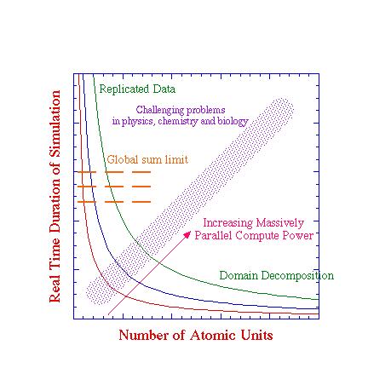
Limitations on Parallel Algorithms
Straightforward application of raw parallel power insufficient to probe most interesting phenomena
Advances in theory and technique needed to enable simulation of large systems over long times
Figure from P.T. Cummings

Slide 15
Parallelizing Monte Carlo
Parallel moves in independent regions
  moves and range of interactions cannot span large distances
Hybrid Monte Carlo
  apply MC as bad MD, and apply MD parallel methods
    time information lost while introducing limitations of MD
Farming of independent tasks or simulations
  equilibration phase is sequential
  often a not-too-bad approach
Parallel trials with coupled acceptance
  “Esselink” method

Slide 16
Esselink Method
1. Generate k trials from the present configuration
  each trial handled by a different processor
  useful if trials difficult to generate (e.g., chain configurational bias)

Slide 17
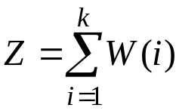







Esselink Method
1. Generate k trials from the present configuration
  each trial handled by a different processor
  useful if trials difficult to generate (e.g., chain configurational bias)
2. Compute an appropriate weight W(i) for each new trial
  e.g., Rosenbluth weight if CCB
  more simply, W(i) = exp[-U(i)/kT]
3. Define a normalization factor

Slide 18

Esselink Method
1. Generate k trials from the present configuration
  each trial handled by a different processor
  useful if trials difficult to generate (e.g., chain configurational bias)
2. Compute an appropriate weight W(i) for each new trial
  e.g., Rosenbluth weight if CCB
  more simply, W(i) = exp[-U(i)/kT]
3. Define a normalization factor
4. Select one trial with probability

Slide 19
Esselink Method
1. Generate k trials from the present configuration
  each trial handled by a different processor
  useful if trials difficult to generate (e.g., chain configurational bias)
2. Compute an appropriate weight W(i) for each new trial
  e.g., Rosenbluth weight if CCB
  more simply, W(i) = exp[-U(i)/kT]
3. Define a normalization factor
4. Select one trial with probability
Now account for reverse trial:
5. Pick a molecule from original configuration
  Need to evaluate a probability it would be generated from trial configuration
  Plan: Choose a path that includes the other (ignored) trials

Slide 20

Esselink Method
1. Generate k trials from the present configuration
  each trial handled by a different processor
  useful if trials difficult to generate (e.g., chain configurational bias)
2. Compute an appropriate weight W(i) for each new trial
  e.g., Rosenbluth weight if CCB
  more simply, W(i) = exp[-U(i)/kT]
3. Define a normalization factor
4. Select one trial with probability
Now account for reverse trial:
5. Pick a molecule from original configuration
  Need to evaluate a probability it would be generated from trial configuration
  Plan: Choose a path that includes the other (ignored) trials
6. Compute the reverse-trial W(o)

Slide 21

Esselink Method
1. Generate k trials from the present configuration
  each trial handled by a different processor
  useful if trials difficult to generate (e.g., chain configurational bias)
2. Compute an appropriate weight W(i) for each new trial
  e.g., Rosenbluth weight if CCB
  more simply, W(i) = exp[-U(i)/kT]
3. Define a normalization factor
4. Select one trial with probability
Now account for reverse trial:
5. Pick a molecule from original configuration
  Need to evaluate a probability it would be generated from trial configuration
  Plan: Choose a path that includes the other (ignored) trials
6. Compute the reverse-trial W(o)
7. Compute reverse-trial normalizer

Slide 22
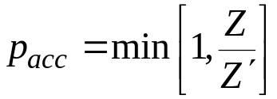
Esselink Method
1. Generate k trials from the present configuration
  each trial handled by a different processor
  useful if trials difficult to generate (e.g., chain configurational bias)
2. Compute an appropriate weight W(i) for each new trial
  e.g., Rosenbluth weight if CCB
  more simply, W(i) = exp[-U(i)/kT]
3. Define a normalization factor
4. Select one trial with probability
Now account for reverse trial:
5. Pick a molecule from original configuration
  Need to evaluate a probability it would be generated from trial configuration
  Choose a path that includes the other (ignored) trials
6. Compute the reverse-trial W(o)
7. Compute reverse-trial normalizer
8. Accept new trial with probability

Slide 23
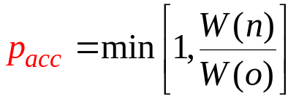
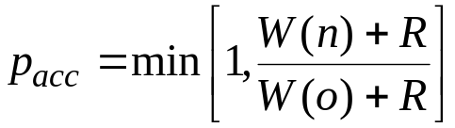
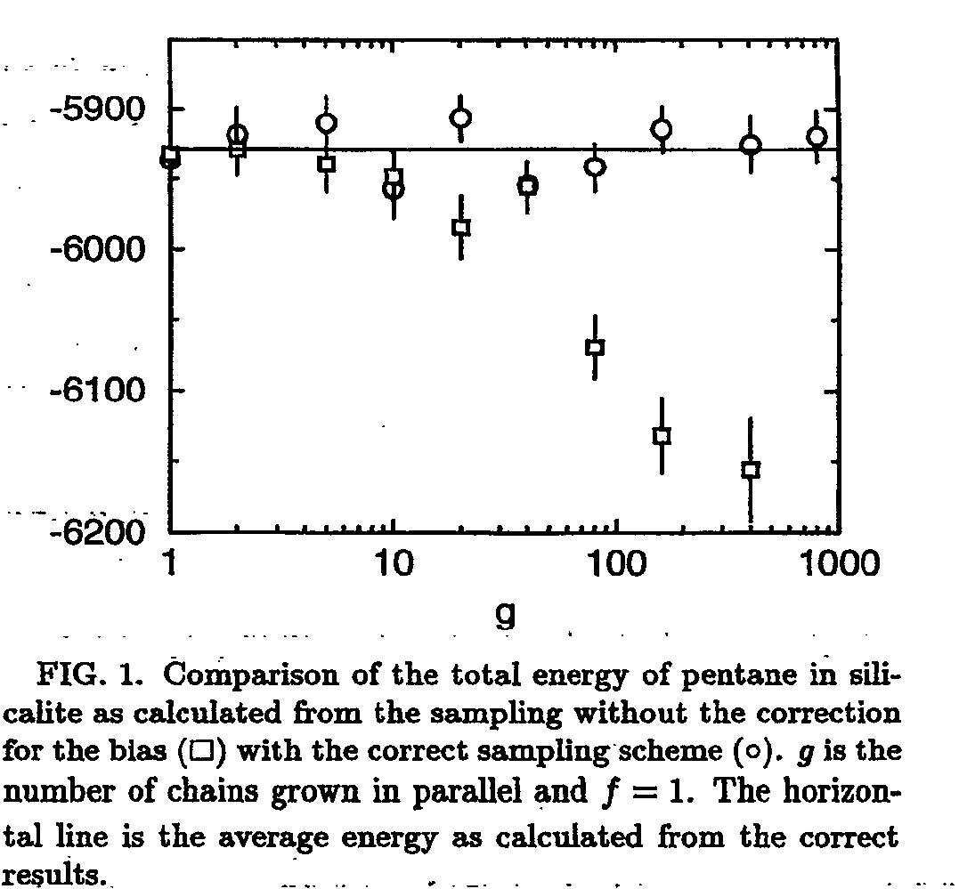
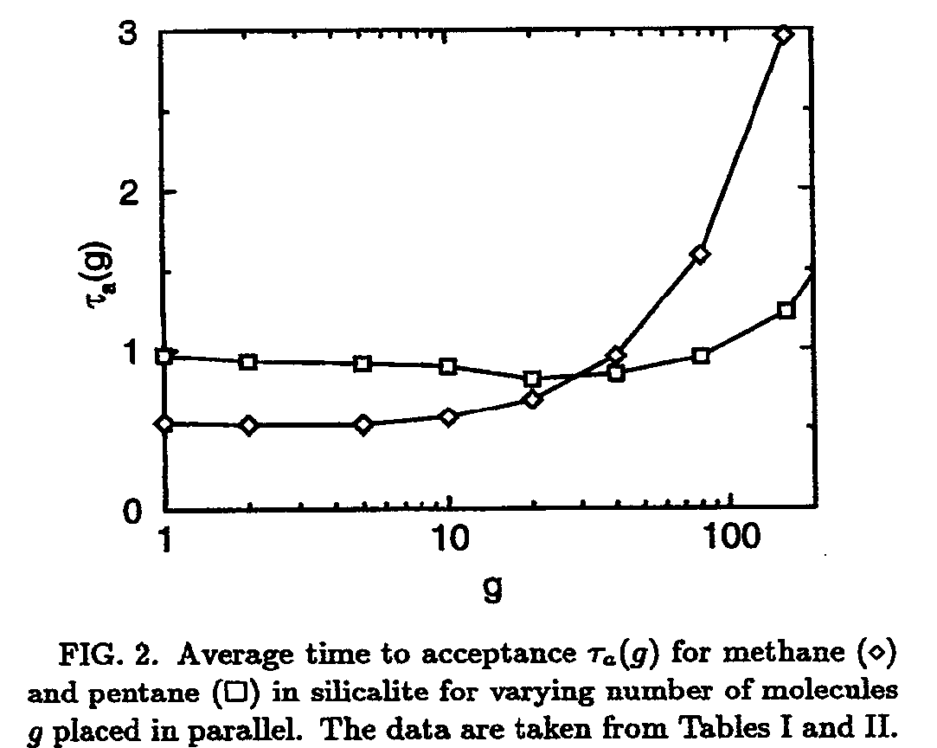
Some Results
Use of an incorrect acceptance probability
A sequential implemention
Average cpu time to acceptance of a trial
  independent of number of trials g up to about g = 10
  indicates parallel implementation with g = 10 would have 10× speedup
  larger g is wasteful because acceptable configurations are rejected
    only one can be accepted per move
Esselink et al., PRE, 51(2) 1995

Slide 24


Simulation of Infrequent Events
Some processes occur quickly but infrequently; e.g.
  rotational isomerization
  diffusion in a solid
  chemical reaction
Time between events may be microseconds or longer, but event transpires over picoseconds
observable
time

Slide 25
Transition-State Theory
Analysis of activation barrier for process
Transition is modeled as product of two probabilities
  probability that reaction coordinate has maximum value
    given by free-energy calculation (integration to top of barrier)
  probability that it proceeds to “product” given that it is at the maximum
    given by linear-response theory calculation performed at top of barrier
Requires a priori specification of rxn coordinate and barrier value
Free energy
Reaction coordinate

Slide 26
Parallel Replica Method
(Voter’s Method)
Establish several configurations with same coordinates, but different initial momenta
Specify criterion for departure from current “basin” in phase space
  e.g., location of energy minimum
    evaluate with steepest-descent or conjugate-gradient methods
Perform simulation dynamics in parallel for different initial systems
Continue simulations until one of the replicas is observed to depart its local basin
Advance simulation clock by sum of simulation times of all replicas
Repeat beginning all replicas with coordinates of escaping replica

Slide 27

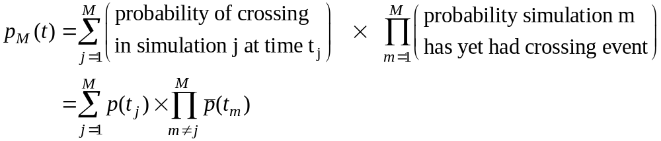
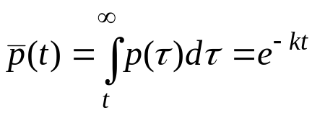
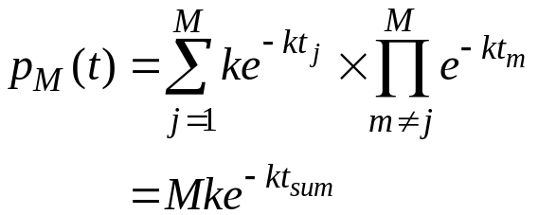
Theory Behind Voter’s Method
Assumes independent, uncorrelated crossing events
Probability distribution for a crossing event (sequential calculation)
Probability distribution for crossing event in any of M simulations
No-crossing cumulative probability
Thus
k = crossing rate constant
Rate constant for independent crossings is same as for individual crossings, if t_{sum} is used

Slide 28
Appealing Features of Voter’s Method
No a priori specification of transition path / reaction coordinate required
  Works well with multiple (unidentified) transition states
  Does not require specification of “product” states
Parallelizes time calculation
  “Discarded” simulations are not wasted
Works well in a heterogeneous environment of computing platforms
  OK to have processors with different computing power
  Parallelization is loosely coupled

Slide 29
Summary
Some simple efficiencies to apply to simulations
  Table look-up of potentials
  Cell lists for identifying neighbors
Parallelization methods
  Time parallelization is difficult
  Esselink method for parallelization of MC trials
  Voter’s method for parallelization of MD simulation of rare events

