Slide 1
CE 530 Molecular Simulation
Lecture 3
Common Elements of a Molecular Simulation
David A. Kofke
Department of Chemical Engineering
SUNY Buffalo
kofke@eng.buffalo.edu

Slide 2
Boundary Conditions
Impractical to contain system with a real boundary
  Enhances finite-size effects
  Artificial influence of boundary on system properties
Instead surround with replicas of simulated system
  “Periodic Boundary Conditions” (PBC)
  Click here to view an applet demonstrating PBC

Slide 3
Issues with Periodic Boundary Conditions 1.
Minimum image convention
  Consider only nearest image of a given particle when looking for collision partners
Nearest images of colored sphere

Slide 4
Issues with Periodic Boundary Conditions 2.
Caution not to miss collisions
  click here for a bad simulation
…but these will collide
These two are checked...

Slide 5
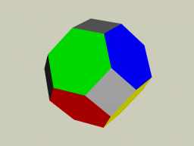
Issues with Periodic Boundary Conditions 3.
Correlations
  new artificial correlations
  supressed long-range correlations
Other issues arise when dealing with longer-range potentials
  accounting for long-range interactions
  nearest image not always most energetic
  splitting of molecules (charges)
  discuss details later
Other geometries possible
  any space-filling unit cell
    hexagonal in 2D
    truncated octahedron in 3D
    rhombic dodecahedron in 3D
  surface of a (hyper)sphere
  variable aspect ratio useful for solids
    relieves artificial stresses

Slide 6
Implementing Cubic Periodic Boundaries 1.
Details vary with representation of coordinates
  Box size
    unit box, coordinates scaled by edge length
    dr.x = dimensions.x * (r1.x - r2.x); //difference in x coordinates
    full-size box, coordinates represent actual values
  Box origin
    center of box, coordinates range from -L/2 to +L/2
    corner of box, coordinates range from 0 to L
Two approaches
  decision based (“if” statements)
  function based (rounding (nint), truncation, modulo)
  relative speed of each approach may vary substantially from one computer platform to another
-0.5
+0.5
+0.5
(0,0)
-0.5

Slide 7
Implementing Cubic Periodic Boundaries 2.
Central-image codes
Involved in most time-consuming part of simulation
(0,1) coordinates, decision based
  r.x -= (r.x > 0.0) ? Math.floor(r.x) : Math.ceil(r.x-1.0); //Java syntax
  examples: -0.2 → +0.8; -1.4 → +0.6; +0.4 → +0.4; +0.6 → +0.6; +1.5 → +0.5
(0,L) coordinates, decision based
  r.x -= dimensions.x * ((r.x > 0.0) ? Math.floor(r.x/dimensions.x) : Math.ceil(r.x/dimensions.x-1.0));
(-1/2, 1/2), decision based
  if(r.x > 0.5) r.x -= 1.0; if(r.x < -0.5) r.x += 1.0; //only first shell
  examples: -0.2 → -0.2; -1.4 → -0.4; +0.4 → +0.4; +0.6 → -0.4; +1.5 →f +0.5
(-1/2, 1/2), function based
  r.x -= Math.round(r.x);//nearest integer (r.x must be float, not double)
(0,L), function based
  r.x %= dimensions.x; if(r.x < 0.0) r.x += dimensions.x;//modulo operator
N.B. Most code segments are untested

Slide 8
Implementing Cubic Periodic Boundaries 3.
Nearest-image codes
Simply apply (-1/2,1/2) central-image code to raw difference!
  dr.x = r1.x - r2.x; //unit box length
  if(dr.x > 0.5) dr.x -= 1.0;
  if(dr.x < -0.5) dr.x += 1.0;
  dr.x *= dimensions.x;
Or…
  dr.x = r1.x - r2.x; //true box length
  dr.x -= dimensions.x * Math.round(dr.x/dimensions.x);
Take care not to lose correct sign, if doing force calculation
Nearest image for non-cubic boundary not always given simply in terms of a central-image algorithm

Slide 9
Structure of a Molecular Simulation 1.
Initialization
Reset block sums
“cycle” or “sweep”
New configuration
moves per cycle
“block”
Move each atom once (on average)
Add to block sum
100’s or 1000’s of cycles
Independent “measurement”
cycles per block
Compute block average
blocks per simulation
Compute final results

Slide 10




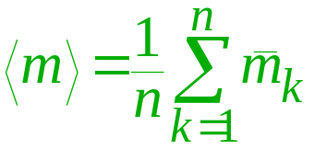
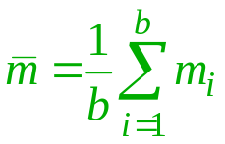
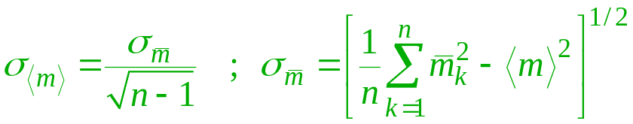
Structure of a Molecular Simulation 2.
Progress of simulation
….
Δt
MD time step or MC cycle
property
value m_{i}
Complete simulation
simulation average
simulation error bar
m₁
m₅
m₇
m₃
m₇
m₉
….
m_{b-1}
m₂
m₄
m₆
m₈
m_{b}
Simulation block
block average

Slide 11



Confidence Limits on Simulation Averages 1.
Given a set of measurements {m_{i}}, for some property M
There exists a distribution of values from which these measurements were sampled
We do not know, a priori, any details of this distribution
We wish to use our measurements {m_{i}} to estimate the mean of the true distribution
Not surprisingly, the best estimate of the mean of the true distribution is given by the mean of the sample
We need to quantify our confidence in the value of this estimate for the mean
We must do this using only the sample data
{0.01, 0.1, 0.9, 0.06, 0.5, 0.3, 0.02}
p(M)
?
0
M
1
<m> = (0.01+0.1+0.9+0.06+0.5+0.3+0.02)/7 = 0.27

Slide 12



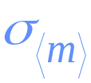
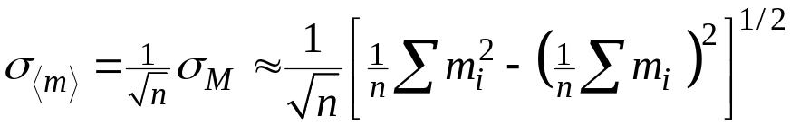

Confidence Limits on Simulation Averages 2.
Imagine repeating this experiment many (infinity) times, each time taking a sample of size n.
If we say “68% of all the sample means <m> lie within [some value] of the true mean.”…
…then [some value] serves as a confidence limit
According to the Central Limit Theorem, the distribution of observations of the sample mean <m> will follow a gaussian, with
  mean
  variance
Our confidence limit is then
We can only estimate this using the sample variance
p(<m>)
<m>
= 0.12
(true value)

Slide 13
Confidence Limits on Simulation Averages 3.
Expression for confidence limit (error bar) assumes independent samples
  successive configurations in a simulation are (usually) not independent
  block averages are independent for “sufficiently large” blocks
Often 2σ is used for error bar (95% confidence interval)
  when reporting error bars it is good practice to state definition
Confidence limits quantify only statistical errors. Sometimes other sources of error are more significant
  systematic errors
    poor sampling (non-ergodic)
    finite-size effects
    insufficient equilibration
  programming errors
  conceptual errors
  limitations of the molecular model

Slide 14
Simulation Initialization
Need to establish initial values for atom positions and momenta before simulation can begin
Two options
  use values from end of another simulation
  generate configuration from scratch
Often an equilibration period is warranted
  lets system “forget” artificial initial configuration
  length of period depends on relaxation time of system
    5000 cycles typical
Re-zero simulation sums
Relaxation cycles
Production cycles

Slide 15
Generating an Initial Configuration
Placement on a lattice is a common choice
  gives rise to “magic” numbers frequently seen in simulations
    2D; N = 2n² (8, 18, 32, 50, 72, 98, 128, …)
    3D, face-center cubic (fcc);
    N = 4n³ (32, 128, 256, 500, 864, 1372, 2048,…)
Other options involve “simulation”
  place at random, then move to remove overlaps
  randomize at low density, then compress
  other techniques invented as needed
Orientations done similarly
  lattice or random, if possible
PBC image atoms
hexagonal incompatible with cubic PBC

Slide 16



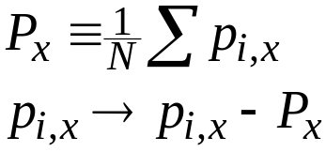
Initial Velocities
Random direction
  randomize each component independently
  randomize direction by choosing point on spherical surface
Magnitude consistent with desired temperature. Choices:
  Maxwell-Boltzmann:
  Uniform over (-1/2,+1/2), then scale so that
  Constant at
  Same for y, z components
Be sure to shift so center-of-mass momentum is zero
Unnecessary for Monte Carlo simulations (of course)

Slide 17
Summary of Simulation Elements
Specification of state
Units and dimensions, scaling
Initialization
Generation of configurations
Property measurement
Confidence limits
Cycles and blocks
Periodic boundaries
Organizing and cycling through atom lists

