Slide 1
CE 530 Molecular Simulation
Lecture 6
Statistical Mechanics
David A. Kofke
Department of Chemical Engineering
SUNY Buffalo
kofke@eng.buffalo.edu

Slide 2
Statistical Mechanics
Theoretical basis for derivation of macroscopic behaviors from microscopic origins
Two fundamental postulates of equilibrium statistical mechanics
  microstates of equal energy are equally likely
  time average is equivalent to ensemble average
Formalism extends postulates to more useful situations
  thermal, mechanical, and/or chemical equilibrium with reservoirs
    systems at constant T, P, and/or μ
  yields new formulas for probabilities of microstates
    derivation invokes thermodynamic limit of very large system
Macroscopic observables given as a weighted sum over microstates
  dynamic properties require additional formalism

Slide 3
Ensembles
Definition of an ensemble
  Collection of microstates subject to at least one extensive constraint
    “microstate” is specification of all atom positions and momenta
    fixed total energy, total volume, and/or total number of molecules
    unconstrained extensive quantities are represented by full range of possible values
  Probability distribution π describing the likelihood of observing each state, or the weight that each state has in ensemble average
Example: Some members of ensemble of fixed N
  isothermal-isobaric (TPN)
    all energies and volumes represented
Low-probability state

Slide 4
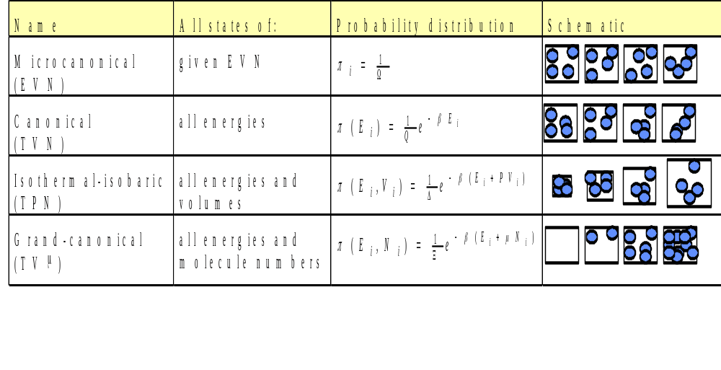

Commonly Encountered Ensembles

Slide 5
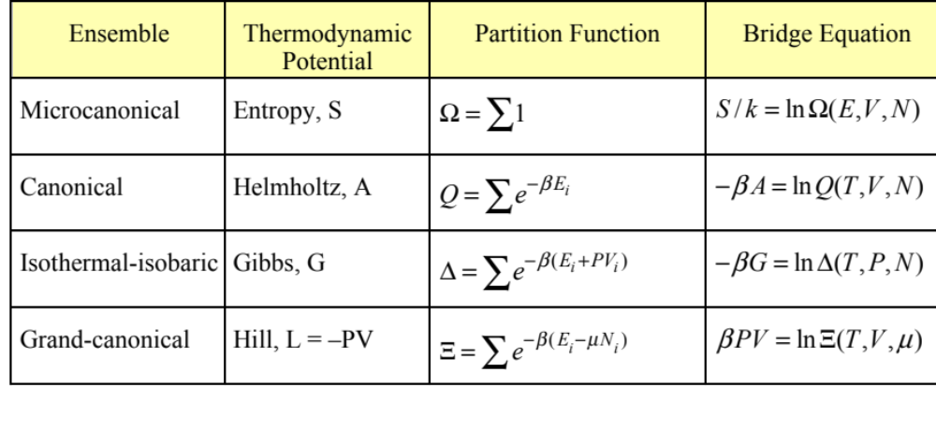
Partition Functions
The normalization constants of the probability distributions are physically significant
  known as the partition function
  relates to a corresponding free energy, or thermodynamic potential, via a bridge equation

Slide 6


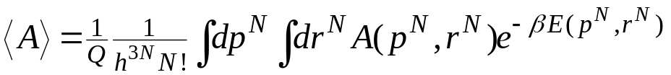
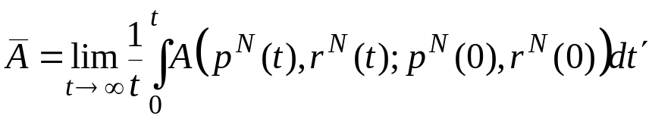
Ensemble and Time Averaging
Configuration given by all positions and momenta
  “phase space”
Configuration variable A(r^{N},p^{N})
Ensemble average
  Weighted sum over all members of ensemble
  In general
  For example, canonical ensemble, classical mechanics:
Time average
  Sum over all states encountered in dynamical trajectory of system
r^{N} shorthand for “positions of all N atoms”
Should average over initial conditions
Given by equations of motion

Slide 7
Ergodicity
If a time average does not give complete representation of full ensemble, system is non-ergodic
  Truly nonergodic: no way there from here
  Practically nonergodic: very hard to find route from here to there
Term applies to any algorithm that purports to generate a representative set of configurations from the ensemble
Click here for an applet describing ergodicity.
Phase space

Slide 8

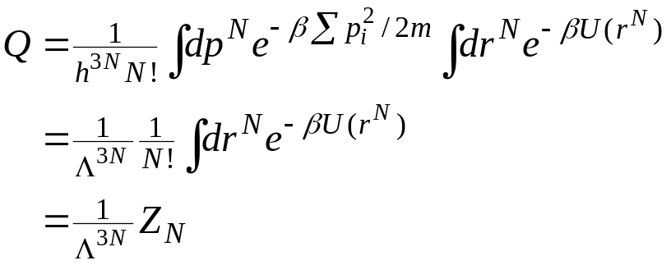

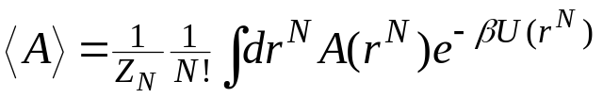
Separation of the Energy
Total energy is sum of kinetic and potential parts
  E(p^{N},r^{N}) = K(p^{N}) + U(r^{N})
Kinetic energy is quadratic in momenta
Kinetic contribution can be treated analytically in partition function
And it drops out of position averages
thermal de Broglie wavelength
configuration integral

Slide 9
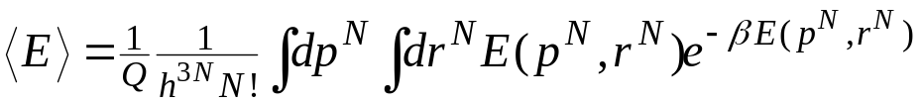
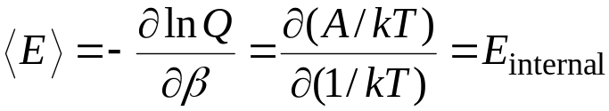
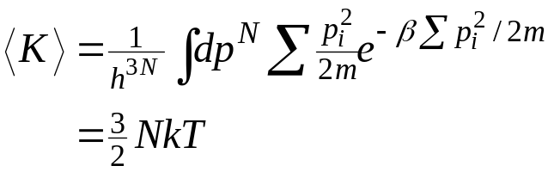
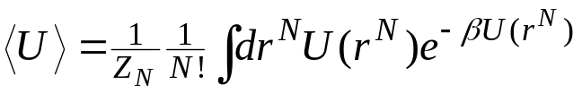
Simple Averages 1. Energy
Average energy
Note thermodynamic connection
Average kinetic energy
Average potential energy
definition of Q; calculus
bridge equation
Gibbs-Helmholtz equation
Equipartition of energy: kT/2 for each degree of freedom

Slide 10
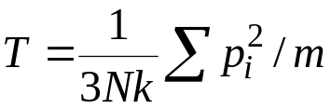

Simple Averages 2. Temperature
Need to measure temperature in microcanonical ensemble (NVE) simulations
Define instantaneous kinetic temperature
Thermodynamic temperature is then given as ensemble average
Relies on equipartition as developed in canonical ensemble
A better formulation has been developed recently
More generally, divide by number of molecular degrees of freedom instead of 3N

Slide 11
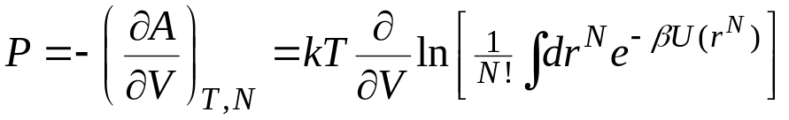
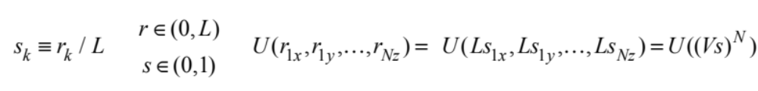
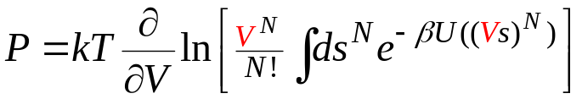
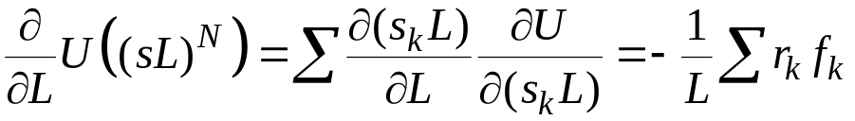
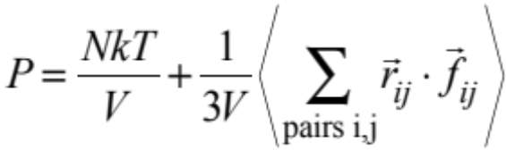
Simple Averages 3a. Pressure
From thermodynamics and bridge equation
Volume appears in limits of integration
  Scale coordinates to move volume dependence into the potential
  L-derivative of U is related to force
Result
V = L³
L
1

Slide 12
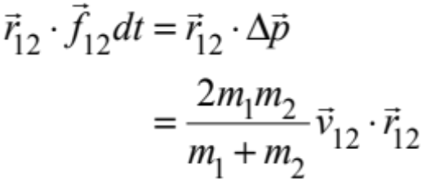
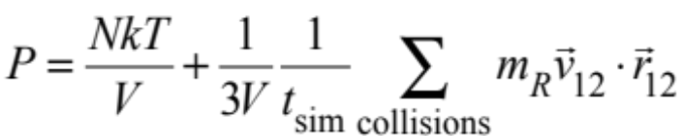
Simple Averages 3b. Hard-Sphere Pressure
Force is zero except at collision
Time integration of virial over instant of collision is finite
  contribution over instant of collision
Pressure is sum over collisions

Slide 13
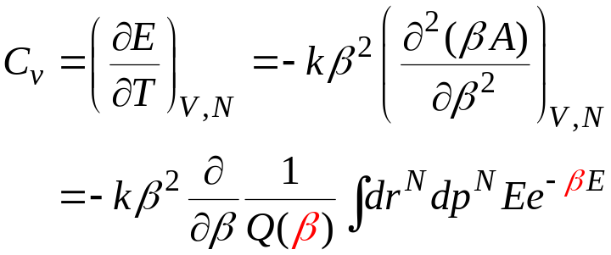

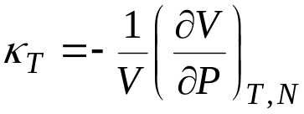
Simple Averages 4. Heat Capacity
Example of a “2nd derivative” property
Expressible in terms of fluctuations of the energy
Other 2nd-derivative or “fluctuation” properties
  isothermal compressibility
Note: difference between two O(N²) quantities to give a quantity of O(N)

Slide 14
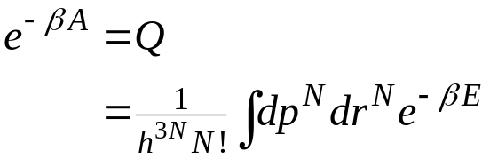
(Not) Simple Averages 5. Free Energy
Free energy given as partition-function integral
Impossible to evaluate
  Even numerically!
  Click here for an applet demonstrating the difficulty
Free energy involves properties of entire ensemble
  No value associated with a single member of ensemble
  For example, the size of (number of members in) the ensemble
The trick is to settle for computing free-energy differences
Return to this topic later in course

Slide 15
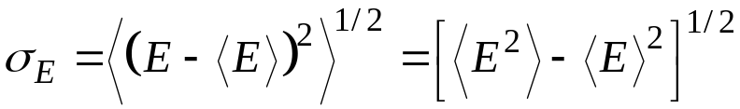

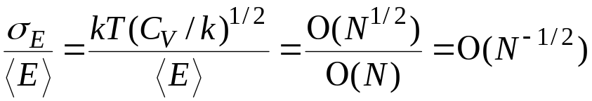
Fluctuations
How complete is the mean as a statistic of ensemble behavior?
  Are there many members of the ensemble that have properties that deviate substantially from the mean?
  Look at the standard deviation σ
  This relates to the heat capacity
  Relative to mean is the important measure
Fluctuations vanish in thermodynamic limit N➔∞
Similar measures apply in other ensembles
  volume fluctuations in NPT; molecule-number fluctuations in μVT
Click here for an applet illustrating fluctuations
p(E)
σ_{E}
E
<E>

