Slide 1
CE 530 Molecular Simulation
Lecture 7
Monte Carlo Integration and Importance Sampling
David A. Kofke
Department of Chemical Engineering
SUNY Buffalo
kofke@eng.buffalo.edu

Slide 2
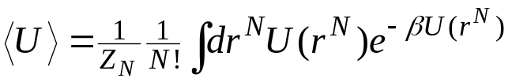

Monte Carlo Simulation
Gives properties via ensemble averaging
  No time integration
  Cannot measure dynamical properties
Employs stochastic methods to generate a (large) sample of members of an ensemble
  “random numbers” guide the selection of new samples
Permits great flexibility
  members of ensemble can be generated according to any convenient probability distribution…
  …and any given probability distribution can be sampled in many ways
  strategies developed to optimize quality of results
    ergodicity — better sampling of all relevant regions of configuration space
    variance minimization — better precision of results
MC “simulation” is the evaluation of statistical-mechanics integrals
still too hard!

Slide 3

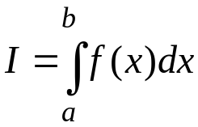

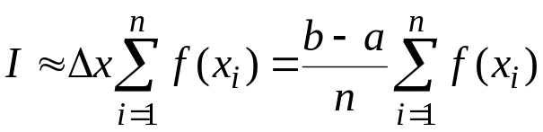
One-Dimensional Integrals
Methodical approaches
  rectangle rule, trapezoid rule, Simpson’s rule
Quadrature formula
Sum areas of shapes approximating shape of curve
Evaluating the general integral
n uniformly separated points

Slide 4
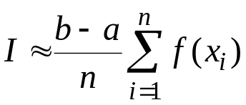

Monte Carlo Integration
Stochastic approach
Same quadrature formula, different selection of points
Click here for an applet demonstrating MC integration
n points selected from uniform distribution π(x)

Slide 5

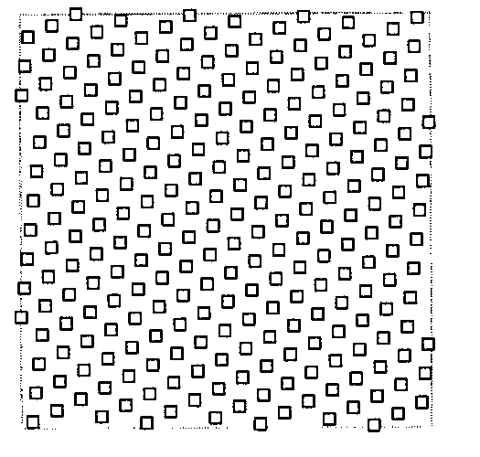
Random Number Generation
Random number generators
  subroutines that provide a new random deviate with each call
  basic generators give value on (0,1) with uniform probability
  uses a deterministic algorithm (of course)
    usually involves multiplication and truncation of leading bits of a number
Returns set of numbers that meet many statistical measures of randomness
  histogram is uniform
  no systematic correlation of deviates
    no idea what next value will be from knowledge of
    present value (without knowing generation algorithm)
    but eventually, the series must end up repeating
Some famous failures
  be careful to use a good quality generator
linear congruential sequence
Plot of successive deviates (X_{n},X_{n+1})
Not so random!

Slide 6




Errors in Random vs. Methodical Sampling
for example (Simpson’s rule)
Comparison of errors
  methodical approach
  Monte Carlo integration
MC error vanishes much more slowly for increasing n
For one-dimensional integrals, MC offers no advantage
This conclusion changes as the dimension d of the integral increases
  methodical approach
  MC integration
MC “wins” at about d = 4
independent of dimension!
d = 2
36 points, 36^{1/2} = 6 in each row

Slide 7
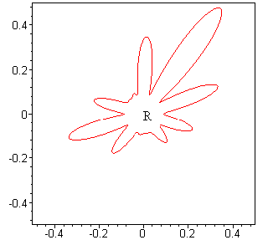
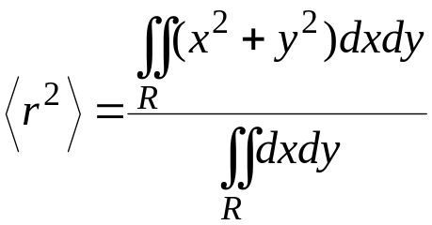
Shape of High-Dimensional Regions
Two (and higher) dimensional shapes can be complex
How to construct and weight points in a grid that covers the region R?
Example: mean-square distance from origin

Slide 8

Shape of High-Dimensional Regions
Two (and higher) dimensional shapes can be complex
How to construct and weight points in a grid that covers the region R?
  hard to formulate a methodical algorithm in a complex boundary
  usually do not have analytic expression for position of boundary
  complexity of shape can increase unimaginably as dimension of integral grows
We need to deal with 100+ dimensional integrals
Example: mean-square distance from origin

Slide 9
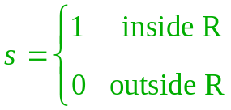
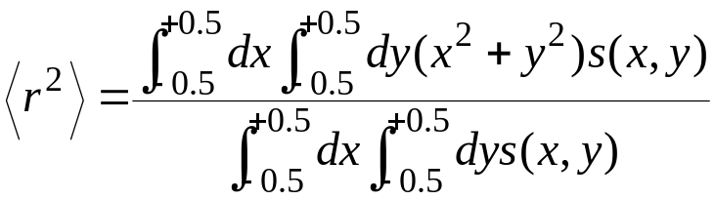
Integrate Over a Simple Shape? 1.
Modify integrand to cast integral into a simple shaped region
  define a function indicating if inside or outside R
Difficult problems remain
  grid must be fine enough to resolve shape
  many points lie outside region of interest
  too many quadrature points for our high-dimensional integrals (see applet again)
Click here for an applet demonstrating 2D quadrature

Slide 10

Integrate Over a Simple Shape? 2.
Statistical-mechanics integrals typically have significant contributions from miniscule regions of the integration space
  contributions come only when no spheres overlap
  e.g., 100 spheres at freezing the fraction is 10⁻²⁶⁰
Evaluation of integral is possible only if restricted to region important to integral
  must contend with complex shape of region
  MC methods highly suited to “importance sampling”

Slide 11
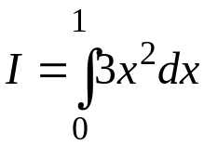

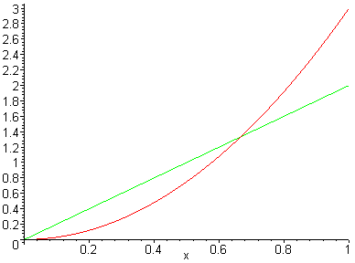

Importance Sampling
Put more quadrature points in regions where integral receives its greatest contributions
Return to 1-dimensional example
Most contribution from
region near x = 1
Choose quadrature points
not uniformly, but according
to distribution π(x)
  linear form is one possibility
How to revise the integral to remove the bias?

Slide 12
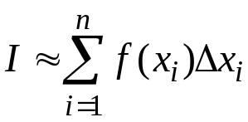
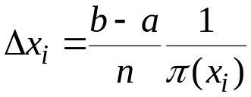




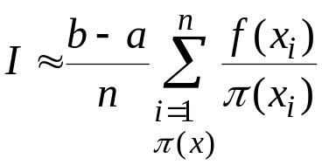
The Importance-Sampled Integral
Consider a rectangle-rule quadrature with unevenly spaced abscissas
Spacing between points
  reciprocal of local number of points per unit length
Importance-sampled rectangle rule
  Same formula for MC sampling
…
Greater π ==> more points ➔ smaller spacing
choose x points according to π

Slide 13
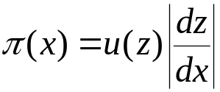



Generating Nonuniform Random Deviates
Probability theory says...
  ...given a probability distribution u(z)
  if x is a function x(z),
  then the distribution of π(x) obeys
Prescription for π(x)
  solve this equation for x(z)
  generate z from the uniform random generator
  compute x(z)
Example
  we want on x = (0,1)
  then
  so x = z^{1/2}
  taking square root of uniform deviate gives linearly distributed values
Generating π(x) requires knowledge of
a and c from “boundary conditions”

Slide 14
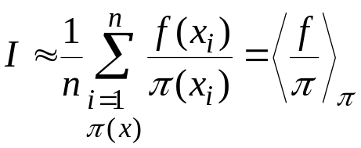
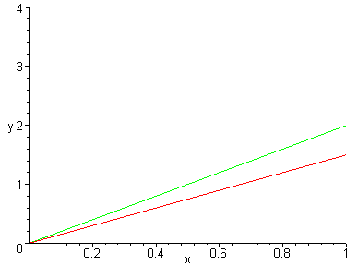
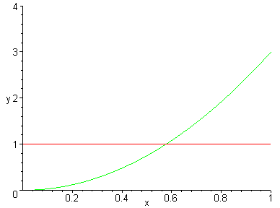
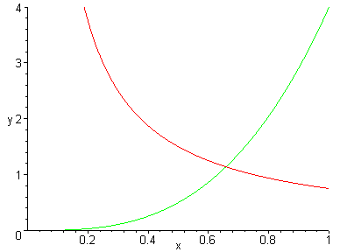





Choosing a Good Weighting Function
MC importance-sampling quadrature formula
Do not want π(x) to be too much smaller or too much larger than f(x)
  too small leads to significant contribution from poorly sampled region
  too large means that too much sampling is done in region that is not (now) contributing much

Slide 15

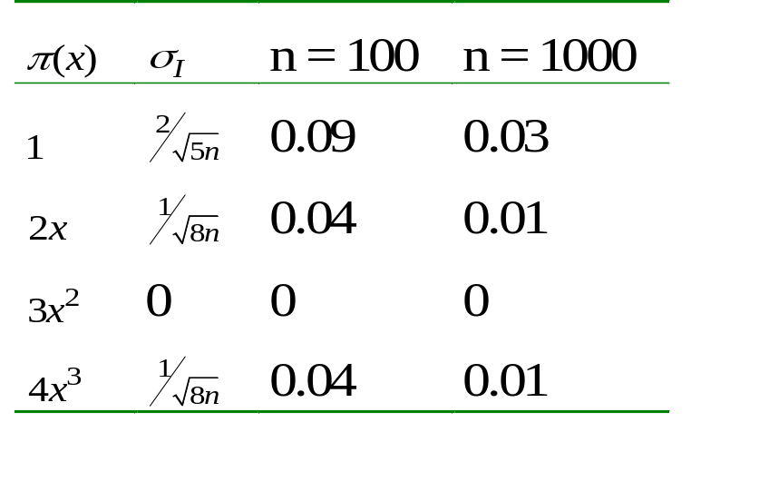
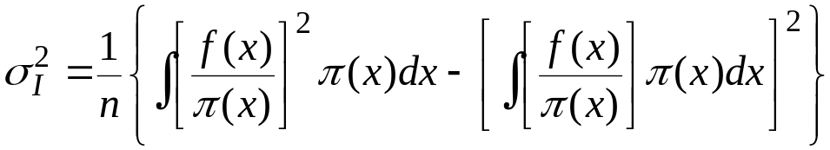

Variance in Importance Sampling Integration
Choose π to minimize variance in average
Smallest variance in average corresponds to π(x) = c × f(x)
  not a viable choice
  the constant here is selected to normalize π
  if we can normalize π we can evaluate
  this is equivalent to solving the desired integral of f(x)
Click here for an applet demonstrating importance sampling

Slide 16
Summary
Monte Carlo methods use stochastic process to answer a non-stochastic question
  generate a random sample from an ensemble
  compute properties as ensemble average
  permits more flexibility to design sampling algorithm
Monte Carlo integration
  good for high-dimensional integrals
    better error properties
    better suited for integrating in complex shape
Importance Sampling
  focuses selection of points to region contributing most to integral
  selecting of weighting function is important
  choosing perfect weight function is same as solving integral
Next up:
  Markov processes: generating points in a complex region

