Slide 1
CE 530 Molecular Simulation
Lecture 8
Markov Processes
David A. Kofke
Department of Chemical Engineering
SUNY Buffalo
kofke@eng.buffalo.edu

Slide 2
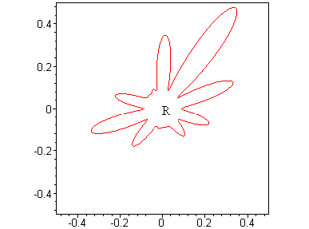
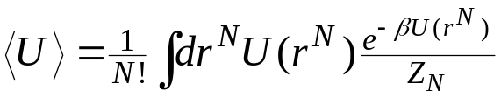
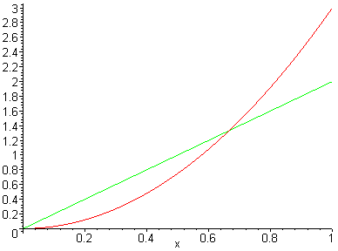
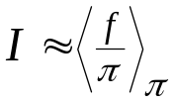
Monte Carlo Integration: Review
Stochastic evaluation of integrals
  sum integrand evaluated at randomly generated points
  most appropriate for high-dimensional integrals
    error vanishes more quickly (1/n^{1/2})
    better suited for complex-shaped domains of integration
Monte Carlo simulation
  Monte Carlo integration for ensemble averages
Importance Sampling
  emphasizes sampling in domain where integrand is largest
  it is easy to generate points according to a simple distribution
  stat mech π distributions are too complex for direct sampling
  need an approach to generate random multidimensional points according to a complex probability distribution
  then integral is given by
π(r^{N})

Slide 3
Markov Processes
Stochastic process
  movement through a series of well-defined states in a way that involves some element of randomness
  for our purposes,“states” are microstates in the governing ensemble
Markov process
  stochastic process that has no memory
  selection of next state depends only on current state, and not on prior states
  process is fully defined by a set of transition probabilities π_{ij}
    π_{ij} = probability of selecting state j next, given that presently in state i.
    Transition-probability matrix Π collects all π_{ij}

Slide 4
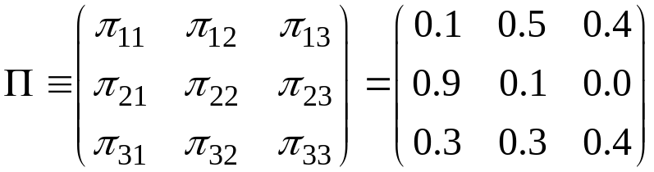
Transition-Probability Matrix
Example
  system with three states
Requirements of transition-probability matrix
  all probabilities non-negative, and no greater than unity
  sum of each row is unity
  probability of staying in present state may be non-zero
If in state 1, will stay in state 1 with probability 0.1
If in state 1, will move to state 3 with probability 0.4
Never go to state 3 from state 2

Slide 5
Distribution of State Occupancies
Consider process of repeatedly moving from one state to the next, choosing each subsequent state according to Π
  1→ 2 → 2 → 1→3 → 2 → 2 → 3 → 3 → 1 → 2 → 3 → etc.
Histogram the occupancy number for each state
  n₁ = 3 π₁ = 0.33
  n₂ = 5 π₂ = 0.42
  n₃ = 4 π₃ = 0.25
After very many steps, a limiting distribution emerges
Click here for an applet that demonstrates a Markov process and its approach to a limiting distribution
2
1
3

Slide 6
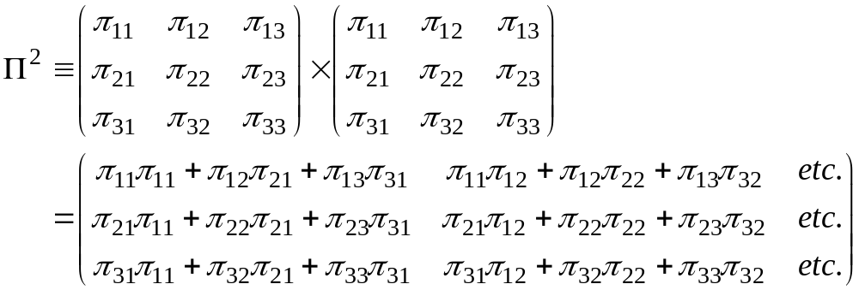

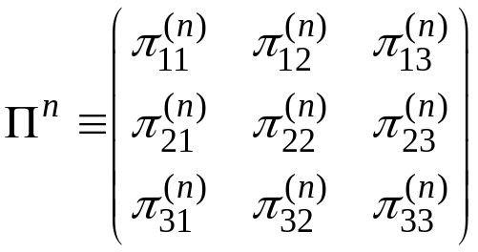

The Limiting Distribution 1.
Consider the product of Π with itself
In general is the n-step transition probability matrix
  probabilities of going from state i to j in exactly n steps
All ways of going from state 1 to state 2 in two steps
Probability of going from state 3 to state 2 in two steps

Slide 7


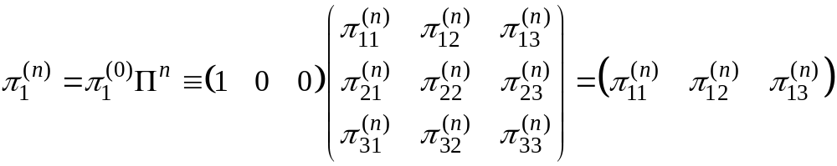

The Limiting Distribution 2.
Define as a unit state vector
Then is a vector of probabilities for ending at each state after n steps if beginning at state i
The limiting distribution corresponds to n → ∞
  independent of initial state

Slide 8
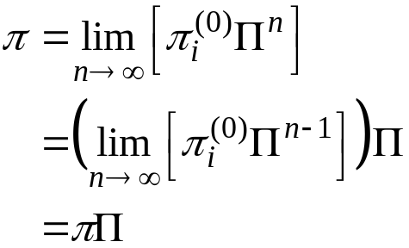
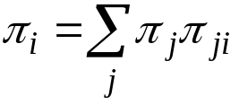
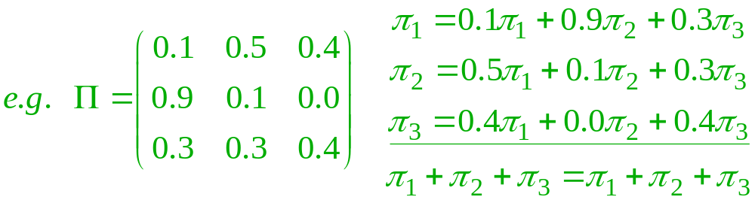
The Limiting Distribution 3.
Stationary property of π
π is a left eigenvector of Π with unit eigenvalue
  such an eigenvector is guaranteed to exist for matrices with rows that each sum to unity
Equation for elements of limiting distribution π
not independent

Slide 9

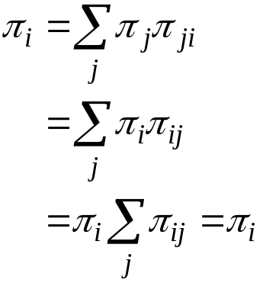
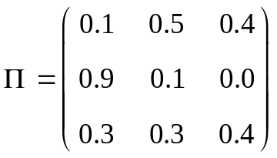

Detailed Balance
Eigenvector equation for limiting distribution
A sufficient (but not necessary) condition for solution is
  “detailed balance” or “microscopic reversibility”
Thus
For a given Π, it is not always possible to satisfy detailed balance; e.g. for this Π
zero

Slide 10
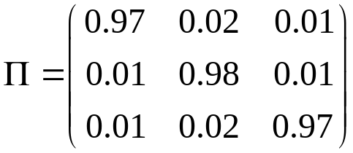

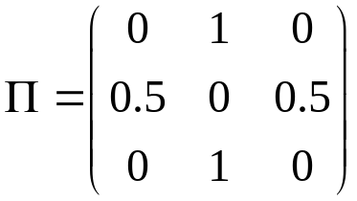
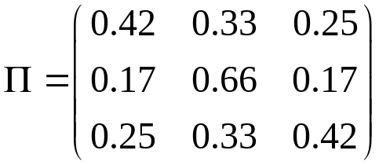
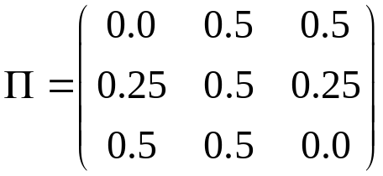
Deriving Transition Probabilities
Turn problem around...
…given a desired π, what transition probabilities will yield this as a limiting distribution?
Construct transition probabilities to satisfy detailed balance
Many choices are possible
  e.g.
  try them out
Least efficient
Most efficient
Barker
Metropolis

Slide 11

Metropolis Algorithm 1.
Prescribes transition probabilities to satisfy detailed balance, given desired limiting distribution
Recipe:
From a state i…
  with probability τ_{ij}, choose a trial state j for the move (note: τ_{ij} = τ_{ji})
  If π_{j} > π_{i}, accept j as the new state
  otherwise, accept state j with probability π_{j}/π_{i}
    generate a random number R on (0,1); accept if R < π_{j}/π_{i}
  if not accepting j as the new state, take the present state as the next one in the Markov chain
Metropolis, Rosenbluth, Rosenbluth, Teller and Teller, J. Chem. Phys., 21 1087 (1953)

Slide 12
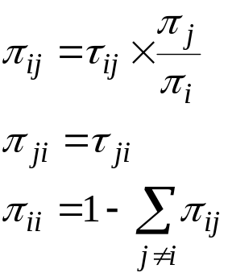

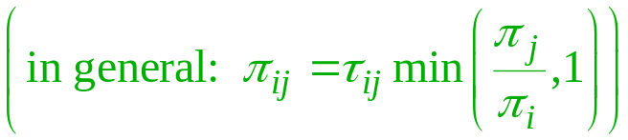
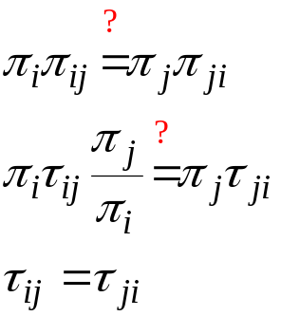
Metropolis Algorithm 2.
What are the transition probabilities for this algorithm?
  Without loss of generality, define i as the state of greater probability
Do they obey detailed balance?
Yes, as long as the underlying matrix Τ of the Markov chain is symmetric
  this can be violated, but acceptance probabilities must be modified

Slide 13
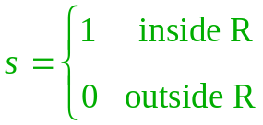
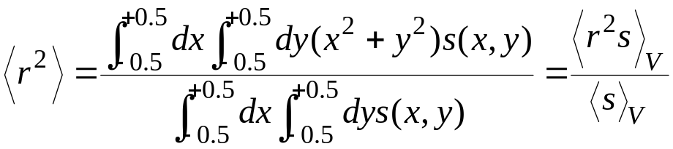

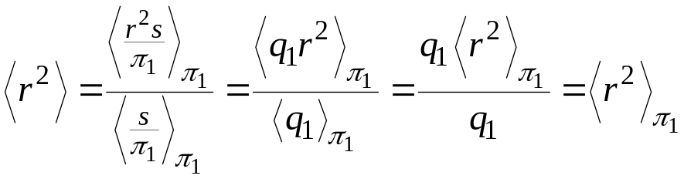
Markov Chains and Importance Sampling 1.
Importance sampling specifies the desired limiting distribution
We can use a Markov chain to generate quadrature points according to this distribution
Example
  Method 1: let
  then
q = normalization constant
V
Simply sum r² with points given by Metropolis sampling

Slide 14

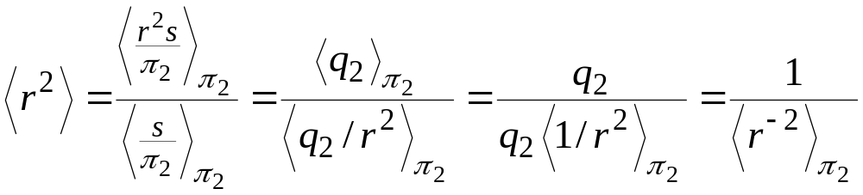

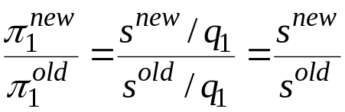

Markov Chains and Importance Sampling 2.
Example (cont’d)
  Method 2: let
  then
Algorithm and transition probabilities
  given a point in the region R
  generate a new point in the vicinity of given point
    x^{new} = x + r(-1,+1)δx y^{new} = y + r(-1,+1)δy
  accept with probability
  note
  Method 1: accept all moves that stay in R
  Method 2: if in R, accept with probability
Normalization constants cancel!

Slide 15
Markov Chains and Importance Sampling 3.
Subtle but important point
  Underlying matrix Τ is set by the trial-move algorithm (select new point uniformly in vicinity of present point)
  It is important that new points are selected in a volume that is independent of the present position
  If we reject configurations outside R, without taking the original point as the “new” one, then the underlying matrix becomes asymmetric
Different-sized trial sampling regions

Slide 16
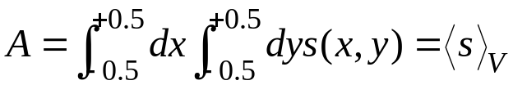
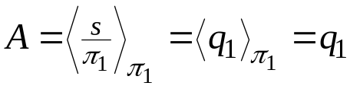
Evaluating Areas with Metropolis Sampling
What if we want the absolute area of the region R, not an average over it?
  Let
  then
  We need to know the normalization constant q₁
  but this is exactly the integral that we are trying to solve!
Absolute integrals difficult by MC
  relates to free-energy evaluation

Slide 17
Summary
Markov process is a stochastic process with no memory
Full specification of process is given by a matrix of transition probabilities Π
A distribution of states are generated by repeatedly stepping from one state to another according to Π
A desired limiting distribution can be used to construct transition probabilities using detailed balance
  Many different Π matrices can be constructed to satisfy detailed balance
  Metropolis algorithm is one such choice, widely used in MC simulation
Markov Monte Carlo is good for evaluating averages, but not absolute integrals
Next up: Monte Carlo simulation

