Slide 1
CE 530 Molecular Simulation
Lecture 9
Monte Carlo Simulation
David A. Kofke
Department of Chemical Engineering
SUNY Buffalo
kofke@eng.buffalo.edu

Slide 2
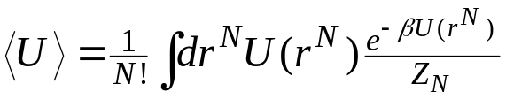


Review
We want to apply Monte Carlo simulation to evaluate the configuration integrals arising in statistical mechanics
Importance-sampling Monte Carlo is the only viable approach
  unweighted sum of U with configurations generated according to distribution
Markov processes can be used to generate configurations according to the desired distribution π(r^{N}).
  Given a desired limiting distribution, we construct single-step transition probabilities that yield this distribution for large samples
  Construction of transition probabilities is aided by the use of detailed balance:
  The Metropolis recipe is the most commonly used method in molecular simulation for constructing the transition probabilities
π(r^{N})

Slide 3
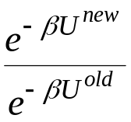
Monte Carlo Simulation
State k
MC techniques applied to molecular simulation
Almost always involves a Markov process
  move to a new configuration from an existing one according to a well-defined transition probability
Simulation procedure
  generate a new “trial” configuration by making a perturbation to the present configuration
  accept the new configuration based on the ratio of the probabilities for the new and old configurations, according to the Metropolis algorithm
  if the trial is rejected, the present configuration is taken as the next one in the Markov chain
  repeat this many times, accumulating sums for averages
State k+1

Slide 4
Trial Moves
A great variety of trial moves can be made
Basic selection of trial moves is dictated by choice of ensemble
  almost all MC is performed at constant T
    no need to ensure trial holds energy fixed
  must ensure relevant elements of ensemble are sampled
    all ensembles have molecule displacement, rotation; atom displacement
    isobaric ensembles have trials that change the volume
    grand-canonical ensembles have trials that insert/delete a molecule
Significant increase in efficiency of algorithm can be achieved by the introduction of clever trial moves
  reptation, crankshaft moves for polymers
  multi-molecule movements of associating molecules
  many more

Slide 5
General Form of Algorithm
Monte Carlo Move
Entire Simulation
New configuration
Initialization
Reset block sums
Select type of trial move
each type of move has fixed probability of being selected
“cycle” or “sweep”
New configuration
moves per cycle
“block”
Move each atom once (on average)
Add to block sum
100’s or 1000’s of cycles
Independent “measurement”
Perform selected trial move
cycles per block
Compute block average
blocks per simulation
Compute final results
Decide to accept trial configuration, or keep original

Slide 6
Simulation API: Integrator
Integrator
  repeatedly changes configuration to follow a sampling algorithm
  public void doStep()
  deploys subclass-specific agent to each atom
  only one integrator acts on a given box
  some integrators act on multiple boxes
    IntegratorGEMC (Gibbs ensemble Monte Carlo)
    IntegratorPT (Parallel tempering)
IntegratorMD
  IntegratorVelocityVerlet
  IntegratorHard
    discontinuous molecular dynamics
IntegratorMC

Slide 7
Simulation API: IntegratorMC
IntegratorMC
  Monte Carlo sampling
  Selects trial move, performs trial, decides acceptance, notifies move and other listeners
MCMove
  Performs Monte Carlo trial
  Reports information needed to determine acceptance
    ln(π_{new}/π_{old}), ln(τ_{ij}/τ_{ji})
    Holds fields needed for evaluation
  Does appropriate update for acceptance or rejection
  For example
    MCMoveAtom
    MCMoveInsertDelete
    MCMoveRotateMolecule
    MCMoveVolume
  Sampled ensemble is determined by set of MCMoves added to integrator

Slide 8
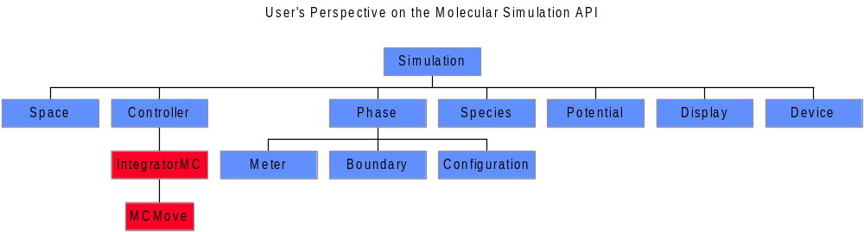
Monte Carlo in the Molecular Simulation API
IntegratorMC (examine code)
  performs selection of type of move to conduct at each trial
MCMove (examine code)
  methods to implement the Monte Carlo trial and make acceptance decision
  different subclasses perform different types of moves
  usually several of these associated with IntegratorMC

Slide 9
Displacement Trial Move
1. Specification
Gives new configuration of same volume and number of molecules
Basic trial:

Slide 10
Displacement Trial Move
1. Specification
Gives new configuration of same volume and number of molecules
Basic trial:
  displace a randomly selected atom to a point chosen with uniform probability inside a cubic volume of edge 2δ centered on the current position of the atom
Select an atom at random

Slide 11
Displacement Trial Move
1. Specification
Gives new configuration of same volume and number of molecules
Basic trial:
  displace a randomly selected atom to a point chosen with uniform probability inside a cubic volume of edge 2δ centered on the current position of the atom
2δ
Consider a region about it

Slide 12
Displacement Trial Move
1. Specification
Gives new configuration of same volume and number of molecules
Basic trial:
  displace a randomly selected atom to a point chosen with uniform probability inside a cubic volume of edge 2δ centered on the current position of the atom
Consider a region about it

Slide 13
Displacement Trial Move
1. Specification
Gives new configuration of same volume and number of molecules
Basic trial:
  displace a randomly selected atom to a point chosen with uniform probability inside a cubic volume of edge 2δ centered on the current position of the atom
Move atom to point chosen uniformly in region

Slide 14
Displacement Trial Move
1. Specification
Gives new configuration of same volume and number of molecules
Basic trial:
  displace a randomly selected atom to a point chosen with uniform probability inside a cubic volume of edge 2δ centered on the current position of the atom
Consider acceptance of new configuration
?

Slide 15
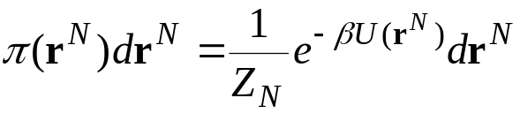
Displacement Trial Move
1. Specification
Gives new configuration of same volume and number of molecules
Basic trial:
  displace a randomly selected atom to a point chosen with uniform probability inside a cubic volume of edge 2δ centered on the current position of the atom
Limiting probability distribution
  canonical ensemble
  for this trial move, probability ratios are the same in other common ensembles, so the algorithm described here pertains to them as well
Examine underlying transition probabilities to formulate acceptance criterion
?

Slide 16
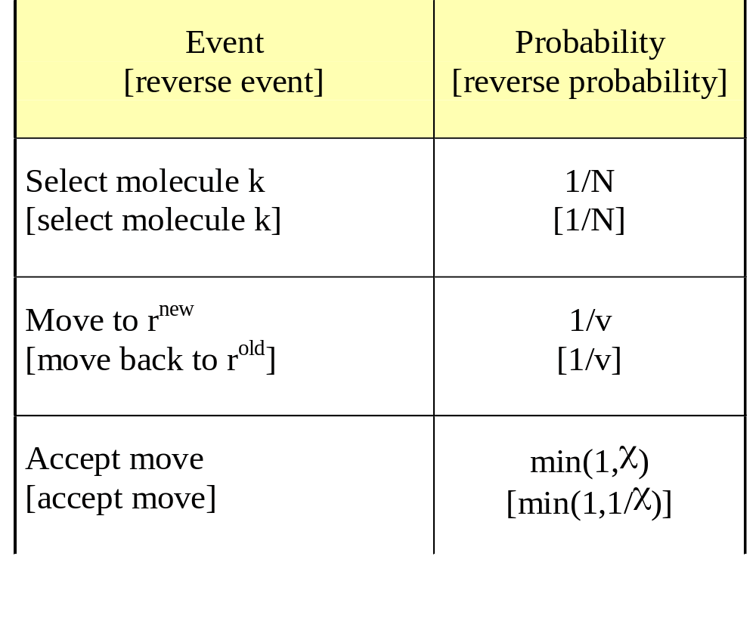
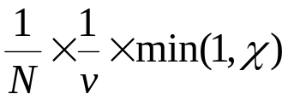
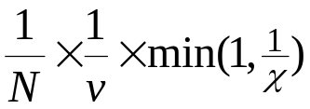
Displacement Trial Move
2. Analysis of Trial Probabilities
Detailed specification of trial moves and probabilities
Forward-step trial probability
Reverse-step trial probability
v = (2δ)^{d}
χ is formulated to satisfy detailed balance

Slide 17
Displacement Trial Move
3. Analysis of Detailed Balance
Forward-step trial probability
Reverse-step trial probability
Detailed balance
π_{i}
π_{ij}
=
π_{j}
π_{ji}
Limiting distribution

Slide 18
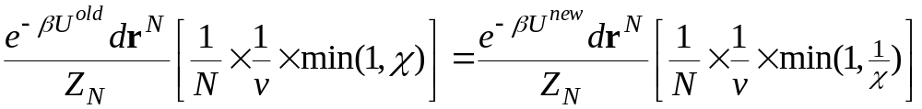
Displacement Trial Move
3. Analysis of Detailed Balance
Forward-step trial probability
Reverse-step trial probability
Detailed balance
π_{i}
π_{ij}
=
π_{j}
π_{ji}
Limiting distribution

Slide 19

Displacement Trial Move
3. Analysis of Detailed Balance
Forward-step trial probability
Reverse-step trial probability
Detailed balance
π_{i}
π_{ij}
=
π_{j}
π_{ji}
Acceptance probability

Slide 20
Displacement Trial Move
4. Simulation Example
Have a look at a simple MC simulation applet
If the link doesn’t work, enter this URL in your browser:
http://www.eng.buffalo.edu/~kofke/applets/SimpleMC.html

Slide 21
Displacement Trial Move
5. Tuning
Size of step is adjusted to reach a target rate of acceptance of displacement trials
  typical target is 50%
  for hard potentials target may be lower (rejection is efficient)
Large step leads to less acceptance but bigger moves
Small step leads to less movement but more acceptance

Slide 22
Volume-change Trial Move
1. Specification
Gives new configuration of different volume and same N and s^{N}
Basic trial:

Slide 23
Volume-change Trial Move
1. Specification
Gives new configuration of different volume and same N and s^{N}
Basic trial:
  increase or decrease the total system volume by some amount within ±δV, scaling all molecule centers-of-mass in proportion to the linear scaling of the volume
+δV
−δV
Select a random value for volume change

Slide 24
Volume-change Trial Move
1. Specification
Gives new configuration of different volume and same N and s^{N}
Basic trial:
  increase or decrease the total system volume by some amount within ±δV, scaling all molecule centers-of-mass in proportion to the linear scaling of the volume
Perturb the total system volume

Slide 25
Volume-change Trial Move
1. Specification
Gives new configuration of different volume and same N and s^{N}
Basic trial:
  increase or decrease the total system volume by some amount within ±δV, scaling all molecule centers-of-mass in proportion to the linear scaling of the volume
Scale all positions in proportion

Slide 26
Volume-change Trial Move
1. Specification
Gives new configuration of different volume and same N and s^{N}
Basic trial:
  increase or decrease the total system volume by some amount within ±δV, scaling all molecule centers-of-mass in proportion to the linear scaling of the volume
Consider acceptance of new configuration
?

Slide 27
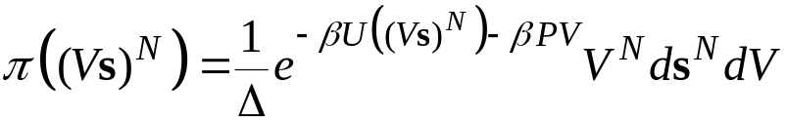
Volume-change Trial Move
1. Specification
Gives new configuration of different volume and same N and s^{N}
Basic trial:
  increase or decrease the total system volume by some amount within ±δV, scaling all molecule centers-of-mass in proportion to the linear scaling of the volume
Limiting probability distribution
  isothermal-isobaric ensemble
Examine underlying transition probabilities to formulate acceptance criterion
Remember how volume-scaling was used in derivation of virial formula

Slide 28
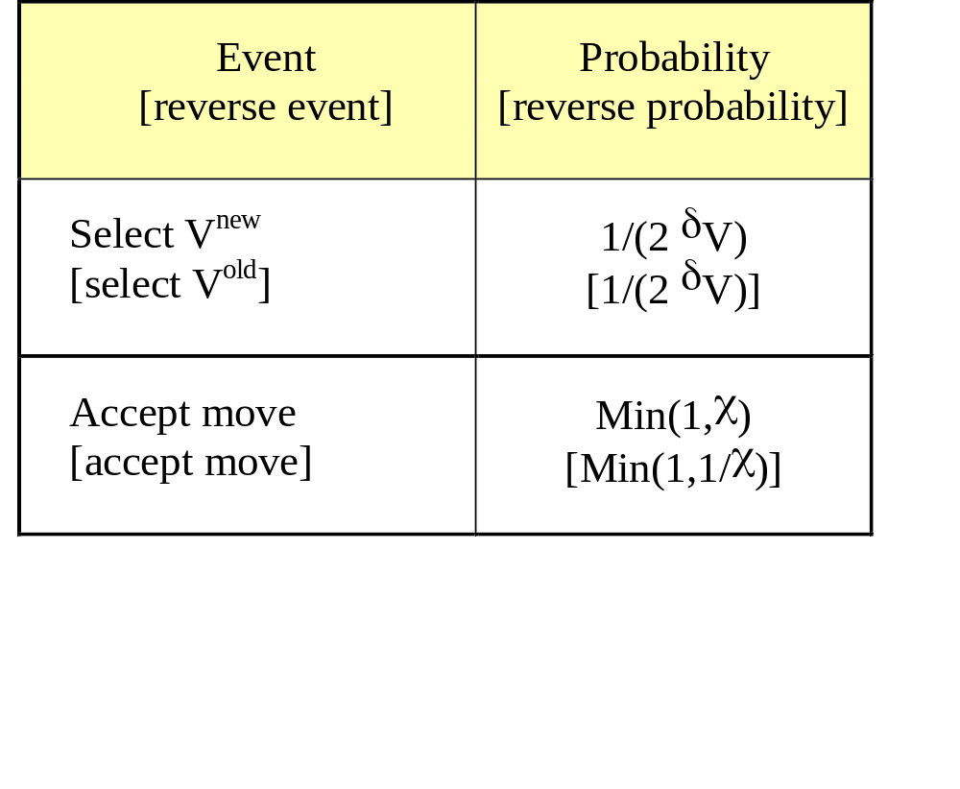
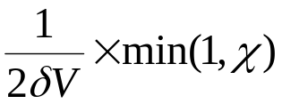
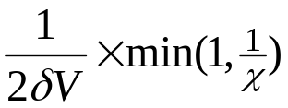
Volume-change Trial Move
2. Analysis of Trial Probabilities
Detailed specification of trial moves and probabilities
Forward-step trial probability
Reverse-step trial probability
χ is formulated to satisfy detailed balance

Slide 29
Volume-change Trial Move
3. Analysis of Detailed Balance
Forward-step trial probability
Reverse-step trial probability
Detailed balance
π_{i}
π_{ij}
=
π_{j}
π_{ji}
Limiting distribution

Slide 30
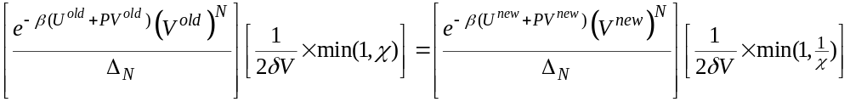
Volume-change Trial Move
3. Analysis of Detailed Balance
Forward-step trial probability
Reverse-step trial probability
Detailed balance
π_{i}
π_{ij}
=
π_{j}
π_{ji}
Limiting distribution

Slide 31
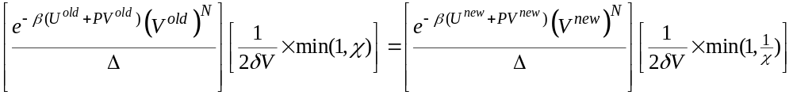
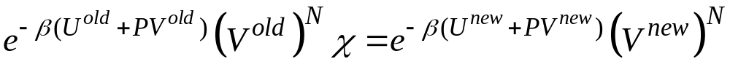
Volume-change Trial Move
3. Analysis of Detailed Balance
Forward-step trial probability
Reverse-step trial probability
Detailed balance
π_{i}
π_{ij}
=
π_{j}
π_{ji}
Acceptance probability

Slide 32
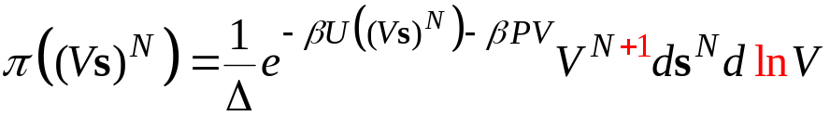


Volume-change Trial Move
4. Alternative Formulation
Step in ln(V) instead of V
  larger steps at larger volumes, smaller steps at smaller volumes
Limiting distribution
Trial move
Acceptance probability min(1,χ)

Slide 33
Volume-change Trial Move
5. Simulation Example
Have a look at a simple NPT MC simulation applet
If the link doesn’t work, here’s the URL:
http://www.eng.buffalo.edu/~kofke/applets/nptMCLJ.html

Slide 34
Summary
Monte Carlo simulation is the application of MC integration to molecular simulation
Trial moves made in MC simulation depend on governing ensemble
  many trial moves are possible to sample the same ensemble
Careful examination of underlying transition matrix and limiting distribution give acceptance probabilities
  particle displacement
  volume change
Next up: simple biasing methods

