Slide 1
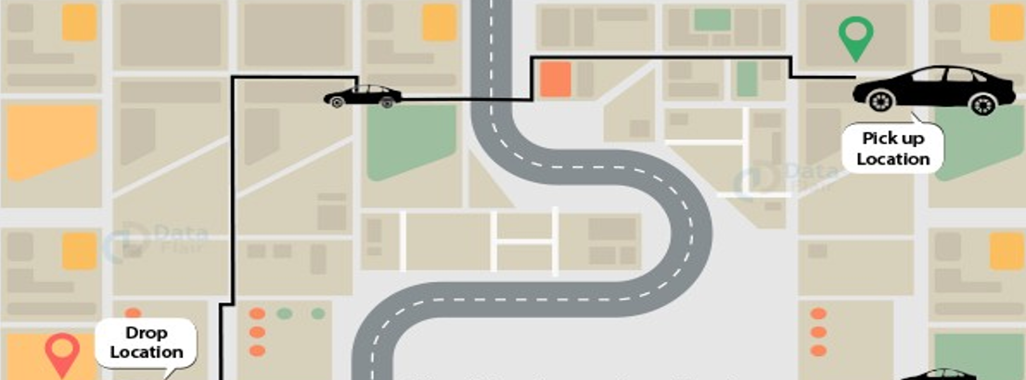
UBER DATA ANALYSIS

Slide 2
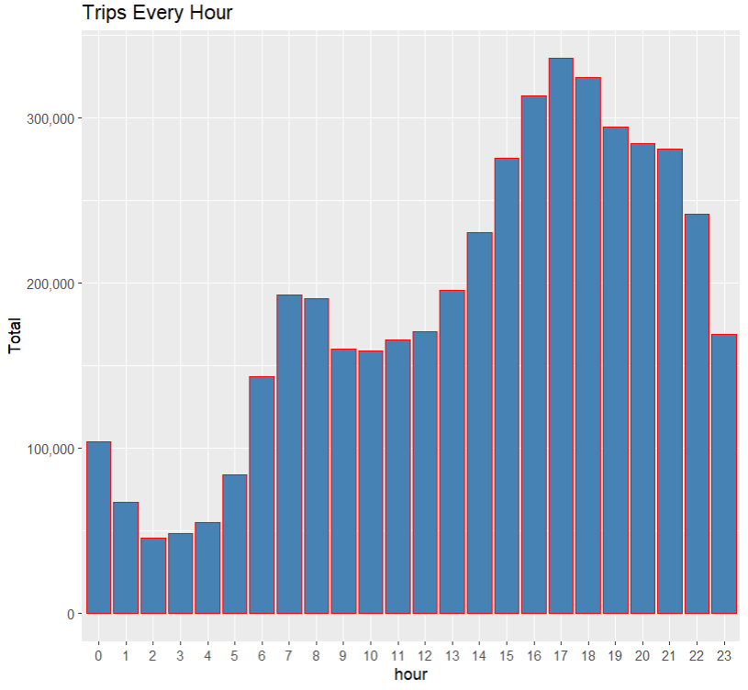
CODE -
library(ggplot2) #ggplot2 used for creating aesthetic visualization plots
library(ggthemes) #create extra themes and scales with the mainstream ggplot2 package
library(lubridate) #time-frames
library(dplyr) #data manipulation in R.
library(tidyr) #each observation is represented by a row and each value depicts a cell.
library(DT) #we will be able to interface with the JavaScript Library called as Data-tables
library(scales) #map the data to the correct scales with well-placed axes and legends
# Creating vector of colors to be implemented in our plots
colors = c("#CC1011", "#665555", "#05a399", "#cfcaca", "#f5e840", "#0683c9", "#e075b0")
apr_data <- read.csv("uber-raw-data-apr14.csv")
may_data <- read.csv("uber-raw-data-may14.csv")
jun_data <- read.csv("uber-raw-data-jun14.csv")
jul_data <- read.csv("uber-raw-data-jul14.csv")
aug_data <- read.csv("uber-raw-data-aug14.csv")
sep_data <- read.csv("uber-raw-data-sep14.csv")
data_2014 <- rbind(apr_data,may_data, jun_data, jul_data, aug_data, sep_data)
View(data_2014)
data_2014$Date.Time <- as.POSIXct(data_2014$Date.Time, format = "%m/%d/%Y %H:%M:%S")
summary(data_2014)
data_2014$Time <- format(as.POSIXct(data_2014$Date.Time, format = "%m/%d/%Y %H:%M:%S"), format="%H:%M:%S")
data_2014$Date.Time <- ymd_hms(data_2014$Date.Time)
data_2014$day <- factor(day(data_2014$Date.Time))
data_2014$month <- factor(month(data_2014$Date.Time, label = TRUE))
data_2014$year <- factor(year(data_2014$Date.Time))

Slide 3
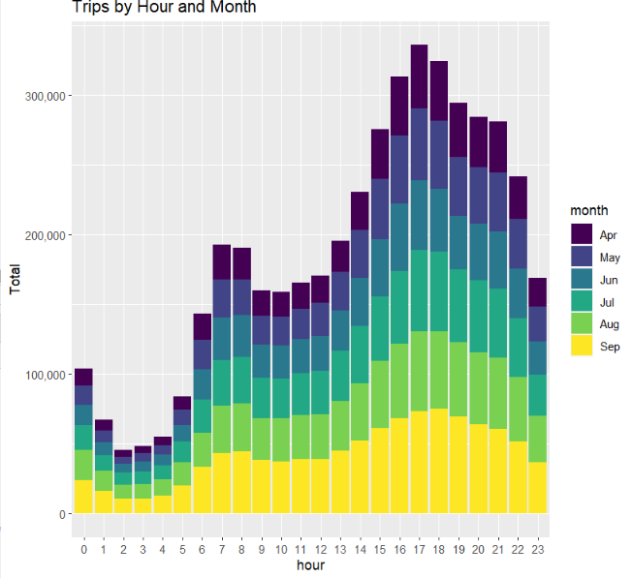
data_2014$dayofweek <- factor(wday(data_2014$Date.Time, label = TRUE))
data_2014$hour <- factor(hour(hms(data_2014$Time)))
data_2014$minute <- factor(minute(hms(data_2014$Time)))
data_2014$second <- factor(second(hms(data_2014$Time)))
# Plotting the trips by the hours in a day
hour_data <- data_2014 %>%
group_by(hour) %>%
dplyr::summarize(Total = n())
datatable(hour_data)
ggplot(hour_data, aes(hour, Total)) +
geom_bar( stat = "identity", fill = "steelblue", color = "red") +
ggtitle("Trips Every Hour") +
theme(legend.position = "none") +
scale_y_continuous(labels = comma)
month_hour <- data_2014 %>%
group_by(month, hour) %>%
dplyr::summarize(Total = n())
ggplot(month_hour, aes(hour, Total, fill = month)) +
geom_bar( stat = "identity") +
ggtitle("Trips by Hour and Month") +
scale_y_continuous(labels = comma)
# Plotting data by trips during every day of the month
day_group <- data_2014 %>%
group_by(day) %>%
dplyr::summarize(Total = n())

Slide 4
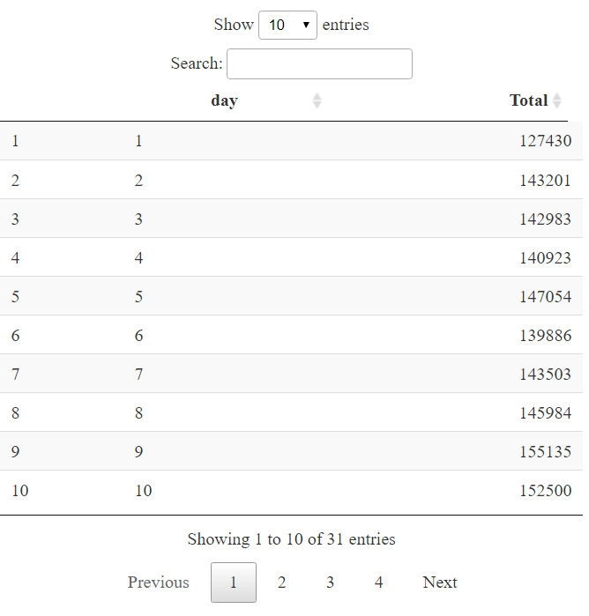
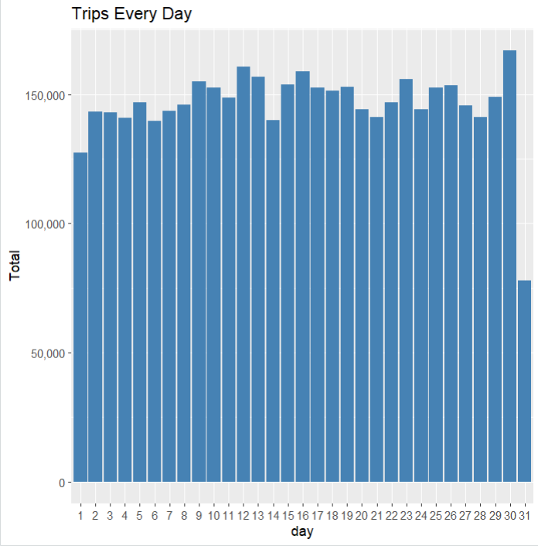
datatable(day_group)
ggplot(day_group, aes(day, Total)) +
geom_bar( stat = "identity", fill = "steelblue") +
ggtitle("Trips Every Day") +
theme(legend.position = "none") +
scale_y_continuous(labels = comma)
day_month_group <- data_2014 %>%
group_by(month, day) %>%
dplyr::summarize(Total = n())
ggplot(day_month_group, aes(day, Total, fill = month)) +
geom_bar( stat = "identity") +
ggtitle("Trips by Day and Month") +
scale_y_continuous(labels = comma) +
scale_fill_manual(values = colors)
# Number of Trips taking place during months in a year
month_group <- data_2014 %>%
group_by(month) %>%
dplyr::summarize(Total = n())
datatable(month_group)
ggplot(geom_point, aes(month, Total, fill = month)) +
geom_bar( stat = "identity") +
ggtitle("Trips by Month") +

Slide 5
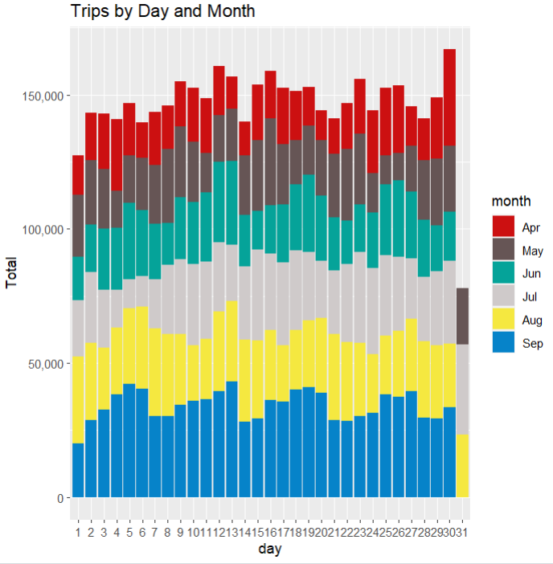
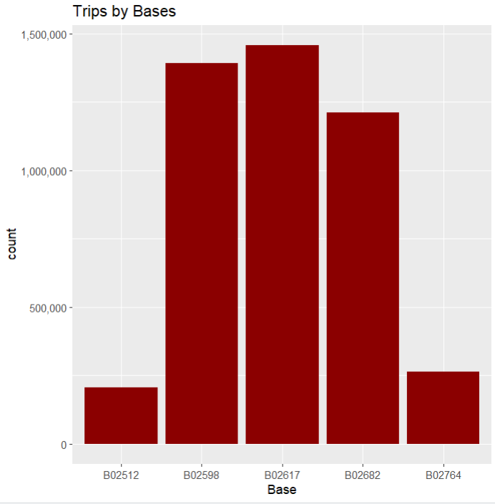
theme(legend.position = "none") +
scale_y_continuous(labels = comma) +
scale_fill_manual(values = colors)
month_weekday <- data_2014 %>%
group_by(month, dayofweek) %>%
dplyr::summarize(Total = n())
ggplot(month_weekday, aes(month, Total, fill = dayofweek)) +
geom_bar( stat = "identity", position = "dodge") +
ggtitle("Trips by Day and Month") +
scale_y_continuous(labels = comma) +
scale_fill_manual(values = colors)
# Finding out the number of Trips by bases
ggplot(data_2014, aes(Base)) +
geom_bar(fill = "darkred") +
scale_y_continuous(labels = comma) +
ggtitle("Trips by Bases")
ggplot(data_2014, aes(Base, fill = month)) +
geom_bar(position = "dodge") +
scale_y_continuous(labels = comma) +
ggtitle("Trips by Bases and Month") +
scale_fill_manual(values = colors)

Slide 6
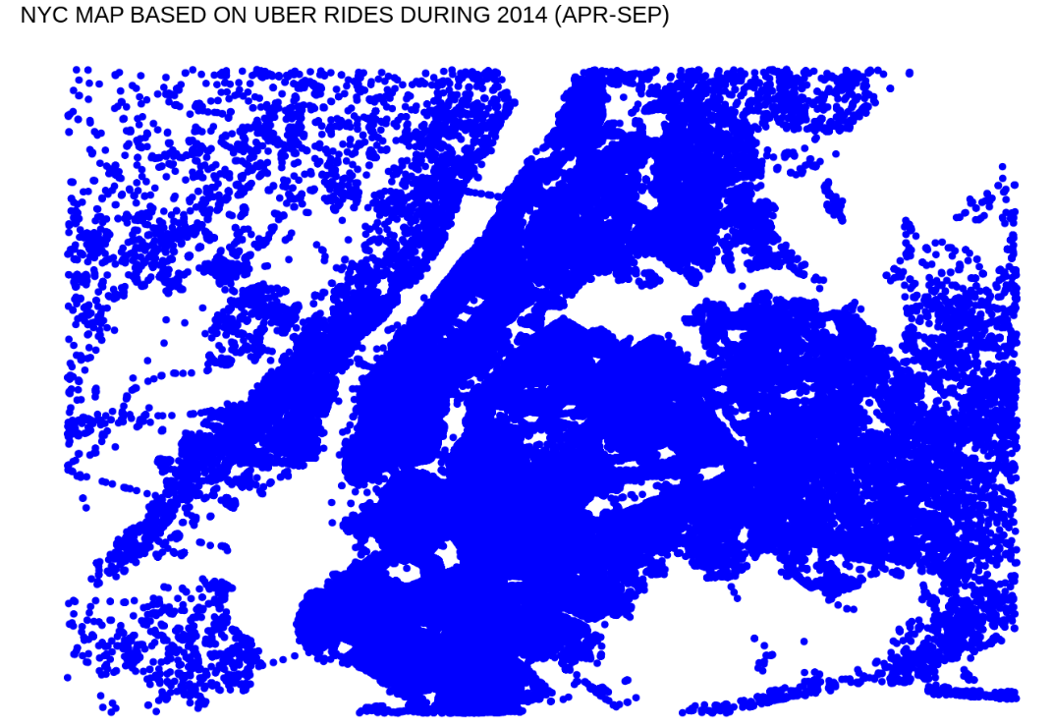
#Creating a Heatmap visualization of day, hour and month
day_and_hour <- data_2014 %>%
group_by(day, hour) %>%
dplyr::summarize(Total = n())
datatable(day_and_hour)
ggplot(day_and_hour, aes(day, hour, fill = Total)) +
geom_tile(color = "white") +
ggtitle("Heat Map by Hour and Day")
ggplot(day_month_group, aes(day, month, fill = Total)) +
geom_tile(color = "white") +
ggtitle("Heat Map by Month and Day")
ggplot(month_weekday, aes(dayofweek, month, fill = Total)) +
geom_tile(color = "white") +
ggtitle("Heat Map by Month and Day of Week")
month_base <- data_2014 %>%
group_by(Base, month) %>%
dplyr::summarize(Total = n())
day0fweek_bases <- data_2014 %>%
group_by(Base, dayofweek) %>%
dplyr::summarize(Total = n())

Slide 7
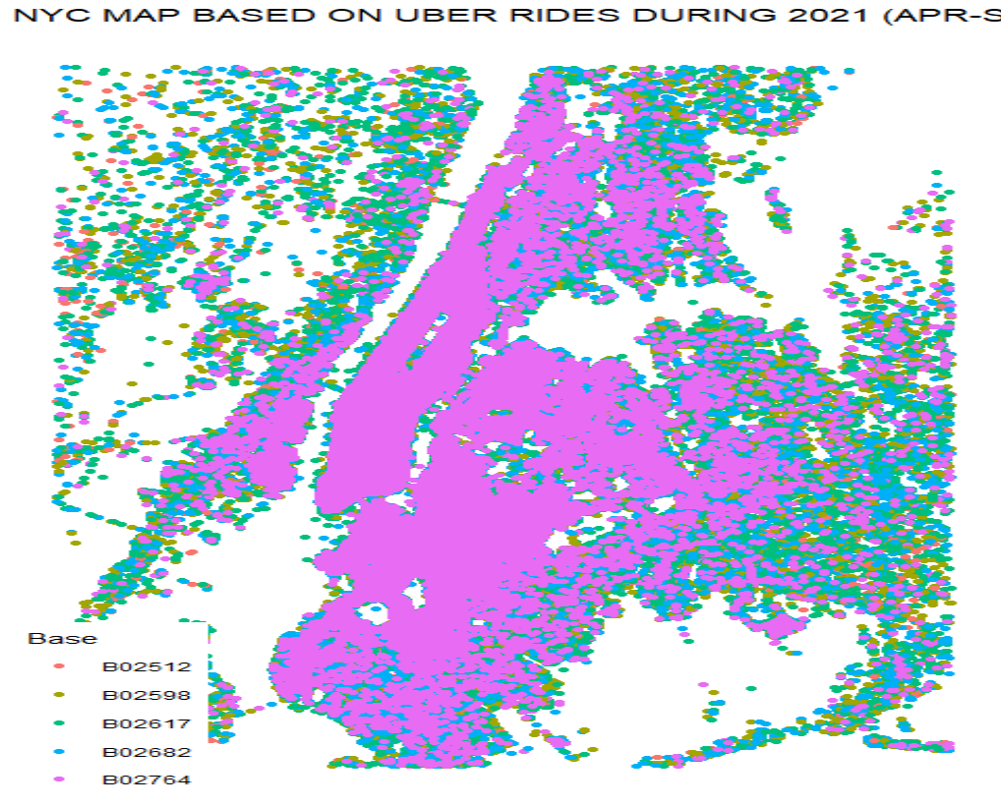
ggplot(month_base, aes(Base, month, fill = Total)) +
geom_tile(color = "white") +
ggtitle("Heat Map by Month and Bases")
ggplot(day0fweek_bases, aes(Base, dayofweek, fill = Total)) +
geom_tile(color = "white") +
ggtitle("Heat Map by Bases and Day of Week")
# Creating a map visualization of rides
min_lat <- 40.5774
max_lat <- 40.9176
min_long <- -74.15
max_long <- -73.7004
ggplot(data_2014, aes(x=Lon, y=Lat)) +
geom_point(size=1, color = "blue") +
scale_x_continuous(limits=c(min_long, max_long)) +
scale_y_continuous(limits=c(min_lat, max_lat)) +
theme_map() +
ggtitle("NYC MAP BASED ON UBER RIDES DURING 2021 (APR-SEP)")
ggplot(data_2014, aes(x=Lon, y=Lat, color = Base)) +
geom_point(size=1) +
scale_x_continuous(limits=c(min_long, max_long)) +
scale_y_continuous(limits=c(min_lat, max_lat)) +
theme_map() +
ggtitle("NYC MAP BASED ON UBER RIDES DURING 2021 (APR-SEP) by BASE")

Slide 8
THANK-YOU

