Slide 1
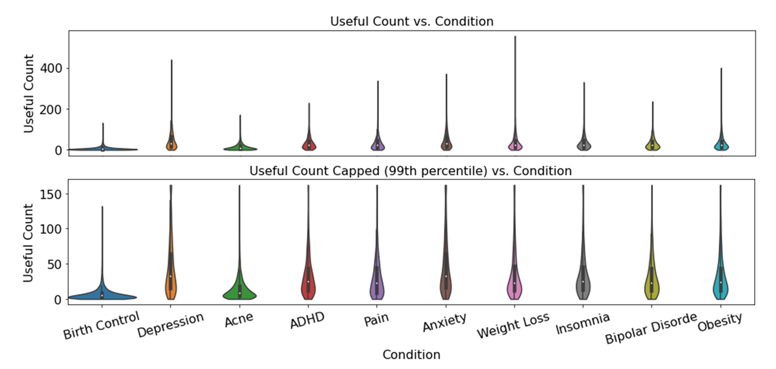
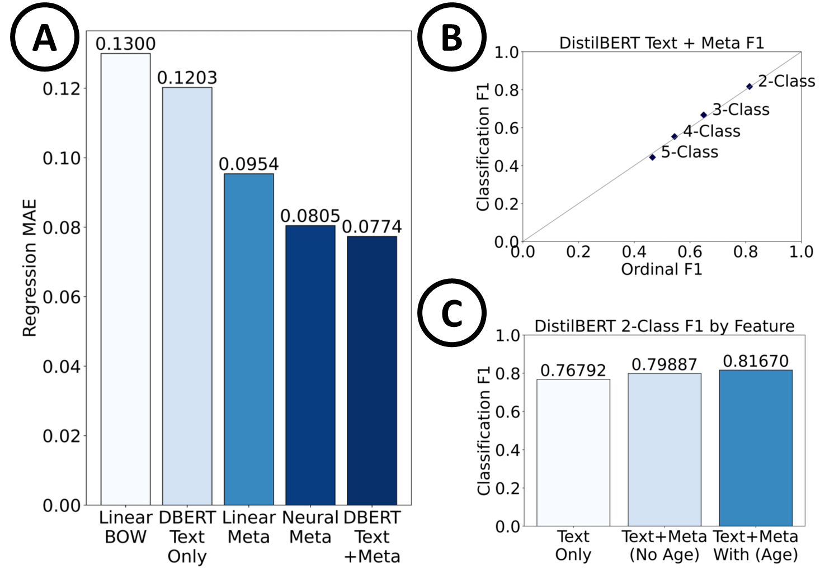

Slide 2
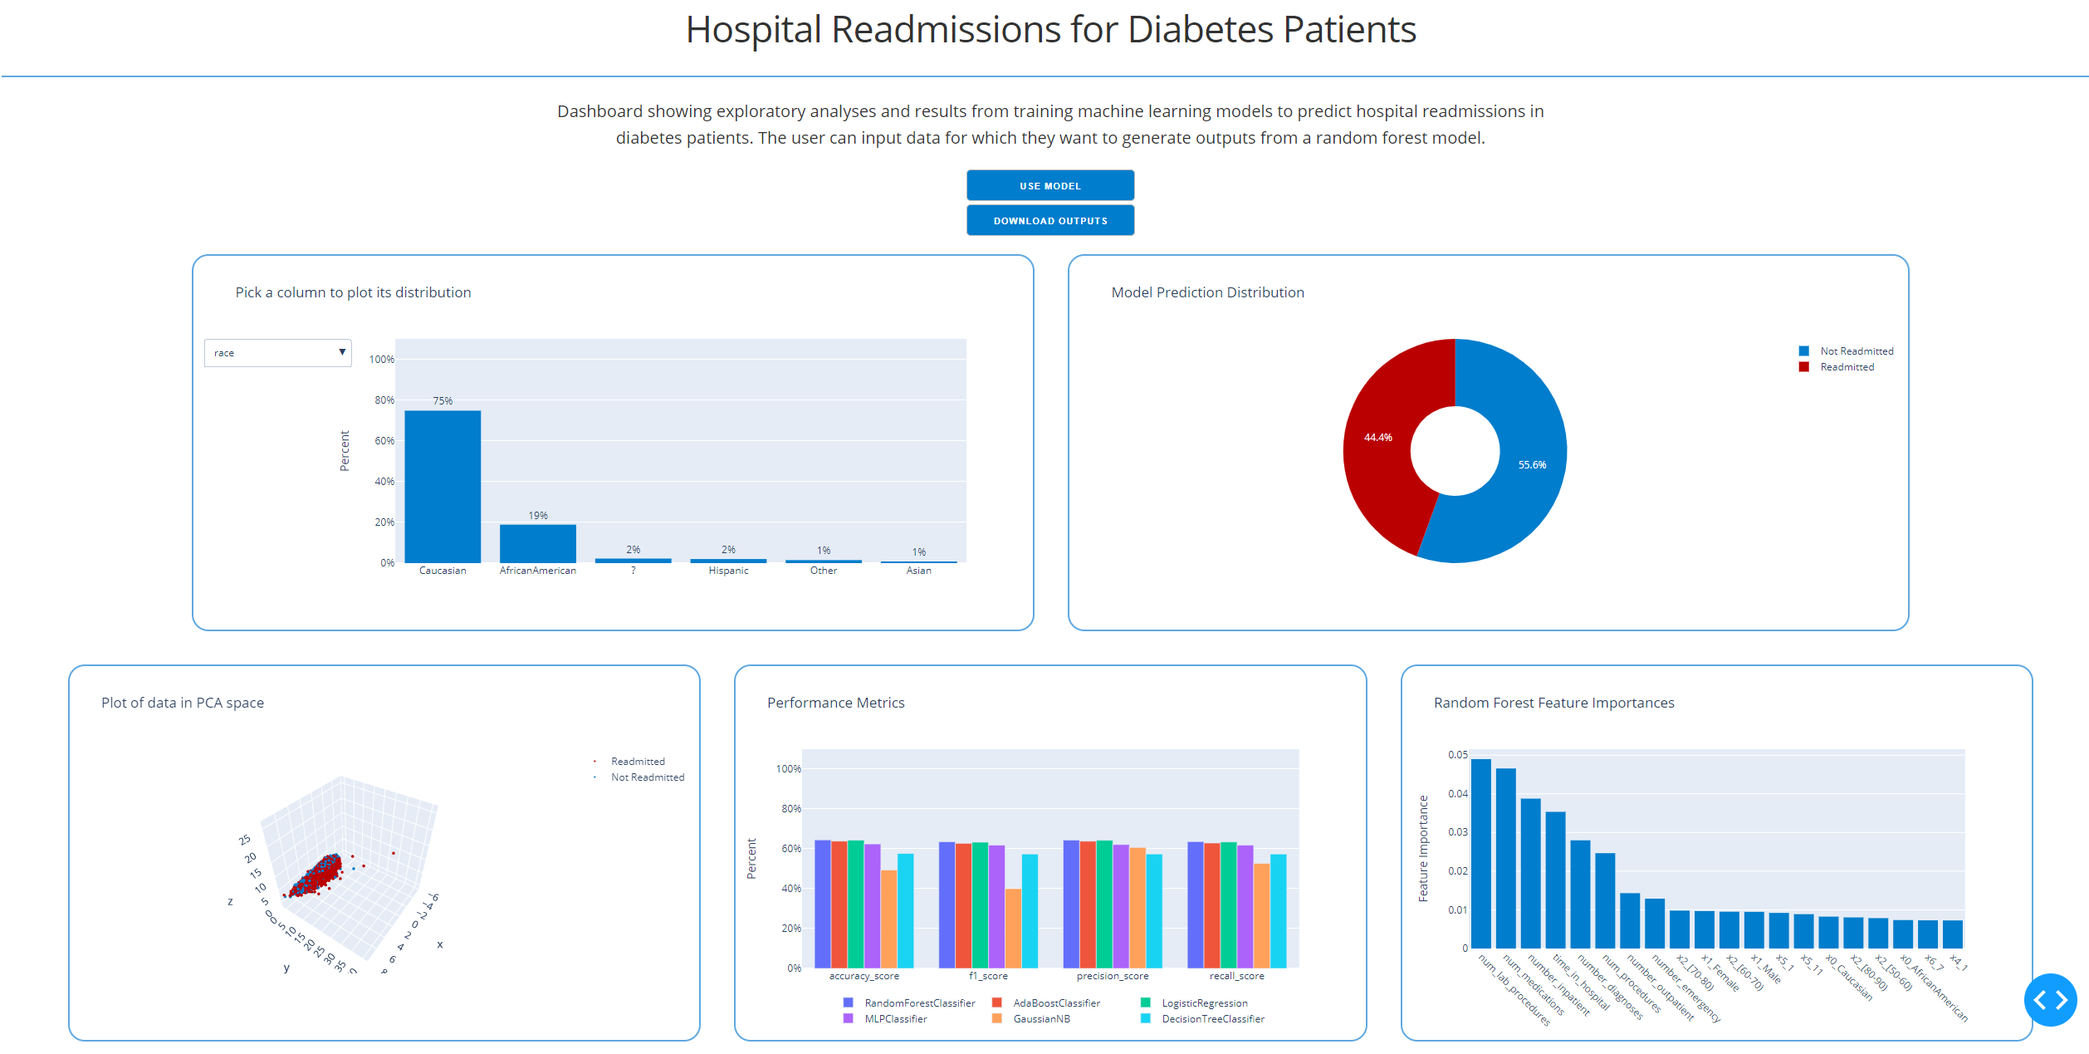

Slide 3
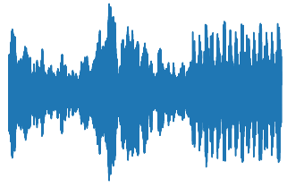
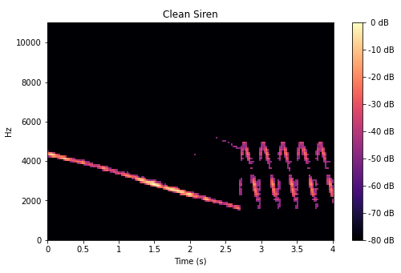
Raw Audio
Spectrogram
Conv2D
Convolutional Neural Network
Leaky ReLU
MaxPool2D
Prediction Label

Slide 4
MTL_{t1,t2}
t1, t2
MTL_{t1}
t1, t2 | t2 | t1 | t1
t1 | t1
t2
MTL_{t2}
System A
MTL_{t1,t2}
t1, t2 | t2 | t1 | t1
System B
t1, t2
MTL_{t1}
t1, t2 | t2 | t1 | t1
t1 | t1
t2
MTL_{t2}
System C

Slide 5
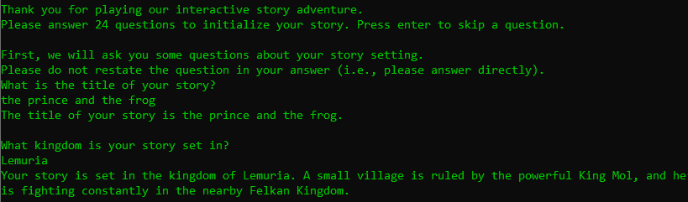

Slide 8
Shared Layers
Task-specific Layers

