Slide 1




AGRO-SHIELD
Protect Every Harvest. Empower Every Farmer.
A smart agricultural ecosystem connecting farmers,
buyers, agricultural organizations and consumers.
TEAM AGRO-SHIELD
IDOMA CENTENARY PLUS+ HACKATHON 2026
Build • Validate • Demonstrate • Impact

Slide 2
THE PROBLEM
Agricultural value is lost when people, products and markets cannot connect.
01
Post-harvest losses
02
Unfair pricing
Poor storage, limited market access and delayed sales leave farmers with unsold or spoiled produce.
Farmers struggle to find legitimate buyers and are often pressured to sell cheaply.
03
Weak buyer discovery
04
Limited outreach
Businesses and poultry farms depend on radio announcements and local networks to find suppliers/customers.
Agricultural agencies struggle to reach genuine farmers with quality inputs, training and opportunities.
THE GAP: good agricultural products exist, but the right people cannot reliably find one another.
2

Slide 3
WHAT WE DISCOVERED
Field research with businesses, farmers, government and potential consumers.
✓
Green Harvest Food Stuff Industry
They rely on radio announcements to find farmers and suppliers; they also highlighted water challenges.
✓
Ewake Poultry Farm
Local customers buy, but payments can be incomplete. Customers outside the area struggle to locate the farm.
✓
Benue State Ministry of Agriculture
Quality seeds, fertilizer and other products are available, but reaching genuine farmers is difficult.
✓
3 Farmers
Reported post-harvest losses, low market prices and difficulty finding legitimate buyers; want buyers to see produce before harvest.
✓
Potential consumers
Want a convenient platform to discover and order food products without searching physically through markets.
Research insight: users want visibility, trusted connections, fairer pricing and convenient access.
3

Slide 4
OUR SOLUTION
One digital ecosystem connecting the agricultural value chain.
FARMERS
AGENCIES
AGRO-SHIELD
• Farmer registration and authentication
• Marketplace for agricultural products
• Buyer and seller discovery
• AI-powered farming assistance
• Dashboards, orders and communication
BUYERS
CONSUMERS
4

Slide 5
OUR FUNCTIONAL MVP
A deployed product that can be accessed, tested and demonstrated.
AGRO-SHIELD
AGRO-SHIELD
AGRO-SHIELD
AGRO-SHIELD
Landing Page
Farmer Dashboard
Marketplace
AI Assistant
Introduces Agro-Shield and guides users into the platform.
Supports farmer profiles and agricultural activities.
Enables discovery and listing of agricultural products.
Provides an agricultural question-and-answer workflow.
LIVE DEMO • https://agro-shield.onrender.com
The MVP is already deployed and ready for evaluation.
5

Slide 6
CURRENT CAPABILITIES
What Agro-Shield can demonstrate today.
✓
Farmer registration
✓
Role-based dashboards
Secure account creation and profile management.
Separate experiences for farmers and buyers.
✓
Marketplace
✓
AI farming assistant
Digital product discovery and agricultural listings.
Gemini-powered agricultural guidance workflow.
✓
PostgreSQL database
✓
Authentication & security
Persistent relational storage with migrations.
Protected routes, password hashing and access control.
6

Slide 7
AI FARMING ASSISTANT
Practical agricultural guidance integrated into the platform.
AGRO-SHIELD AI
Why it matters
✓ Disease and pest questions
• Lowers the barrier to basic agricultural information.
• Available as part of the digital platform.
• Creates a foundation for future disease and advisory tools.
• Can complement human extension services and expert support.
✓ Treatment and prevention guidance
✓ Crop-care support
✓ Practical farming recommendations
Integrated through the Gemini API.
7

Slide 8
VALIDATION & KEY FINDINGS
The product direction is grounded in real conversations.
USER GROUP
KEY FINDING
WHAT THEY NEED
Farmers
Legitimate buyers are difficult to find.
Better market access + price transparency.
Food businesses
Reliable farmers and suppliers are difficult to reach.
Consistent supplier discovery.
Poultry farms
Customers outside the local area cannot easily locate them.
Online visibility + ordering.
Agricultural agencies
Reaching genuine farmers is difficult.
Digital outreach and partnerships.
Consumers
Buying quality food can require physical market searching.
Convenient product discovery.
VALIDATION PRINCIPLE • Build around real pain points, then demonstrate the workflow.
8

Slide 9
BUSINESS & REVENUE MODEL
Multiple paths toward long-term sustainability.
₦
Transaction commission
₦
Premium business accounts
Small commission on successful marketplace transactions.
Optional premium tools for businesses and high-volume buyers.
₦
Premium farmer services
₦
Institutional partnerships
Advanced analytics, forecasting and market/storage tools.
Partnerships with agencies, cooperatives and organizations.
Illustrative marketplace commission: 2–5% per successful transaction
9

Slide 10
MARKET, IMPACT & JOB CREATION
A digital layer for people already active in agriculture.
✓
Target users
Smallholder farmers, buyers, food businesses, consumers and agricultural organizations.
LONG-TERM VISION
✓
Impact goals
A trusted digital agricultural ecosystem where farmers can be found, buyers can source confidently, organizations can reach communities, and consumers can access quality produce.
Reduce post-harvest losses; improve price transparency; increase farmer income and market access.
✓
Economic opportunity
Create roles around onboarding, field verification, customer support, logistics and partnerships.
Local discovery → trusted transactions → stronger communities
10

Slide 11
ROADMAP
From functional MVP toward a complete agricultural ecosystem.
PHASE 1
PHASE 2
PHASE 3
PHASE 4
FOUNDATION
MARKETPLACE
SMART AGRICULTURE
RURAL ACCESS
✓ Registration
✓ Authentication
✓ Dashboards
✓ AI assistant
✓ PostgreSQL
✓ Deployment
✓ Product listings
✓ Buyer interaction
→ Orders & payments
✓ Negotiation
→ Ratings
→ Price prediction
◐ Storage monitoring — IN PROGRESS
◐ Disease detection — IN PROGRESS
◐ Weather insights — IN PROGRESS
→ USSD access
→ Local languages
→ Offline/low-connectivity tools
→ Farmer education
→
→
→
11

Slide 12
TECHNOLOGY & ARCHITECTURE
A practical stack for a secure and maintainable MVP.
Go (Golang)
net/http
SYSTEM FLOW
User Interface • HTML / CSS / JS
HTML • CSS • JavaScript
PostgreSQL + pgx
HTTP Server • Go net/http
Gemini API
bcrypt / authentication
Application • Handlers + Services
Git & GitHub
Render deployment
Data Access • Repository + pgx
Database • PostgreSQL
12

Slide 13
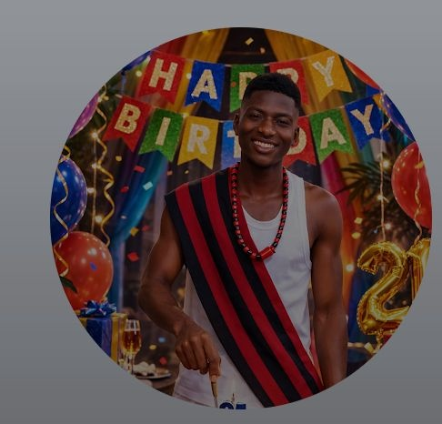
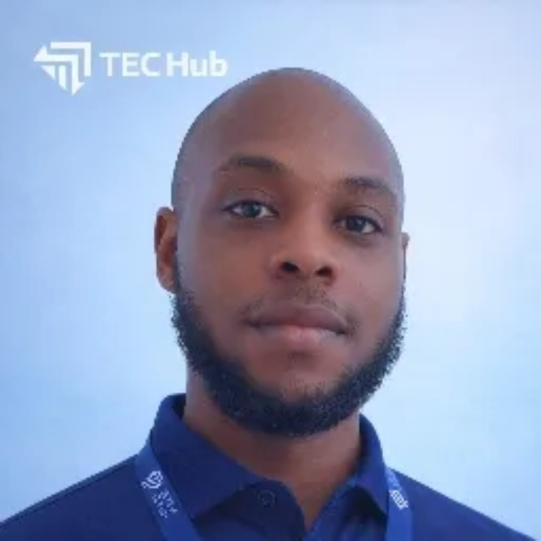
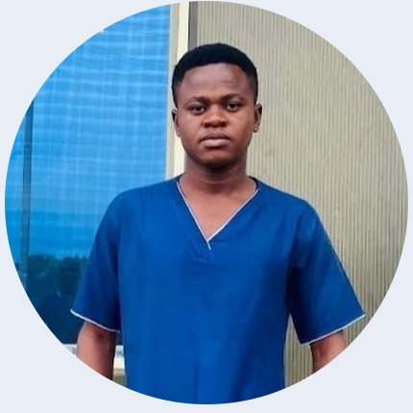
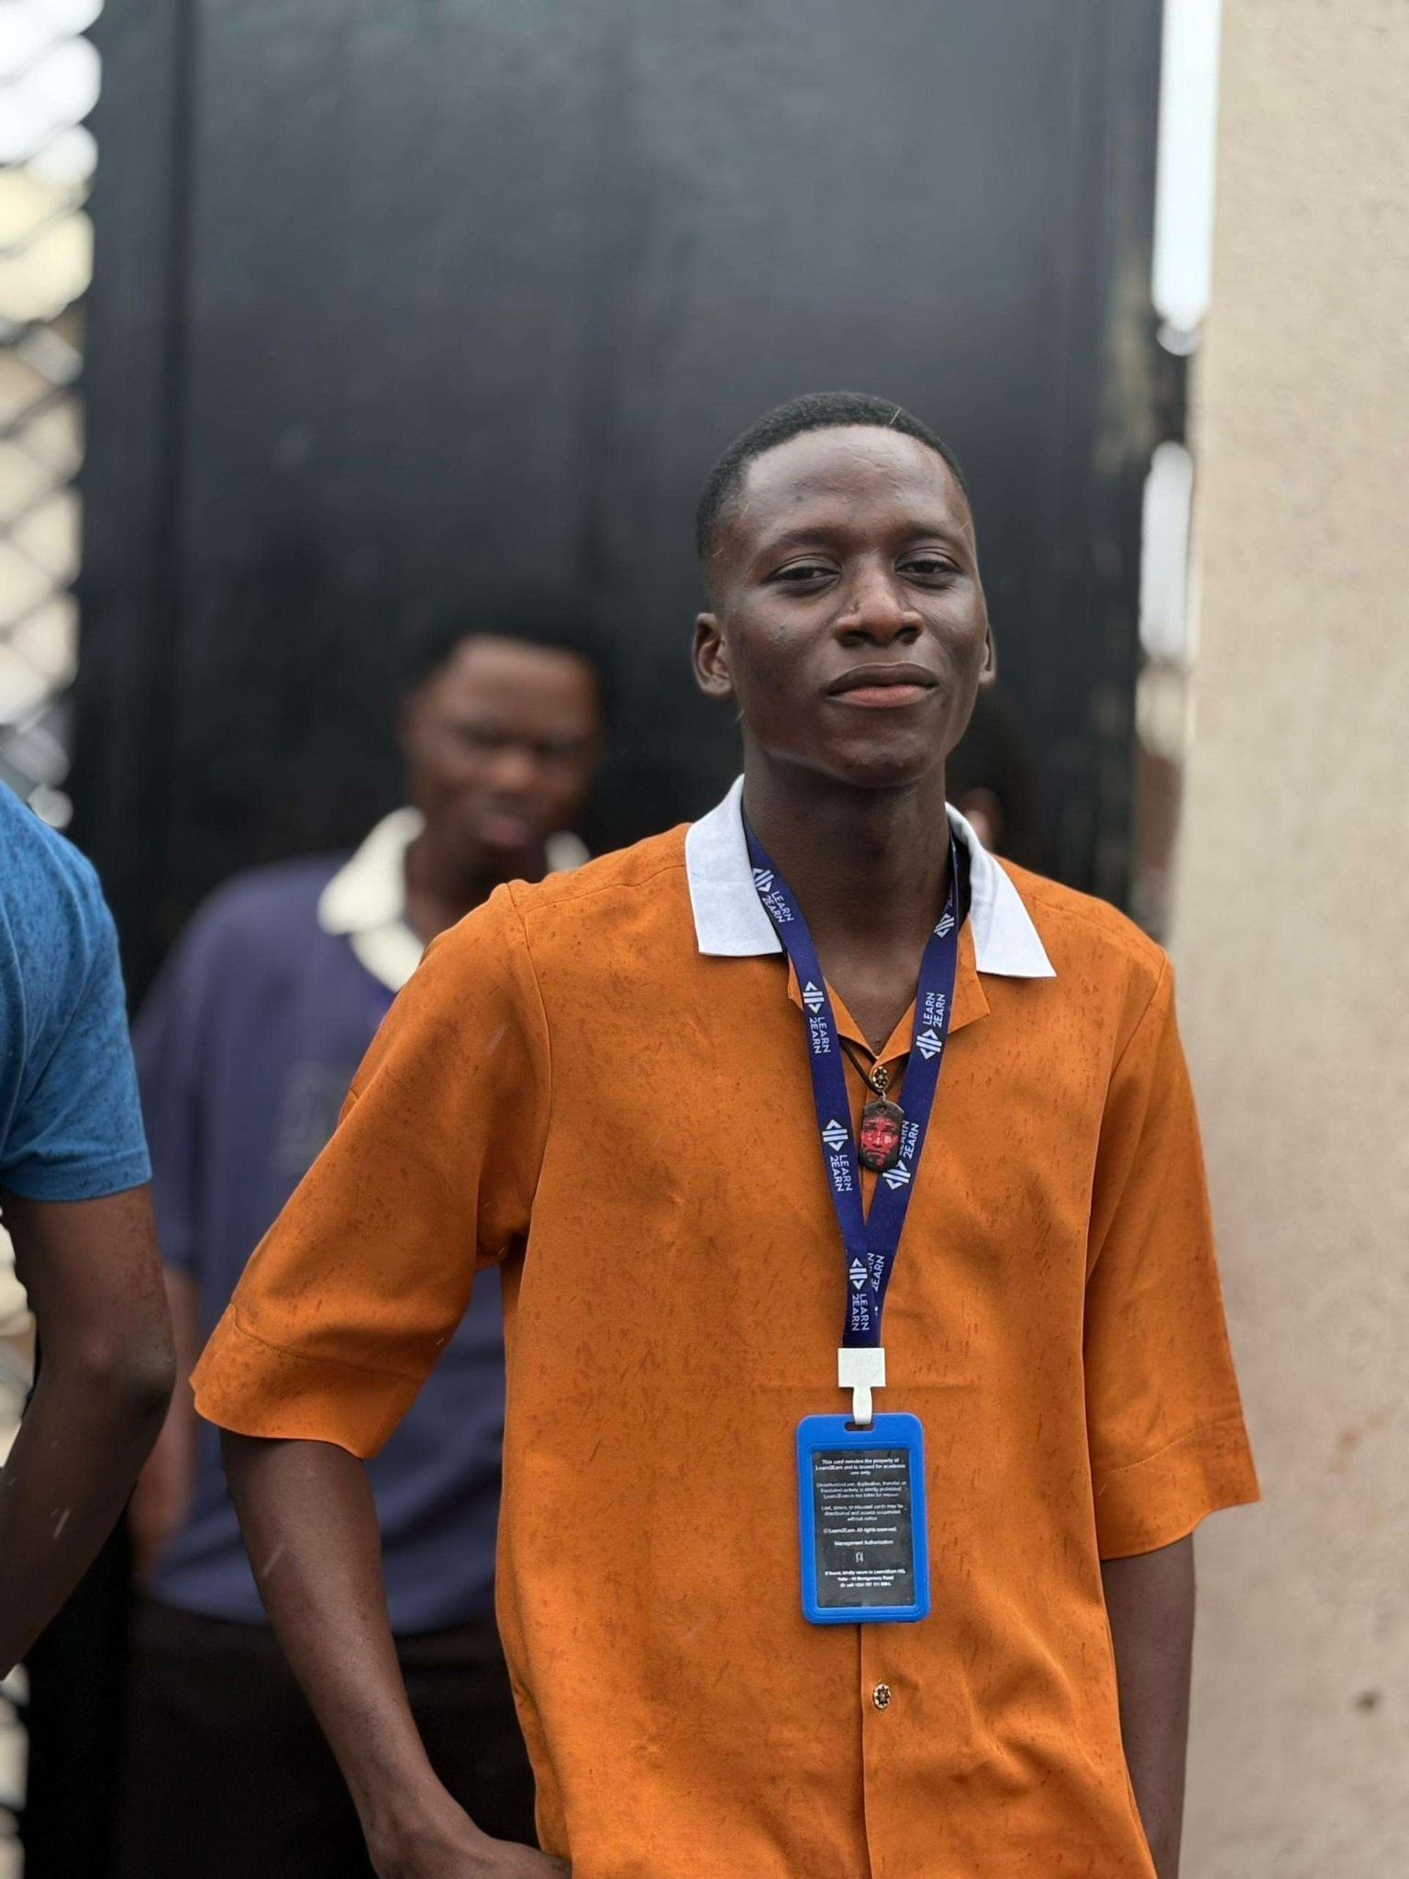
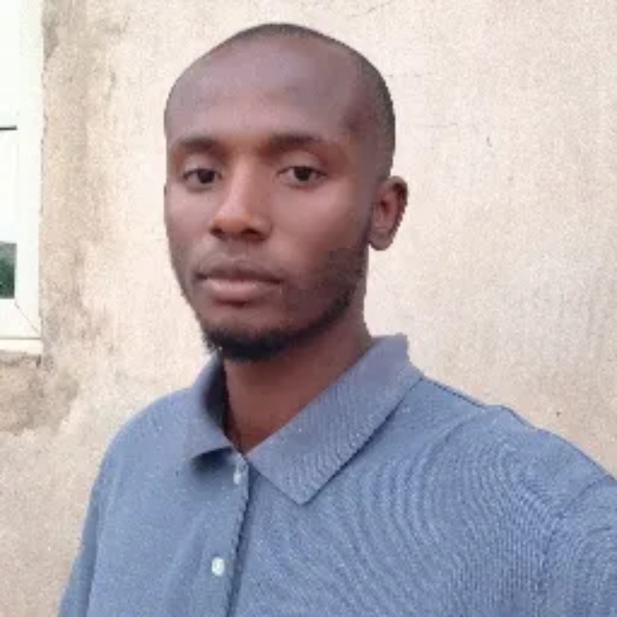
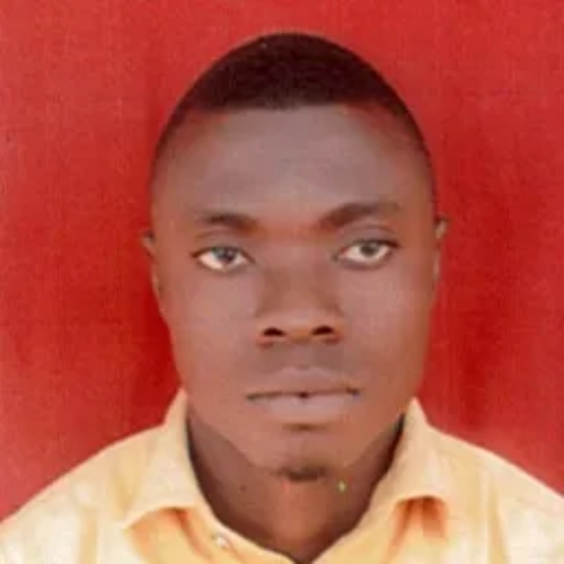
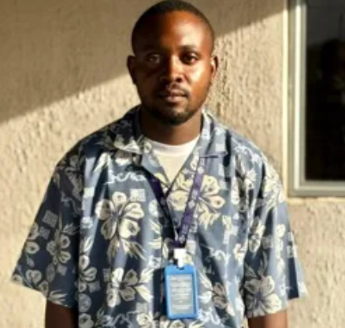
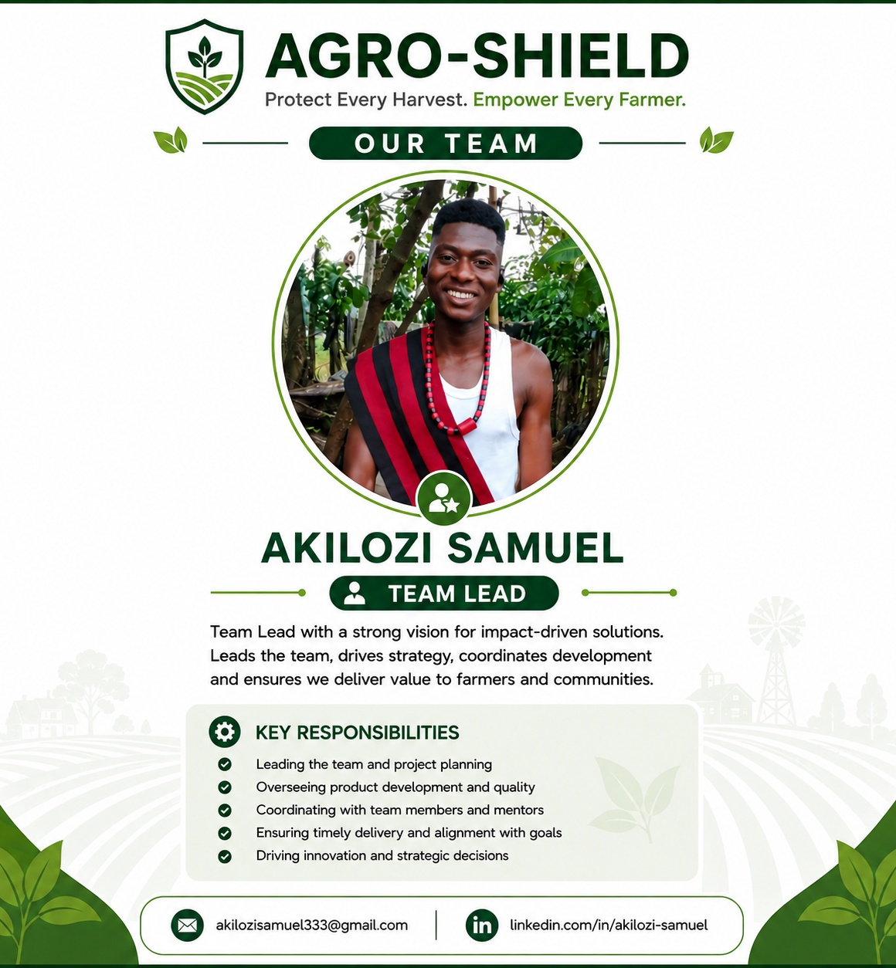
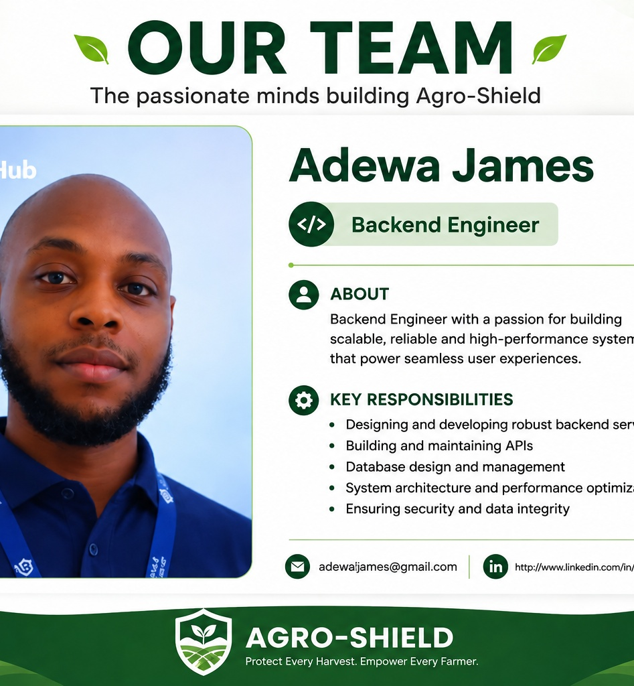
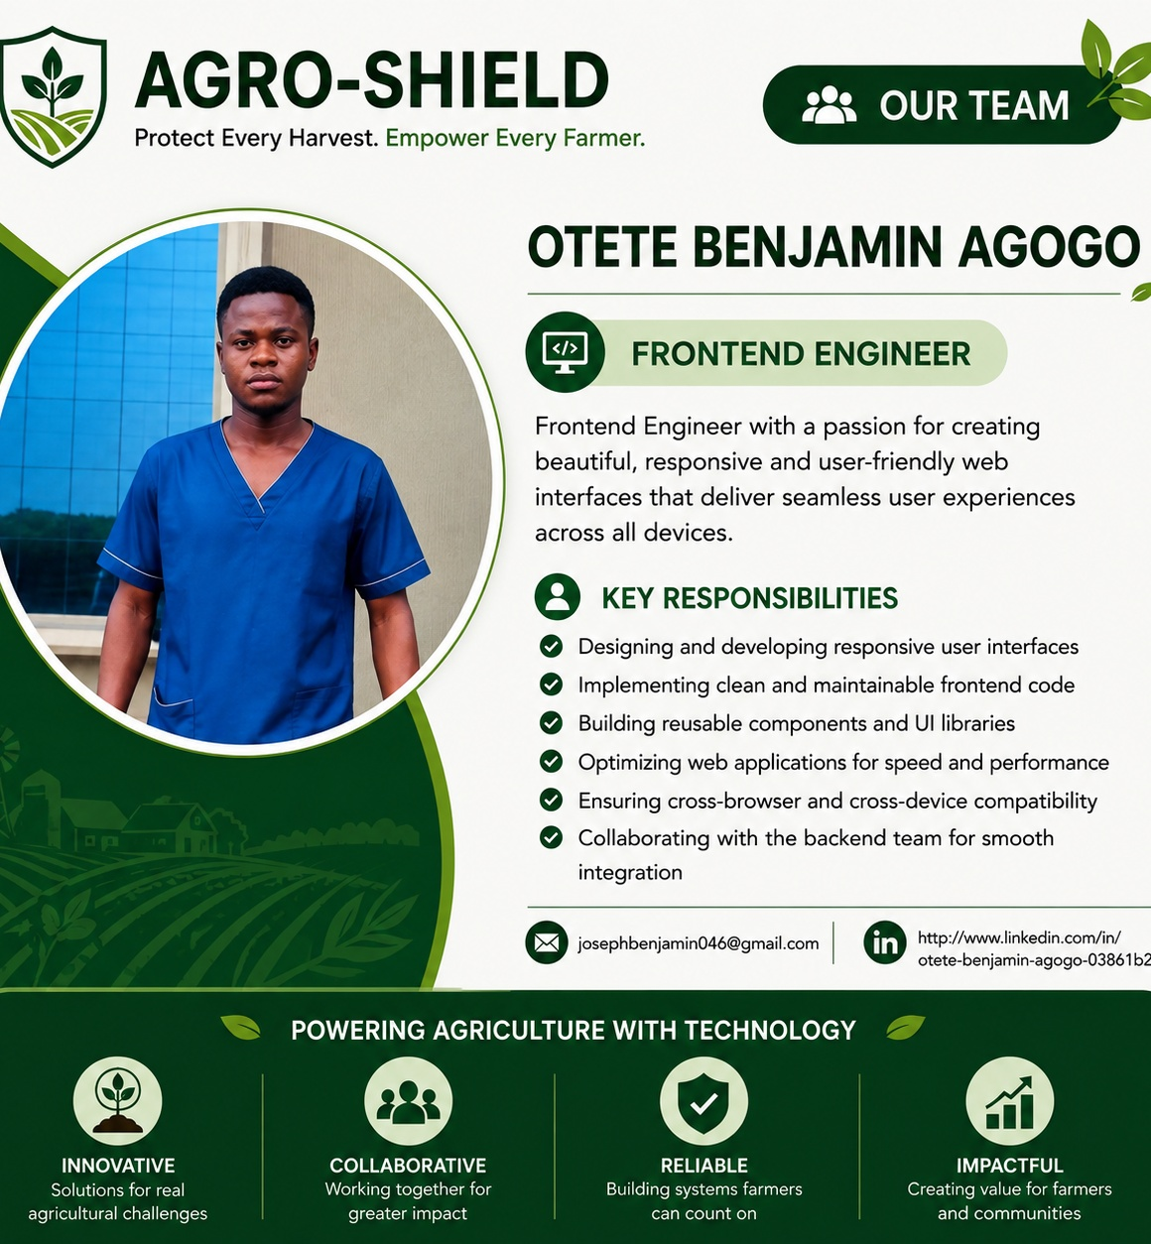
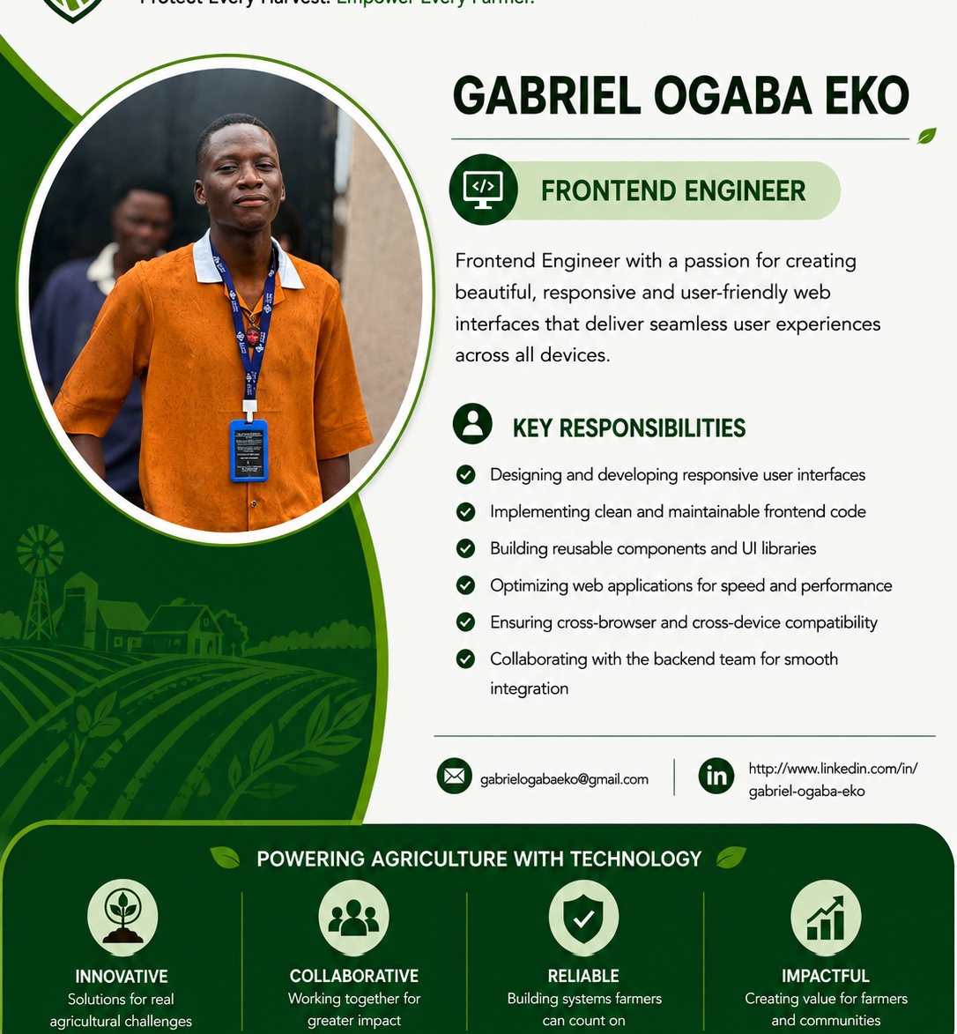
OUR TEAM
Passionate people building technology that empowers farmers and connects the agricultural value chain.
Akilozi Samuel
Adewa James
Otete Benjamin Agogo
Gabriel Ogaba Eko
Team Lead
Backend Engineer
Frontend Engineer
Frontend Engineer
Strategy • Coordination • Architecture • Delivery
Backend • APIs • Database • Security
Frontend • UI/UX • Responsive design
Frontend • User experience • Testing
Alex Ugwu
Emmanuel Eligwu
Agene Okoh
Backend Engineer
QA & Support Engineer
Team Member
Backend • APIs • Database • Security
Testing • Quality assurance • User support
Shared ownership • Collaboration • Product focus • Delivery
13

Slide 14
LIVE DEMO
Experience Agro-Shield in action.
https://agro-shield.onrender.com
Suggested demo flow
PROTECT EVERY HARVEST.
EMPOWER EVERY FARMER.
• Visit Agro-Shield
• Register / sign in
• Explore the marketplace
• Try the AI farming assistant
• Explore the dashboard experience
Thank you • Team Agro-Shield

