Slide 1
Programming Fundamentals
Smart Student Task Manager
A Tkinter-Based Productivity Tool
Presented by: Group - E

Slide 2
Group Members
ETOMET PATRICK | VU-BBC-2411-1019-DAY
NSIMIRE CLEMENCE | VU-BIT-2411-1304-DAY
GRACE KANYONYO | VU-BIT-2411-0581-Day
WATANGWA PRISCA | VU-BCS-2411-0236-DAY
DAADA SUZAN SAMUEL | VU-BCS-2411-0237-DAY

Slide 3
Introduction to Python and Tkinter
Python is a high-level programming language that is simple, readable, and beginner-friendly.
It is widely used in web development, automation, data science, and software development.
Tkinter is Python’s built-in library for creating Graphical User Interfaces (GUIs).
It allows users to create windows, buttons, labels, and more with minimal code.
Tkinter Alternatives:
PyQt – Powerful and professional, but harder to learn.
Kivy – Great for building mobile-friendly apps.
wxPython – Offers native-looking desktop apps.

Slide 4
Project Overview
The Smart Student Task Manager is a desktop application built using Python and Tkinter.
It helps students to:
Add tasks and academic responsibilities
Set due dates and priority levels
Track task status (Pending / Completed)
Edit or delete tasks as needed
It is designed for simplicity and ease of use, especially for students who are new to programming.

Slide 5
Problem Statement
Many students struggle to manage their academic deadlines and assignments.
Some forget to submit work or pay tuition on time due to a lack of organization tools.
Existing tools can be too complex or not student-focused.
There is a need for a simple, customizable solution to help students stay organized.

Slide 6
Key Features
User-friendly and minimal graphical interface for easy navigation.
Ability to add, edit, delete, and mark tasks as completed.
Includes task priority selection: High, Medium, Low.
Due date input with format validation (dd/mm/yyyy).
View tasks in a table format (using Treeview)
Data is stored and retrieved using a JSON file

Slide 7
Technologies and Concepts Used
Python 3 – for writing logic and handling data
Tkinter – for building the user interface (GUI)
Treeview Widget – to display tasks in a table
JSON Module – to save and load task data
Key Concepts Used:
Functions and variables
Conditional statements and loops
Event handling (e.g., button clicks)
File handling (reading and writing JSON files)

Slide 8
GUI Components Used
tk.Entry – for capturing text input (e.g., title, date).
tk.Label – for displaying input field labels.
ttk.Combobox – for selecting task priority.
ttk.Treeview – to display all tasks in a tabular format.
tk.Button – to trigger events like Add, Edit, Delete, Complete.
messagebox – for error messages and user confirmations.

Slide 9
Code Highlights
Defined functions for each main action: add_task(), edit_task(), etc.
Integrated date format validation to reduce user error.
Used a Treeview widget for displaying task records neatly.
Stored task data in a tasks.json file with structured formatting.
Each function updates both the GUI and the underlying data storage.

Slide 10
Challenges Faced
Ensuring widgets aligned correctly and the interface remained clean.
Validating input formats, especially due date format (dd/mm/yyyy).
Working around schedule conflicts to meet as a team.
Debugging errors from Tkinter event-handling and JSON writes.

Slide 11
Lessons Learnt
Understanding of event-driven programming with GUI interaction.
Effective use of Tkinter and ttk widgets for UI design.
Importance of error handling and validating user input.

Slide 12
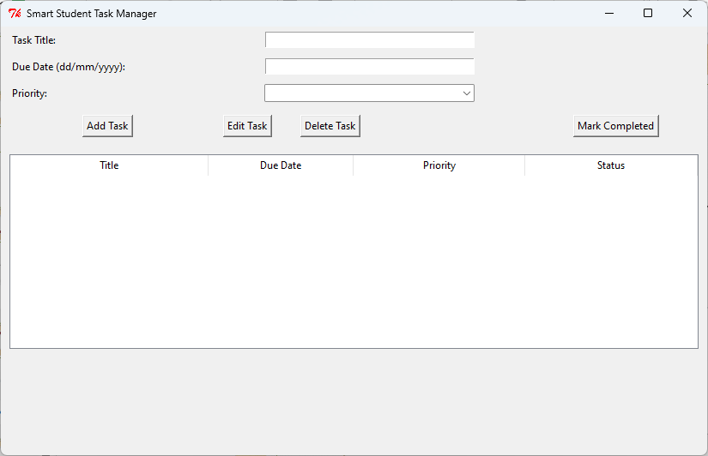
Blank GUI

Slide 13
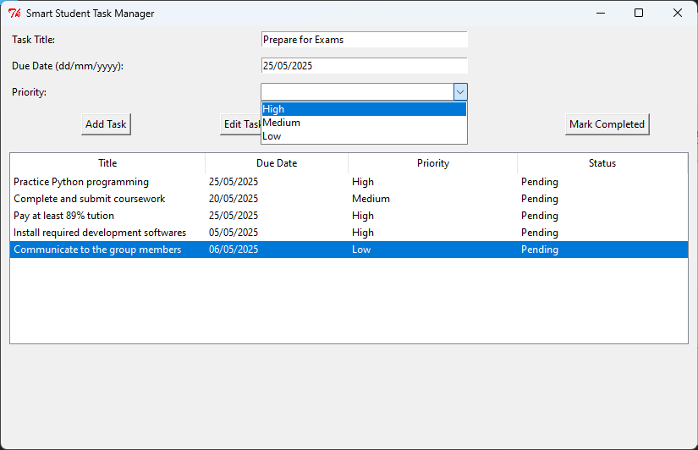
Populated Interface

Slide 14
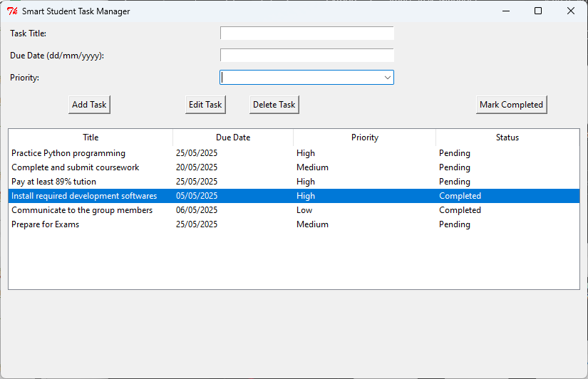
Some completed tasks

Slide 15
Live Demo
Show interface and explain each component briefly.
Add a task: demonstrate correct and incorrect input formats.
Edit and delete a task from the list.
Mark a task as completed and show visual update in the table.
Close and reopen to show data persistence via tasks.json.

Slide 16
Conclusion
The Smart Student Task Manager is a practical and educational project.
It demonstrates:
Basic Python programming
GUI development with Tkinter
Real-world application of programming concepts
Can be improved with features like date picker, filters, or reminders.

Slide 17
Q&A
We welcome any questions or feedback on the project.
Thank you for your time and attention!

