Slide 1
Programming Fundamentals
Smart Student Task Manager
A Tkinter-Based Productivity Tool
Presented by: Group - E

Slide 2
Group Members
ETOMET PATRICK | VU-BBC-2411-1019-DAY
NSIMIRE CLEMENCE | VU-BIT-2411-1304-DAY
GRACE KANYONYO | VU-BIT-2411-0581-Day
WATANGWA PRISCA | VU-BCS-2411-0236-DAY
DAADA SUZAN SAMUEL | VU-BCS-2411-0237-DAY

Slide 3
Project Overview
A Python desktop application to help students manage academic tasks.
Built using the Tkinter GUI library for a simple and interactive interface.
Stores tasks locally in a JSON file for persistence.
Encourages productivity and time management among students.

Slide 4
Objectives
Apply programming fundamentals in a real-world scenario.
Build a fully functional GUI-based Python application.
Create a tool that directly addresses student productivity needs.

Slide 5
Key Features
User-friendly and minimal graphical interface for easy navigation.
Ability to add, edit, delete, and mark tasks as completed.
Includes task priority selection: High, Medium, Low.
Due date input with format validation (dd/mm/yyyy).
All tasks are saved to a JSON file, ensuring data is not lost on exit.

Slide 6
GUI Components Used
tk.Entry – for capturing text input (e.g., title, date).
tk.Label – for displaying input field labels.
ttk.Combobox – for selecting task priority.
ttk.Treeview – to display all tasks in a tabular format.
tk.Button – to trigger events like Add, Edit, Delete, Complete.
messagebox – for error messages and user confirmations.

Slide 7
Code Highlights
Defined functions for each main action: add_task(), edit_task(), etc.
Integrated date format validation to reduce user error.
Used a Treeview widget for displaying task records neatly.
Stored task data in a tasks.json file with structured formatting.
Each function updates both the GUI and the underlying data storage.

Slide 8
Challenges Faced
Ensuring widgets aligned correctly and the interface remained clean.
Validating input formats, especially due date format (dd/mm/yyyy).
Working around schedule conflicts to meet as a team.
Debugging errors from Tkinter event-handling and JSON writes.

Slide 9
Lessons Learnt
Understanding of event-driven programming with GUI interaction.
Effective use of Tkinter and ttk widgets for UI design.
Importance of error handling and validating user input.

Slide 10
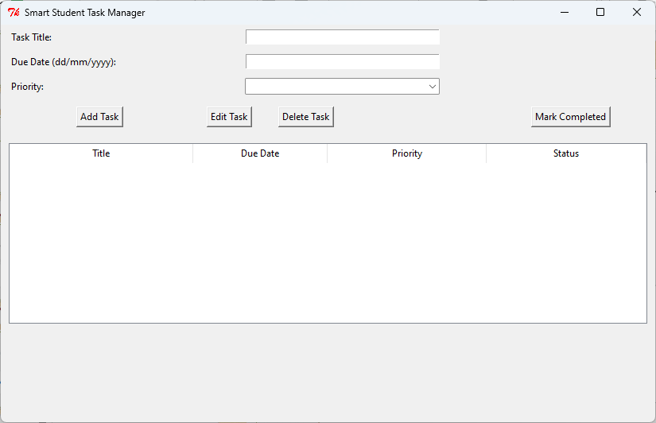
Blank GUI

Slide 11
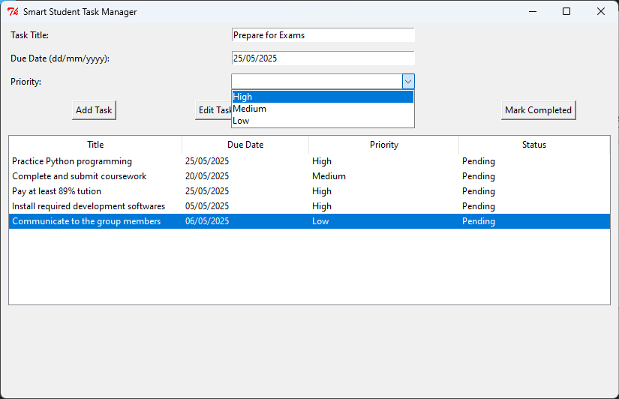
Populated Interface

Slide 12
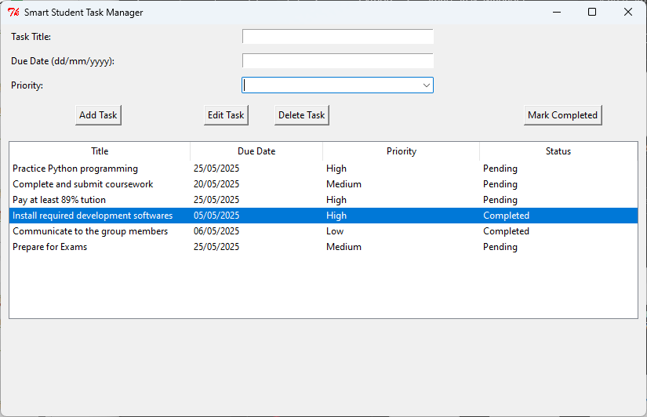
Some completed tasks

Slide 13
Live Demo
Show interface and explain each component briefly.
Add a task: demonstrate correct and incorrect input formats.
Edit and delete a task from the list.
Mark a task as completed and show visual update in the table.
Close and reopen to show data persistence via tasks.json.

Slide 14
Conclusion
Application is practical and addresses common student needs.
Can be improved with features like date picker, filters, or reminders.

Slide 15
Q&A
We welcome any questions or feedback on the project.
Thank you for your time and attention!

