Slide 1
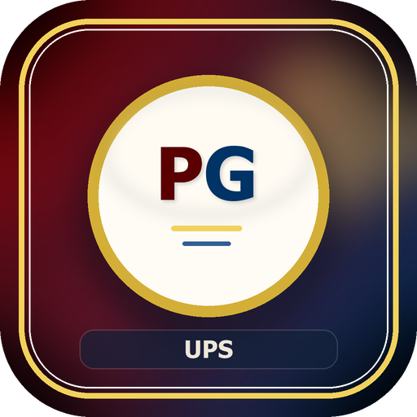
PensionApp Technical Team Briefing
Architecture, domain model, governance, and engineering priorities
Audience: Technical Team
UPS PensionsGo
Prepared from the live repository and documentation set
Repository snapshot: 2026-05-28

Slide 2
Technical Overview
Why This Platform Matters
What the technical team needs to hold in view
UPS PensionsGo is a full-stack pension administration platform with workflow, registry, payroll, arrears, messaging, feedback, and pensioner self-service.
The current codebase spans 41 HTML pages, 51 JavaScript files, 264 PHP API files, and 83 database tables.
The shared runtime spine is concentrated in backend/config.php, which combines settings, security, schema hardening, and reusable domain helpers.
The strongest business-data thread runs from tb_staffdue to tb_fileregistry and then into tasks, payroll, arrears, documents, and pensioner services.
UPS PensionsGo
2

Slide 3
Technical Overview
System Footprint
Current repository and data-model scale
41
51
264
83
HTML pages
JS files
PHP APIs
DB tables
Operational, admin, public, and pensioner interfaces
Vanilla JS controllers plus shared modules
Small endpoint-style service layer
Workflow, registry, payroll, arrears, governance, and content
Runtime schema hardening remains concentrated in backend/config.php and helper files, so release discipline still matters.
The ERD pack is mature enough to support onboarding, refactoring, and cross-domain debugging, including system health diagnostics coverage.
UPS PensionsGo
3

Slide 4
Architecture
Architecture Stack
How the application is layered today
Application Layers
Operational Characteristics
Frontend: static HTML + CSS + vanilla JS
PWA shell: manifest + service worker
API layer: focused PHP endpoints under backend/api
Shared runtime: backend/config.php and helper files
Persistence: MySQL/MariaDB schema under database/schema.sql
Worker layer: notification queue CLI process
Role-aware navigation and API enforcement
Settings-driven behavior across security, retention, notifications, and portal access
RegNo-centered cross-domain joins
Upload-heavy workflows for registry, payroll, messaging, and accountability
Governance surfaces for delete, restore, export, backup, and cleanup
UPS PensionsGo
4

Slide 5
Domains
Capability Map
Nine functional domains dominate the codebase
Operational Domains
Service & Governance Domains
Workflow & Tasks
Claims & Intake
Registry & Document Control
Payroll & Suspensions
Arrears & Budget
Messaging & Notifications
Feedback / FAQ / Terms / Podcast
Pensioner Self-Service
Administration & Operations
ERD / documentation support assets
UPS PensionsGo
5

Slide 6
Data and Flow
End-to-End Operating Flow
The sequence the codebase is built around
1
2
3
4
5
Intake
Workflow
Registry
Payroll
Accountability
Staff due records captured in tb_staffdue
Queueing, status tracking, tasks, and approvals
Canonical pension file created and maintained
Monthly cycles uploaded and matched
Arrears, documents, exports, and governance
Use this flow to reason about ownership boundaries, bug locations, and change impact.
Most debugging sessions become easier once the affected stage is identified correctly.
UPS PensionsGo
6

Slide 7
Data and Flow
Data Model Spine
The tables that connect the grouped ERDs back into a whole
Anchor Tables
ERD Navigation Strategy
tb_users: identity and actor trail
tb_staffdue: pre-registry intake record
tb_fileregistry: canonical pension file
tb_tasks: operational orchestration
tb_payroll_upload_cycles: monthly reconciliation spine
tb_arrears_payments: financial accountability spine
Start with docs/ERD.pdf or docs/erd.md
Deep-dive via docs/erd-domains/*.md
Reconnect through interdomain_links and interdomain_matrix
Use _missing_tables.txt as the completeness check
UPS PensionsGo
7

Slide 8
Security and Governance
Security Model
Controls already present in code
Core Controls
Governance Controls
Role-based access with dynamic roles and permission overrides
Effective-role resolution for cloned and alias roles
CSRF and origin validation support
Session and device-token controls
Admin re-authentication and inactivity handling
Delete queues and recycle-bin restore flow
Settings-driven retention and cleanup
Audit logs, system logs, workflow logs, delegation logs
Server-side mirrors for front-end restrictions
Restricted Data Management access for admin and OC/deputy OC roles
UPS PensionsGo
8

Slide 9
Operations
Deployment and Runtime Ops
Where the platform expects operational discipline
Runtime Model
Operational Jobs
PHP/Apache hosting with MySQL/MariaDB
XAMPP-local and cPanel-style deployment examples
SMTP or PHP mail transport
CLI notification worker for queue processing
Uploads stored under backend/uploads
Notification queue processing
Analytics digests and message-storage snapshots
Data import/export routines
Backup and restore
Data cleanup and storage reporting
UPS PensionsGo
9

Slide 10
Engineering Posture
Strengths and Risks
Where the codebase is strong and where it needs care
Current Strengths
Current Risks
Broad functional coverage in one platform
Good governance instincts in access and lifecycle flows
Existing ERD/documentation pack reduces onboarding cost
Settings-driven behavior makes operations adaptable
PWA shell improves resilience and reach
Monolithic backend/config.php increases coupling
Request-time schema mutation hides migration discipline
Large endpoint count makes discovery hard without catalogues
Automated test coverage is very limited
Legacy naming overlap and historical artifacts need pruning
UPS PensionsGo
10

Slide 11
Engineering Posture
Recent Repo Hygiene
Current cleanup item to keep in mind
The overlapping fetch_staff* duplication has been reduced; only backend/api/fetch_staffdue.php remains in the repository.
This is a good direction: route clarity matters in a PHP endpoint-heavy codebase.
The next step is to keep naming conventions consistent so page controllers, APIs, and docs line up cleanly.
UPS PensionsGo
11

Slide 12
Roadmap
Recommended Near-Term Priorities
What the technical team should do next
Introduce formal versioned migrations so runtime ensure-functions become defensive rather than primary schema drivers.
Build regression coverage around auth, registry update paths, payroll uploads, recycle-bin restore, task routing, and pensioner restrictions.
Publish an API catalogue or OpenAPI baseline for the most critical operational endpoints.
Split backend/config.php into coherent service modules for settings, RBAC, logs, notifications, and domain-specific utilities.
Continue removing ambiguous or duplicate routes and keep docs aligned with those changes.
UPS PensionsGo
12

Slide 13
Close
Technical Discussion Prompts
Suggested framing for the review session
Which domain should be modularized first without breaking momentum?
Which workflows most urgently need automated tests?
Where should formal migrations begin: roles/settings, registry, or payroll?
Which access-control rules deserve a central policy map next?
UPS PensionsGo
13

