Slide 1
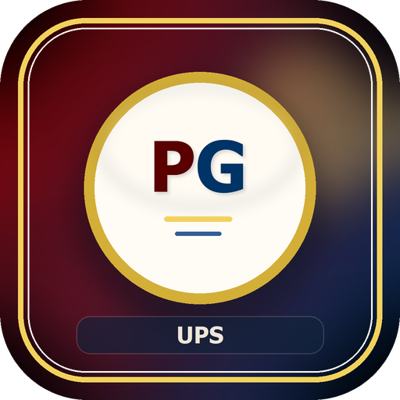
PensionApp User Briefing
How to use UPS PensionsGo safely, consistently, and confidently
Audience: Operational Users
UPS PensionsGo
Prepared from the live repository and documentation set
Repository snapshot: 2026-05-28

Slide 2
User Overview
What PensionsGo Is For
The platform's practical purpose for daily work
PensionsGo brings pension workflow, registry, claims, payroll visibility, tasks, messaging, and support tools into one place.
The current platform baseline includes 41 pages, 264 service endpoints, and a maintained schema with 83 tables.
It helps teams move work forward with clearer ownership, stronger traceability, and less dependence on informal follow-up.
The system is role-aware, so not every user sees the same menu or actions.
The goal is not only speed, but safe and accountable processing.
UPS PensionsGo
2

Slide 3
User Overview
Who Uses the System
Access is based on role and responsibility
Main User Groups
Special Access Groups
Clerks and intake staff
OC/Pension and deputy supervisors
Workflow officers
Registry and records staff
Payroll and finance staff
Administrators
Support staff
Pensioner users
Public feedback users
Content and communications managers
UPS PensionsGo
3

Slide 4
Getting Started
Using the Platform Day to Day
The basic pattern most users should follow
Log in with the correct account and wait for the page to finish loading before acting.
Start from the dashboard when you need a summary, and from the module page when you already know the task.
Apply filters before exporting, printing, or reporting figures.
Use the system's forms, queues, and workflow buttons instead of informal workarounds.
UPS PensionsGo
4

Slide 5
Workflow
Standard Working Flow
A simple way to understand where your work fits
1
2
3
4
5
Capture
Route
Record
Reconcile
Support
Staff due or application data is entered
Tasks, statuses, and approvals move the work
Registry and documents become the source of truth
Payroll and arrears data are checked
Users message, export, review, and follow up
If a case seems stuck, first work out which stage it is in before escalating.
UPS PensionsGo
5

Slide 6
Modules
Core Working Modules
Where users go for the main kinds of work
Operational Modules
Control and Support Modules
Dashboard
Staff Due for Retirement
Pension File Registry
Claims & Arrears
Tasks
Messages
Life Certificate management
Payroll upload history
Users management
Feedback management
Settings
Data Management
UPS PensionsGo
6

Slide 7
Modules
What Good Use Looks Like
Practical operating habits that keep the platform reliable
Do This
Avoid This
Confirm you are updating the correct record
Use the correct module for the task
Keep comments and notes factual
Review filters before exporting
Escalate through the proper supervisor route
Skipping workflow stages without instruction
Sharing accounts or passwords
Treating message threads as informal, off-record chat
Deleting or purging data outside approved flows
Changing settings casually without documenting why
UPS PensionsGo
7

Slide 8
Governance
Data Management and Restore Rules
Users should understand these controls even if they cannot perform them
Registry deletions do not simply disappear; they move through a governed delete and recycle-bin flow.
Data Management access is restricted to administrators and OC/Pension-equivalent leadership roles.
Staff-due deletion follows a separate approval queue, so users should use the proper request path.
Restore and purge actions must be treated as controlled governance actions, not convenience shortcuts.
UPS PensionsGo
8

Slide 9
Pensioner Support
Supporting Pensioner-Facing Work
What staff should know when helping pensioners
Pensioner portal access may be enabled or disabled centrally.
Pensioner lookup visibility depends on consent settings.
Some contact fields are intentionally restricted in special lifecycle states.
If a pensioner cannot change details, check whether the record is in a protected condition before assuming the system is broken.
UPS PensionsGo
9

Slide 10
Security
Security and Good Practice
Simple habits that prevent avoidable incidents
Every User Should
Supervisors and Admins Should
Protect credentials
Respect timeout and re-auth prompts
Handle exports and attachments as sensitive data
Use only authorized actions for the current role
Report unusual behavior quickly
Review access regularly
Watch delete, restore, export, and cleanup activity carefully
Use the dashboard as a prompt, then verify in the source module
Document important settings changes
Guide users toward the governed path, not workarounds
UPS PensionsGo
10

Slide 11
Troubleshooting
When Something Goes Wrong
A simple first-response checklist
If login fails: check credentials, role, lockout, and maintenance-mode conditions.
If an action is denied: confirm both role and permission scope before escalating.
If numbers look wrong: refresh, confirm filters, and verify the source module.
If a deleted record is needed: check the delete queue or recycle bin instead of assuming permanent loss.
If a pensioner cannot edit details: confirm whether lifecycle restrictions are in effect.
UPS PensionsGo
11

Slide 12
Close
Key Message for Users
The platform works best when the process is followed as designed
Use the right module for the right job.
Let the workflow, queues, and approvals do the coordination work.
Treat every change as part of an auditable operational record.
Ask early when access, data state, or workflow ownership is unclear.
UPS PensionsGo
12

