Slide 1
specs and Scala
Tips and tricks for a friendly DSL syntax
Notes:
Why I got interested in specs?
How specs can help you?
How to achieve the wonderful syntax?
Implicit
restrict-combine-add,add-be lazy
bag of tricks: operators, class manifests
resources + QA
Buy a clicker!!!!

Slide 2

Tuesday, September 21, 2010
About…
specs tour
Implicit def
Restrict
Combine
Add , add
Be lazy
!&%$#>
Manifests
Resources

Slide 3

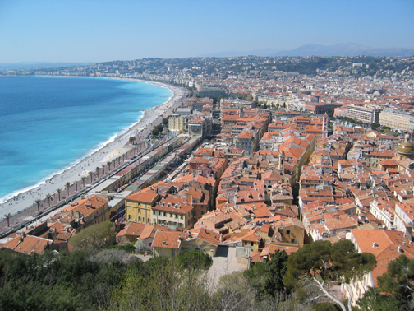
About…

Slide 4


About…

Slide 5
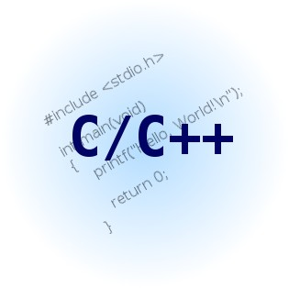

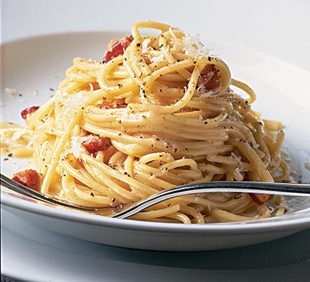



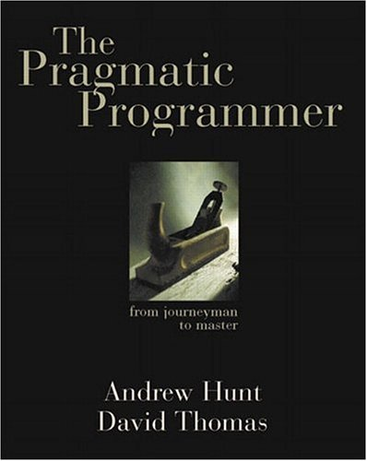



About…

Slide 6

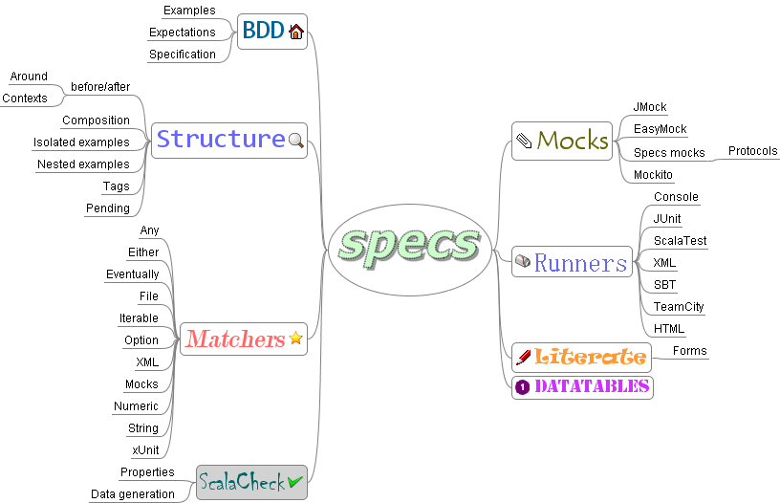
tour

Slide 7

tour
Test
Specification
specify
example
example
example
example
example
example
example
example
example
Notes:
BDD linguo:
Tests come after the fact so TDD is more like specifying the behavior to implement
- Then what is a specification? At the most basic level it is a bunch of examples

Slide 8
tour
import IncredibleStringReverser._
class ReverserSpec extends Specification {
"a reversed empty string must be empty" in {
reverse("") must_== ""
}
"a reversed empty string must really *be empty*" in {
reverse("") must be empty
}
"a reversed string must be reversed abc -> cba" in {
reverse("abc") must be_==("cba")
}
"a longer string must also be reversed. Whoops!" in {
reverse("abcdef") must be_==("xxxxx")
}
}

Slide 9
tour
"a reversed empty string must be empty" in {
reverse("") must be empty
}

Slide 10
tour
Specification "ReverserSpec"
+ a reversed empty string must be empty
+ a reversed empty string must really *be empty*
+ a reversed string must be reversed abc -> cba
x a longer string must also be reversed. Whoops!
'fedcba' is not equal to 'xxxxx' (ReverserSpec.scala:17)
Total for specification "ReverserSpec":
Finished in 0 second, 140 ms
4 examples, 4 expectations, 1 failure, 0 error

Slide 11

tour
repetition
repetition
repetition
repetition
repetition
repetition
organize
System
Under
Specification

Slide 12
tour
class Reverser2Spec extends Specification {
"a reversed empty string" should {
val reversed = reverse("")
"be empty" in {
reversed must_== ""
}
"really *be empty*" in {
reversed must be empty
}
}
"a reversed non-empty string" should {
val reversed = reverse("abc")
"be reversed abc -> cba" in {
reversed must be_==("cba")
}
"have the same size as the original string" in {
reversed must have size(3)
}
}
}

Slide 13
tour
"a reversed empty string" should {
val reversed = reverse("")
…
}
"a reversed non-empty string" should {
val reversed = reverse("abc")
…
}

Slide 14
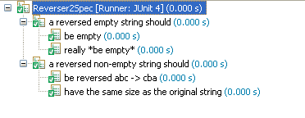
tour

Slide 15


tour
Be specific
Matchers

Slide 16
tour
trait HelloWorldSnippet {
def hello(s: String)=
<div class="txt">Hello {s}</div>
}
"the snippet must output a div element" >> {
hello("Eric") must \\(<div/>)
}
"it must have an attribute class=txt" >> {
hello("You") must \\(<div/>, "class" -> "txt")
}

Slide 17
tour
hello("Eric") must \\(<div/>)

Slide 18


tour
Be exhaustive
Properties

Slide 19
tour
class Reverser3Spec extends Specification with ScalaCheck {
"reverse must preserve the length of a string" verifies {
s: String => reverse(s).size == s.size
}
"reverse applied twice must return the same string" verifies {
s: String => reverse(reverse(s)) == s
}
"reverse 2 concatenated strings must return the reversed second
string concatenated with the reversed first one" verifies {
(s1: String, s2: String) => reverse(s1 + s2) ==
reverse(s2) + reverse(s1)
}
def center(s: String) = s(s.size / 2)
"keep the same 'center' character - Whoops!" verifies {
s: String => s.isEmpty || center(reverse(s)) == center(s)
}
}

Slide 20
tour
"reverse applied twice must return " +
"the same string" verifies {
s: String => reverse(reverse(s)) == s
}

Slide 21
tour
x keep the same 'center' character - Whoops!
A counter-example is 'bc'
(after 1 try – shrinked ('bcab' -> 'bc'))

Slide 22

tour
Isolate
Mocks

Slide 23
tour
/**
* A simple Observable-Observer implementation
*/
trait Observable {
private var observers: List[Observer] = Nil
def add(o: Observer) =
observers = o :: observers
def changed(event: String) =
observers foreach (_.notify(event))
}
trait Observer {
def notify(event: String)
}

Slide 24
tour
class ObservableSpec extends Specification with Mockito {
val observer = mock[Observer]
val observable = new Observable { add(observer) }
"An observable notifies its observers if changed" >> {
observable.changed("event")
there was one(observer).notify("event")
}
"Each change event is notified" >> {
observable.changed("event1")
observable.changed("event2")
there was two(observer).notify(startWith("event"))
}
}

Slide 25
tour
"An observable notifies its observers if " +
"changed" >> {
observable.changed("event")
there was one(observer).notify("event")
}

Slide 26

DSL
How does it work?

Slide 27

DSL
The best tool in the box
"This is ok" in {
1 + 1
}
// is the same as
"This is ok".in(1 + 1)
"In" method on String ?!

Slide 28
DSL
The best tool in the box
class Example(description: String) {
def in(e: Any) = e
}
implicit def forExample(d: String) = {
new Example(d)
}

Slide 29

DSL
Naming
forExample("this works") in {
1 + 1
}

Slide 30

DSL
Some examples
"This is true" in {
true must beTrue
}
3.seconds
3 seconds
3 times { i => println(i) }

Slide 31
Tuesday, September 21, 2010
About…
specs tour
Implicit def
Restrict
Combine
Add , add
Be lazy
!&%$#>
Manifests
Resources

Slide 32

DSL
Restrict

Slide 33
DSL
Restrict
class Example(description: String) {
def in(e: Any) = expectations
def tag(t: String) = this
}

Slide 34
DSL
Restrict
"this is a" tag ("really?")

Slide 35
DSL
Restrict
class ExampleDesc(description: String) {
def in(e: Any): Example = new
Example(description, e)
}
}
class Example(d: String, e: Any) {
def tag(t: String): Example = this
}

Slide 36

DSL
Combine

Slide 37
DSL
Combine
trait Matcher[-T] {
def apply(y: =>T): (Boolean, String, String)
def not: Matcher[T]
def when(condition: =>Boolean): Matcher[T]
def unless(condition: =>Boolean): Matcher[T]
def orSkip: Matcher[T]
def or[S <: T](m: Matcher[S]): Matcher[S]
def xor[S <: T](m: Matcher[S]): Matcher[S]
def and[S <: T](m: Matcher[S]): Matcher[S]
def ^^[S <: T, U](f: S => U): Matcher[U]
def toIterable: Matcher[Iterable[T]]
}

Slide 38
DSL
Some examples
def beFalse = beTrue.not
condition must beTrue or beFalse
condition must beTrue.unless(condition2)
def trimmedSize(i: Int) = size(i) ^^ (_.trim)
string must have trimmedSize(3)

Slide 39

DSL
Add, add, add

Slide 40
DSL
Repeated parameters
include(spec1)
include(spec1, spec2)
1 must beOneOf(1, 2, 3)

Slide 41
DSL
Use and pass
result + 1 // result = ?
result.pp + 1 // print and pass

Slide 42
DSL
Use and pass
Customers.findBy(_.age >= 18)
aka "adult customers"
must haveSize(3)
> adult customers 'Bob, Lee'
doesn't have size 3

Slide 43
DSL
this.type
class BigSpec extends Spec {
// I want to "tag" the
// slow spec as slow
include(slowSpec, fastSpec)
}

Slide 44
DSL
this.type
class BigSpec extends Spec {
include(slow tag "slow", fast)
}

Slide 45
DSL
this.type
class Spec extends Tagged {
def include(other: Spec*) = …
}
trait Tagged {
def tag(t: String): ?
}

Slide 46
DSL
this.type
// store the tag and return this
def tag(t: String): this.type = this

Slide 47
DSL
Configuration
val prop = forAll { (s: String) =>
reverse(reverse(s)) == s
}
"With the default configuration" in {
prop must pass
}

Slide 48
DSL
Configuration
"With a 3 tests ok" in {
prop must pass(set(minTestsOk -> 3))
}
"With 3 tests ok – in the console" in {
prop must pass(display(minTestsOk -> 3))
}

Slide 49
DSL
Implicit parameters
def pass(implicit p: Params) = {
new Matcher[Prop] {
def apply(prop: =>Prop) = check(prop)(p)
}
}
implicit val defaultParams = new Params

Slide 50

DSL
Be lazy

Slide 51
DSL
Be lazy
"This should not explode" in {
error("boom")
}

Slide 52
DSL
Be lazy
class ExampleDesc(d: String) {
def in(e: =>Any) =
new Example(description, e)
}
class Example(d: String, e: =>Any)

Slide 53
DSL
Be lazy
def in(e: =>Any) = …

Slide 54
DSL
By name parameters
⇨ Evaluate once!
class EqualMatcher[T](x: =>T) extends Matcher[T] {
def apply(y: =>T) = {
val (a, b) = (x, y)
(a == b, a + " is equal to " + b,
a + " is not equal to " + b)
}
}

Slide 55
DSL
By name parameters
⇨ With varargs?
// not legal!!
def method[T](params: =>T*)
method(1., 2., math.pow(100, 100))

Slide 56
DSL
By name parameters
⇨ With varargs!
implicit def lazyfy[T](value: =>T) =
new LazyParameter(() => value)
class LazyParameter[T](value: () => T) {
lazy val v = value()
def get() = v
}

Slide 57
DSL
By name parameters
⇨ With varargs!
def method[T](params: LazyParameter[T]*)

Slide 58
Tuesday, September 21, 2010
About…
specs tour
Implicit def
Restrict
Combine
Add , add
Be lazy
!&%$#>
Manifests
Resources

Slide 59
DSL
Operators
class ExampleDesc(d: String) {
def >>(e: =>Any) = new Example(d, e)
}
"When I setup the system" >> {
"And a customer is entered" >> {
"if he has a discount" >> {}
"if he doesn't have a discount" >> {}
}
}

Slide 60
DSL
Operators
// contexts
"A full stack" ->-(fullStack) should { … }
// matchers
xml must \\(<node/>)
// repl matcher
> "This is the expected result"

Slide 61
DSL
DataTables
/**
* Fit-like table in Scala?
*
* | a | b | c |
* | 1 | 2 | 3 |
* | 2 | 2 | 4 |
*
*/
Use ‘!‘ to separate cells and
‘|‘ to separate rows

Slide 62
DSL
DataTables
class DataTablesSpec extends Specification with DataTables {
"lots of examples" >> {
"a" | "b" | "a + b" |
1 ! 2 ! 3 |
2 ! 2 ! 4 |
2 ! 3 ! 4 |> { (a, b, c) =>
a + b must_== c
}
}
}

Slide 63
DSL
DataTables
// the ‘play’ operator |>
2 ! 3 ! 4 |> { (a, b, c) =>

Slide 64
DSL
Class manifests
// How to avoid
// throwA(classOf[FailureException])
(1 must_== 2) must
throwA[FailureException]

Slide 65
DSL
Class manifests
import scala.reflect._
def throwA[T](implicit m: ClassManifest[T]) =
new Matcher[Any] {
// use m.erasure
}

Slide 66
DSL
Make a guess
"When I setup the system" >> {
"And a customer is entered" >> {
"if he has a discount" >> {}
"if he doesn't have a discount" >> {}
}
}
Discover leaves without executing?

Slide 67
DSL
Make a guess
def in[T : Manifest](e: =>T) = {
expectationsAre(e)
if (manifest[T].erasure == getClass)
hasNestedExamples = true
this
}

Slide 68
Tuesday, September 21, 2010
About…
specs tour
Implicit def
Restrict
Combine
Add , add
Be lazy
!&%$#>
Manifests
Resources

Slide 69

DSL
http://code.google.com/p/specs
http://etorreborre.blogspot.com/oscon-2010
Scala 2.8.0
inside !

Slide 70

DSL
Bag of tricks

Slide 71
DSL
I want a pony
/**
* how to write:
* I want a pony ??
*/
/**
* 2 solutions:
*
* I.want(a.pony) => ScalaTest
* (I.want(a)).pony => specs
*/

Slide 72
DSL
Some examples
list must have size(3)
list must be empty
list must have size(2) or have size(3)
(((list must have).size(2)).or(have)).size(3)
⇨ Fancy but difficult to reason about

Slide 73
DSL
I want a pony
trait Word; class AWord extends Word
class Result[T](v: T)
class Expectable[T](v: T) {
def want(a: Word) = new Result[T](v)
}
implicit def theValue[T](v: T): Expectable[T] = …
implicit def ponyable[T](r: Result[T]) {
def pony = // check the result
}
val a = new Aword; val I = 1
I want a pony

Slide 74
DSL
apply
object DBContext extends Specification {
val setup = new SpecContext {
beforeExample(deleteUsersTable)
aroundExpectations(inDatabaseSession(_))
}
}
object RepositorySpecification extends Specification {
// equivalent to: DBContext.setup.apply(this)
DBContext.setup(this)
"A Users repository" can { /*...*/ }
}
object.apply(object) ⇨ verb(object)

Slide 75
DSL
Variance
⇨ Know the rules!
trait Matcher[-T] { def apply(y: =>T): Boolean }
class EqualMatcher(x: Any) extends Matcher[Any] {
def apply(y: =>Any) = x == y
}
class HelloMatcher extends Matcher[String] {
def apply(x: =>String) = x == "hello"
}
val beHello = new HelloMatcher
val equalToHello = new EqualMatcher("hello")
"hello" must beHello
"hello" must equalToHello

Slide 76
DSL
typing
implicit def forExample(d: String): Example
“An implicit conversion without explicit result type is visible only in the text following its own definition”

