Slide 1

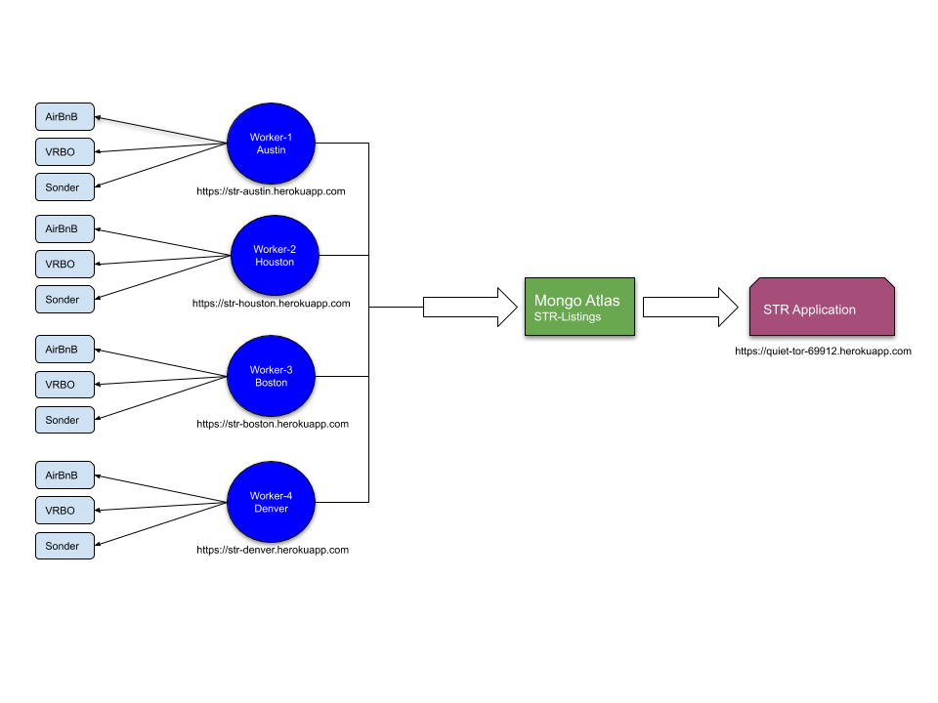
STR - Application Architecture Overview Diagram
Pointy Goblins
Application comprised of 5 heroku free tier applications
Data obtained using web scraping technologies of cheerio and puppeteer NPM modules
Architecture uses one free tier heroku instance for each cities data obtained
Scraping workers scheduled every 10 minutes using heroku free tier scheduler
Results from web scrapers stored into a mongodb instance
One heroku instance used to host client side react application

