Slide 1

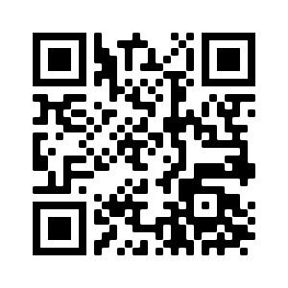
Not sure about your future?
Have you considered a PhD in computing?
Attend a virtual information session and recruiting event for PhD programs on November 6!
Get paid to earn a Master’s degree!
Learn about cutting-edge research!
Network with professors and folks from industry!
Hear from current PhD students!
Learn what a PhD program is really like!
MYTH: Only ”smart” people get PhDs.
FACT: A PhD is a training program, emphasizes skills and work, and anyone who can earn a Bachelor’s degree is plenty smart!
MYTH: You need excellent grades to get a PhD.
FACT: Grades don’t matter as much as research potential, which is about tenacity!
MYTH: Only get a PhD if you want to be a professor.
FACT: A PhD can open many doors!
MYTH: PhD research doesn’t matter in the real world.
FACT: PhD research is foundational for society, and the amount your work affects the real world is up to you!
Fill out our participation survey:
https://phd-recruiting.etosch.w3.uvm.edu/

