Slide 1
Model and State Estimation in Hybrid Systems
Maxim Egorov and Andrew Bylard
June 1st, 2016

Slide 2
Outline
Introduction
Hybrid Systems
Interacting Multiple Model Estimator (IMM)
Our Approach: Fast-IMM
Experiments
Conclusion

Slide 3
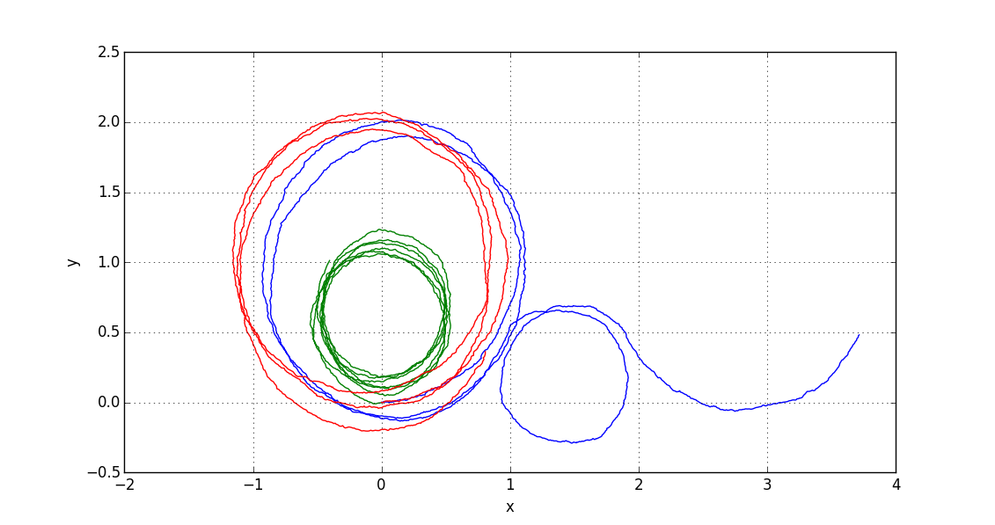
Introduction
How to do state estimation when dynamic model of system varies over time?

Slide 4
Introduction
Two step process:
Estimate continuous state (know how to do this)
Estimate model that drives state dynamics (more complicated)
Applications: target tracking, anomaly detection, behavior prediction

Slide 5


Introduction
Two step process:
Estimate continuous state (know how to do this)
Estimate model that drives state dynamics (more complicated)
Applications: target tracking, anomaly detection, behavior prediction

Slide 6
Hybrid Systems
Formalize: model set, models switch stochastically

Slide 7
Interacting Multiple Model Estimator
Have system with N possible models
M_{t+1} ~ P(M_{t+1}|M_{t})
Closed form solution requires N^{t} filters: Generalized Pseudo-Bayesian Method (GPB)
IMM uses N filters in parallel
3 Steps: interaction, filtering, and combination

