Slide 1
Sentences in the past simple,
the verb "to be," and other
verbs
Name: Marcos Eduardo Tovar Rodriguez
Tuition: 437276
Class: Lengua extranjera I
Teacher: Jose Miguel Estrada Trevizo
Notes:
Cover. Topics: past simple of the verb to be (was/were) and past simple of other verbs, regular and irregular.

Slide 2
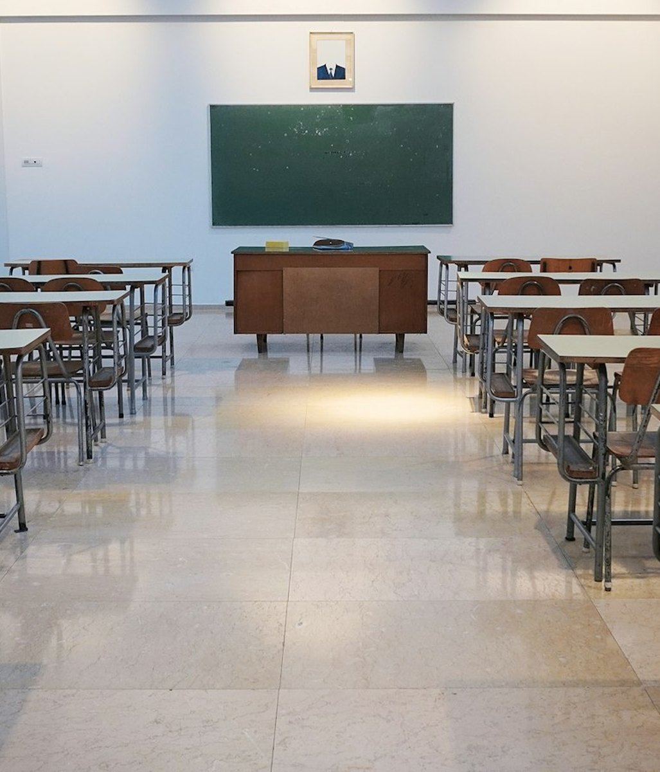
I was at school yesterday.

Slide 3
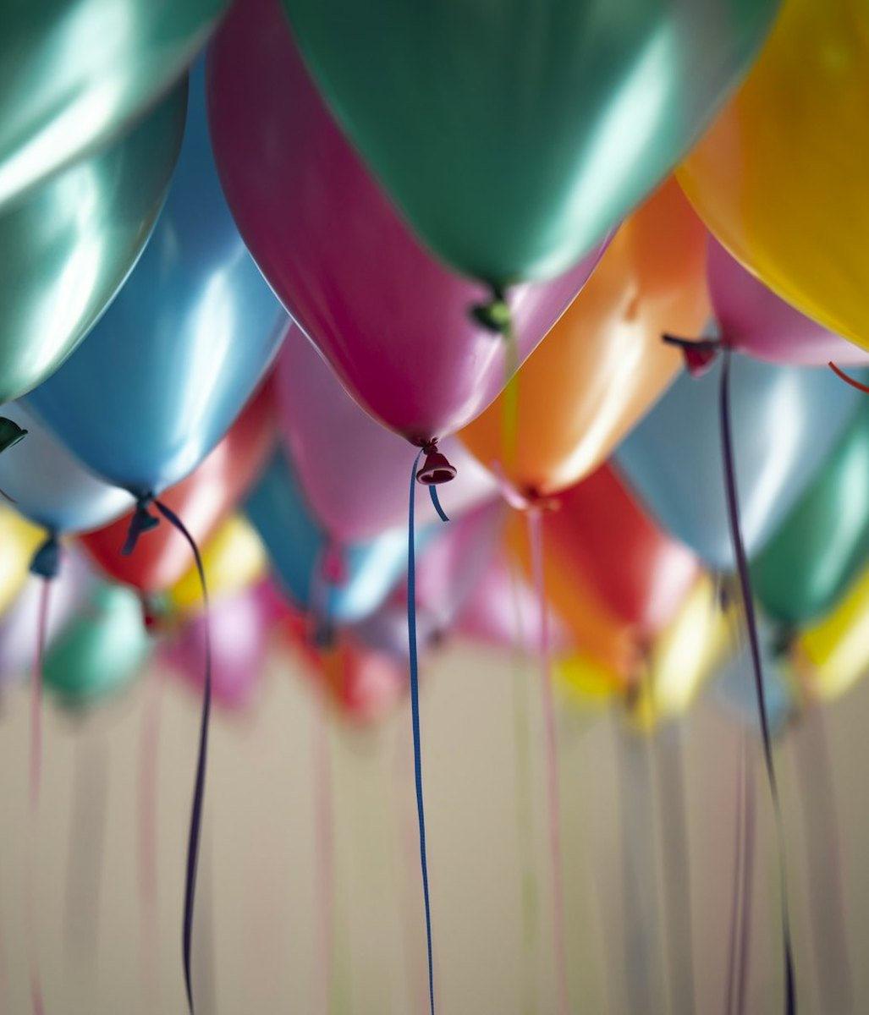
She was happy at the party.

Slide 4
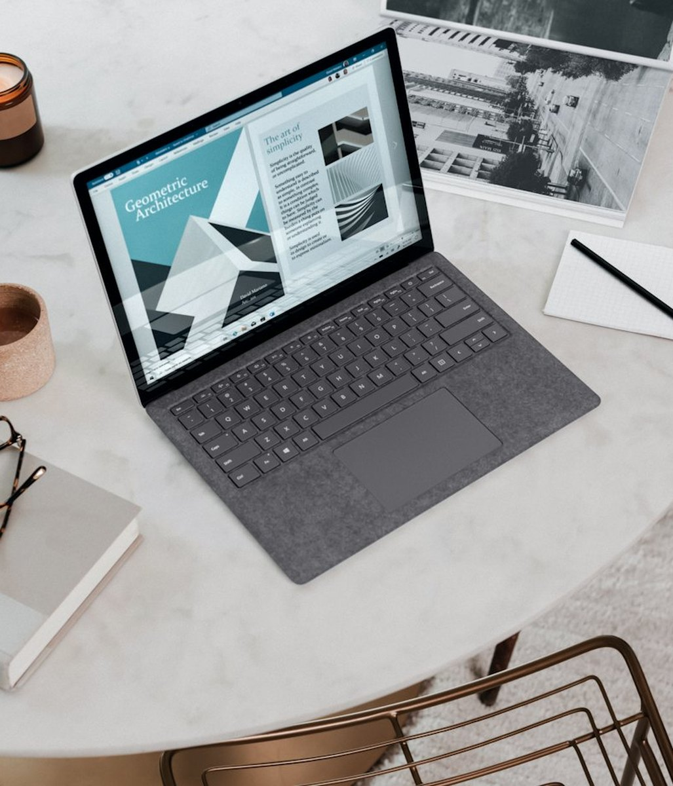
She was at the office.

Slide 5
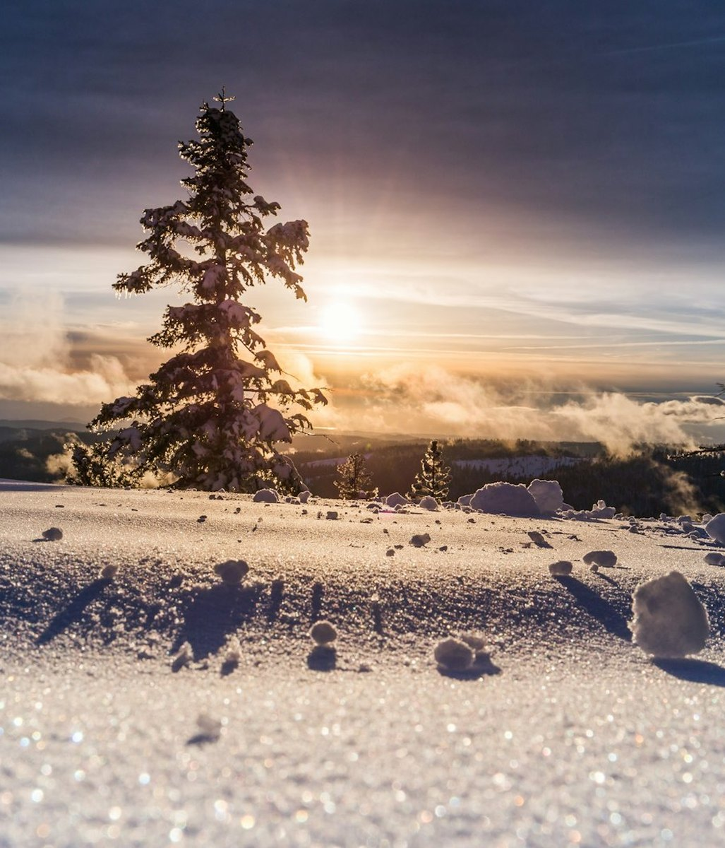
It was a cold morning.

Slide 6
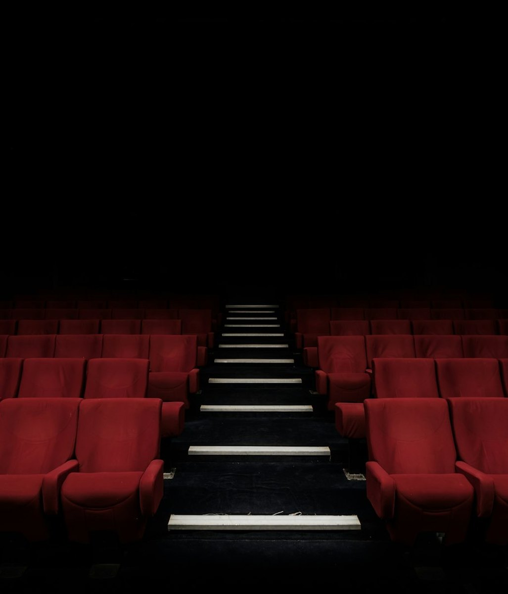
The movie was interesting.

Slide 7
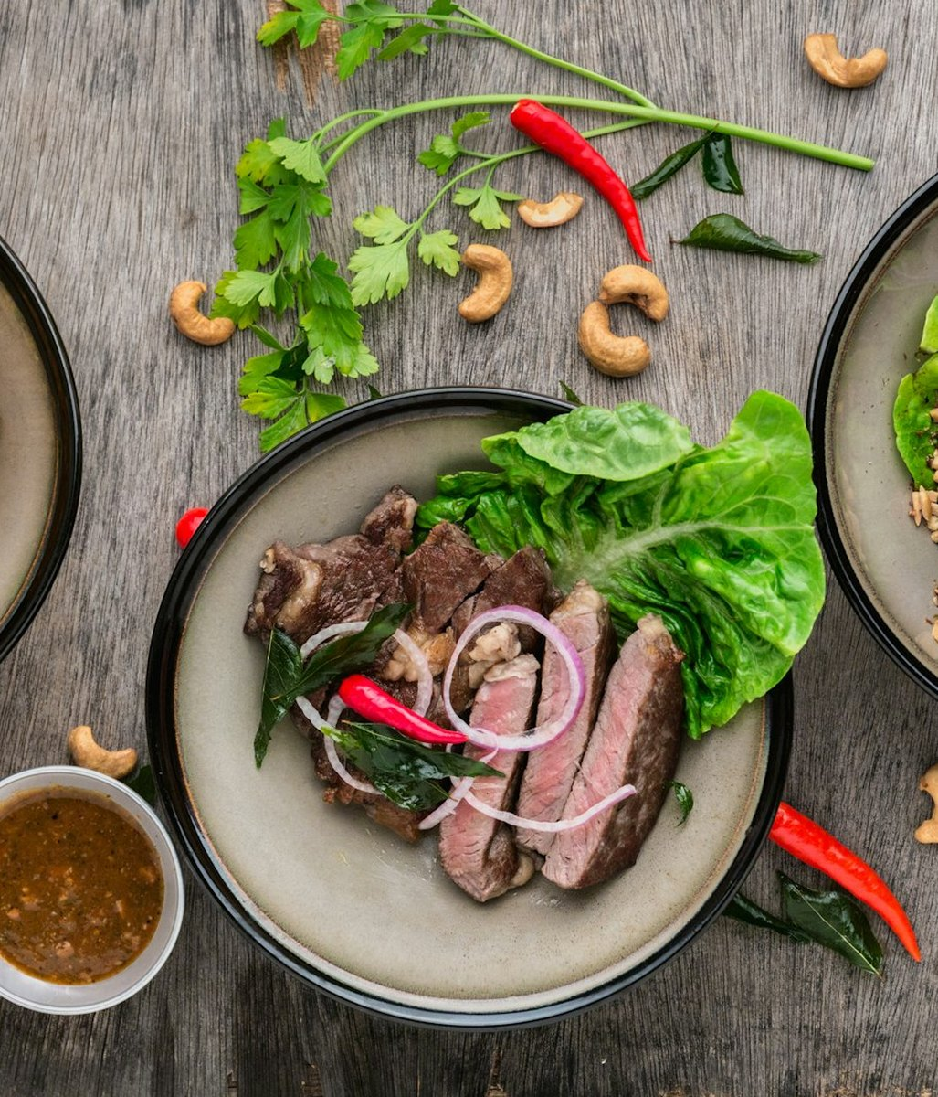
The food was delicious.

Slide 8
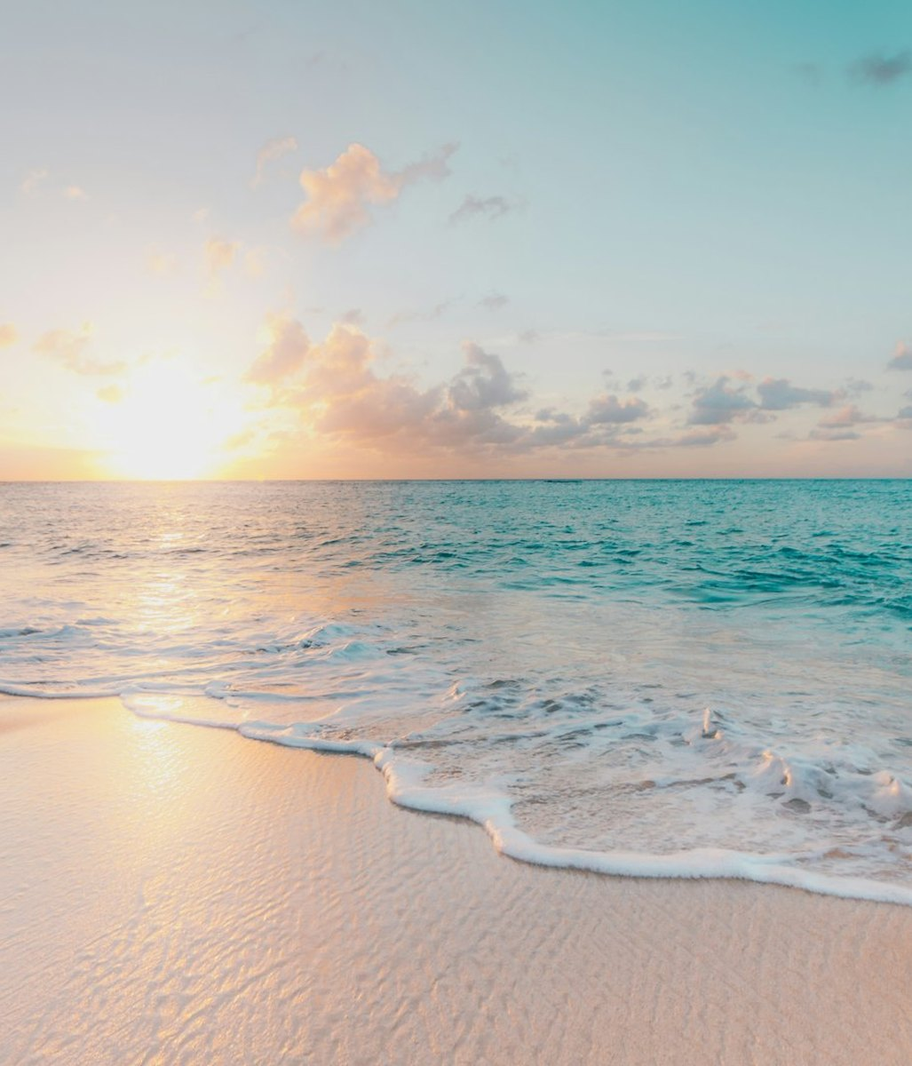
We were at the beach last summer.

Slide 9
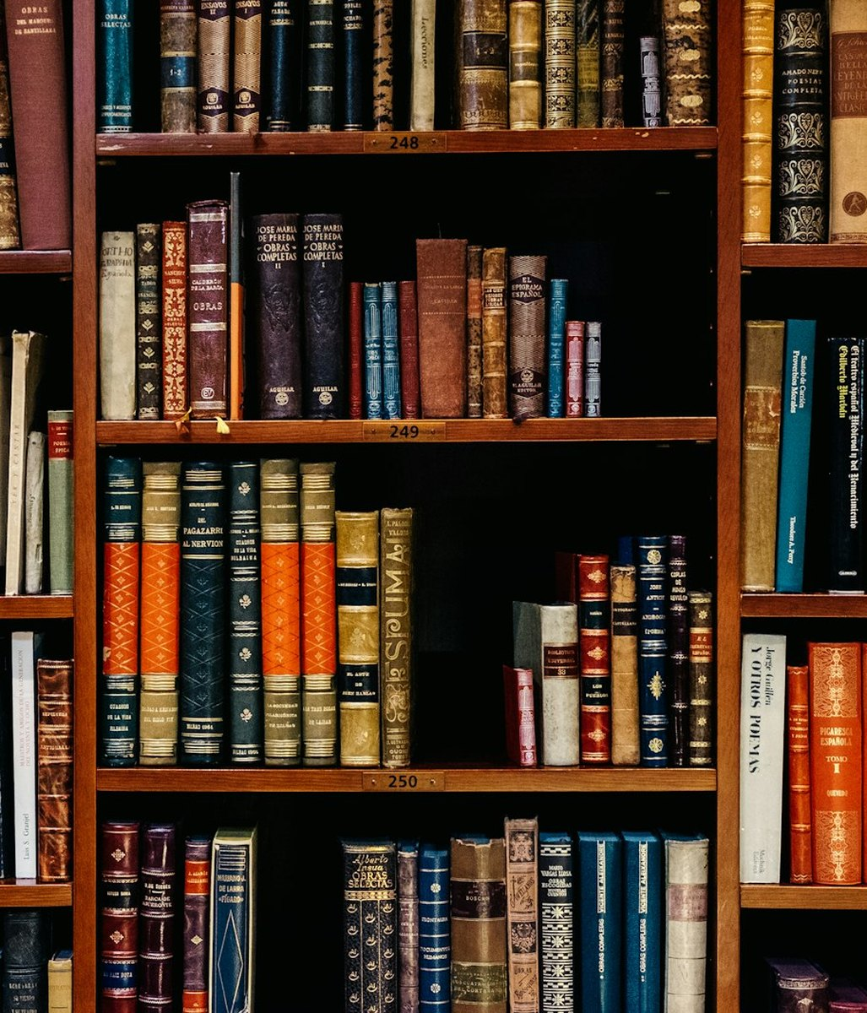
They were in the library.

Slide 10
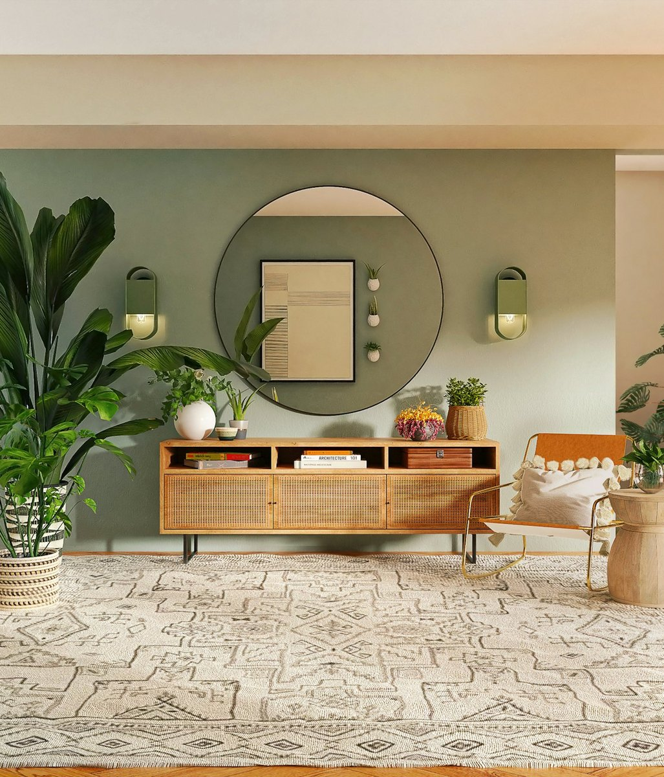
My parents were at home.

Slide 11
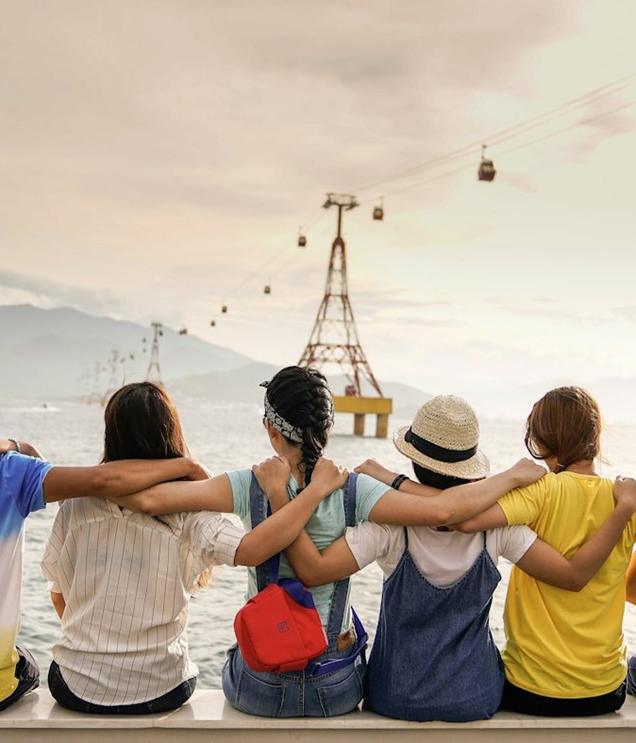
They were happy together.

Slide 12
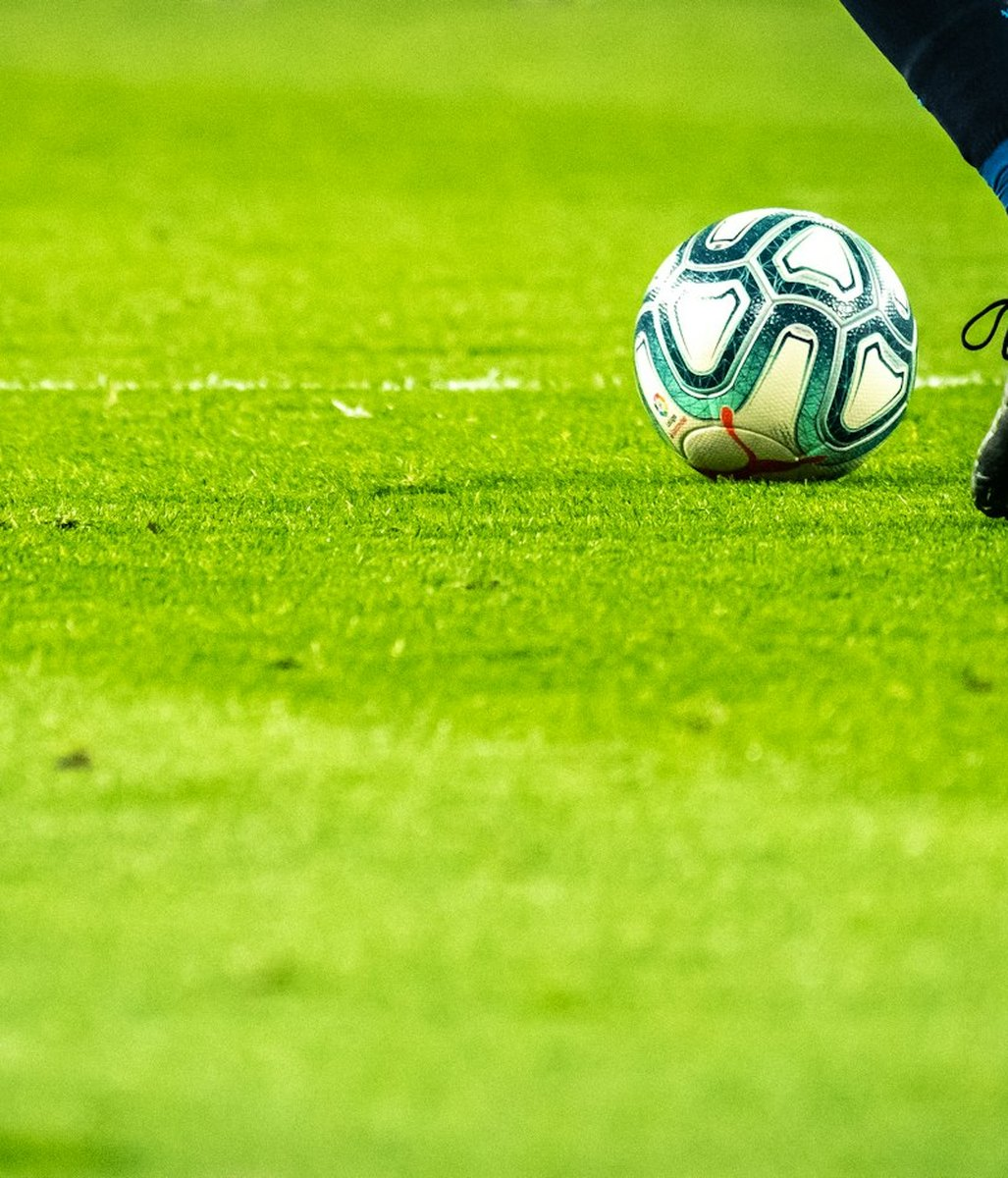
They played soccer.

Slide 13

She watched TV last night.

Slide 14
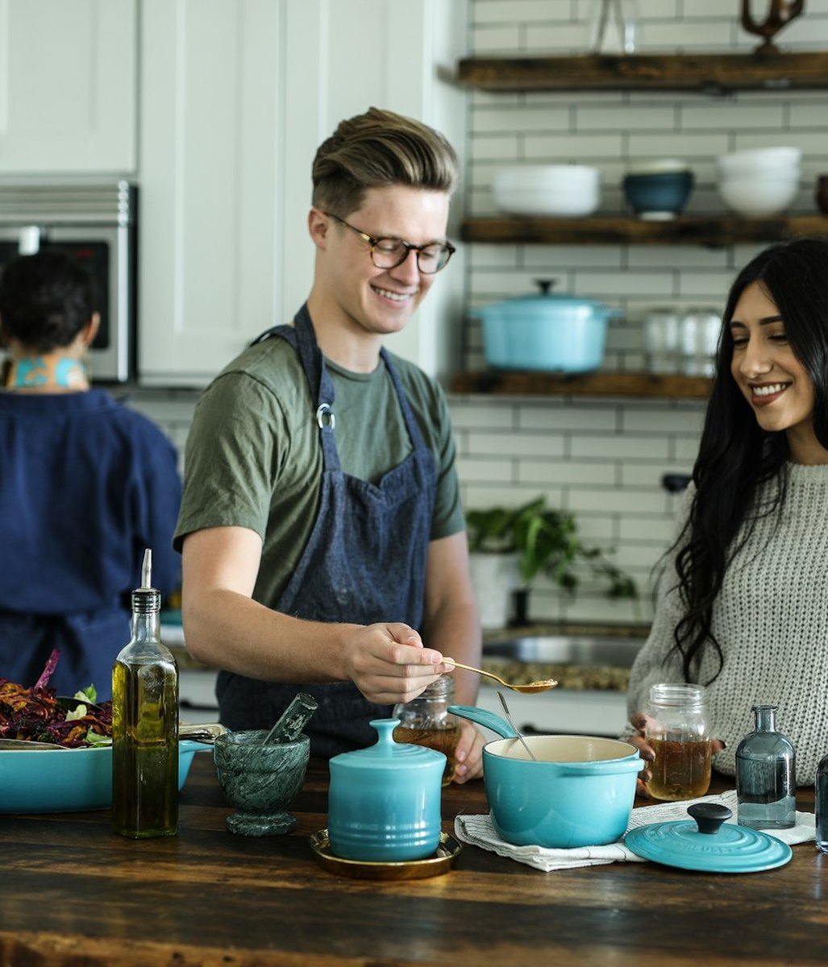
He cooked dinner for his family.

Slide 15
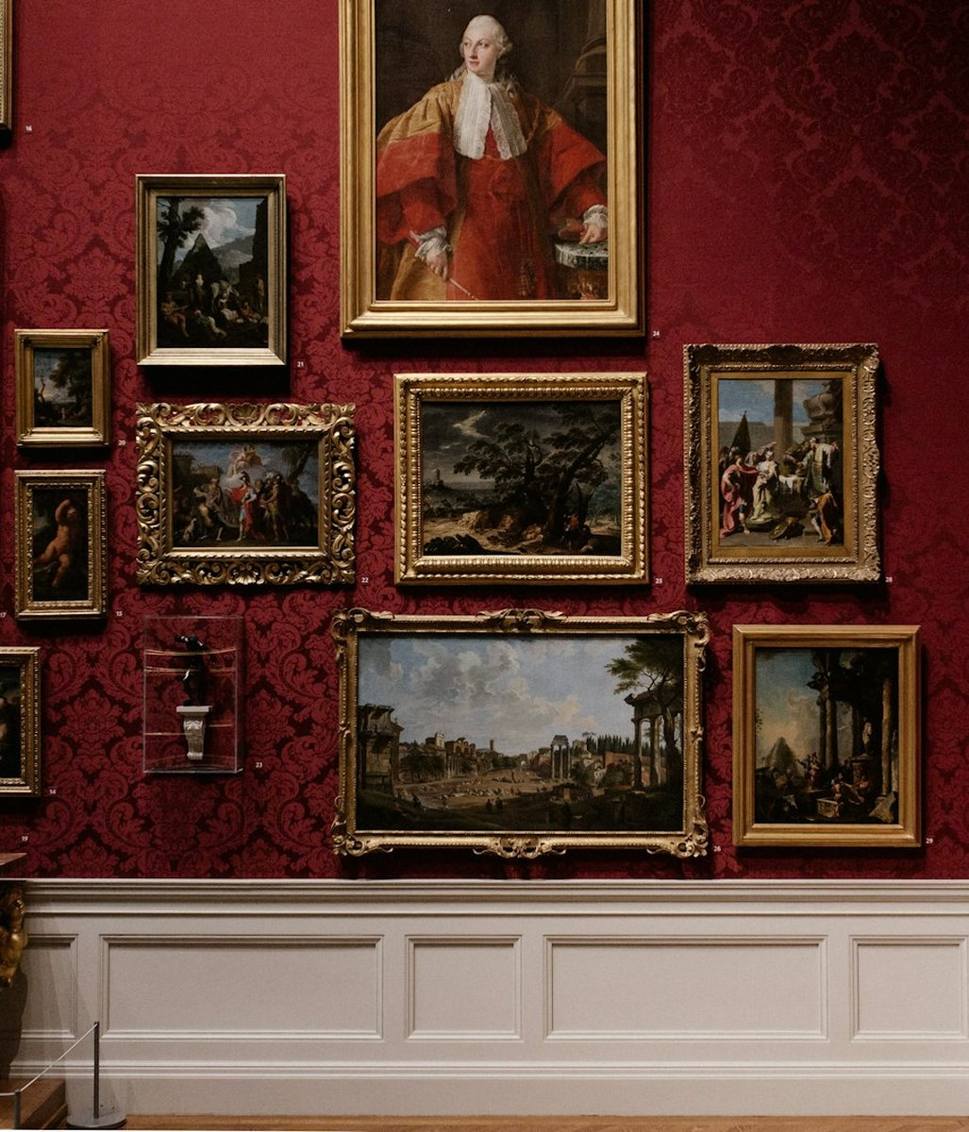
We visited the museum on Saturday.

Slide 16
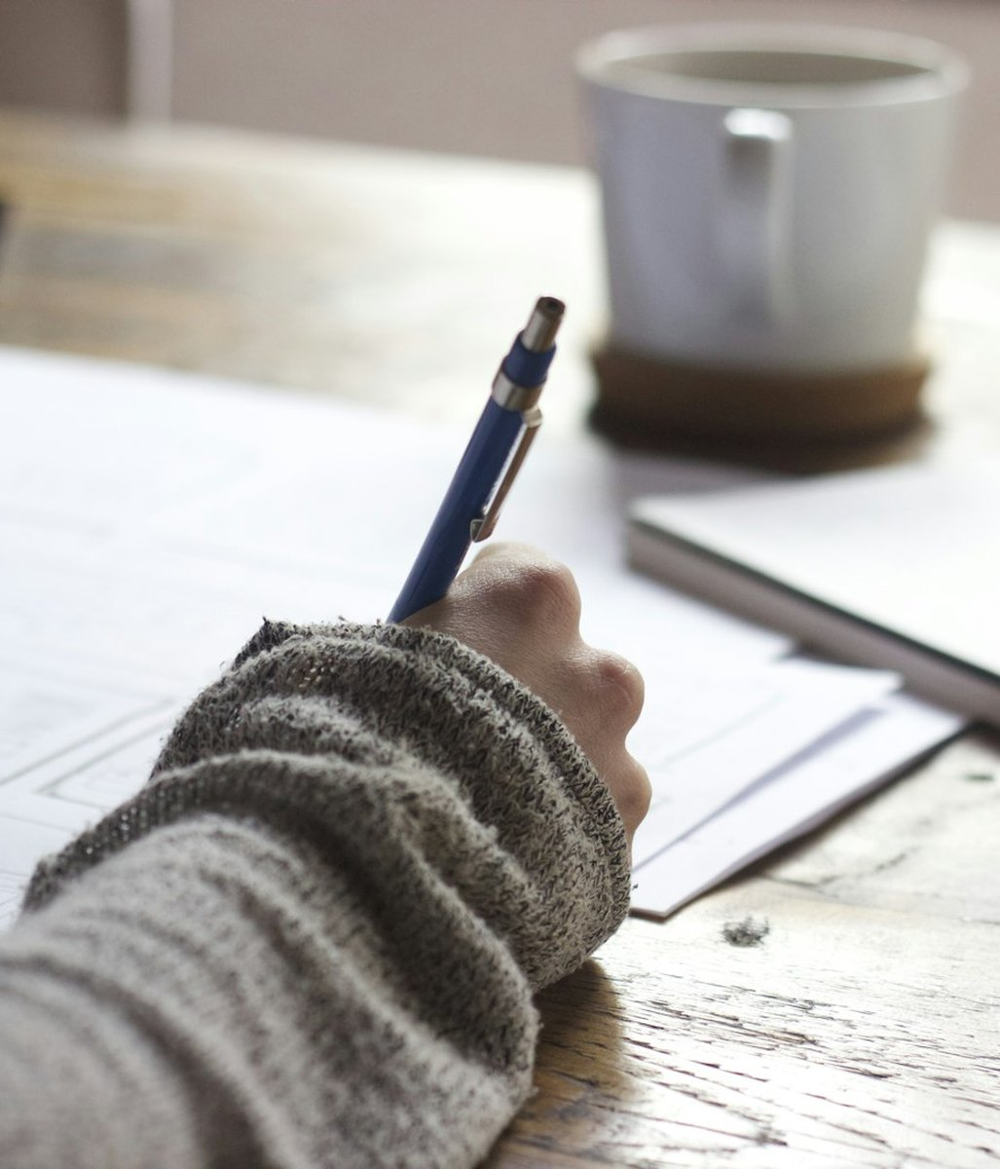
I studied English yesterday.

Slide 17
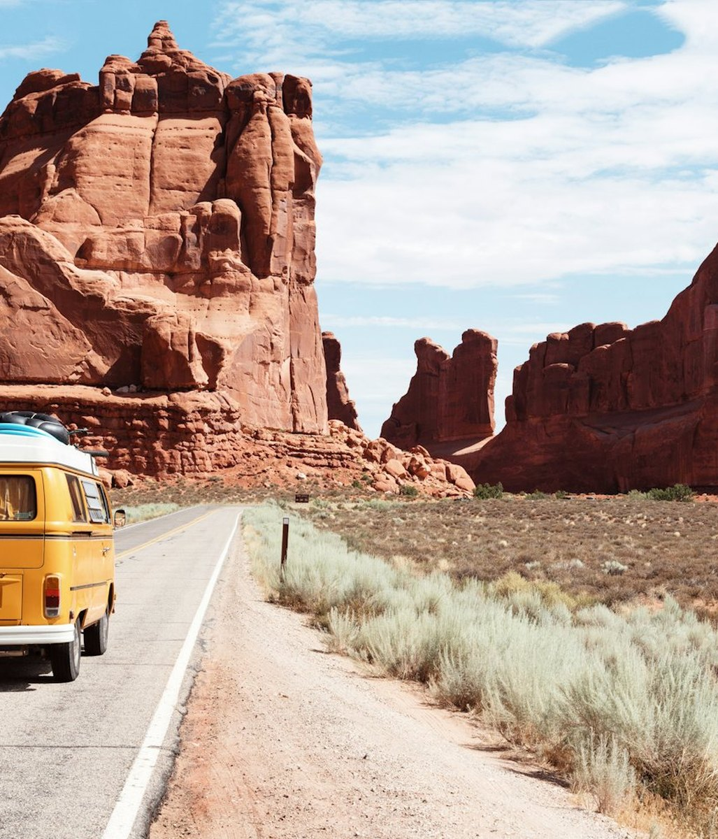
He walked along the road.

Slide 18
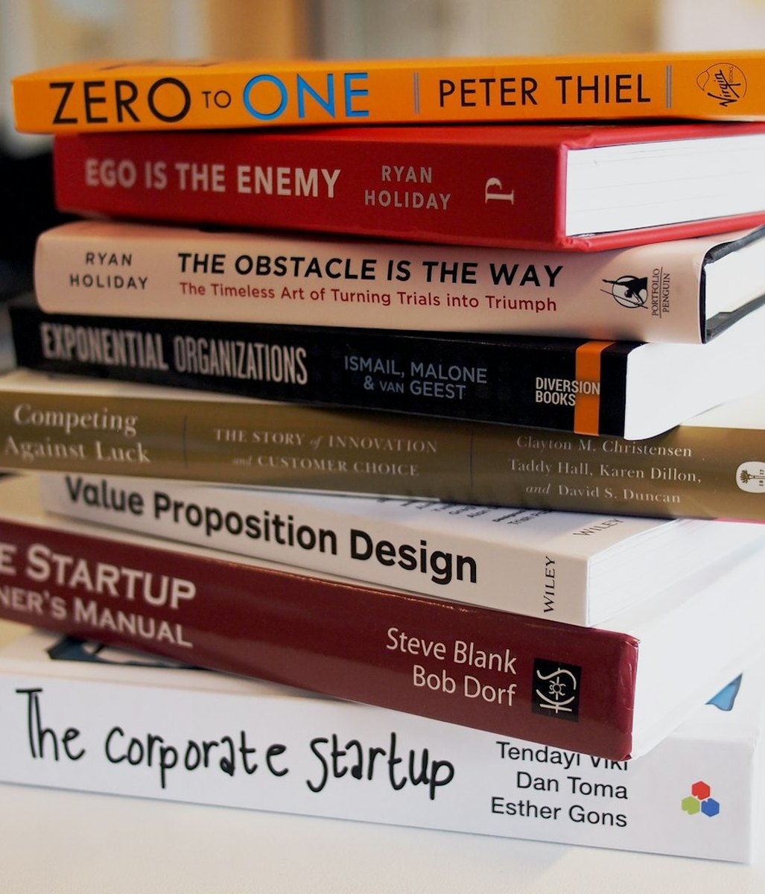
She bought a new book.

Slide 19
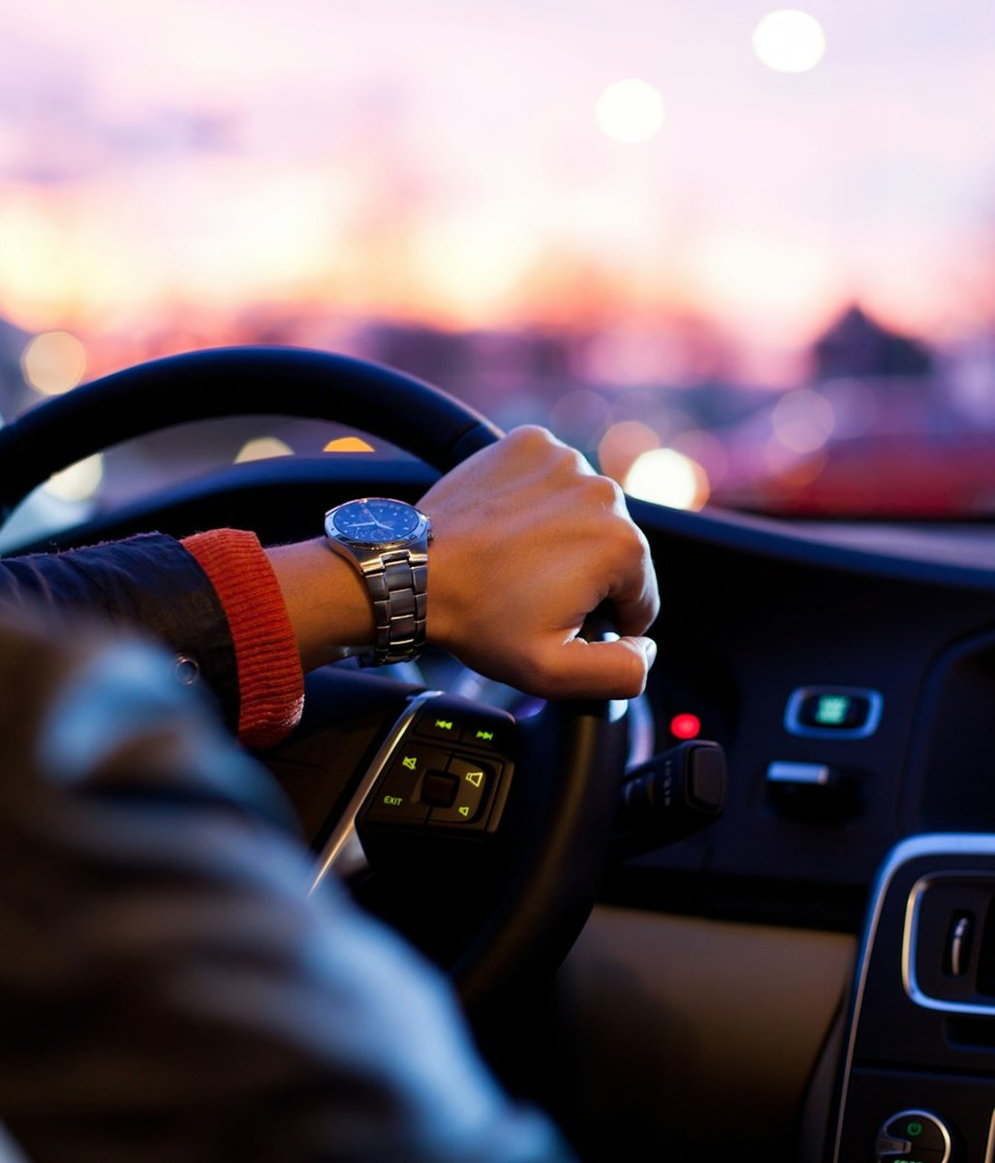
She drove on the highway.

Slide 20
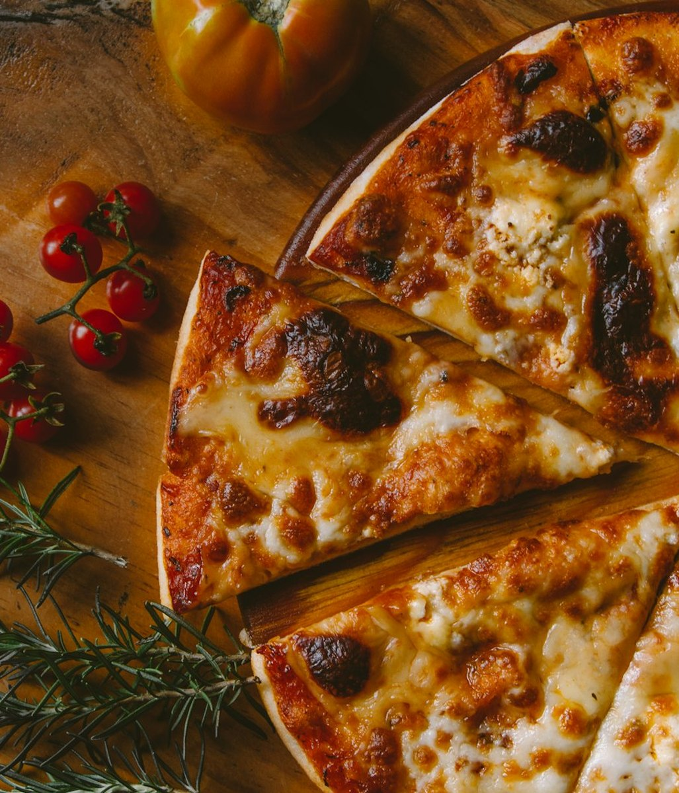
We ate pizza together.

Slide 21
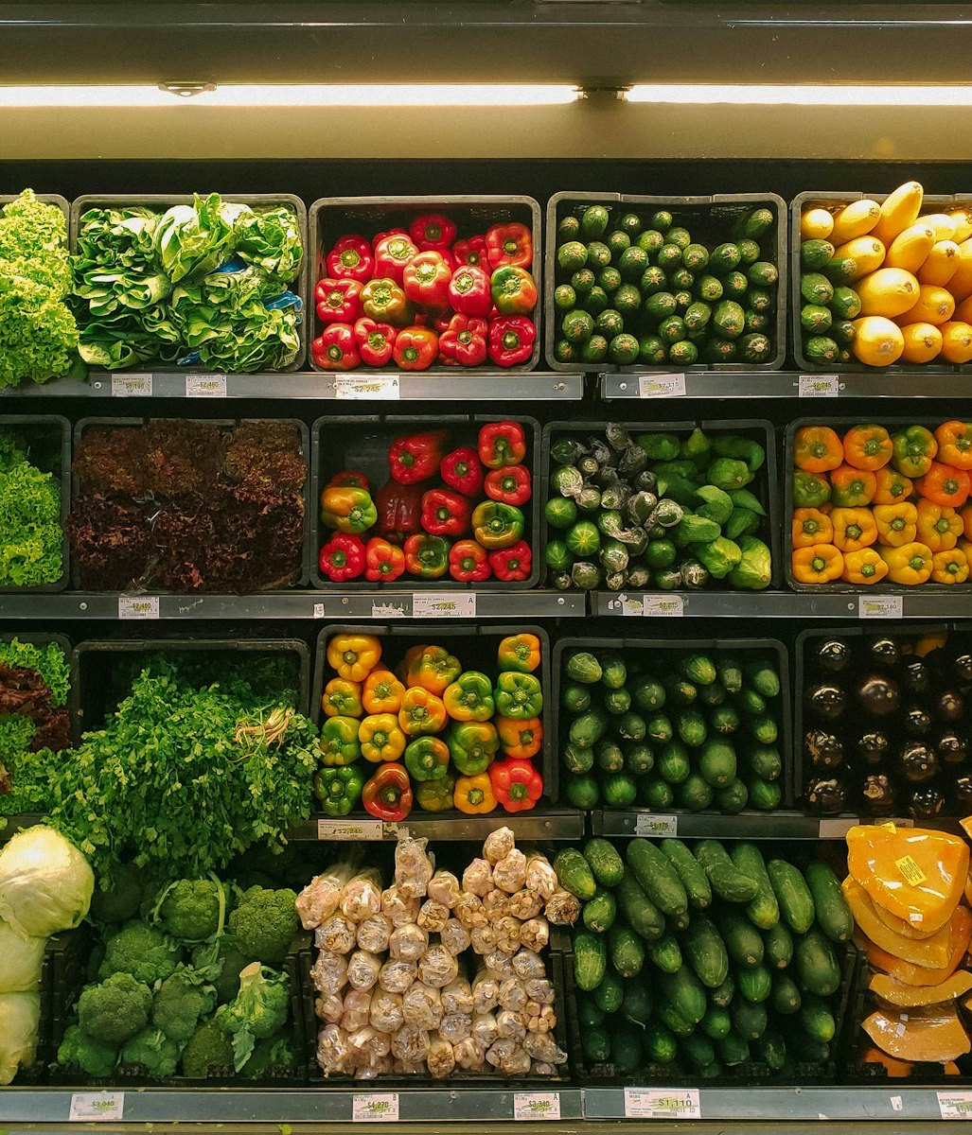
I went to the supermarket.

