Slide 1
PRN 2023 Vote Transferability Analysis
Prepared by: Cheah Jun Yitt

Slide 2
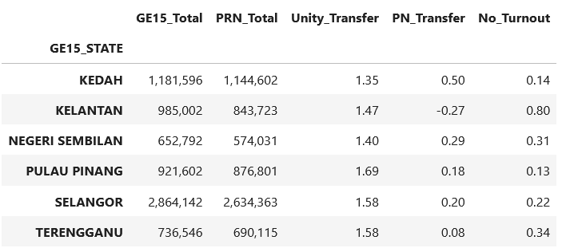
By States

Slide 3
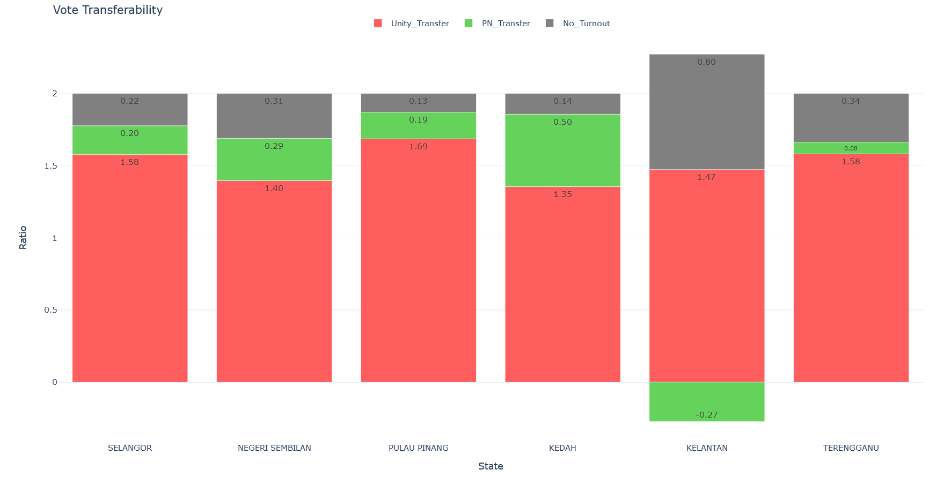
By States

Slide 4
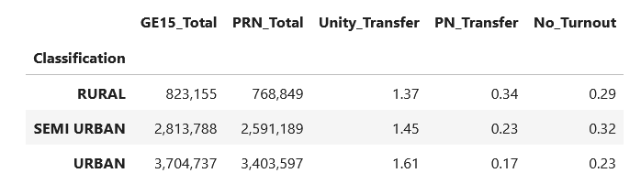
By Rural-Urban Classification (Overall)

Slide 5
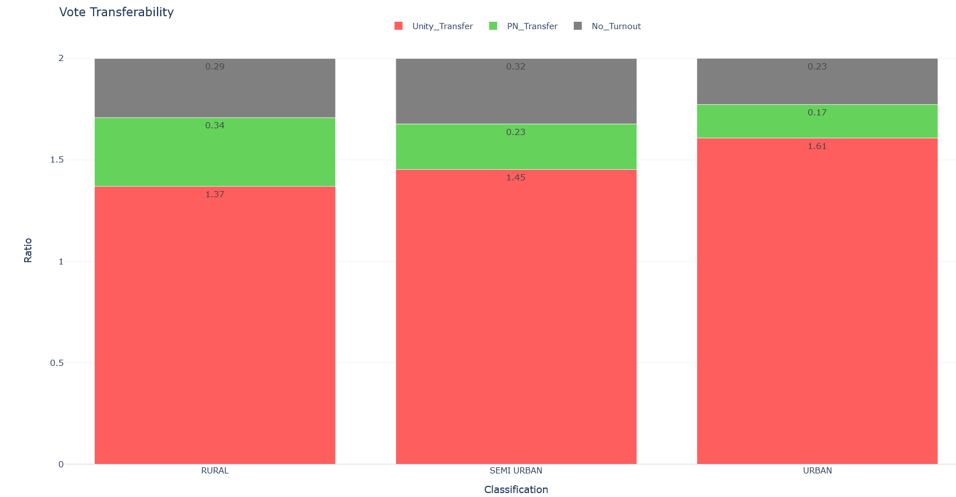
By Urban-Rural Classification (Overall)

Slide 6
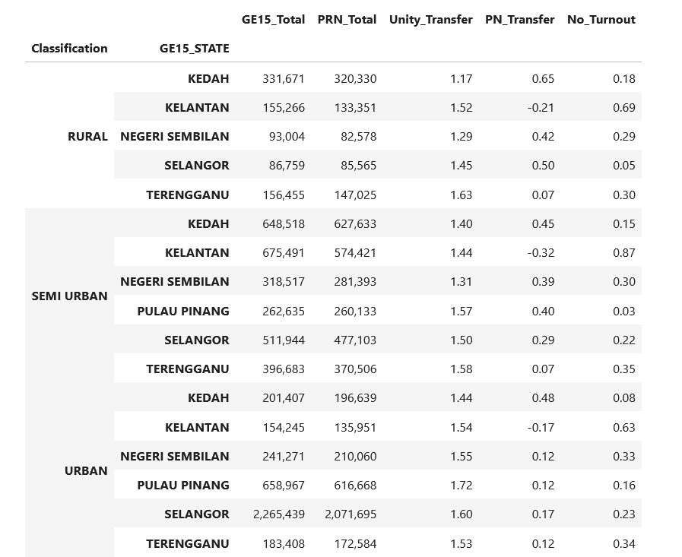
By States & Rural-Urban Classification

Slide 7
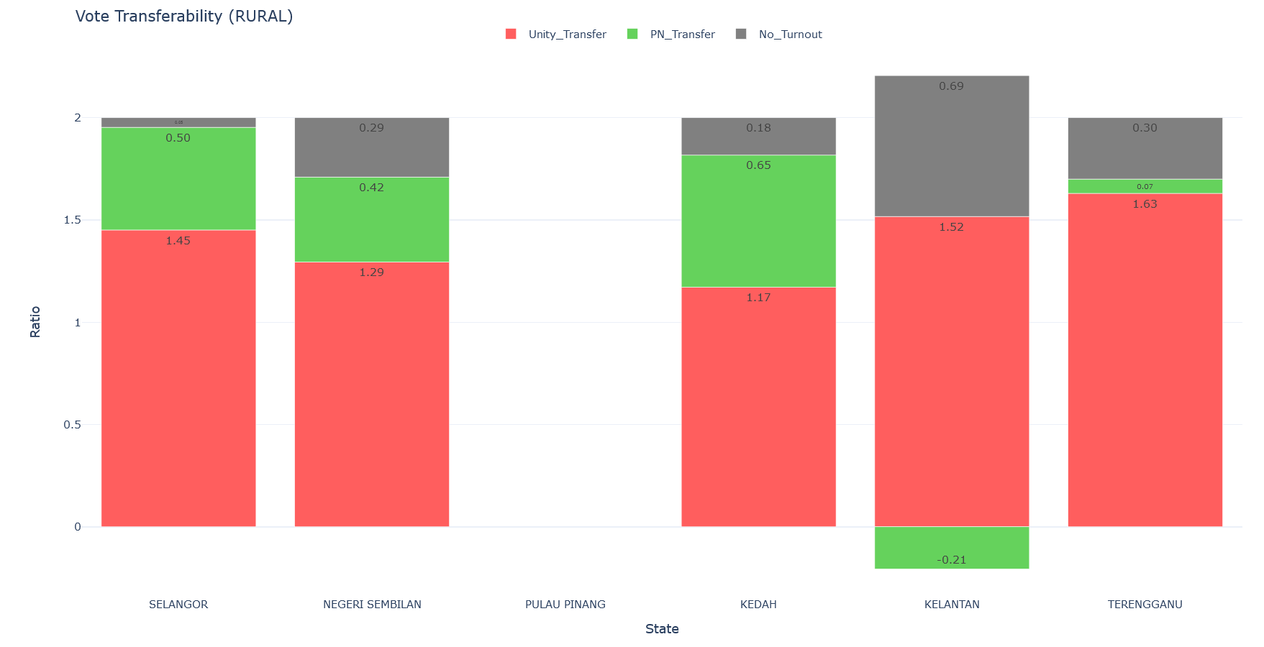
By States (Rural)

Slide 8
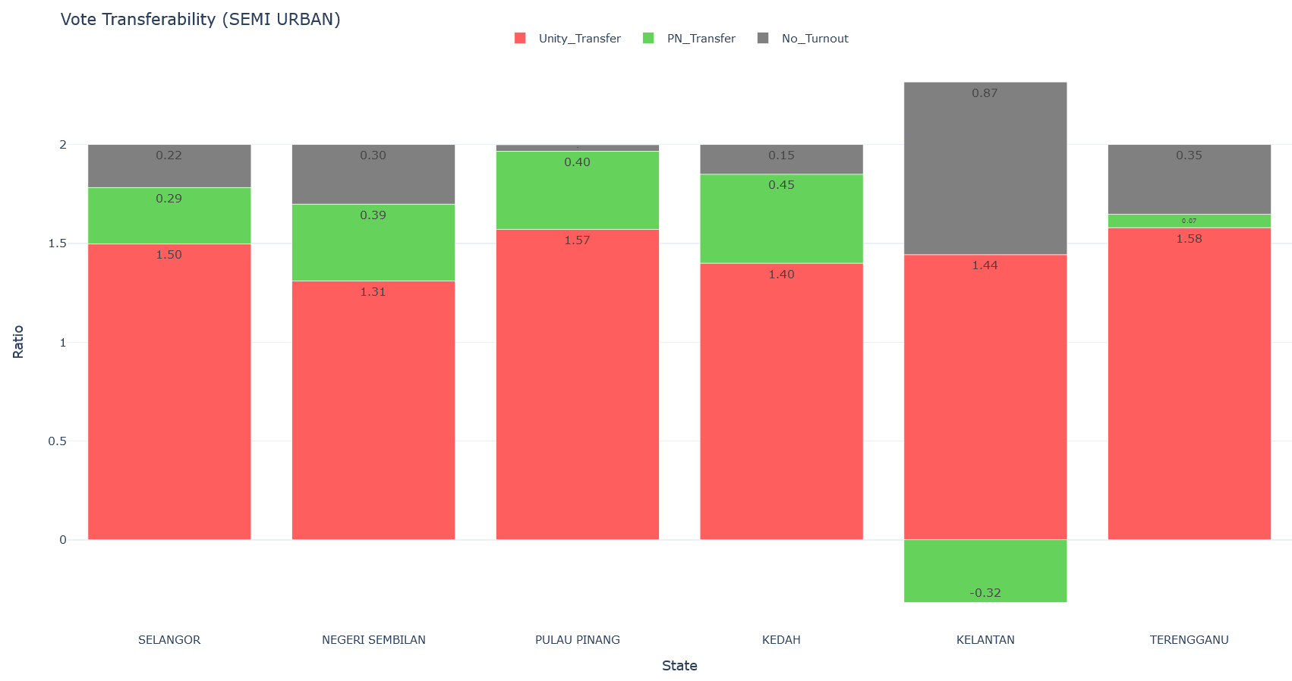
By States (Semi Urban)

Slide 9
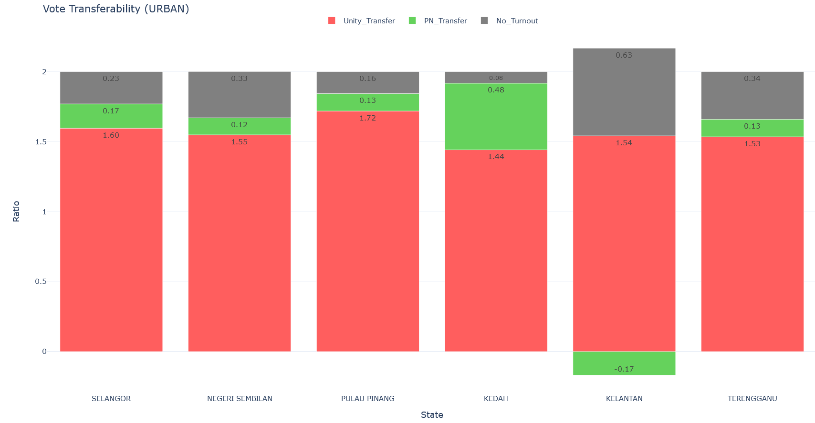
By States (Urban)

Slide 10
Findings
By States
Selangor (1.58) and Pulau Pinang (1.69) has strong vote transferability of 1+1 > 1.5; while Negeri Sembilan (1.40) vote transferability is weak.
Kedah vote transferability is the weakest (1.35). Significant amount of BN supporters have shifted to PN (0.50).
Kelantan anti-establishment sentiment is rising, but it was exhibited in the form of not voting.
BN can still retain most votes in Terengganu.
Overall, 1+1 > 1.5 is better than expected (except for Kedah and Negeri Sembilan).
By Rural-Urban Classification
Obvious pattern where the vote transferability strength is as such: Urban > Semi-Urban > Rural
Urban voters generally can accept the PH-BN coalition.
Going into sub-urban/rural areas, vote transferability deteriorate significantly for Negeri Sembilan and Kedah.

