Slide 1


A Comprehensive Summary
Chapter 3, Part 3
Evaluation Methodology

Slide 2
An Engineer's Toolkit for Evaluation
Language Modelling Metrics
Example: Perplexity What it measures: A model's intrinsic, probabilistic understanding of language.
Best for: Guiding pre-training, comparing base models, and as a general proxy for capability.
Nature: Reference-free.
Exact Evaluation
Example: Functional Correctness
What it measures: The quality of a model's output on a specific task against a known reference.
Best for: Evaluating performance on downstream, task-specific applications.
Nature: Reference-based (often).
A robust evaluation strategy combines both approaches.

Slide 3

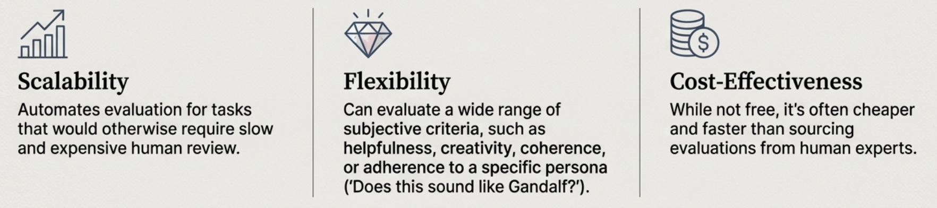
Modern-day Evaluations: AI as a Judge
For many tasks (e.g., creative writing, complex reasoning), there is no single "ground truth." Al as a Judge uses a powerful, general-purpose model (the "judge") to evaluate the quality of another model's output based on a set of criteria.
Why Use an AI Judge?

Slide 4
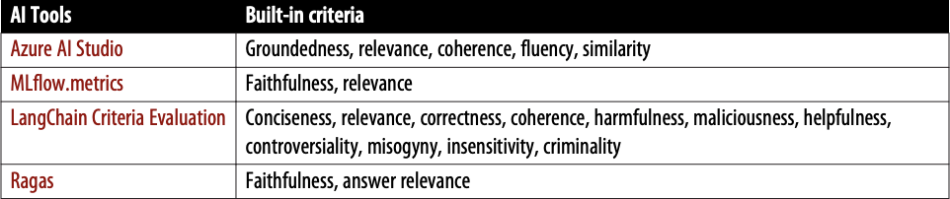
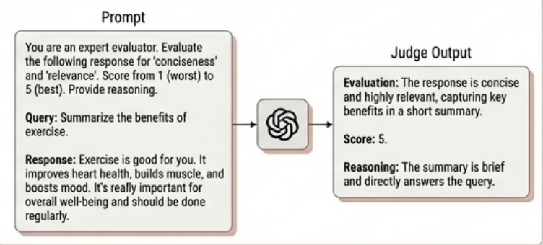
How to Implement an AI Judge
The Process
The core of Al as a Judge is a meticulously crafted prompt given to the judge model.
Key Components of the Prompt
Task Description: Clearly state the evaluation task.
Context: Provide the original query and the model's generated response.
Criteria: Explicitly define what to evaluate (e.g., faithfulness, relevance, conciseness).
Scoring Rubric: Define the output format (e.g., a score from 1-5, A/B preference, Yes/No). Include examples of what constitutes a good or bad score.

Slide 5
Two Core Methods: Pointwise vs. Pairwise
Pointwise Evaluation (Absolute Score)
Pairwise Comparison (Relative Choice)
Asks the judge to assign a single, absolute score.
Example Prompt Structure (MLflow):
Asks the judge to compare two answers and choose the better one.
Example Prompt Structure:
Given these instructions, examples of good/bad answers, and the generated answer, provide a score and reasoning.
Given the question and two answers, evaluate which is better. Output A or B.

Slide 6
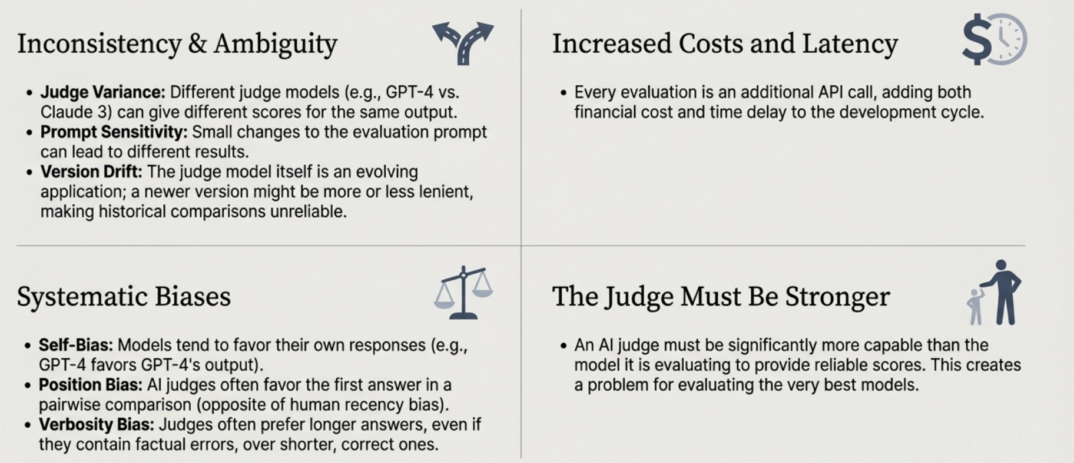
The Critical Limitations of AI Judges

Slide 7
A Taxonomy of Specialized Judges
Three main types of Al judges have emerged for specific evaluation needs:
Reward Models
What they are: A reward model takes in a (prompt, response) pair and scores how good the response is given the prompt.
Use Case: Core component of Reinforcement Learning from Human Feedback (RLHF).
Reference-Based Judges
What they are: Evaluate a generated response against one or more reference ('golden') responses.
Examples: BLEURT and Prometheus. Prometheus assumes the reference response deserves a perfect score (5/5) and scores the generated response relative to it.
Preference Models
What they are: A preference model takes in (prompt, response 1, response 2) as input and outputs which of the two responses is better (preferred by users) for the given prompt.
Use Case: Generating the comparative data needed to train reward models and for direct model ranking.

Slide 8
Ranking Models with Comparative Evaluation
For subjective tasks, it's often easier and more reliable to determine which of two responses is better (comparative) than to assign an absolute score to each (pointwise).
How this works: Collect Comparisons: For a given prompt, generate responses from two different models (e.g., Model A and Model B).
Elicit Preference: Ask an evaluator (human or AI) to choose the better response. This generates a "win," "loss," tie" signal for each model pair.
Compute Ranking: Use a rating algorithm (like Elo, used in chess) to compute a score for each model based on its win/loss record against other models. The models are then ranked by their scores.
“Is it better to score the dancers or just pick the winner?”
Note: A very important thing to keep in mind is that not all questions should be answered by preference. Many questions should be answered by correctness instead

Slide 9
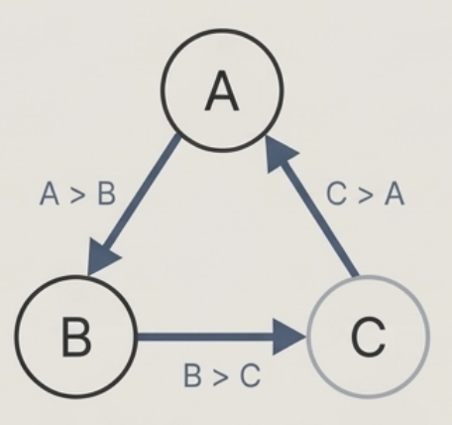
The Challenges of Comparative Evaluation
The Transitivity Assumption
Lack of Standardization & Quality Control
The 'Wild West' of Prompts: Crowdsourced platforms like Chatbot Arena allow any user to submit any prompt. There is no standard for what constitutes a "good" prompt or a "better" response.
Varying User Preferences: Some users prefer polite responses, others prefer unfiltered ones. Users might downvote a model for refusing an inappropriate request, which might be the desired behaviour for an enterprise application.
Pollution: It's hard to control for low-effort voting or malicious users who intentionally prefer toxic or incorrect responses.
Ranking algorithms like Elo assume that if A > B and B > C, then A > C.
This may not hold true for LLMs. Human preference is not always transitive, and evaluations across different prompts or evaluators can create nontransitive "rock-paper-scissors" scenarios where A beats B, B beats C, but C beats A.

Slide 10
In the next part, we will discuss
AI Evaluation
The Challenge of Factual Consistency
The SAFE Method
Benchmarking Truthfulness with TruthfuIQA
Evaluating Instruction-Following Capability
Verifiable Instructions (IFEval)
Optimising for Cost and Latency
and much more…

