Slide 1


A Comprehensive Summary
Chapter 4, Part 2
Evaluate AI Systems

Slide 2
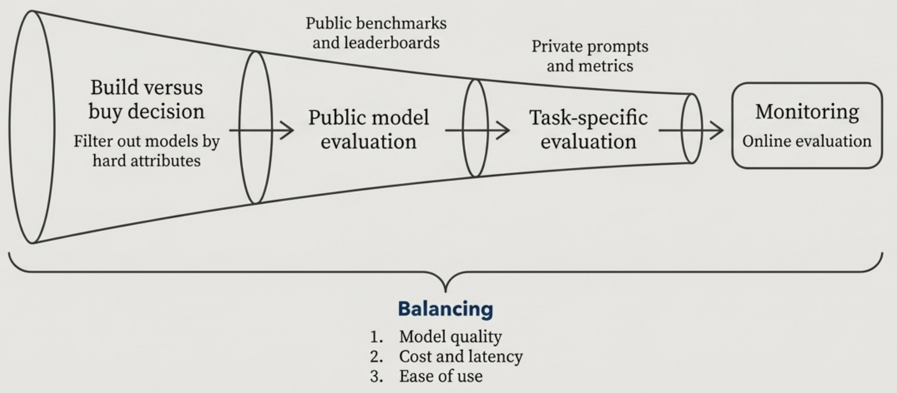
A Systematic Workflow for Model Selection
Choosing the right model is a multi-stage filtering process that moves from broad strategic considerations to fine-grained, task-specific testing. Throughout the process, engineers must balance three key factors: Model Quality, Cost & Latency, and Ease of Use.

Slide 3
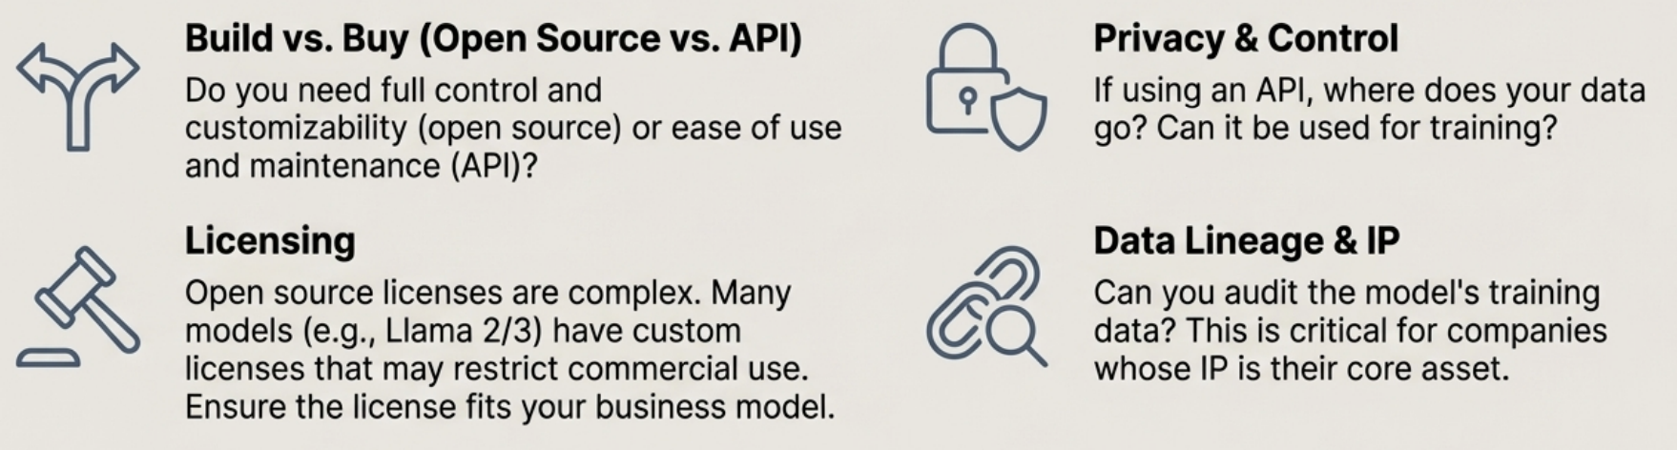
Funnel Stage 1: Filter by Hard Attributes
These are your non-negotiables. A model that fails here is not an option, regardless of its performance.
Real-World Risk In 2023, Samsung banned ChatGPT after employees leaked sensitive source code by pasting it into the tool.

Slide 4
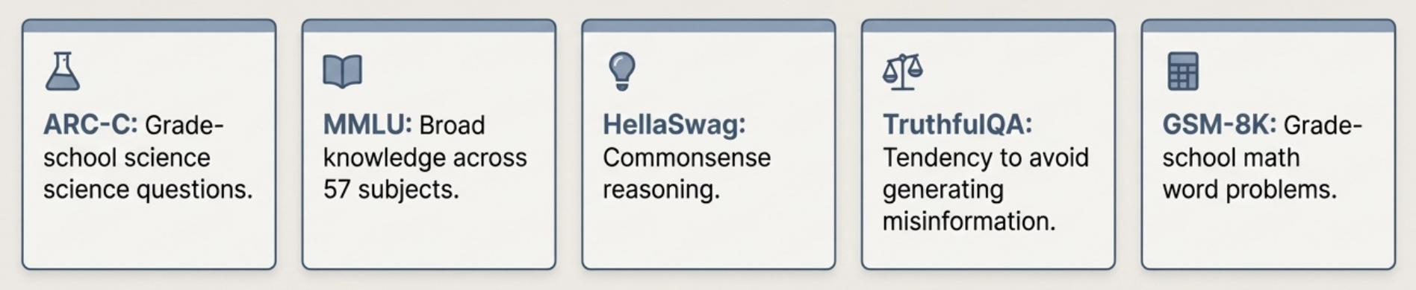
Funnel Stage 2: Evaluate on Public Benchmarks
After filtering by hard attributes, use public benchmarks and leaderboards to assess general capabilities and identify a shortlist of promising candidates.
Important Caveats - No single leaderboard is definitive. Benchmark selection is subjective. - Running benchmarks yourself can be expensive. Stanford's HELM evaluation cost $80,000-$100,000 to run on 30 models.

Slide 5
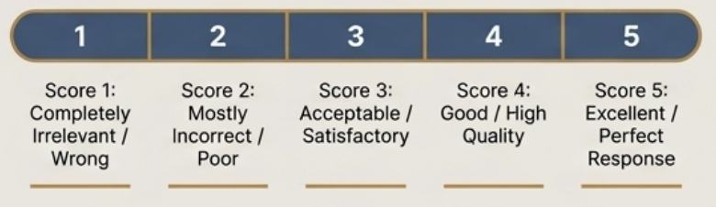
Funnel Stage 3: Test on Private Prompts and Metrics
This is the most important step. A model's performance on a public benchmark does not guarantee its performance on *your* specific use case. You must build your own evaluation set.
Curate an Evaluation
Set Gather 100-200 examples that are representative of your production traffic.
Define What "Good" Looks Like
Determine your scoring system (e.g., a 1-5 scale, pass/fail). Develop a Clear Scoring Rubric This is the backbone of a reliable evaluation.
- What does a score of 1 look like? Why does it deserve a 1?
- What distinguishes a 4 from a 5?
- Validate the rubric with your team. If humans find it ambiguous, an Al judge will too.

Slide 6
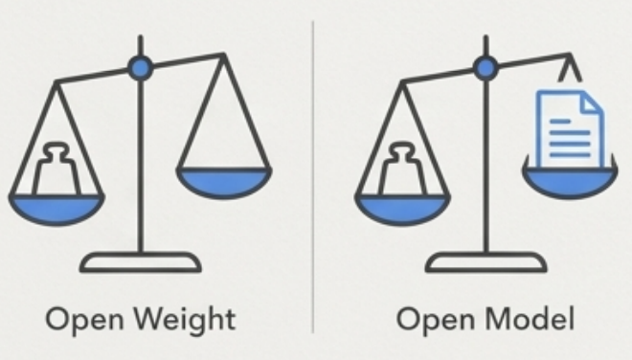


The Nuances of 'Open Source' Models
The term "open source" is not monolithic and requires careful examination.
"Open Weight"
vs.
"Open Model"
A Fragmented License Landscape
The Bottom Line
Most models are "open weight," meaning the model weights are public, but the training data is not. Truly "open models" also provide the training data, allowing for deeper auditing and understanding.
Many models are released under unique, custom licenses, not standard ones like Apache 2.0 or MIT. Examples: Meta's Llama Community Licenses, Hugging Face's BigCode Open RAIL-M v1.
The specific terms of a license have major implications for commercial use and must be reviewed carefully.

Slide 7
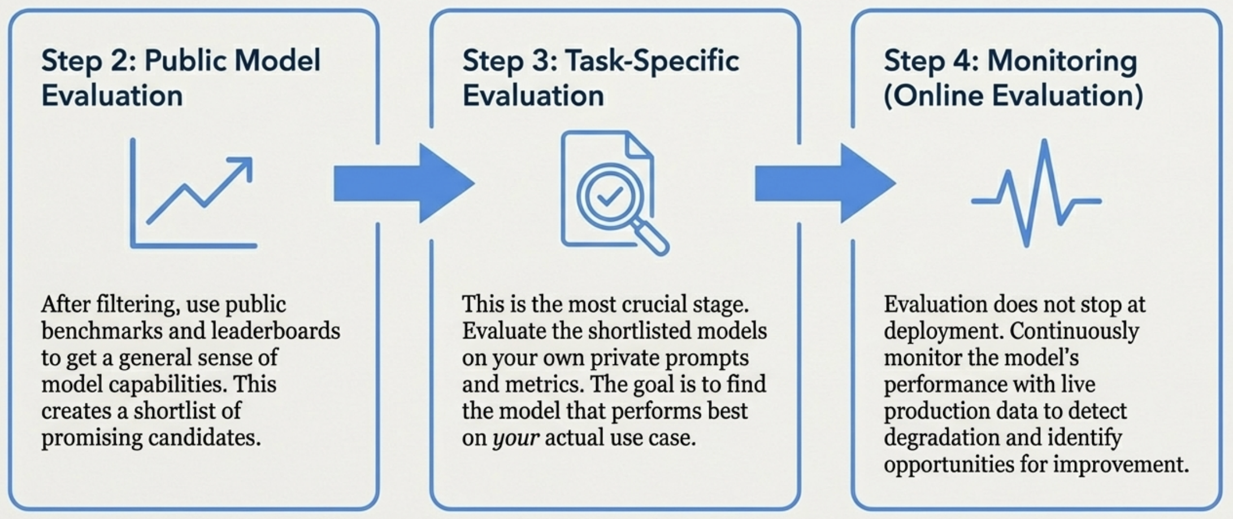
From Public Benchmarks to Production Monitoring

Slide 8
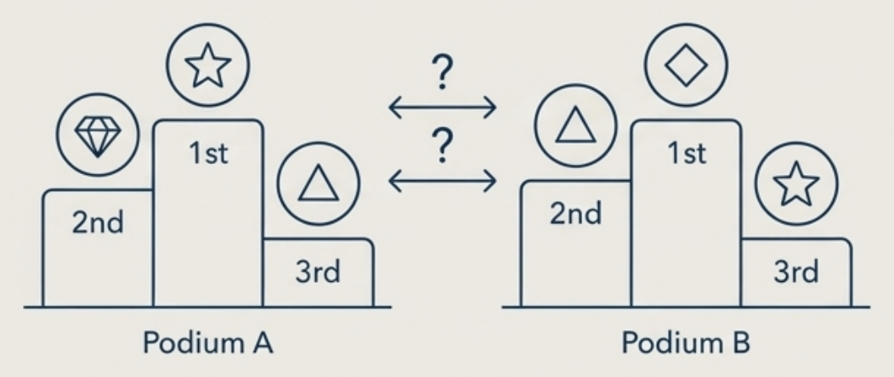
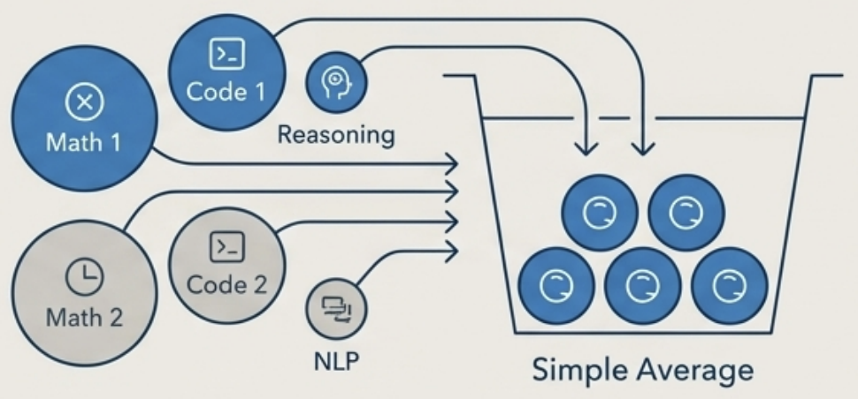
The Challenges of Navigating Public Benchmarks
While useful for initial filtering, public leaderboards have two fundamental challenges that make a single, definitive model ranking difficult.
Benchmark Selection is Not Transparent
Aggregation Can Be Misleading
Different leaderboards use different sets of benchmarks, leading to different rankings. For example, in early 2024, the Hugging Face and Stanford HELM leaderboards used mostly different benchmarks. The reasoning for why certain benchmarks are chosen is often unclear.
Most leaderboards use a simple average to combine scores. This treats all benchmarks as equally important and doesn't account for correlations (e.g., two different math tests), meaning a model's final rank can change significantly based on the aggregation method.

Slide 9
In the next part, we will discuss
Data contamination with public benchmarks
Custom, Weighted Leaderboards
Slicing your Data
Designing Your Own Evaluation Pipeline
Principles for a World-Class Evaluation Pipeline
and much more…

