Slide 1


A Comprehensive Summary
Chapter 9, Part 1
Inference Optimization

Slide 2
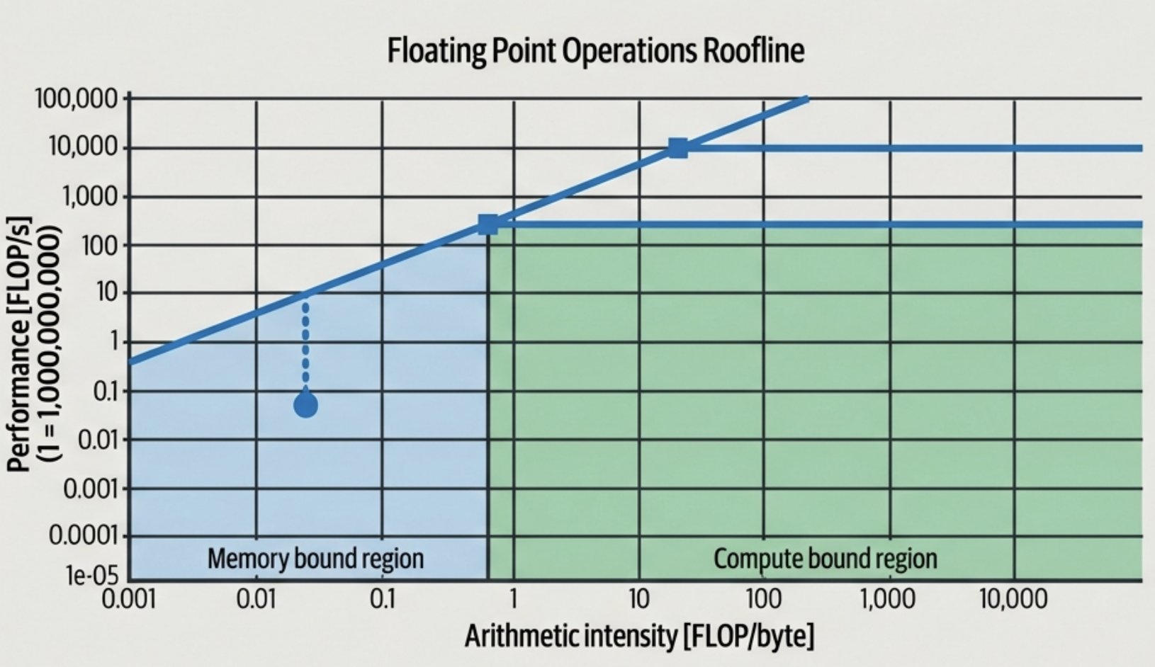
The Physics of Inference: Compute vs. Bandwidth
The Roofline Model
Arithmetic Intensity: X-axis (FLOP/byte). Operations performed per byte of memory access.
Memory-Bound Region (Left): Performance is limited by data transfer speeds. Performance scales with Bandwidth.
Compute-Bound Region (Right): Performance is limited by arithmetic capability. Performance scales with FLOP/s.
Key Insight: LLM Decoding typically sits in the Memory-Bound region due to low arithmetic intensity.

Slide 3

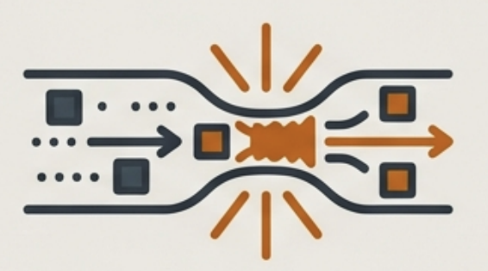
Terminology Ambiguity: Capacity vs. Bandwidth
Memory Capacity-Bound
Memory Bandwidth-Bound
Context: Hardware lacks sufficient RAM to store model weights or KV cache.
Symptom: "RuntimeError: CUDA out of memory" (OOM).
Mitigation: Split model across devices (Parallelism) or offload to CPU.
Context: Computation stalls waiting for data to travel from memory to compute units.
Symptom: High Latency. Low GPU Compute Utilization.
The Reality: In optimization literature (e.g. Roofline), "Memory-Bound" almost always refers to this bandwidth limitation.
Warning: Splitting models to solve Capacity issues often worsens Bandwidth issues due to slow device-to-device transfer.

Slide 4
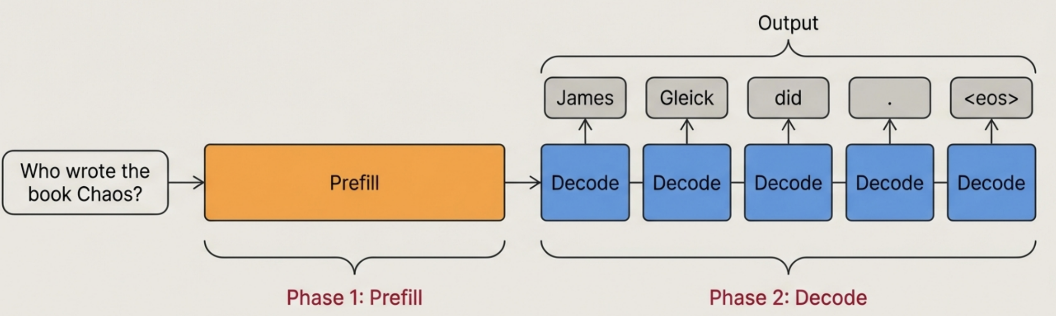
The Anatomy of Inference: Prefill and Decode
Parallel processing of input tokens. Compute-Bound. Creates the initial Key-Value (KV) cache.
Sequential generation (Autoregressive). Memory Bandwidth-Bound. Loads weights for each new token.
Optimization Implication: Decoupling these phases to different hardware instances prevents resource contention.

Slide 5
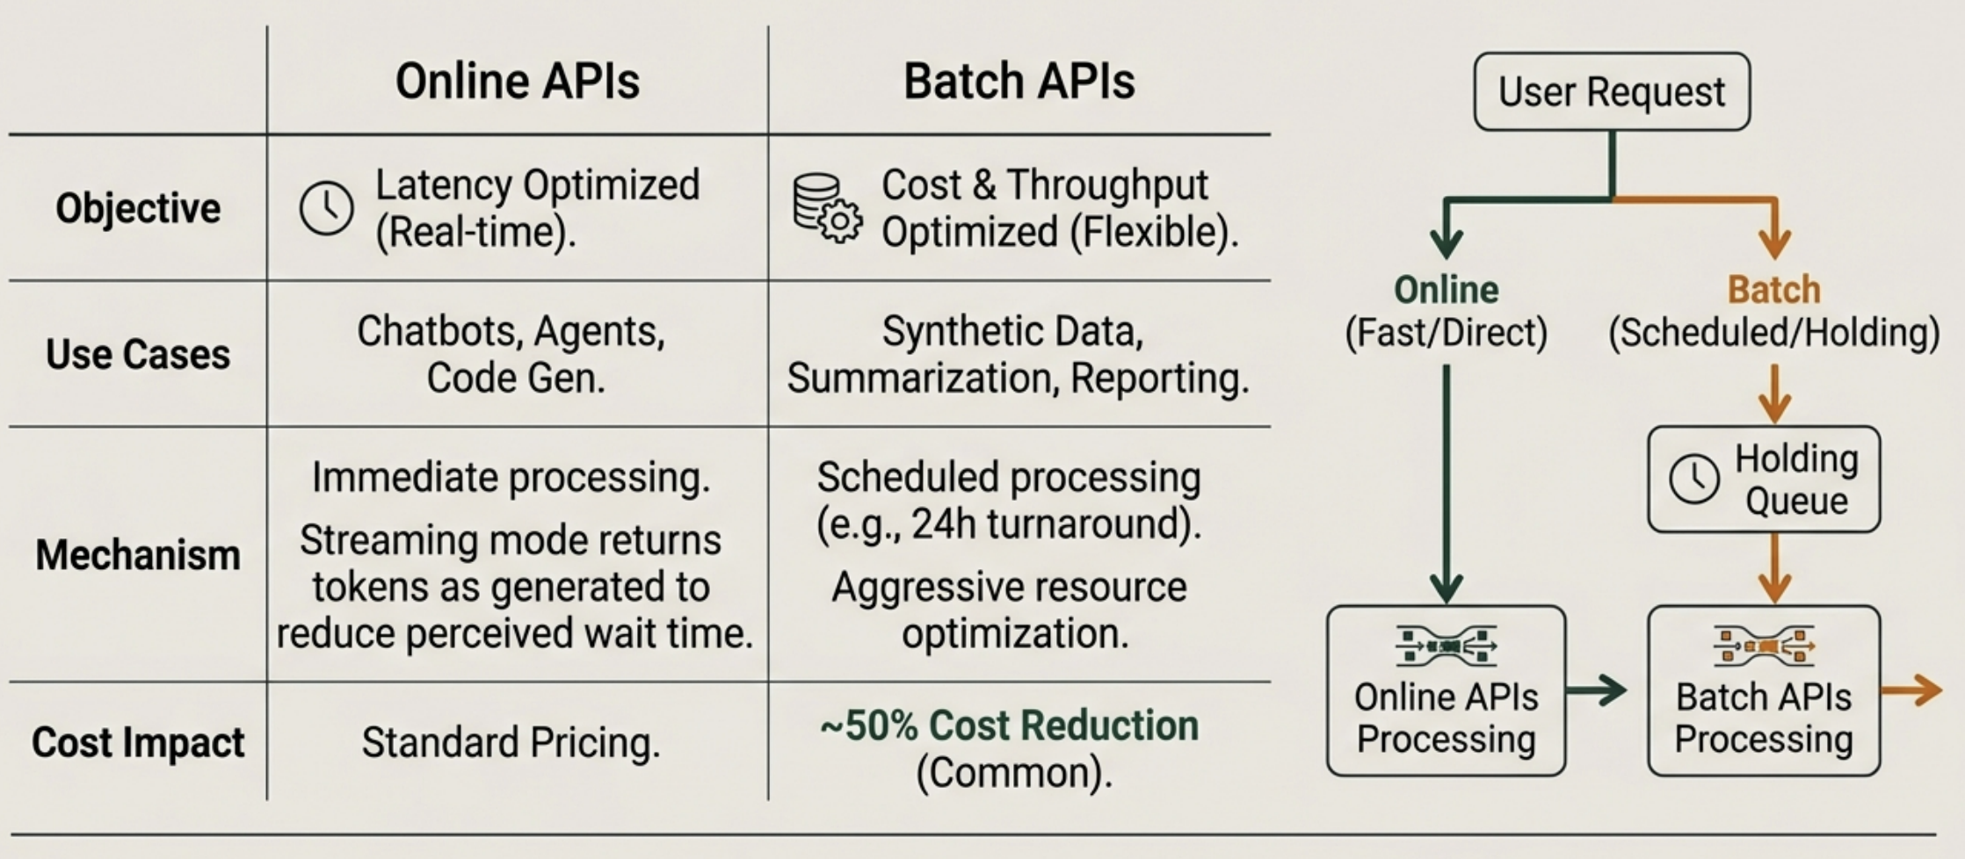
Service Architecture: Online vs. Batch APIs

Slide 6
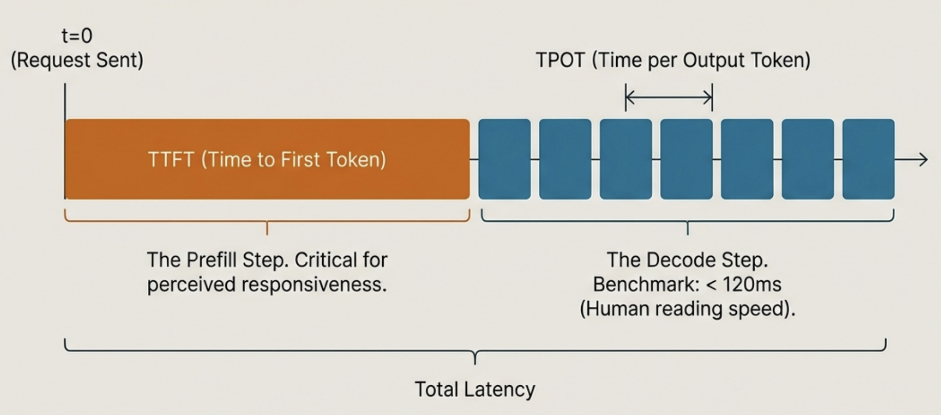
Dissecting Latency: TTFT and TPOT
Nuance: Chain-of-Thought (CoT) processes create 'invisible' latency before the first user-facing token appears.
Total Latency = TTFT + (TPOT x Output Tokens)

Slide 7
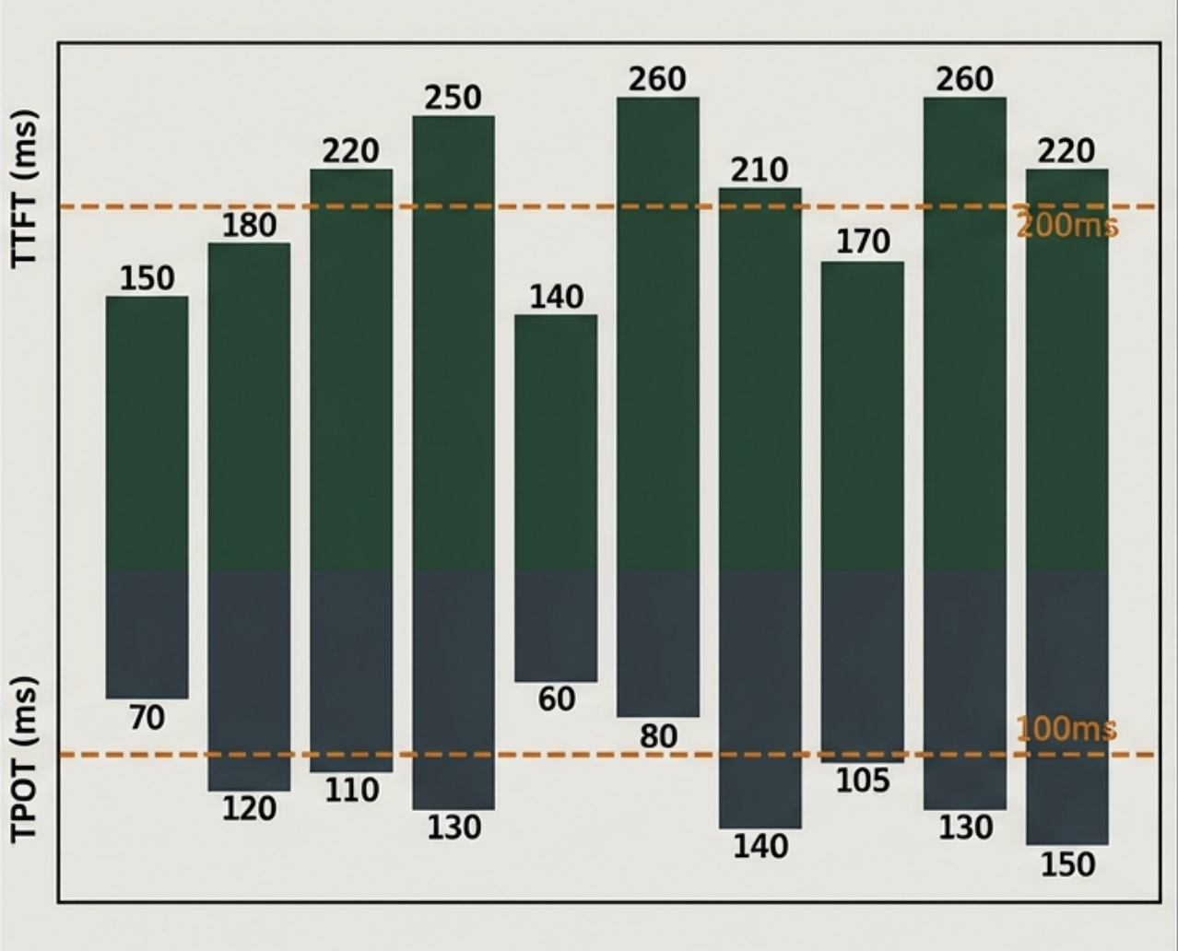
Throughput vs. Goodput: The SLO Reality Check
Throughput (TPS/RPS): Total tokens or requests processed per second. Can be inflated by aggressive batching at the cost of latency.
Goodput: The number of requests per second that satisfy the Service Level Objective (SLO).
Example Analysis: Reference the chart: If 10 requests are processed, but only 3 stay within the orange dashed lines (SLO), the Goodput is only 30% of the Throughput.
Goal: Maximize Goodput to balance cost efficiency with user experience.

Slide 8

The Utilization Trap: Activity vs. Efficiency
GPU Utilization in standard tools measures the % of time the GPU is active, not how much work it is doing. A chip doing 1 operation per second is "100% Active" but "0% Efficient".
MFU (Model FLOP/s Utilization)
MBU (Model Bandwidth Utilization)
Ratio of observed throughput to theoretical peak FLOP/s.
Benchmark: Training > 50%; Inference is typically lower.
Ratio of observed memory bandwidth usage to theoretical peak bandwidth.
Relevance: The primary metric for decoding (memory-bound tasks).

Slide 9
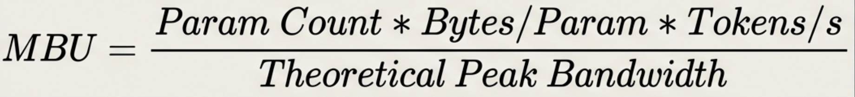
Calculating Model Bandwidth Utilization (MBU)
Worked Example: Llama 2-70B
Model Parameters: 70 Billion
Precision: FP16 (2 bytes per parameter)
Throughput: 100 tokens/sec
Hardware: NVIDIA A100 (Peak Bandwidth ~2000 GB/s)
Bandwidth Used: 70B * 2 * 100 = 700 GB/s
Result: MBU = 700 / 2000 = 35%
Insight: Reducing precision (Quantization) lowers the "Bytes/Param" factor, directly reducing bandwidth demand and improving performance.

Slide 10
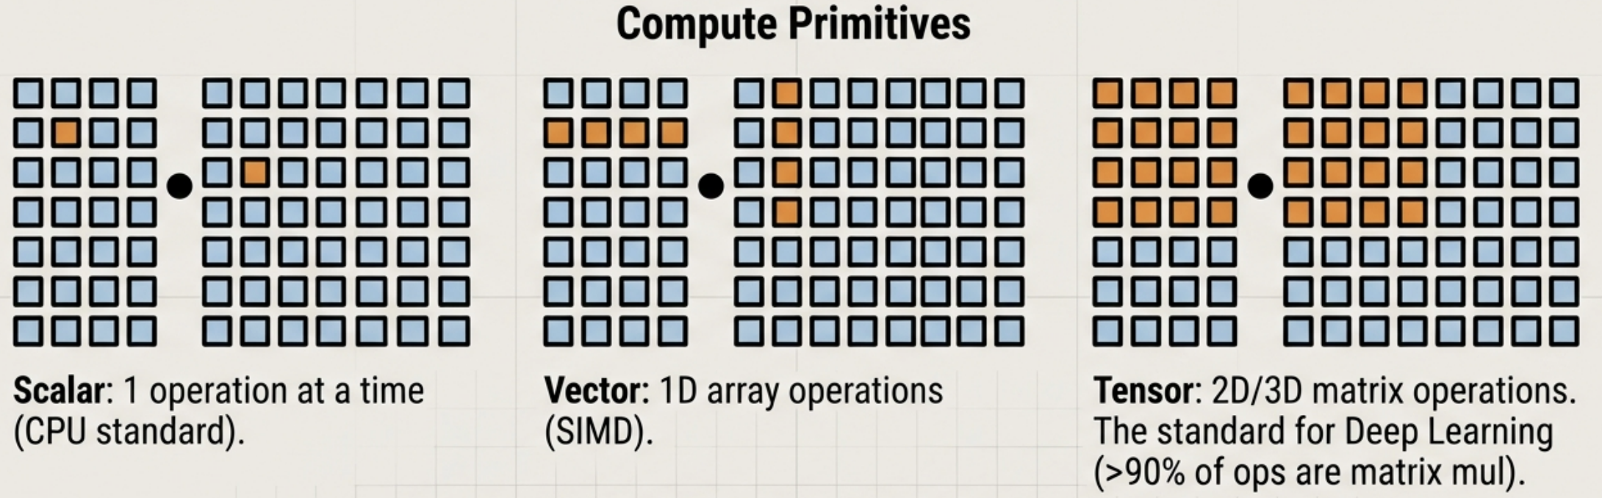
Al Accelerators: Specialized Hardware
Inference vs. Training Chips
Inference Chips: Optimized for fast memory access (bandwidth), lower precision (INT8/FP8), and latency (e.g., AWS Inferentia, Google TPU, Meta MTIA).
Training Chips: Optimized for massive memory capacity (gradients/states) and high precision.

Slide 11
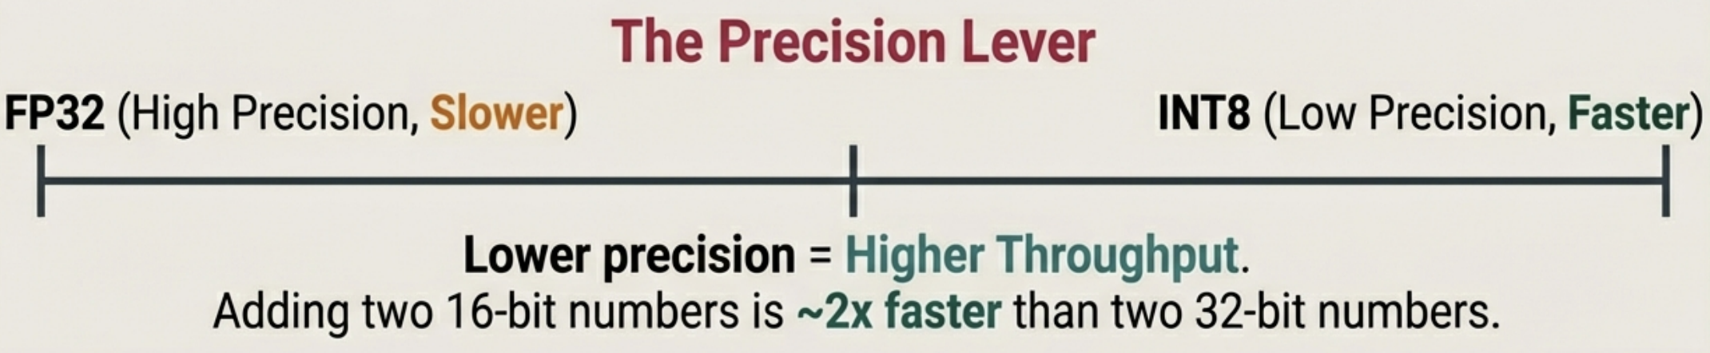
Computational Capabilities: FLOPs vs. FLOP/s
FLOPs (Plural)
Total floating-point operations required to complete a task.
Example: Training GPT-3-175B took ~3.14 x 10^23 FLOPs.
FLOP/s (Rate)
The speed of the hardware (Operations per Second).
Example: NVIDIA H100 Peak ~60 TeraFLOP/s.

Slide 12
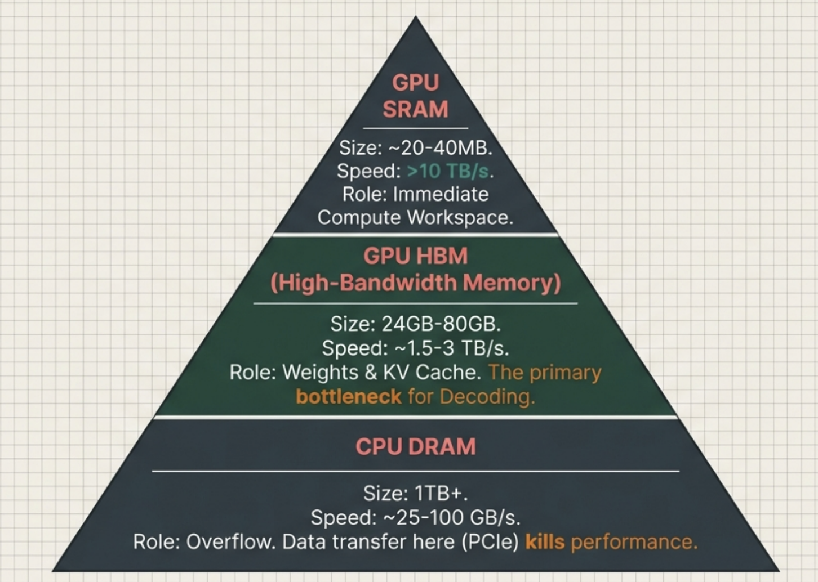
The Memory Hierarchy

Slide 13



The Hidden Constraints: Power and Thermal Limits
TDP (Thermal Design Power)
Max heat a cooling system must dissipate.
e.g., H100 SXM = 700W.
Deployment Limits
Edge devices limited by battery. Data centers limited by grid availability and cooling infrastructure.
Efficiency Metric
Optimization Goal: Minimize Joules per Token.
Power is a hard physical constraint. High power density dictates where hardware can physically exist.

Slide 14
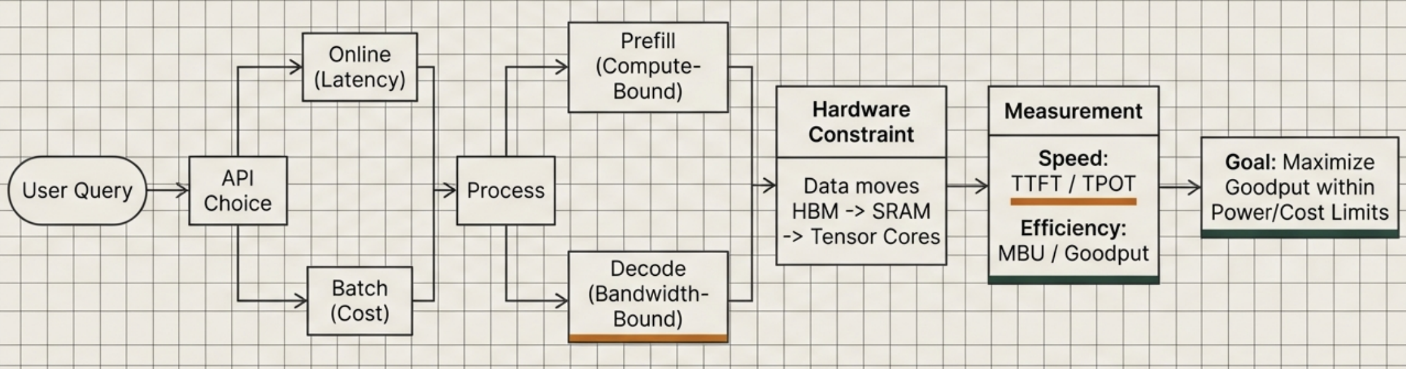
Synthesis: The Inference Optimization Landscape

Slide 15
In the next part, we will discuss
Model Compression
Autoregressive Bottleneck
Speculative Decoding
Parallel Decoding
The KV Cache Bottleneck
Writing Kernels
Inference Service Optimization
Decoupling & Prompt Caching
Parallelism Strategies
and much more…

