Slide 1
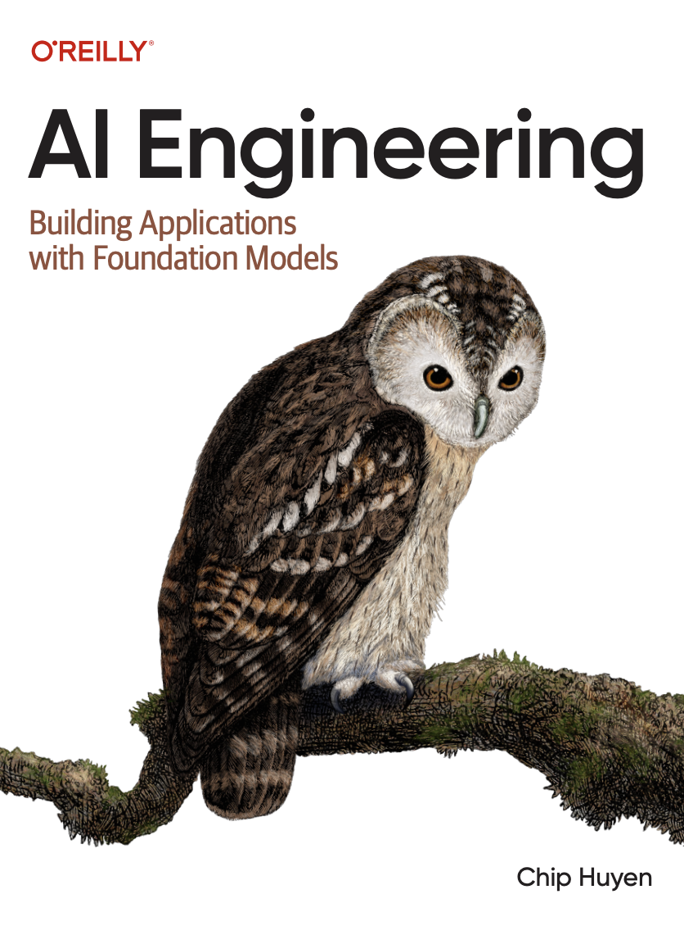
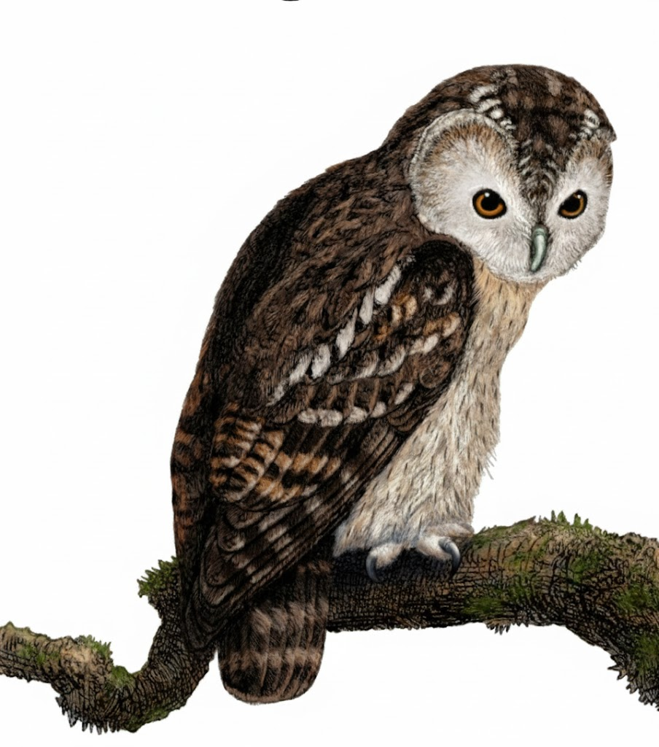
A Comprehensive Summary
Chapter 2, Part 1
Understanding Foundation Models

Slide 2
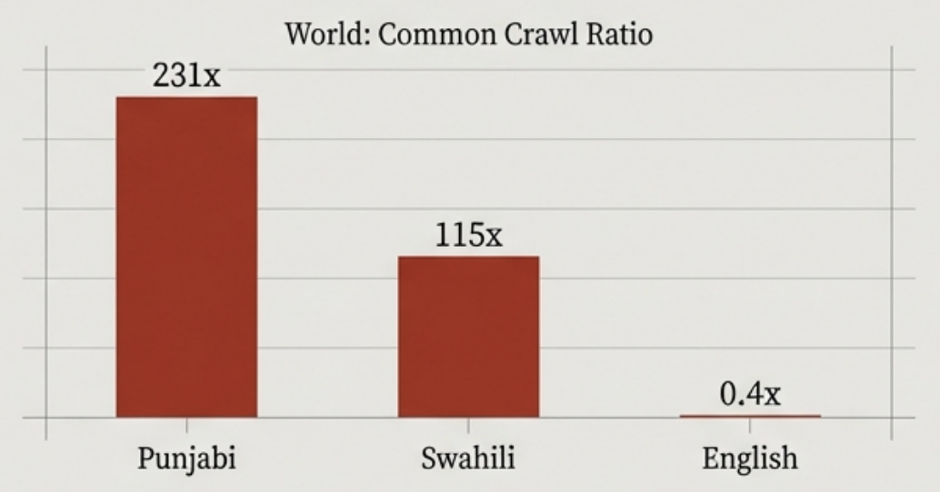
Training Data Quality & Multilingual Challenges
The Scale of Data
The Multilingual Gap
Foundation models are trained on internet-scale datasets, often measured in trillions of tokens.
Example: Llama 3 was trained on 15 trillion tokens.
The Quality Problem
A primary source, Common Crawl, contains vast amounts of noise.
Clickbait | Misinformation | Propaganda | Fake news
Ideally, the ratio between world population representation and Common Crawl representation should be 1. The higher this ratio, the more under-represented this language is in Common Crawl.
Tokenization differs across languages
Tokenization inefficiency means the same meaning in Burmese can require 10x more tokens than in English, increasing cost and latency.

Slide 3
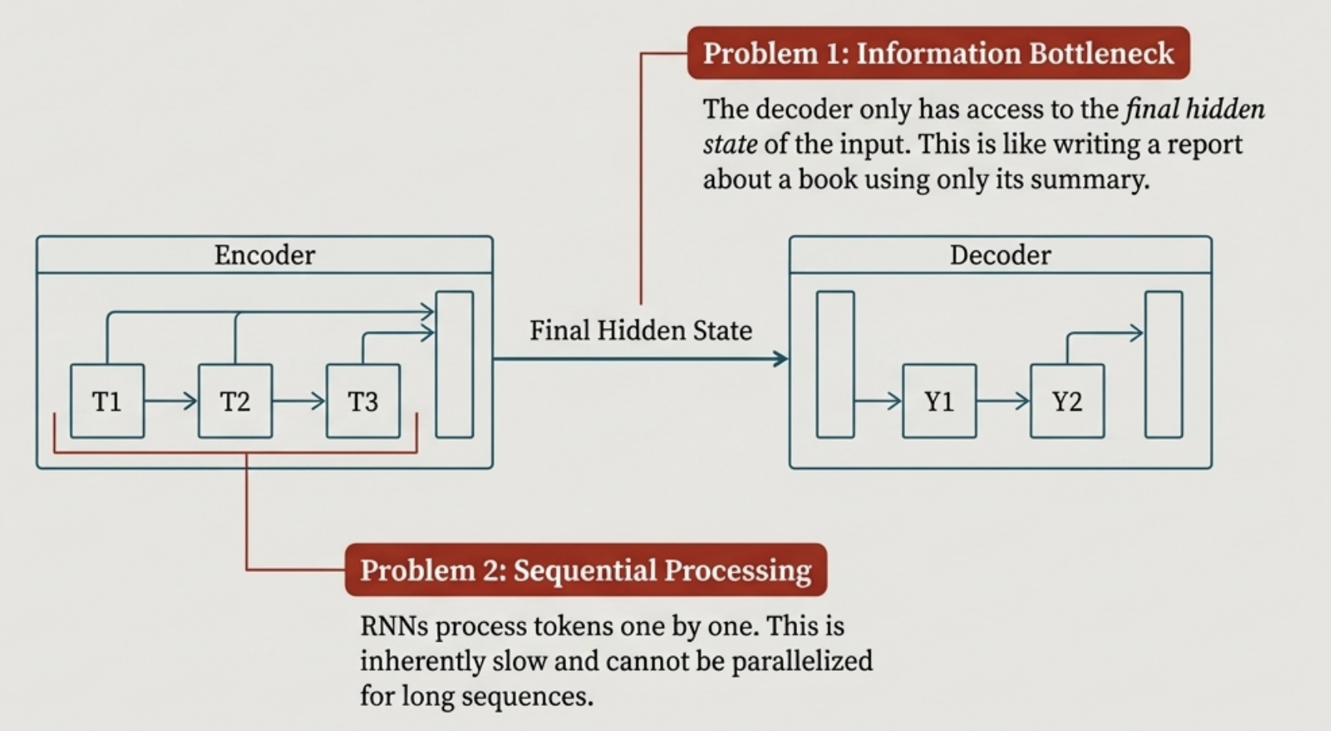
The Engine's Predecessor - The Limitations of Seq2Seq
High-Level View:
An encoder processes an input sequence, and a decoder generates an output sequence.

Slide 4
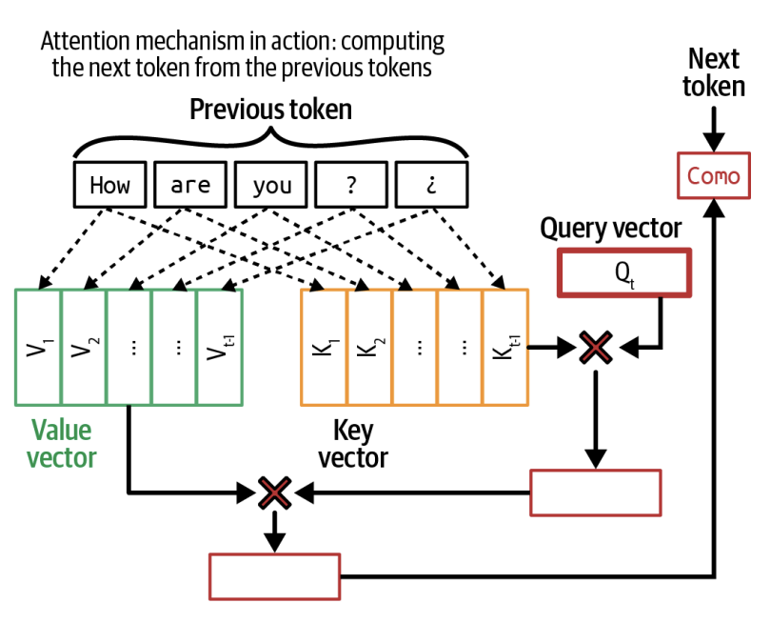
The Transformer's Breakthrough: The Attention Mechanism
Core Concept:
Instead of a single summary, the attention mechanism allows the model to look back at *every* previous token at *every* step of generation.
The Key Components:
Query (Q): Represents the current focus. "What information do I need right now?”
Key (K): An index or label for each previous word. "The address of a piece of information.”
Value (V): The actual content of a previous word. "The information itself.
Simplified Working
The Query vector is compared with every Key vector to calculate an attention score.
A high score means a word is highly relevant.
The model takes a weighted sum of the Value vectors, prioritizing relevant words.

Slide 5
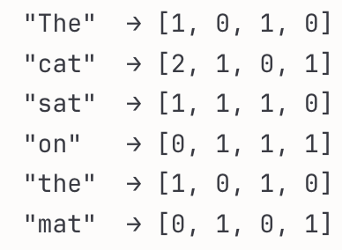
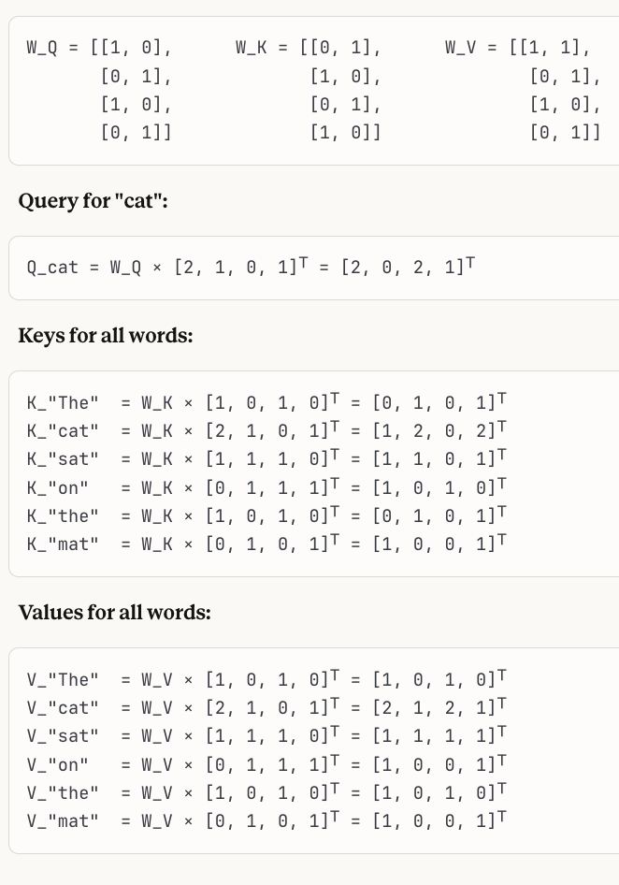
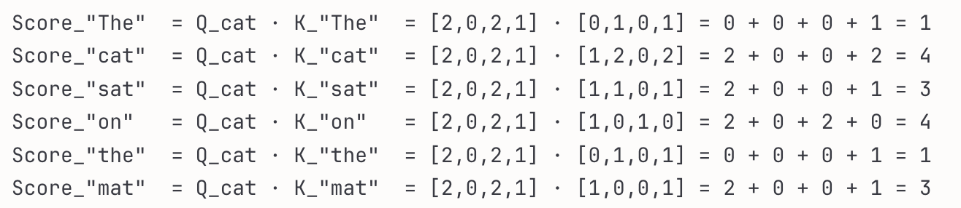
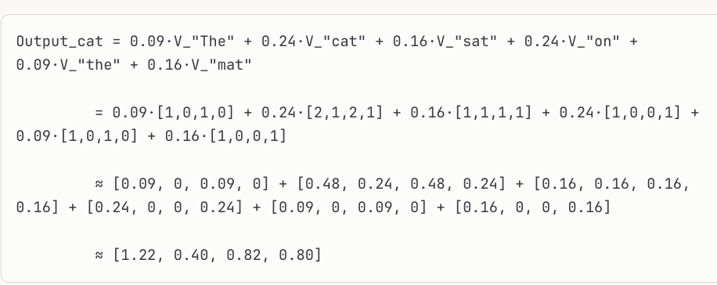
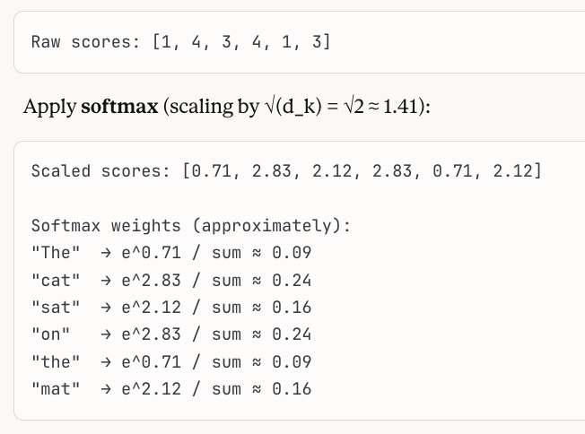
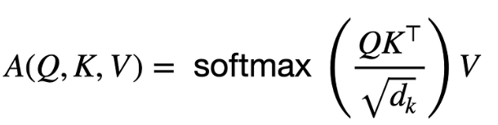
Attention in Action: An Example
Query (Q): What am I looking for? Key (K): What do I have to offer? Value (V): What information can I give?
Problem
In the sentence "The cat sat on the mat", when processing ”cat", the model needs to know which words are relevant to it.
Embedding Vector
Assuming simplified weight matrices, calculate queries, keys, and values:
"How much should the query from 'cat' attend to each key?"
This is done with a dot product between Q and each K:
We convert these scores to probabilities so they sum to 1:
The word "cat" attended most strongly to itself (0.24) and to "on" (0.24)
The entire calculation here encapsulates:

Slide 6
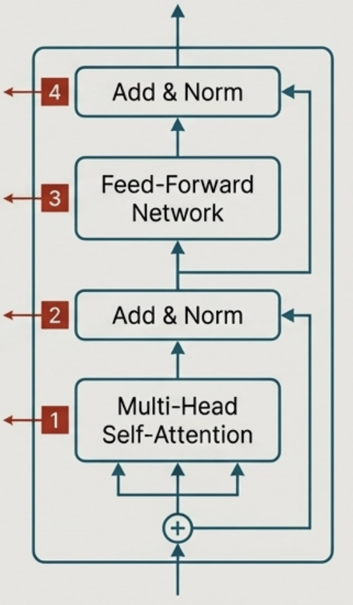
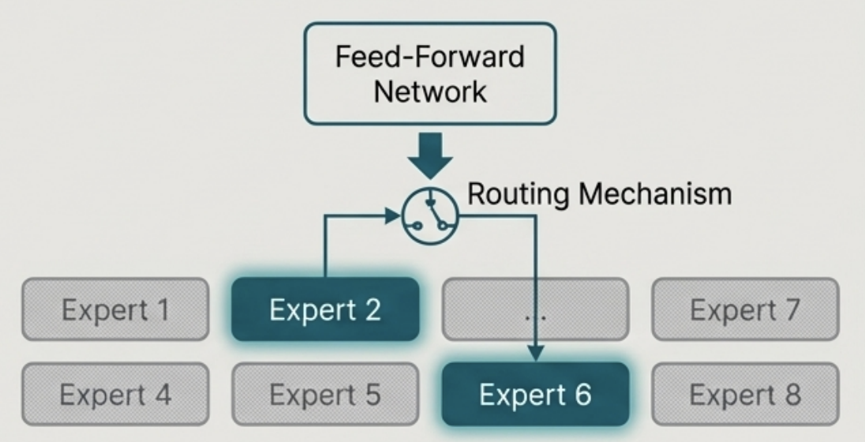
Inside the Transformer Block & The Rise of Sparsity
The Standard Transformer Block
Mixture-of-Experts (MoE)
4. Add & Norm:
Another residual connection and normalization step.
3. Feed-Forward Network:
A standard neural network that processes the attention output.
2. Add & Norm:
Residual connection and layer normalization to aid training.
1. Multi-Head Self-Attention: Runs attention in parallel (Llama 2-7B has 32 heads) to focus on different aspects simultaneously.
Concept: A more efficient alternative to the standard 'dense' Transformer. How it works: The Feed-Forward Network is replaced by multiple "expert" networks. For each token, a routing mechanism activates only a subset of these experts. Example: Mixtral 8x7B has 8 experts. For any given token, only 2 are used. This gives it the power of a ~47B parameter model but with the inference speed of a ~14B model.

Slide 7
In the next part, we will discuss
The Laws of Scale
Chinchilla Paper
Post-Training Alignment
SFT and Reward Model
Mathematics Behind Reward Model
RLHF in Action
and much more…

