Slide 1


A Comprehensive Summary
Chapter 9, Part 2
Inference Optimization

Slide 2
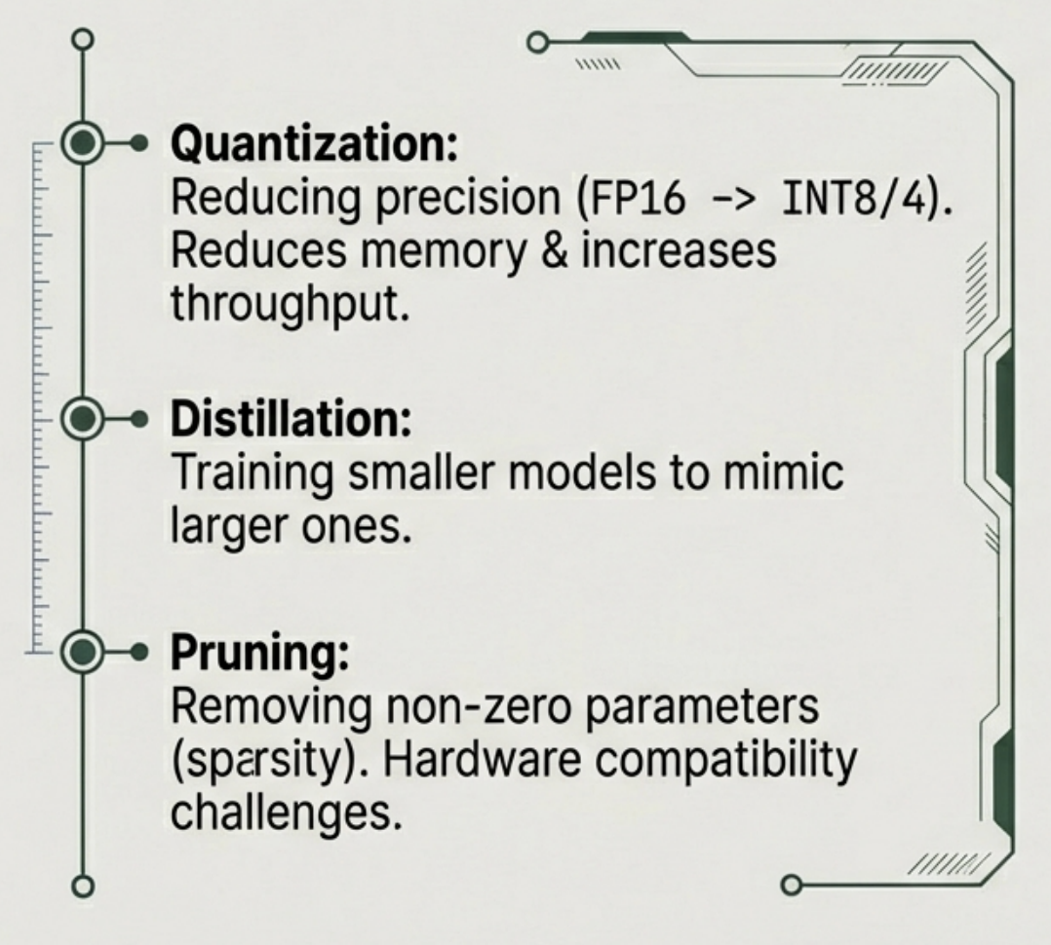
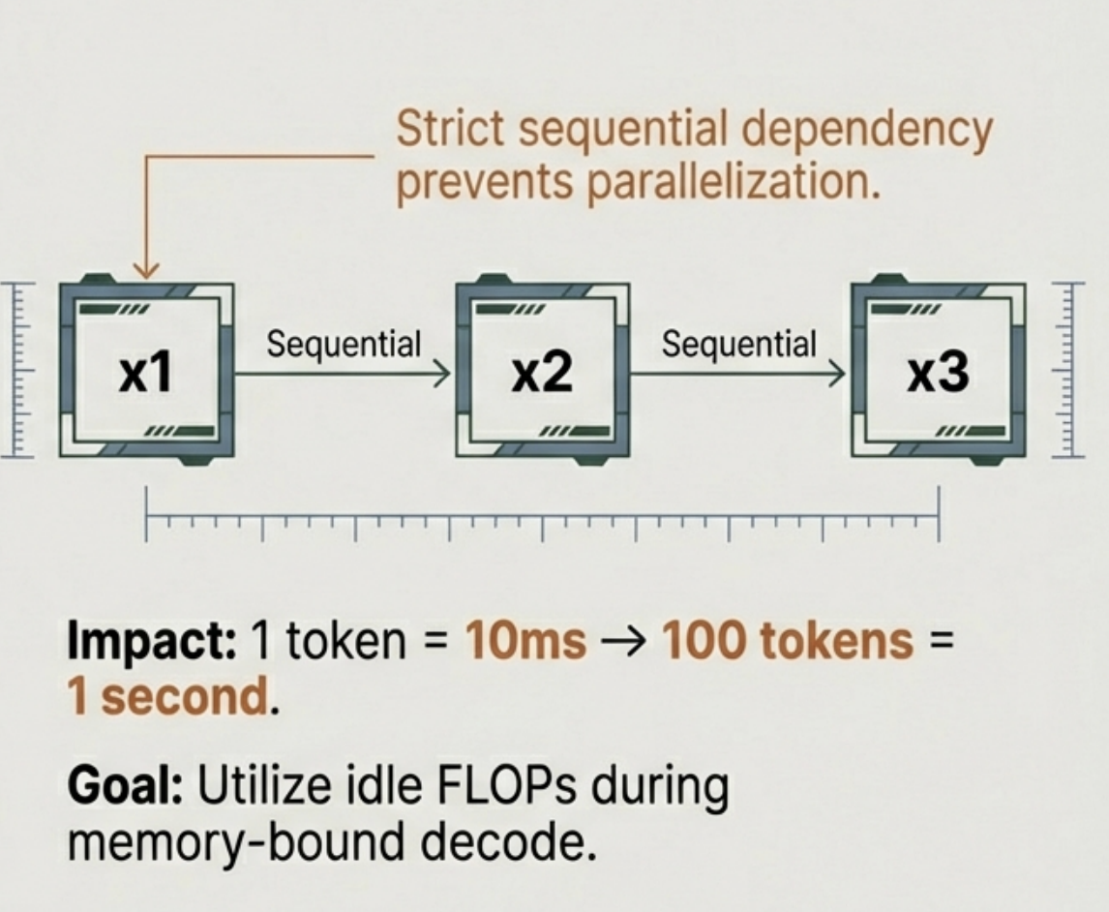
Model Compression & The Autoregressive Bottleneck
Compression Techniques
The Autoregressive Bottleneck

Slide 3
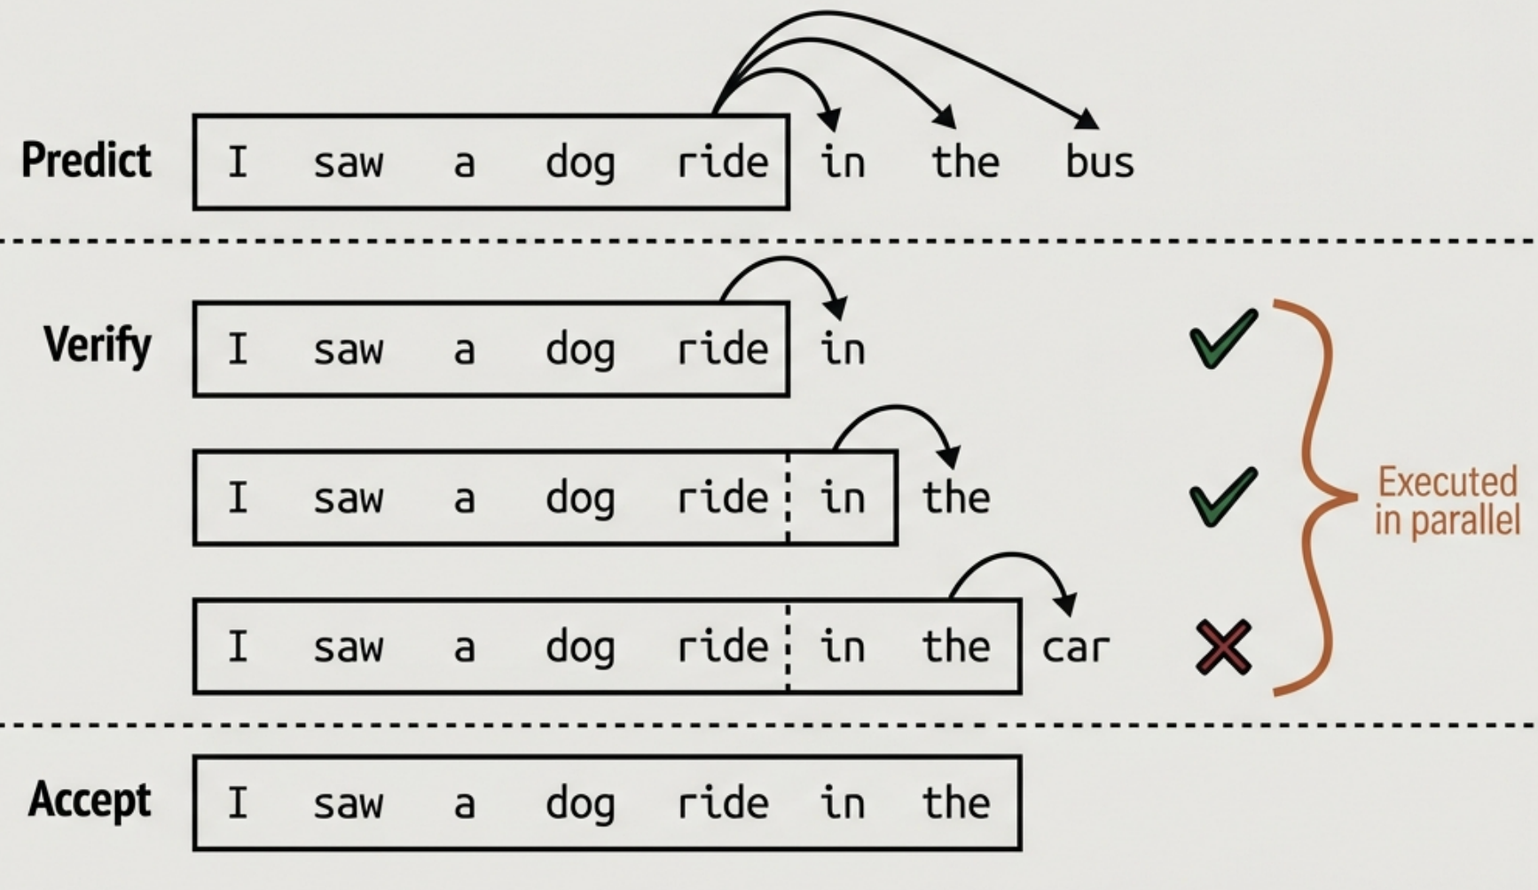
Speculative Decoding
Mechanism:
- Draft: Faster model proposes K tokens.
- Verify: Target model checks K tokens in parallel.
- Accept: Valid tokens kept; invalid discarded.
Insight: Verification is parallelizable; Generation is not.
Result: Converts memory-bound decoding into compute-bound batch processing.

Slide 4
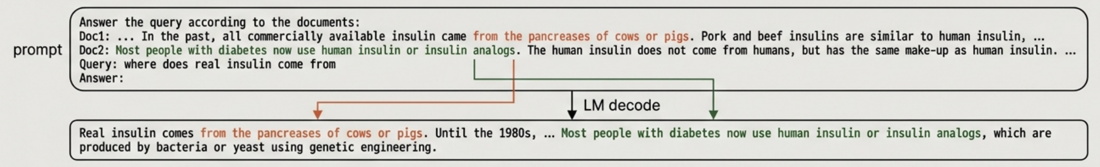
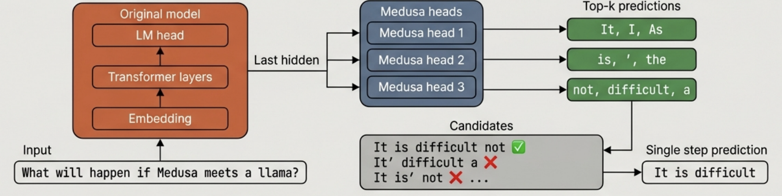
Inference with Reference & Parallel Decoding
Inference with Reference
Lossless acceleration by 'copying' matching spans from context (RAG/Code).
Parallel Decoding: Medusa
Generating multiple future tokens simultaneously using extra decoding heads.

Slide 5
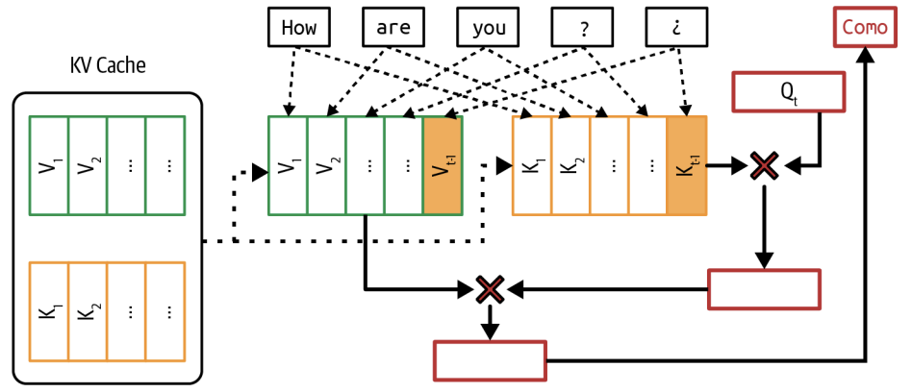
The Attention Mechanism & Computational Cost
Query (Q): Current state seeking info.
Key (K): "Page number" of previous tokens.
Value (V): "Content" of previous tokens.
The Cost: Generating a new token requires attending to ALL previous tokens.
Constraint: Recomputing K and V for the entire history at every step is prohibitively expensive.

Slide 6
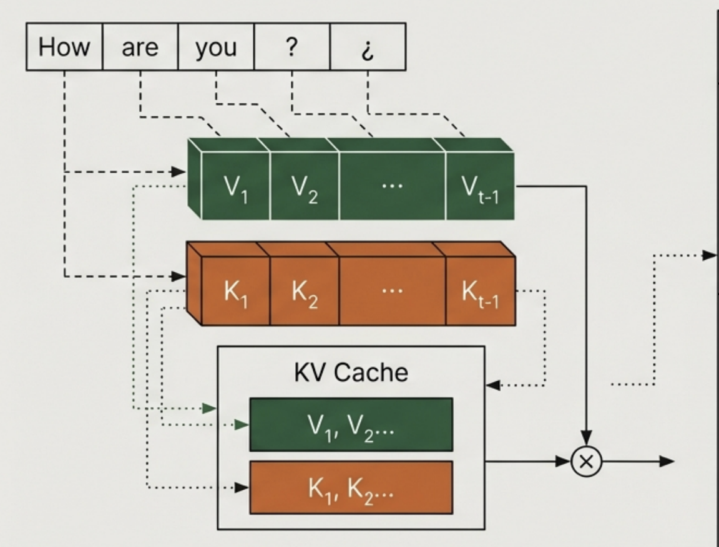
The KV Cache Bottleneck
Calculating the KV Cache Size
B: batch size
S: sequence length
L: number of transformer layers
H: model dimension
M: memory needed for the cache’s numerical representation (e.g. FP16 or FP32).
KV Cache Size = 2 × B × S × L × H × M
Multi-Query Attention (MQA): Shares K/V across all heads.
Grouped-Query Attention (GQA): Shares K/V within groups.
Cross-Layer Attention: Shares K/V аcross adjacent layers.
KV Cache (V & K vectors stored to avoid recomputation)
Growth: Linear with sequence length. Bottleneck: Capacity limited by GPU HBM (High Bandwidth Memory).

Slide 7
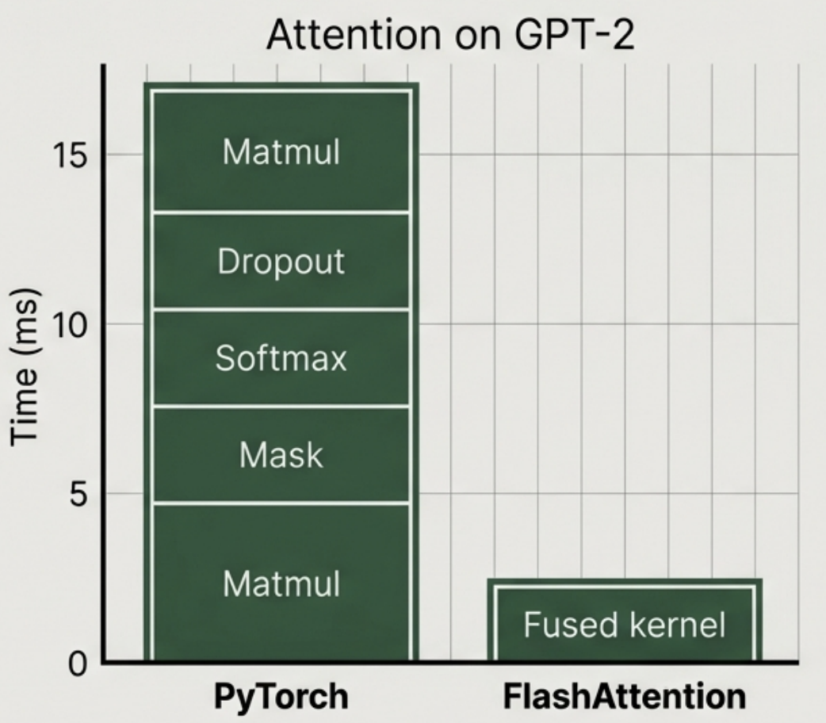
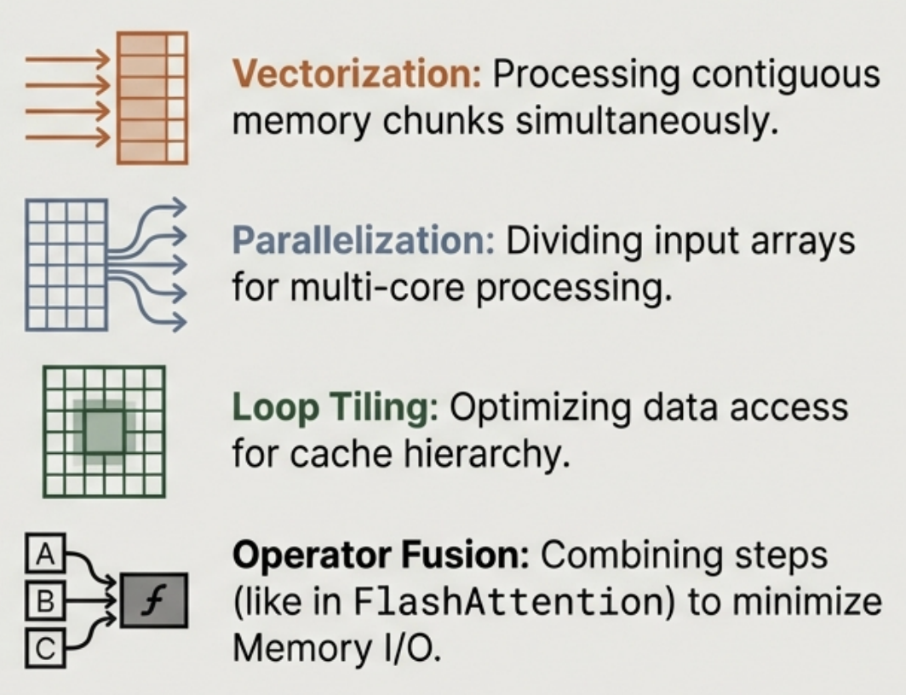
Writing Kernels: FlashAttention & Optimization
Common Kernel Techniques

Slide 8
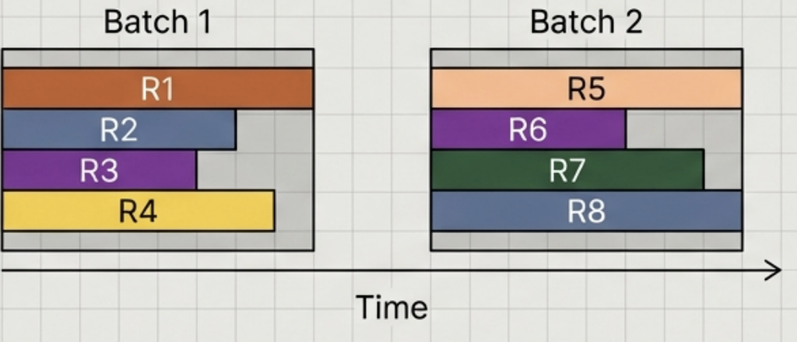
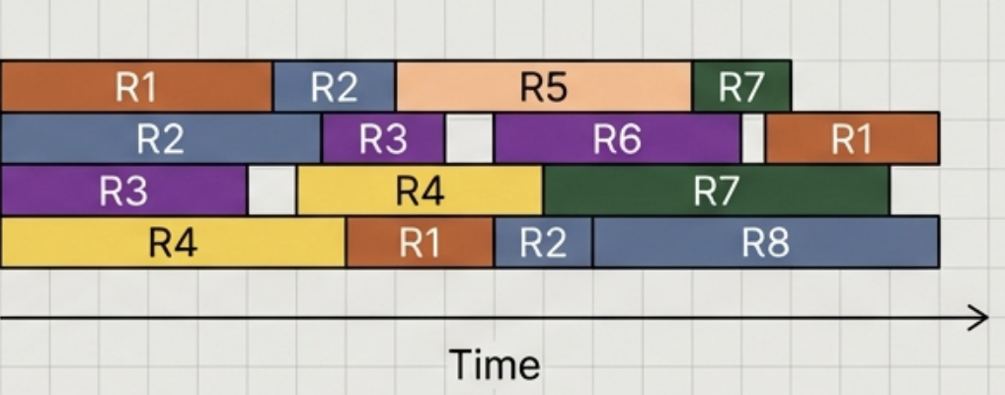
Inference Service Optimization: Batching
Static Batching
Waiting for the bus to fill. Latency limited by the longest request in the batch.
Continuous Batching
Dynamic scheduling. Completed responses return immediately. New requests fill empty slots instantly. Result: Maximized GPU utilization without stalling for stragglers.

Slide 9
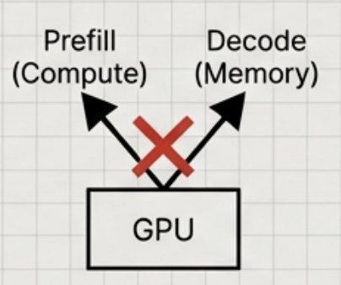
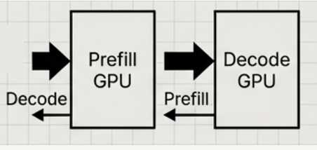
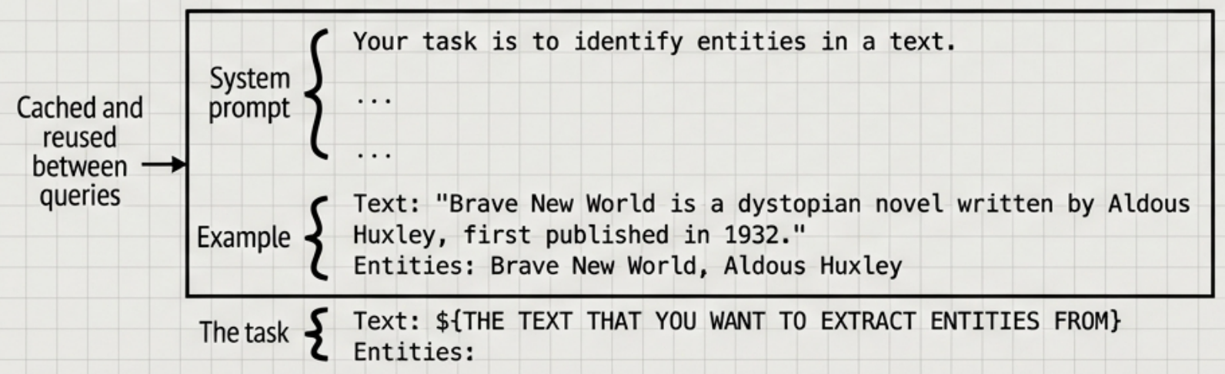
Decoupling & Prompt Caching
Decoupling Prefill and Decode
Problem: Prefill is compute-heavy; Decode is memory-heavy. Resource competition.
Solution: Disaggregate. Assign Prefill specific GPU instances, Decode to others.
Prompt Caching
Ratio Strategy:
4:1 for Long Context
(TTFT priority)
1:2 for Short Context (TPOT priority)

Slide 10
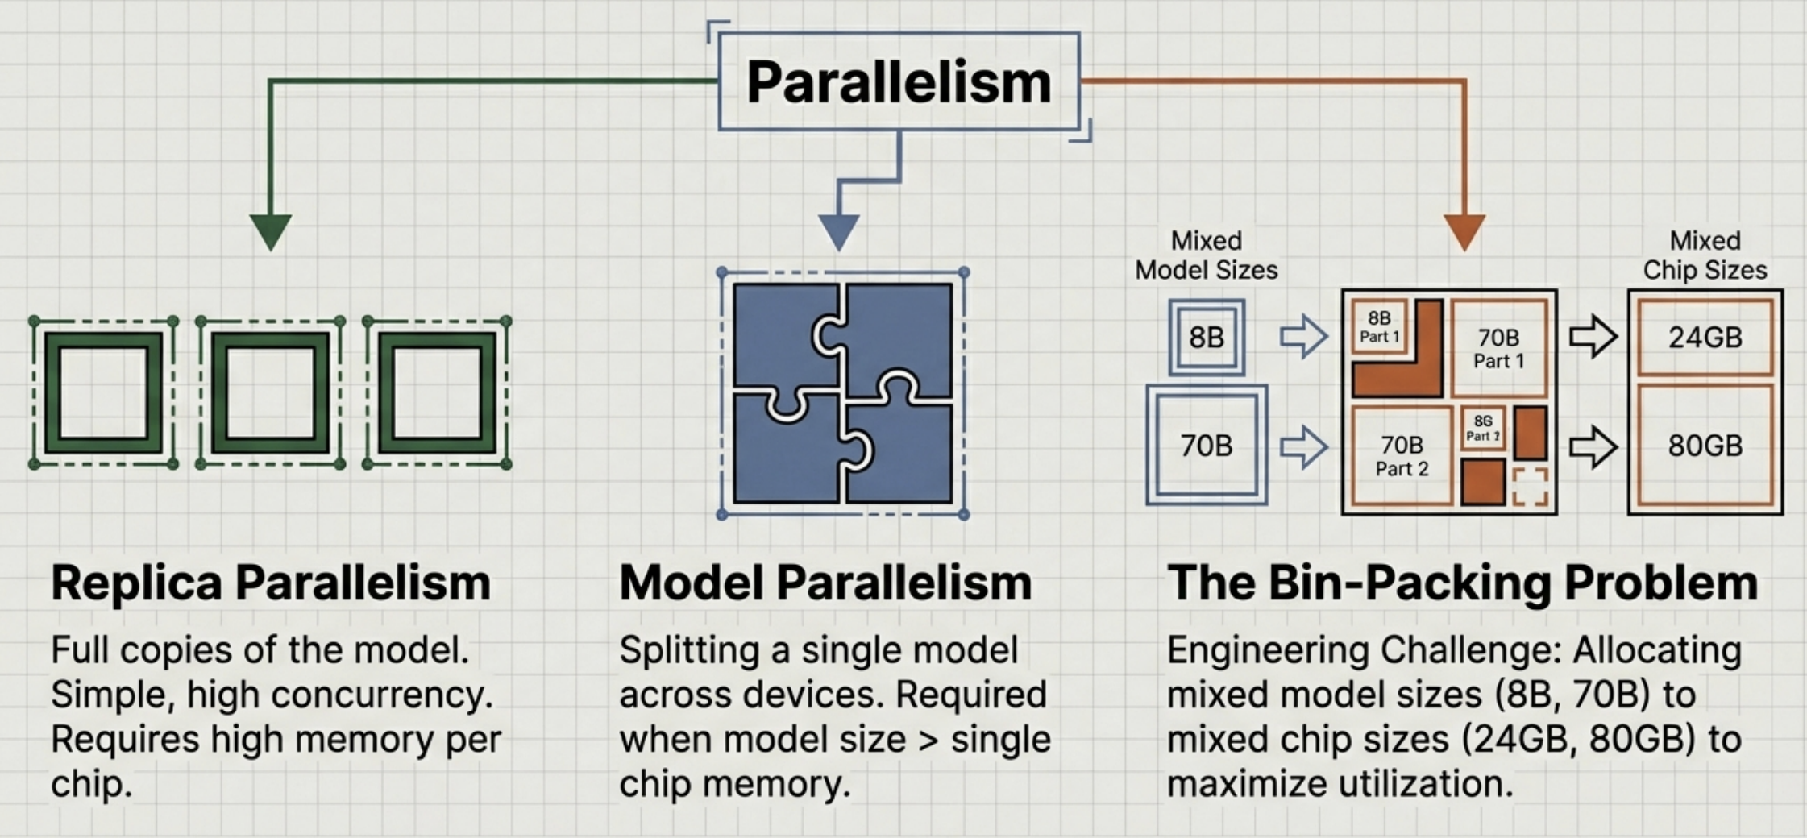
Parallelism Strategies

Slide 11
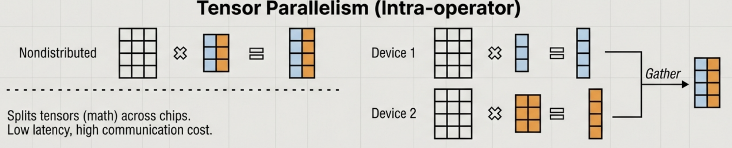
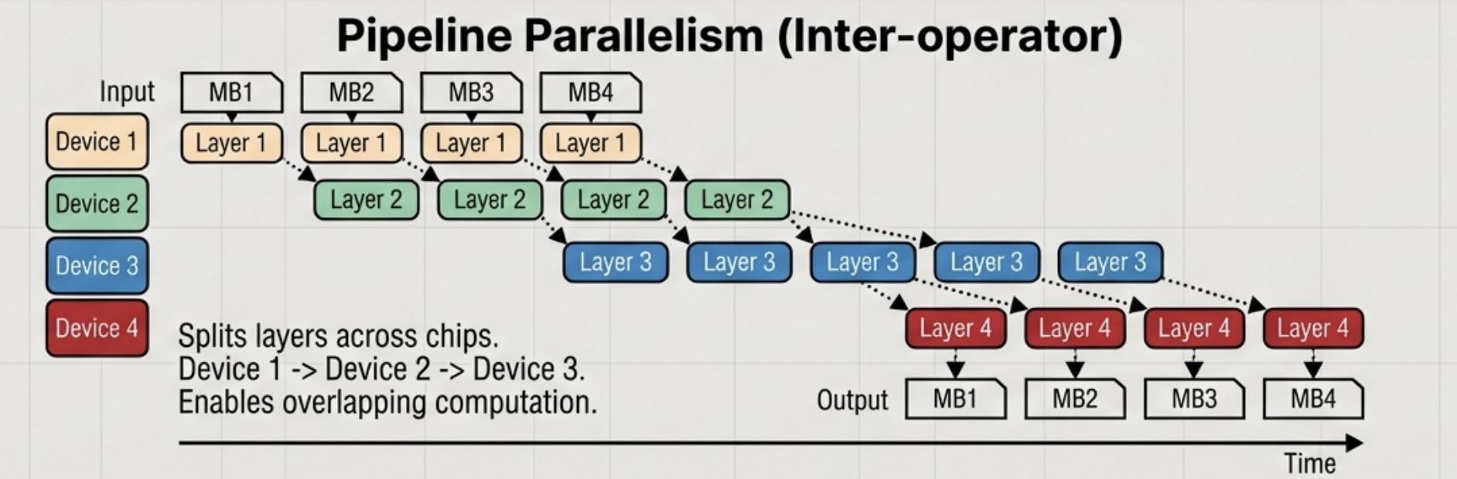
Tensor vs. Pipeline Parallelism

Slide 12
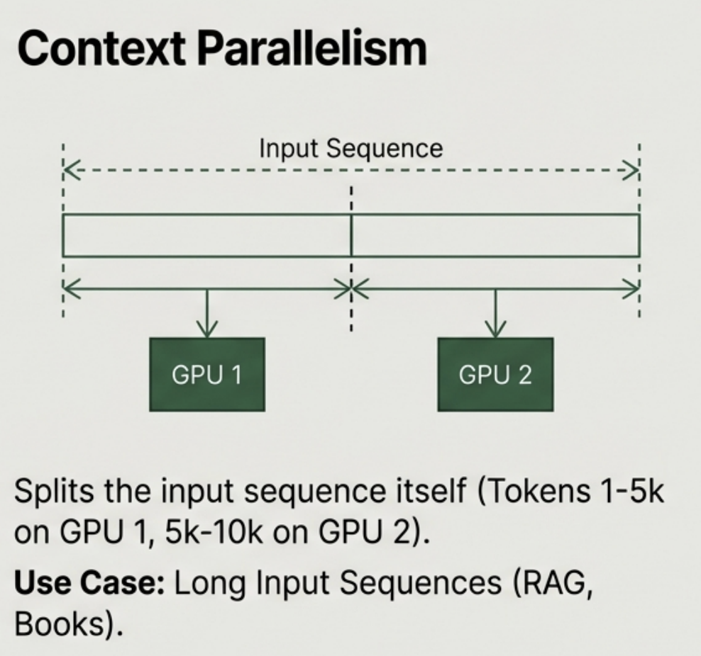
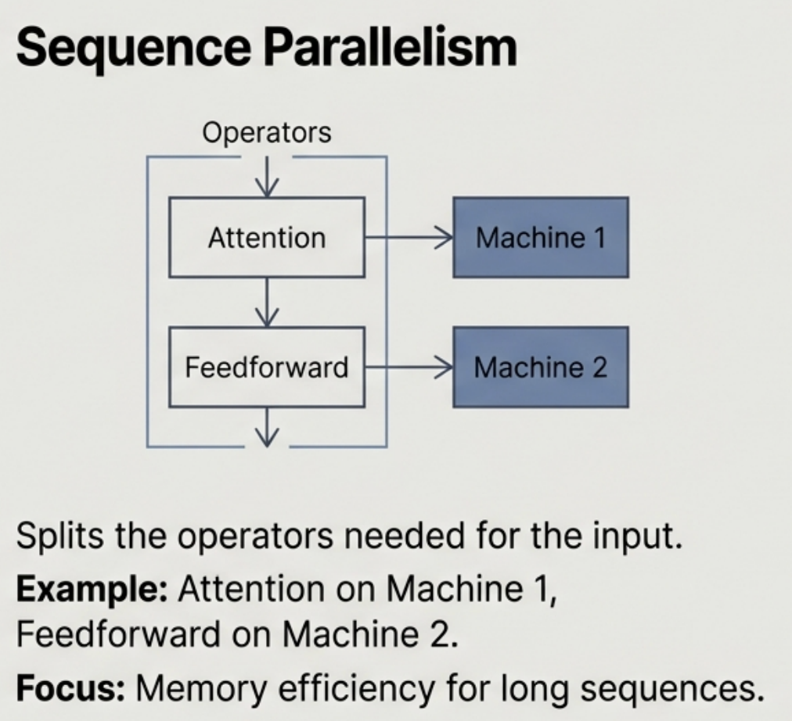
Context & Sequence Parallelism

Slide 13
In the next part, we will discuss
Context Enhancement
Input Guardrails
Output Guardrails
Model Router
Model Gateway
Exact and Semantic Caching
Agent Patterns
Monitoring, Observability
Logging and Tracing
and much more…

