Slide 1

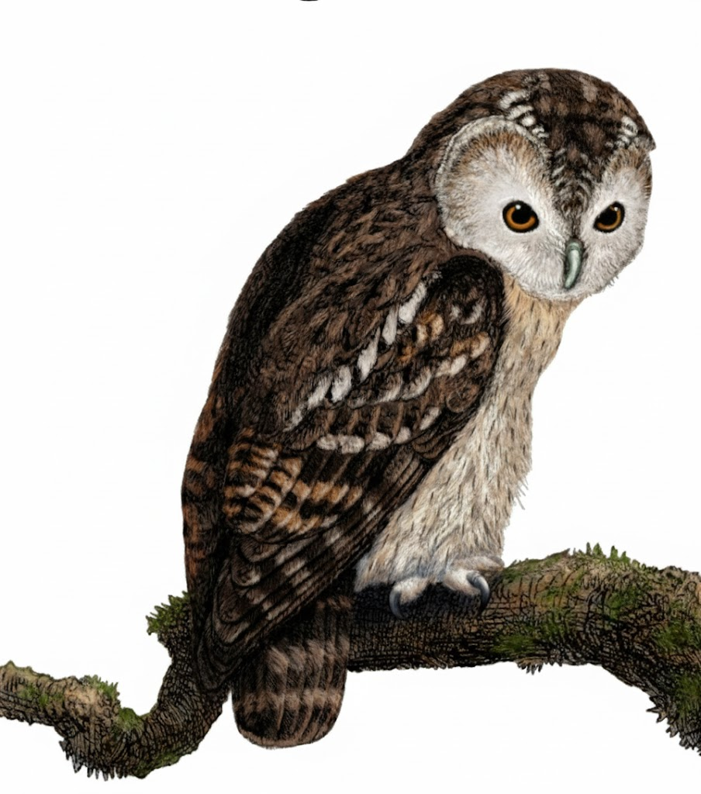
A Comprehensive Summary
Chapter 6, Part 1
RAG and Agents

Slide 2
Retrieval-Augmented Generation: Beyond Memory
RAG connects foundation models to external, up-to-date knowledge sources, enabling them to generate responses grounded in specific, relevant information.
The New Feature Engineering You can think of RAG as a technique to construct context specific to each query, instead of using the same context for all queries. Context construction for foundation models is the new feature engineering for classical ML. It serves the same purpose: giving the model the necessary information to process an input.
"No matter how long a model's context length is, there will be applications that require context longer than that."

Slide 3
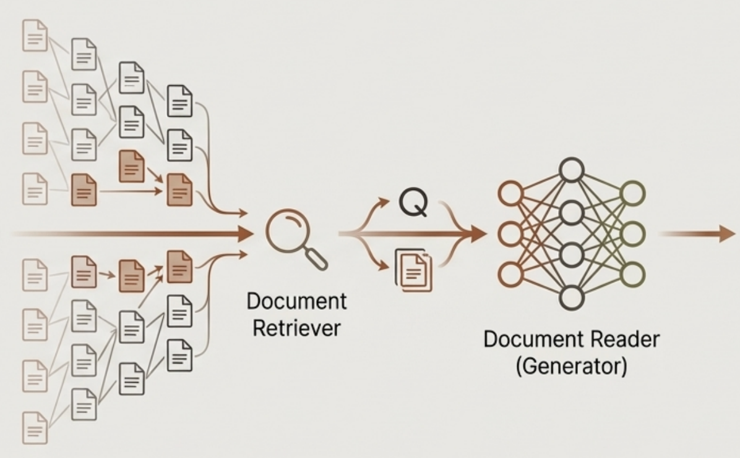
The Two-Part Architecture of RAG
The Retriever Scans a large corpus of documents to find a small subset of relevant information.
A research assistant who finds the right books in a library.
The Generator An LLM that synthesizes an answer using the original query and the context provided by the retriever.
The expert who reads the selected books and writes a concise answer.
Q
A
The quality of the final output depends entirely on the quality of both the retrieval and the generation steps.

Slide 4
Sparse vs. Dense Retrieval
The core of RAG is the retrieval algorithm. The choice depends on your data and expected queries. Two main families dominate:
Sparse Retrieval (Keyword-Based) How it works: Represents text based on the presence or absence of specific words (terms). Core Strength: Excels at matching queries that contain specific keywords found in the source documents. It's fast, efficient, and highly interpretable.
Limitation: Fails to capture semantic meaning. A query for "fastest land animal" won't match a document that only mentions "cheetah speed" if the keywords don't overlap.
Primary Example: BM25
Dense Retrieval (Meaning-Based)
How it works: Represents text as embeddings, a numerical vectors that capture semantic meaning.
Core Strength: Can find relevant documents even if they don't share any keywords with the query, as long as the meaning is similar.
Limitation: Can be computationally expensive and may sometimes miss exact keyword matches that sparse retrievers would catch.
Primary Example: Vector Search

Slide 5

Term-Based Retrieval: The Power of Keywords
TF-IDF (Term Frequency-Inverse Document Frequency) A term's importance is proportional to how often it appears in a document (“TF”) but is offset by how common it is across all documents (“IDF”). Rare, frequent terms are the most important.
Okapi BM25 A more sophisticated algorithm building upon TF-IDF. Its key advantage is addressing TF-IDF's bias toward longer documents, which naturally contain more terms and have higher term frequencies.
BM25 and its variants are formidable baselines for any retrieval system.
"Making a genuine improvement over BM25 or full-text search is hard.”
- Aravind Srinivas, CEO of Perplexity

Slide 6
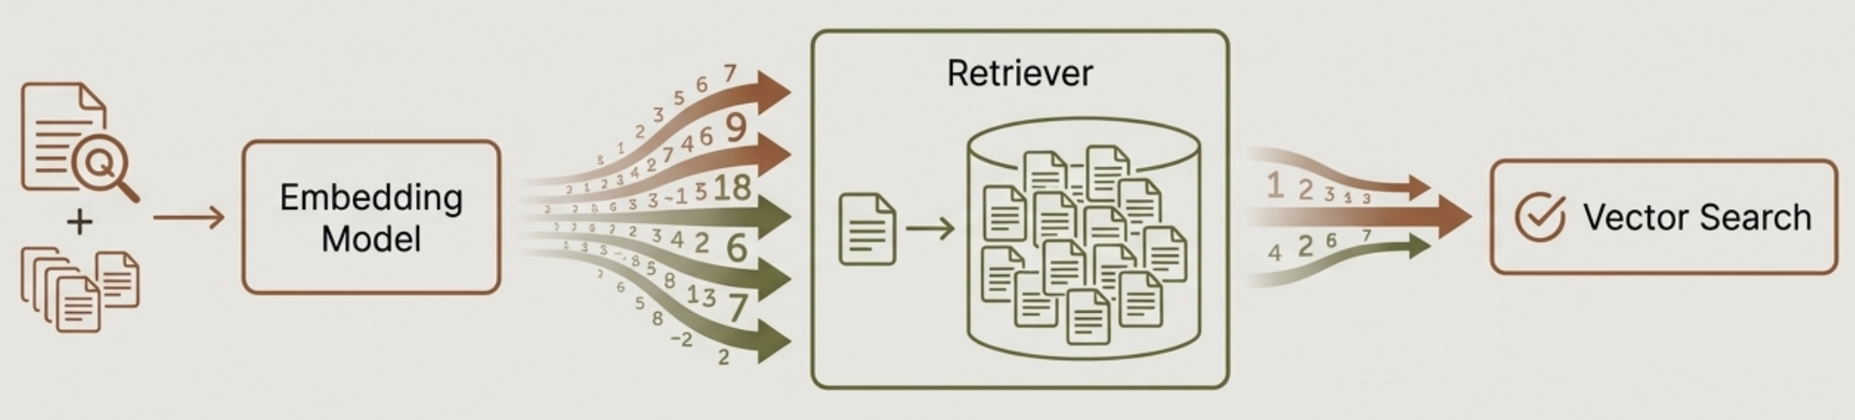
Embedding-Based Retrieval: Searching for Meaning
Step 1: Embedding Model
Function: A neural network that converts the user's query and the documents into high-dimensional numerical vectors (embeddings).
Goal: Texts with similar meanings should have vectors close to each other in the vector space.
Step 2: Retriever Function: Takes the query embedding and searches the database of document embeddings.
Goal: To efficiently find the document vectors that are "nearest" to the query vector.
Step 3: Vector Search Problem:
Finding the nearest neighbours in a massive, high-dimensional space. A naive 'k-NN` search comparing the query to every single document is computationally infeasible.
Solution: Approximate Nearest Neighbor (ANN) search algorithms, which trade a small amount of accuracy for a massive gain in speed.

Slide 7
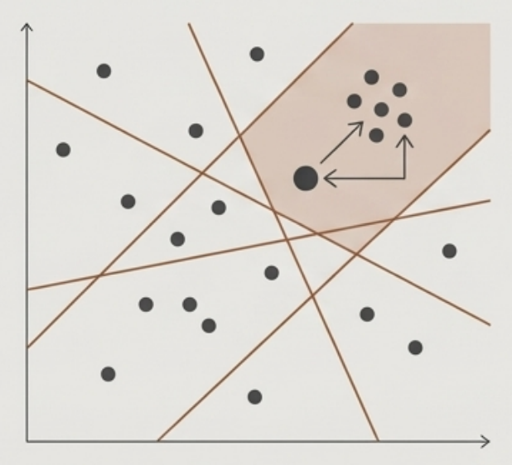
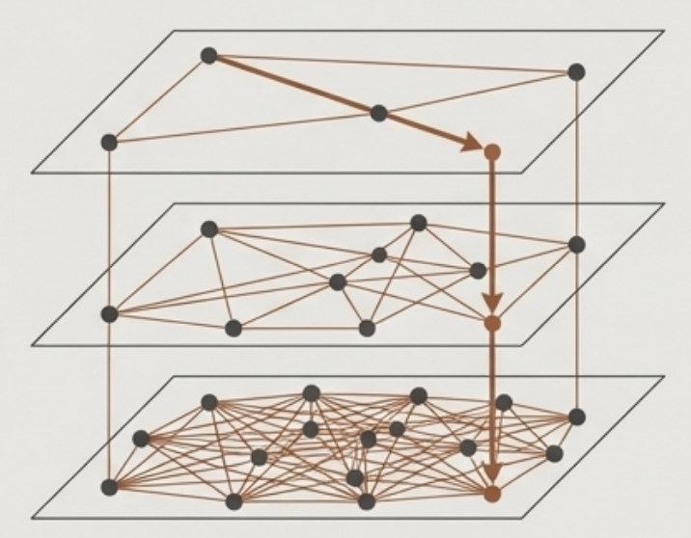
Inside Vector Search: Two ANN Algorithms
How systems efficiently find the closest vectors without checking every single one.
LSH (Locality-Sensitive Hashing)
HNSW (Hierarchical Navigable Small World)
Intuition: Hashing similar input vectors into the same "buckets".
Intuition: Navigating a multi-layered graph of vectors to find the nearest neighbours.
Implementations: Used in libraries like FAISS and Annoy.
Implementations: Used in libraries like FAISS and Milvus.

Slide 8
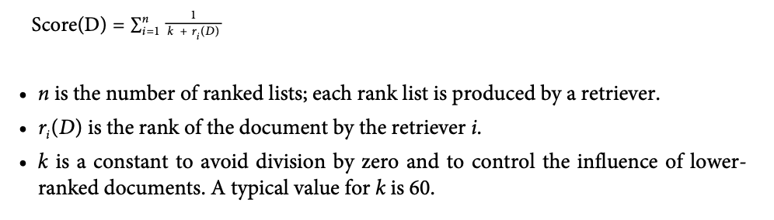
Combining Retrieval Methods for Production Systems
Hybrid Search:
Definition: The practice of combining term-based retrieval (like BM25) and embedding-based retrieval (vector search).
Benefit: Captures both keyword relevance and semantic similarity, leading to more robust and accurate retrieval.
Reciprocal Rank Fusion (RRF)
Problem: How do you merge ranked lists from different systems when their relevance scores are on completely different scales and not comparable?
RRF solution: It assigns each document a score based on its ranking by a retriever. Intuitively, if it ranks first, its score is 1/1 = 1. If it ranks second, its score is ½ = 0.5. The higher it ranks, the higher its score. A document’s final score is the sum of its scores with respect to all retrievers. If a document is ranked first by one retriever and second by another retriever, its score is 1 + 0.5 = 1.5.

Slide 9
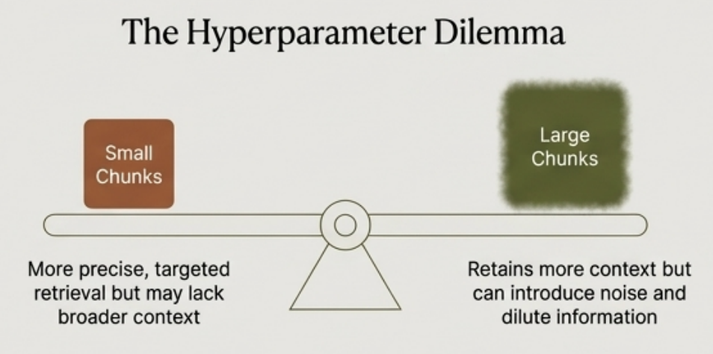
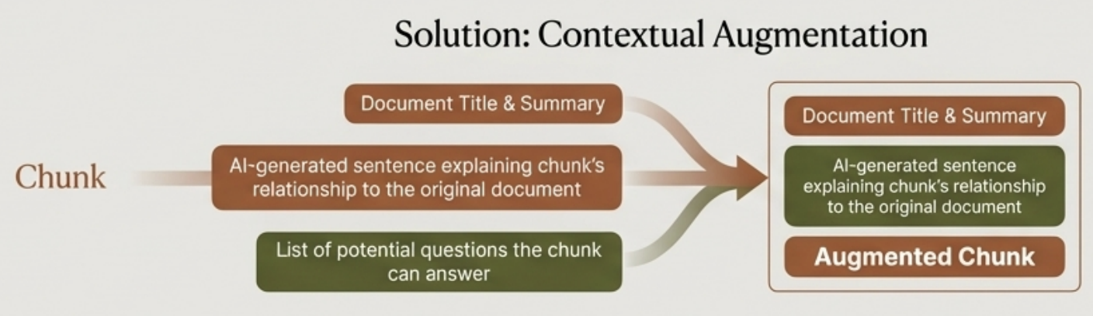
Retrieval Optimization I: The Chunking Strategy
The Core Challenge
Most documents are too long to be used as context directly. They must be split into smaller, manageable "chunks".

Slide 10
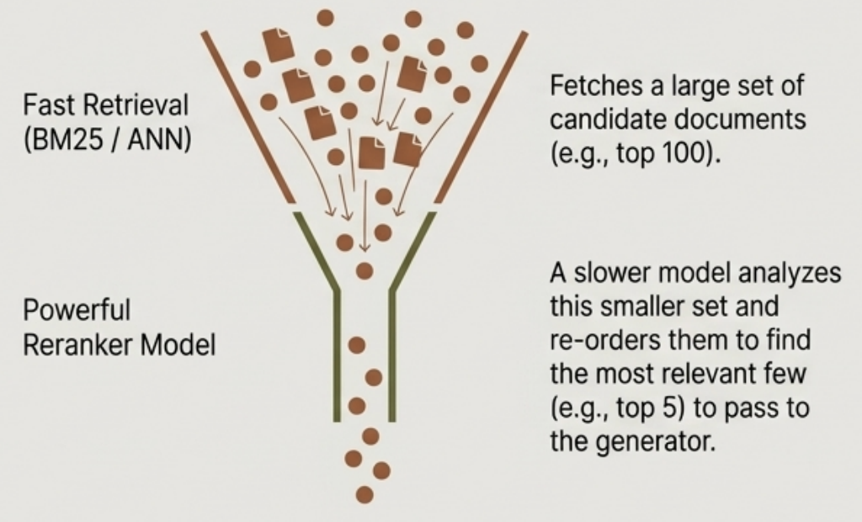
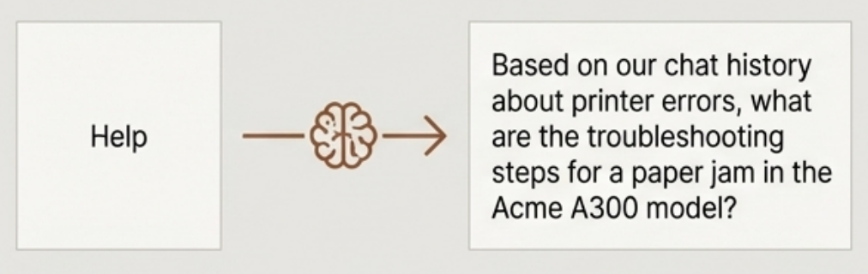
Retrieval Optimization II: Rewriting and Reranking
Improving the Input: Query Rewriting
A user's initial query is often not optimal. An LLM can be used to rewrite or expand the query for better results.
Improving the Output: Reranking
A two-stage retrieval process for higher accuracy.
Challenge Can get complex with tasks like identity resolution. A query like "How about his wife?" requires the model to first resolve who "he" and "his wife" are before rewriting.

Slide 11
Evaluating Retrieval Solutions
A RAG system must be evaluated component-by-component and end-to-end. For the retrieval component, two key questions must be answered:
Context Relevance
Answer Faithfulness
Do the retrieved documents actually contain the information needed to answer the user's query?
Is the final generated answer actually grounded in the provided context?
If the retrieved context is irrelevant, the generator LLM has no chance of producing a correct, factually grounded answer. This is the foundation of the entire RAG pipeline.
This measures whether the generator LLM is faithfully using the retrieved information or "hallucinating" an answer by relying on its parametric memory. An unfaithful answer defeats the purpose of RAG.

Slide 12
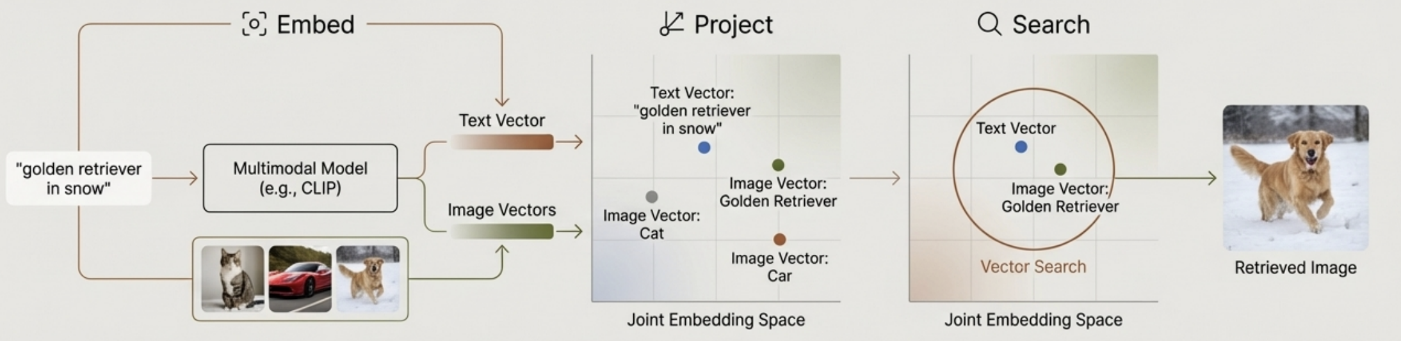
RAG Beyond Text: Multimodal Retrieval
The Challenge: How do you retrieve an image in response to a text query like "Show me a picture of a golden retriever playing in the snow"?
Metadata-Based If images have descriptive metadata (titles, captions, tags), they can be retrieved using standard text-based search on that metadata.
Content-Based
To search the visual content itself, a multimodal embedding model is required.
The Multimodal RAG Process

Slide 13
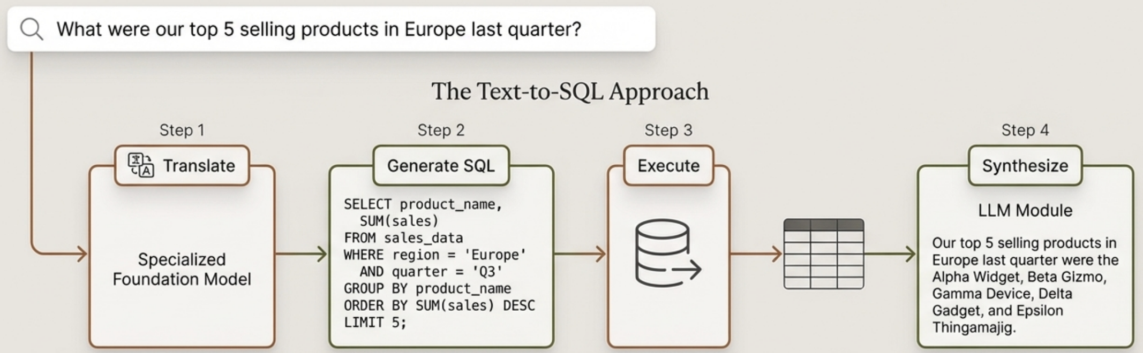
RAG Beyond Text: Querying Tabular Data
The Use Case
Answering natural language questions that require data from structured sources like SQL databases.
Key Takeaway
This turns a complex database into an interactive knowledge source accessible to non-technical users.

Slide 14
In the next part, we will discuss
Intro to Agent
Tools and its core Functions
Agent Memory
Memory Bottleneck
and much more…

