Slide 1
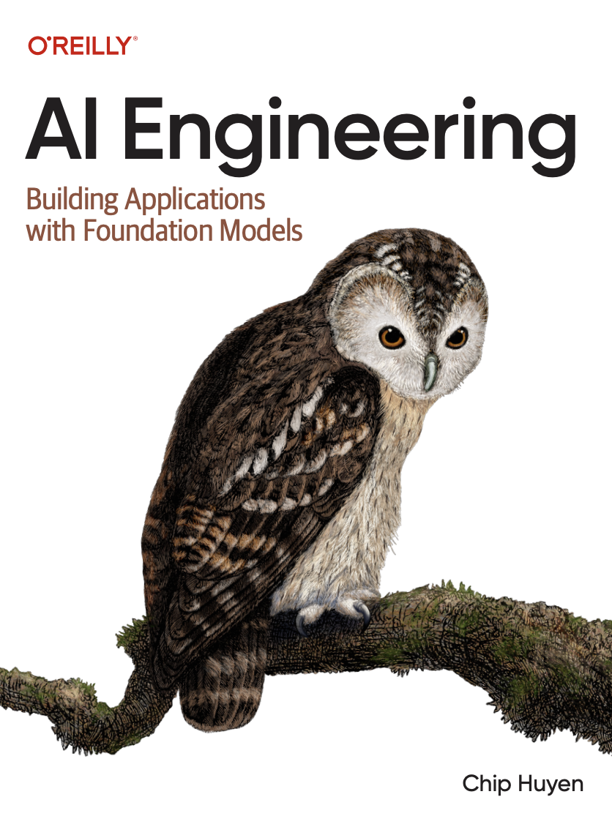
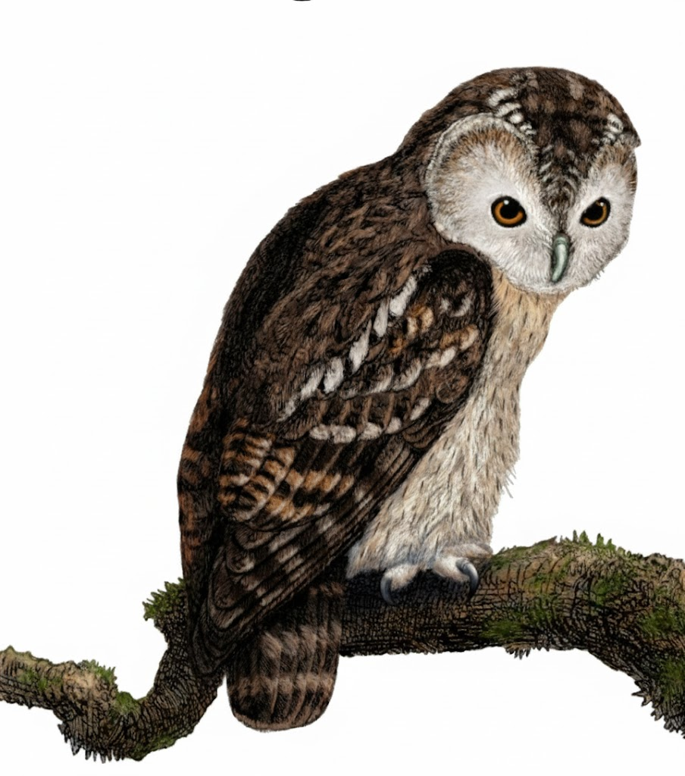
A Comprehensive Summary
Chapter 2, Part 3
Understanding Foundation Models

Slide 2
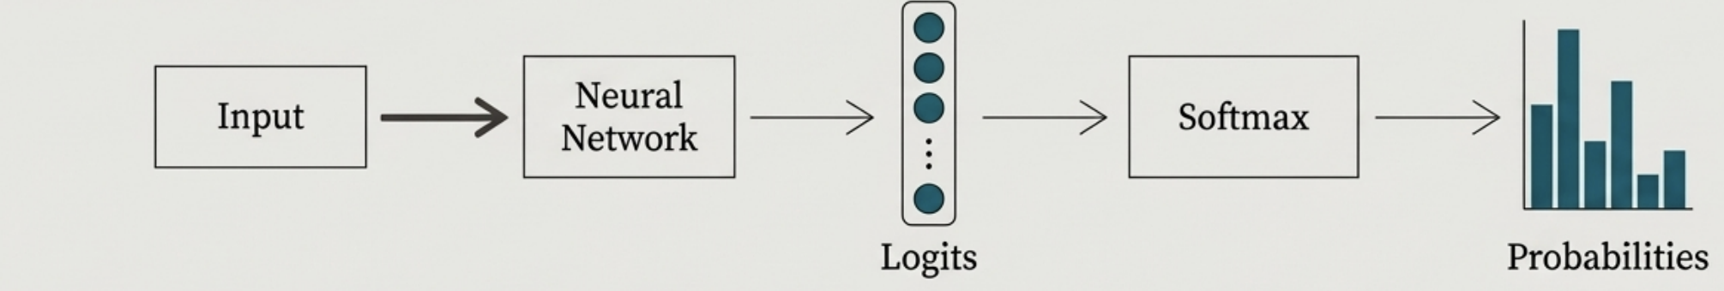
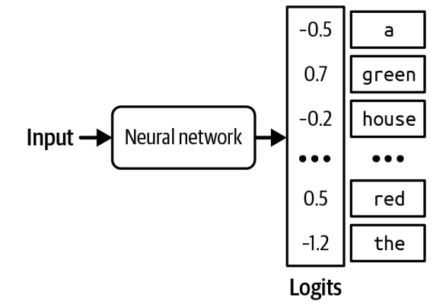
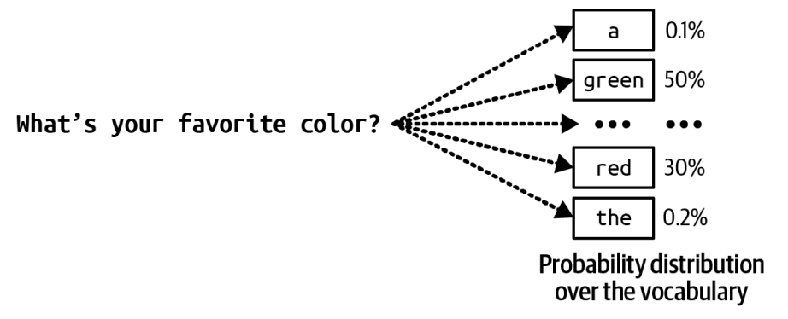
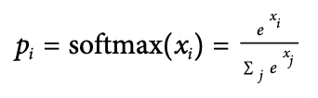
The Path to a Token Prediction
Logits: Raw, unnormalized scores for every possible next token. Softmax: A function that converts logits into a clean probability distribution (values sum to 1).

Slide 3
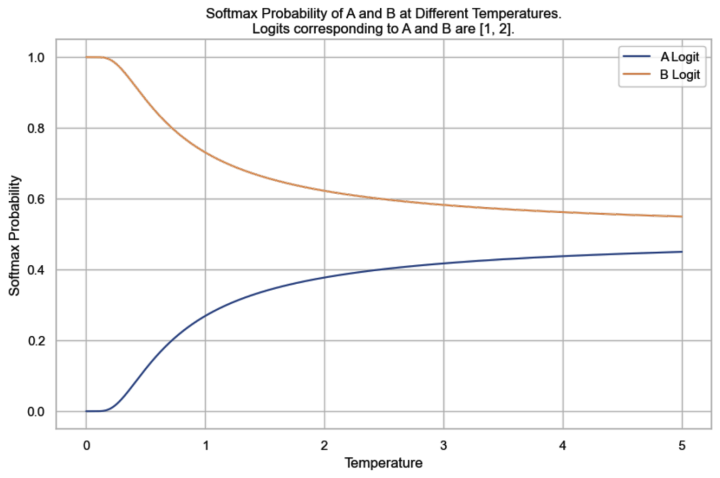
Controlling Creativity with Temperature
Concept: Temperature is a parameter that adjusts the logits before the softmax step. adjusted_logit = logit / T Low Temperature (e.g., 0.2): Increases the probability of the most likely tokens. Outputs are more deterministic, consistent, and "safe". High Temperature (e.g., 1.0): Flattens the probability distribution, making less likely tokens more probable. Outputs are more creative, diverse, but potentially less coherent.

Slide 4
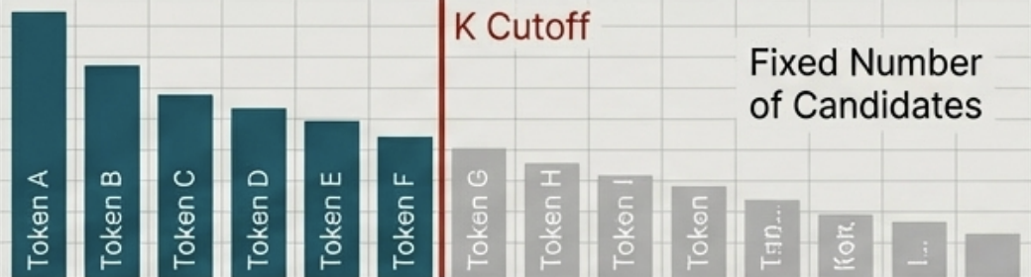
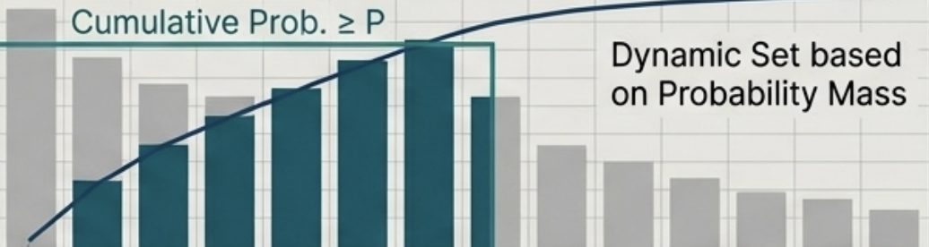
Advanced Sampling & Test-Time Compute
Constraining the Vocabulary Pool
Top-K Sampling
Top-P (Nucleus) Sampling
Consider only the K most probable tokens. (e.g., k=50). Simple, but can cut off a good token just outside the top K.
Consider the smallest set of tokens whose cumulative probability exceeds P. (e.g., p=0.9). More dynamic than Toр-К.

Slide 5
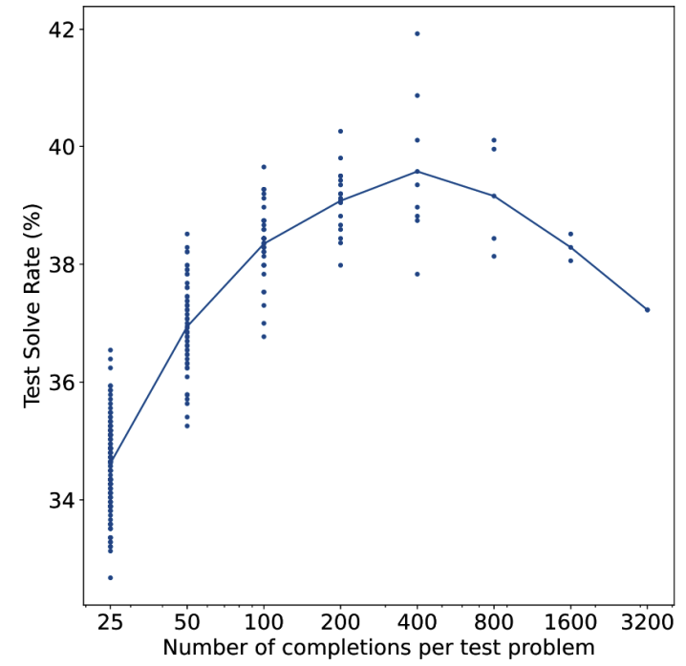
Improving Performance with Test-Time Compute
Concept: Instead of generating one response, generate many (e.g., 10) using different sampling parameters, then select the best one. Selection: The 'best' can be determined by a verifier, a scoring model, or by picking the one with the highest average log probability. Finding: Performance often increases with more samples, but with diminishing returns and a risk of finding adversarial examples that fool the verifier.
OpenAI (2021) found that sampling more outputs led to better performance, but only up to 400 outputs

Slide 6
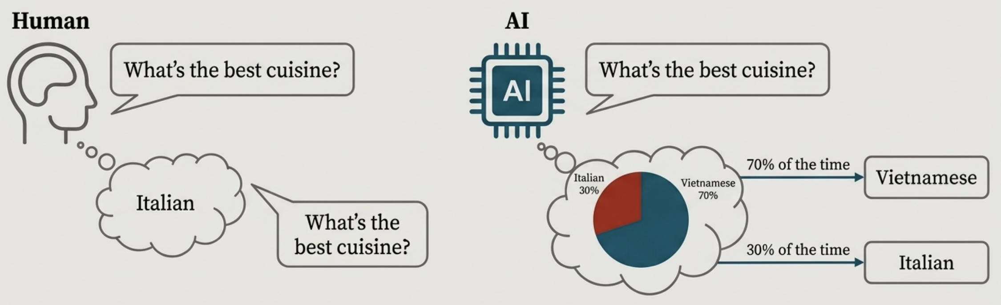
The Probabilistic Nature of AI
Foundation models are inherently probabilistic, not deterministic.
The same input can produce different outputs in the same model unlike human preferences
Is Inconsistency a Bug? No, it's a feature of the sampling process that enables creativity and diversity in responses.
How to Force Consistency: Set Temperature = 0 (greedy decoding). Set a fixed random seed.
*Caveat: Even with these settings, minor hardware differences can lead to micro-variations. 100% consistency is not guaranteed with third-party APIs.*

Slide 7
Understanding Hallucinations
When an AI model generates plausible-sounding but factually incorrect or fabricated information with confidence, often appearing to "make up" facts.
Causes for Hallucinations: Hallucinations arise from the model's fundamental nature as a pattern-generalization engine, not a knowledge-retrieval database.
The first hypothesis, originally expressed by Ortega et al. at DeepMind in 2021, is that a language model hallucinates because it can’t differentiate between the data it’s given and the data it generates.
The second hypothesis is that hallucination is caused by the mismatch between the model’s internal knowledge and the labeller’s internal knowledge. If these responses use the knowledge that the labellers have but the model doesn’t have, we’re effectively teaching the model to hallucinate.
How to Mitigate Hallucinations: Finetuning: Continuously finetune the model on high-quality, factual, and up-to-date data to improve its internal "world model".
Retrieval-Augmented Generation (RAG): Ground the model with real-time, factual information at inference time.

Slide 8
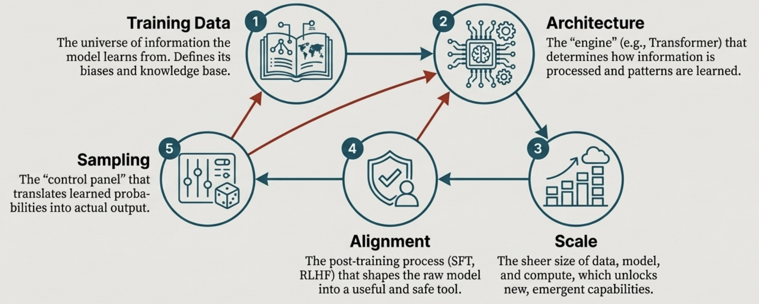
A Unified View of a Foundation Model
A model's behaviour is an emergent property of the complex interplay between all its constituent parts. Understanding any single part in isolation is insufficient.

Slide 9
In the next part, we will discuss
Rise of Evaluation in AI
Entropy
Cross-Entropy
KL Divergence
Perplexity (PPL)
Mathematics behind these
and much more…

