Slide 1
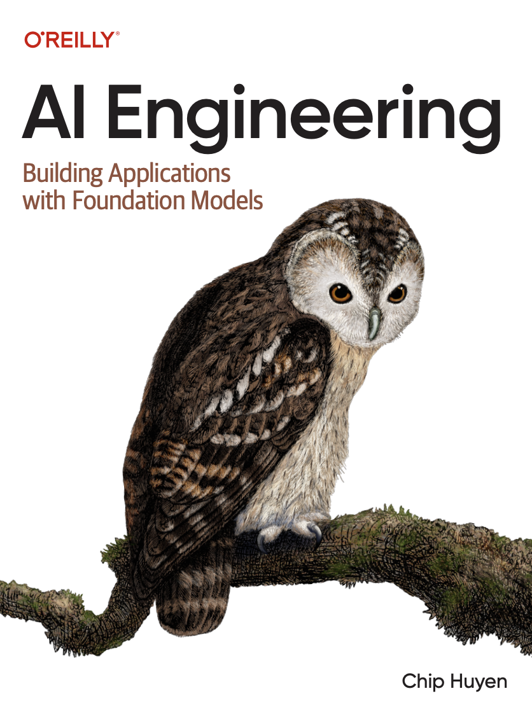

A Comprehensive Summary
Chapter 8, Part 2
Dataset Engineering

Slide 2
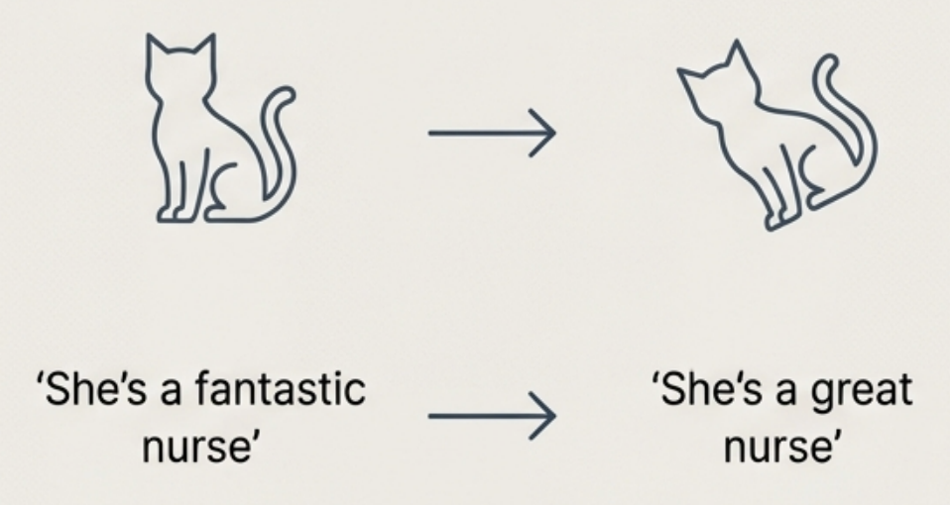
Foundational Synthesis: Templates and Transformations
Template-Based Generation
Use predefined structures with placeholders to generate structured data.
Transaction ID: [Unique Identifier]
Date: [MM/DD/YYYY]
Amount: [Transaction Amount]
Transformation-Based Augmentation Apply simple, meaning-preserving transformations to existing data. Ideal for: Invoices, resumes, configuration files, and math equations. AlphaGeometry was trained on 100M synthetic examples created this way.
Transformation-Based Augmentation
Apply simple, meaning-preserving transformations to existing data.

Slide 3

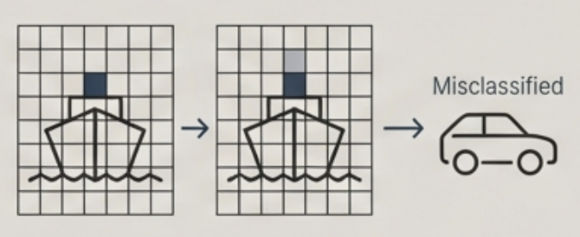

Building Robustness Through Perturbation
Perturbation involves adding controlled noise to existing data to generate new, challenging training examples. This improves model performance and resilience against attacks.
Examples in Practice
Image ImageNet-C and ImageNet-P were created by applying corruptions like noise, snow, and brightness changes to the original ImageNet dataset, forcing models to learn more robust features. Text To train BERT, 1.5% of input tokens were replaced with random words. This simple perturbation led to a measurable performance boost.
Motivating Threat: The "One Pixel Attack"
Su et al. (2017) demonstrated that changing a single pixel can cause a model to misclassify an image (e.g., a ship becomes a car), highlighting the model fragility that perturbation aims to fix.

Slide 4
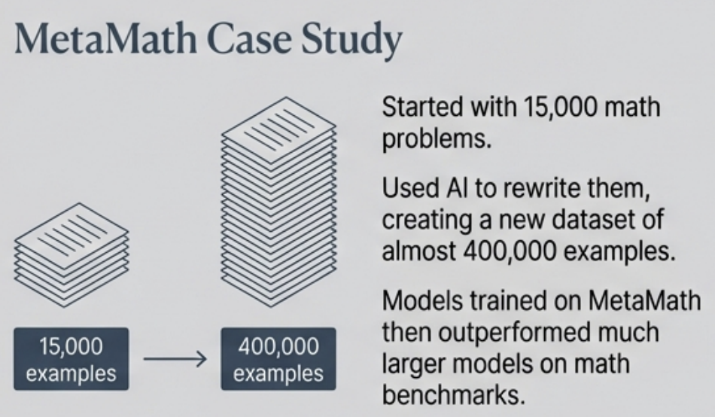

Al-Powered Synthesis I: Rewriting and Translation
Evolving Data with Rewriting Use a powerful Al model to rephrase or reformulate existing examples in diverse ways, dramatically expanding the dataset.
Expanding Reach with Translation Use Al to translate data from high-resource languages (like English) into low-resource languages (like Quechua or Lao).
This is a critical technique for training specialized models for underserved linguistic communities, promoting digital equity.

Slide 5
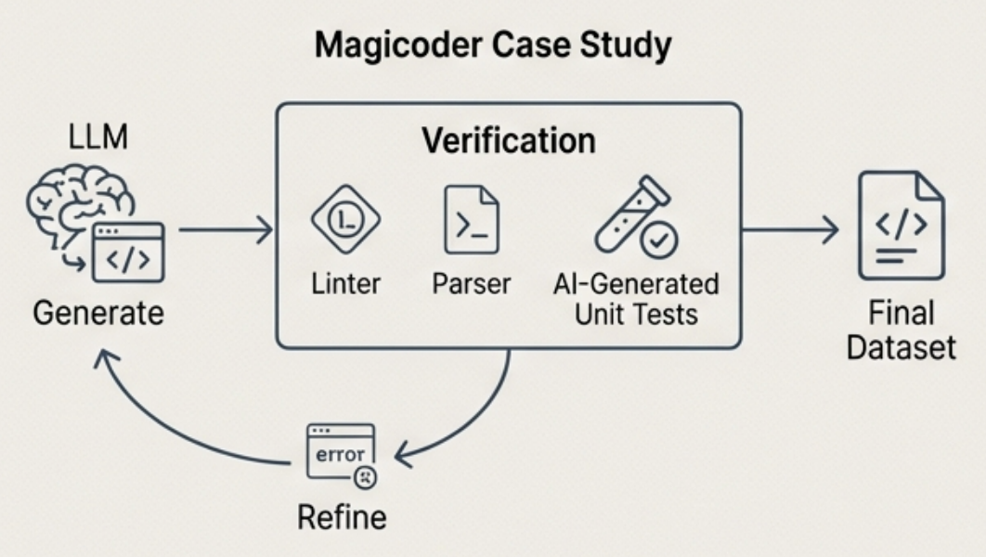
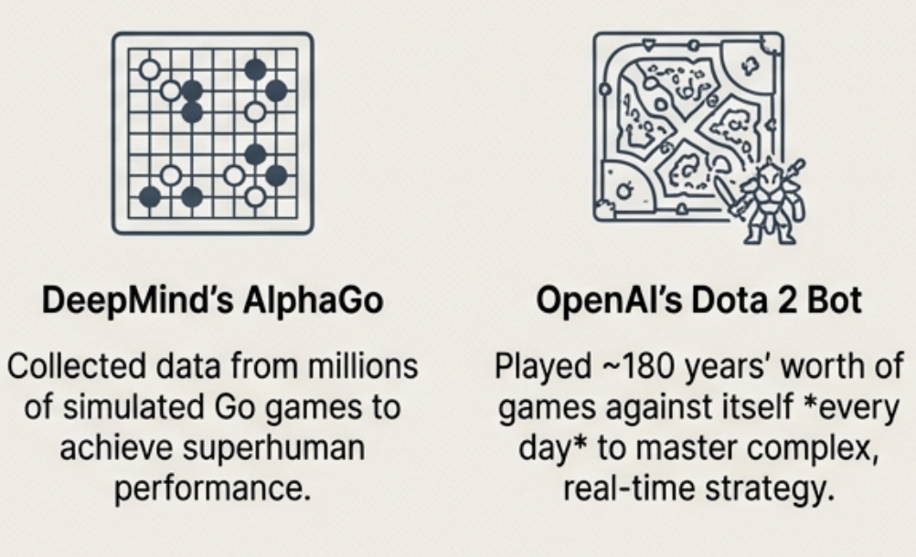
AI-Powered Synthesis II: Code Generation and Self-Play
High-Quality Code Generation with Verification
Learning Through Self-Play
Generating synthetic code is not enough; it must be demonstrably correct.
An Al agent learns and generates vast quantities of training data by playing against itself, discovering novel strategies.

Slide 6
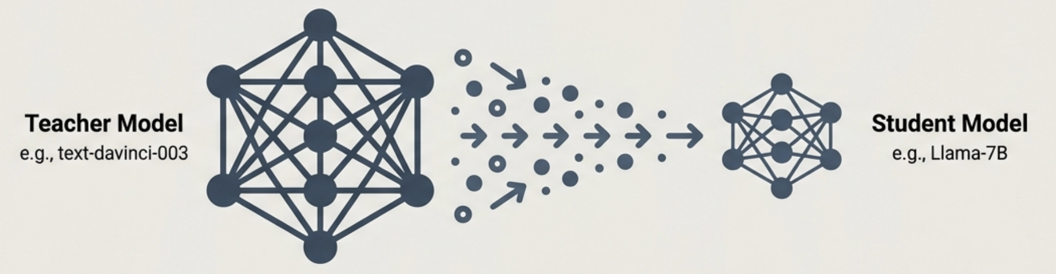
Strategic Apex: Capability Transfer via Model Distillation
A highly capable 'teacher' model generates high-quality examples (prompts and responses) that are used to finetune a smaller 'student' model, effectively transferring its knowledge.
Classic Example: Alpaca Teacher: text-davinci-003 (~175B parameters) Student: Llama-7B
Result: The resulting model, Alpaca, behaved similarly to the teacher while being only 4% of its size.
Advanced Application Distillation can also create better models. NVIDIA used a more capable teacher to generate synthetic data, producing a student model (Nemotron-4) that ultimately outperformed the original teacher.

Slide 7


The Caveats: Limitations of AI-Generated Data
While powerful, synthetic data is not a silver bullet and caries significant risks if not managed carefully.
Factual Errors & Hallucinations
Al-generated data can contain subtle or blatant inaccuracies that can poison a finetuning dataset if not meticulously verified.
Bias Amplification Models trained on their own outputs can amplify existing biases. Reference: Taori and Hashimoto (2023) demonstrated that this "data feedback loop" can amplify dataset biases unless the model's outputs are highly faithful to the original training distribution.
The Llama 3 Finding: Indiscriminately training on self-generated data can degrade performance. Continuous improvement requires robust mechanisms to verify the quality of synthetic data before use.

Slide 8
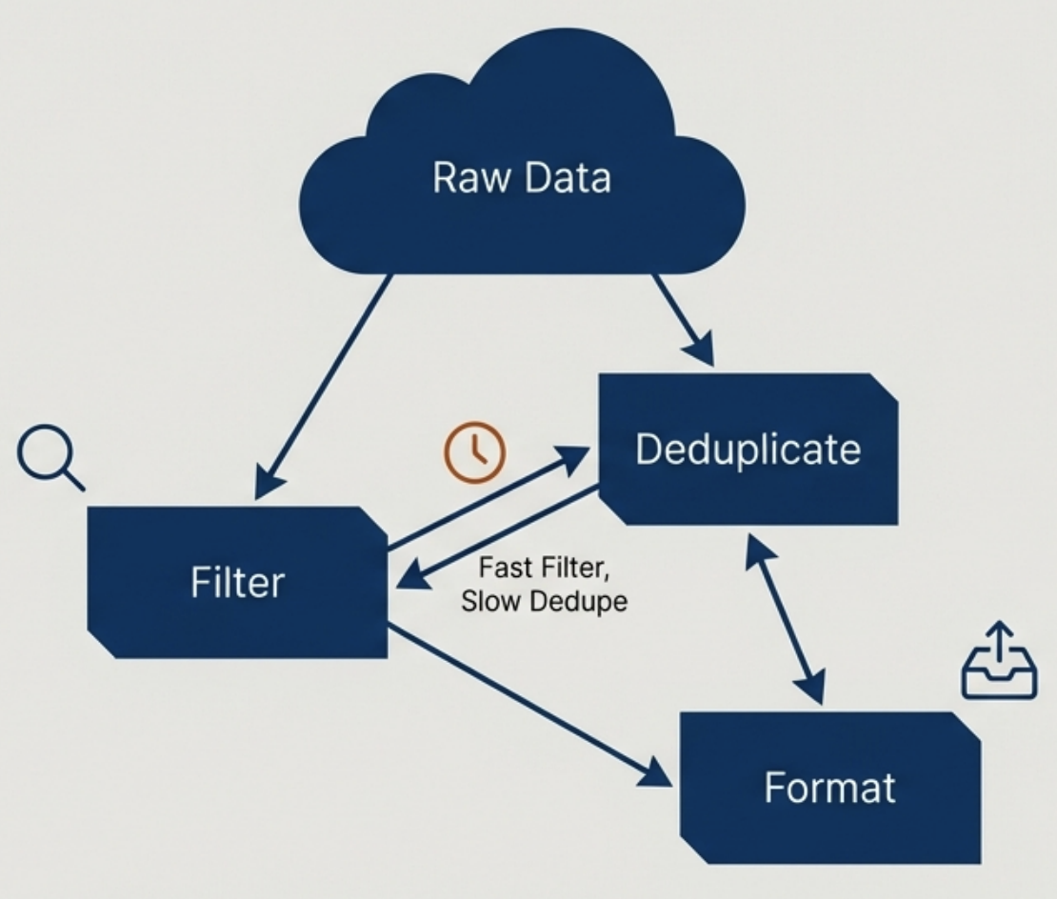
The Philosophy of Data Processing
The steps to clean and prepare a dataset are not always linear and require a strategic approach.
Guiding Principles
Optimize for Efficiency: Execute steps in the order that saves the most time and compute. If deduplication is slow but filtering is fast, filter first.
Validate with Trial Runs: Always test processing scripts on a small sample of data to ensure they work as expected before running them on the entire dataset.
Preserve the Original Data: Avoid changing data in place. Keep an immutable copy of the original raw data to allow for reprocessing and to trace errors back to their source.

Slide 9
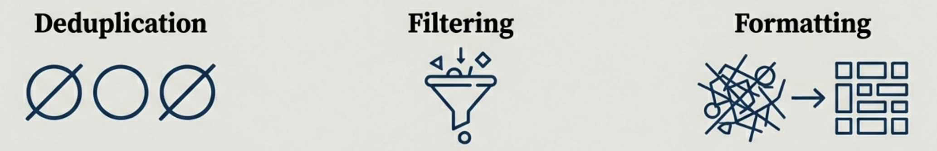
Core Processing Steps: Deduplicate, Filter, Format
Three Essential Actions for Data Refinement:
Removing duplicate examples is critical to creating a "sufficiently unique" dataset. This prevents the model from being biased by over-represented data and avoids data contamination issues.
The process of systematically removing low-quality examples based on predefined criteria (e.g., incorrect labels, irrelevant content, failed verification checks).
Ensuring every data point is correctly structured. This is a non-trivial task.
Case in Point: The development of OpenAl's ChatML format involved eleven senior researchers, highlighting the complexity and importance of getting the data format right.

Slide 10

The Un-automatable Core of Dataset Engineering
While Al can generate data, it cannot automate the critical thinking behind it. The most challenging problems require human creativity and judgment.
Designing clear, unambiguous annotation guidelines.
Thinking through what data you want to create in the first place.
The meticulous attention to detail required to verify quality and find subtle errors.
The most creative solutions in Al often stem from the challenging, human-centric process of building the right dataset.

Slide 11
In the next part, we will discuss
Compute vs Bandwidth
Capacity vs Bandwidth
Prefill and Decode
TTFT, TPOT
Throughput vs Goodput
Activity vs Efficiency
MBU
FLOPs vs FLOP/s
and much more…

